Slide 1
A Python-based GUI Development for Digital Circuit Design
PSU Capstone Project, 2018
Dated: Dec 28, 2017

Slide 2
Confidentiality of documents and data
Please don’t share any documents and data within this file and during our project outside the group members unless we all explicitly agree to share.

Slide 3
Members
Students:
David Yakovlev david.yakovlev@pdx.edu
Xiaoqiao Mu muxiaoq@pdx.edu
Ting Wang ting3@pdx.edu
Linyi Hong linyi@pdx.edu
Faculty Advisor:
Tom Schubert ets2@pdx.edu
Sponsor:
Ataur Patwary patwary@pdx.edu

Slide 4
Background
Everyday mobile products
Example: cell phones or laptops
One key step for manufacturing of these products
Design of digital circuits
The design tasks need analysis of large amount of data for:
Fastest speed or performance: how many GHz?
Maximum time interval between recharging of batteries: how many HOBL

Slide 5
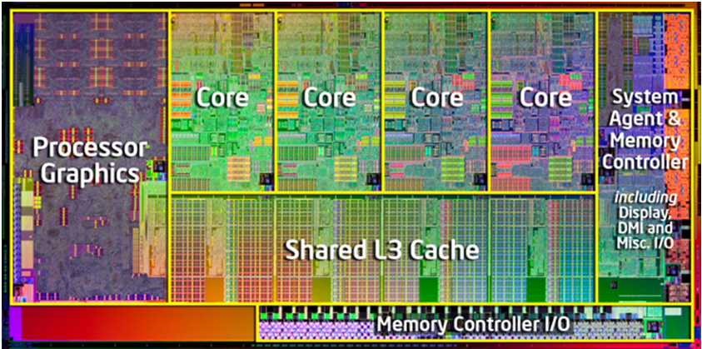
Intel Core i7-2600K : Die Map
Source: www.pcmag.com/

Slide 6
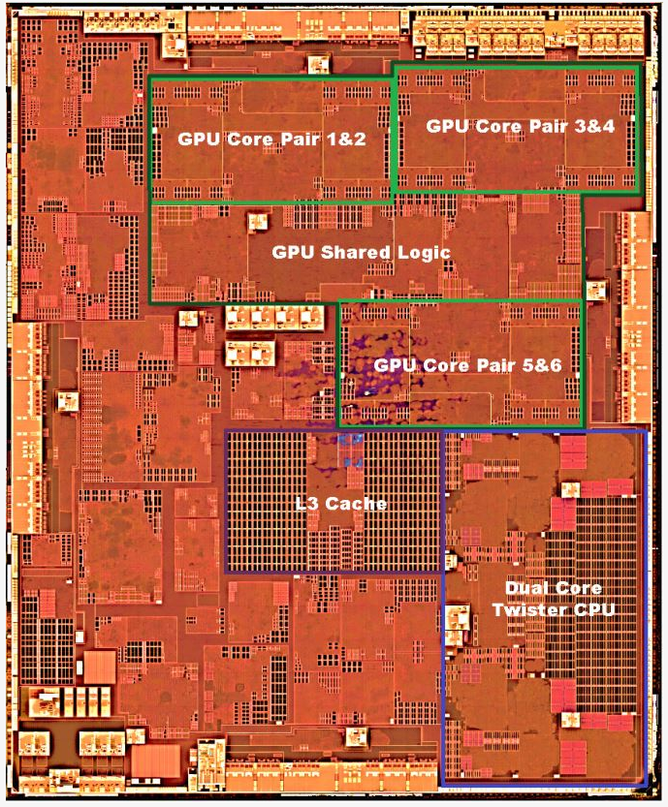
Apple A9: Layout
AnandTech’s Layout Analysis For A9 (Die Shot Courtesy Chipworks)
Source: https://www.anandtech.com/show/9686/the-apple-iphone-6s-and-iphone-6s-plus-review/3

Slide 7
Transistors
Video Animation: Mark Bohr Gets Small: 22nm Explained | Intel
How a CPU is made

Slide 8
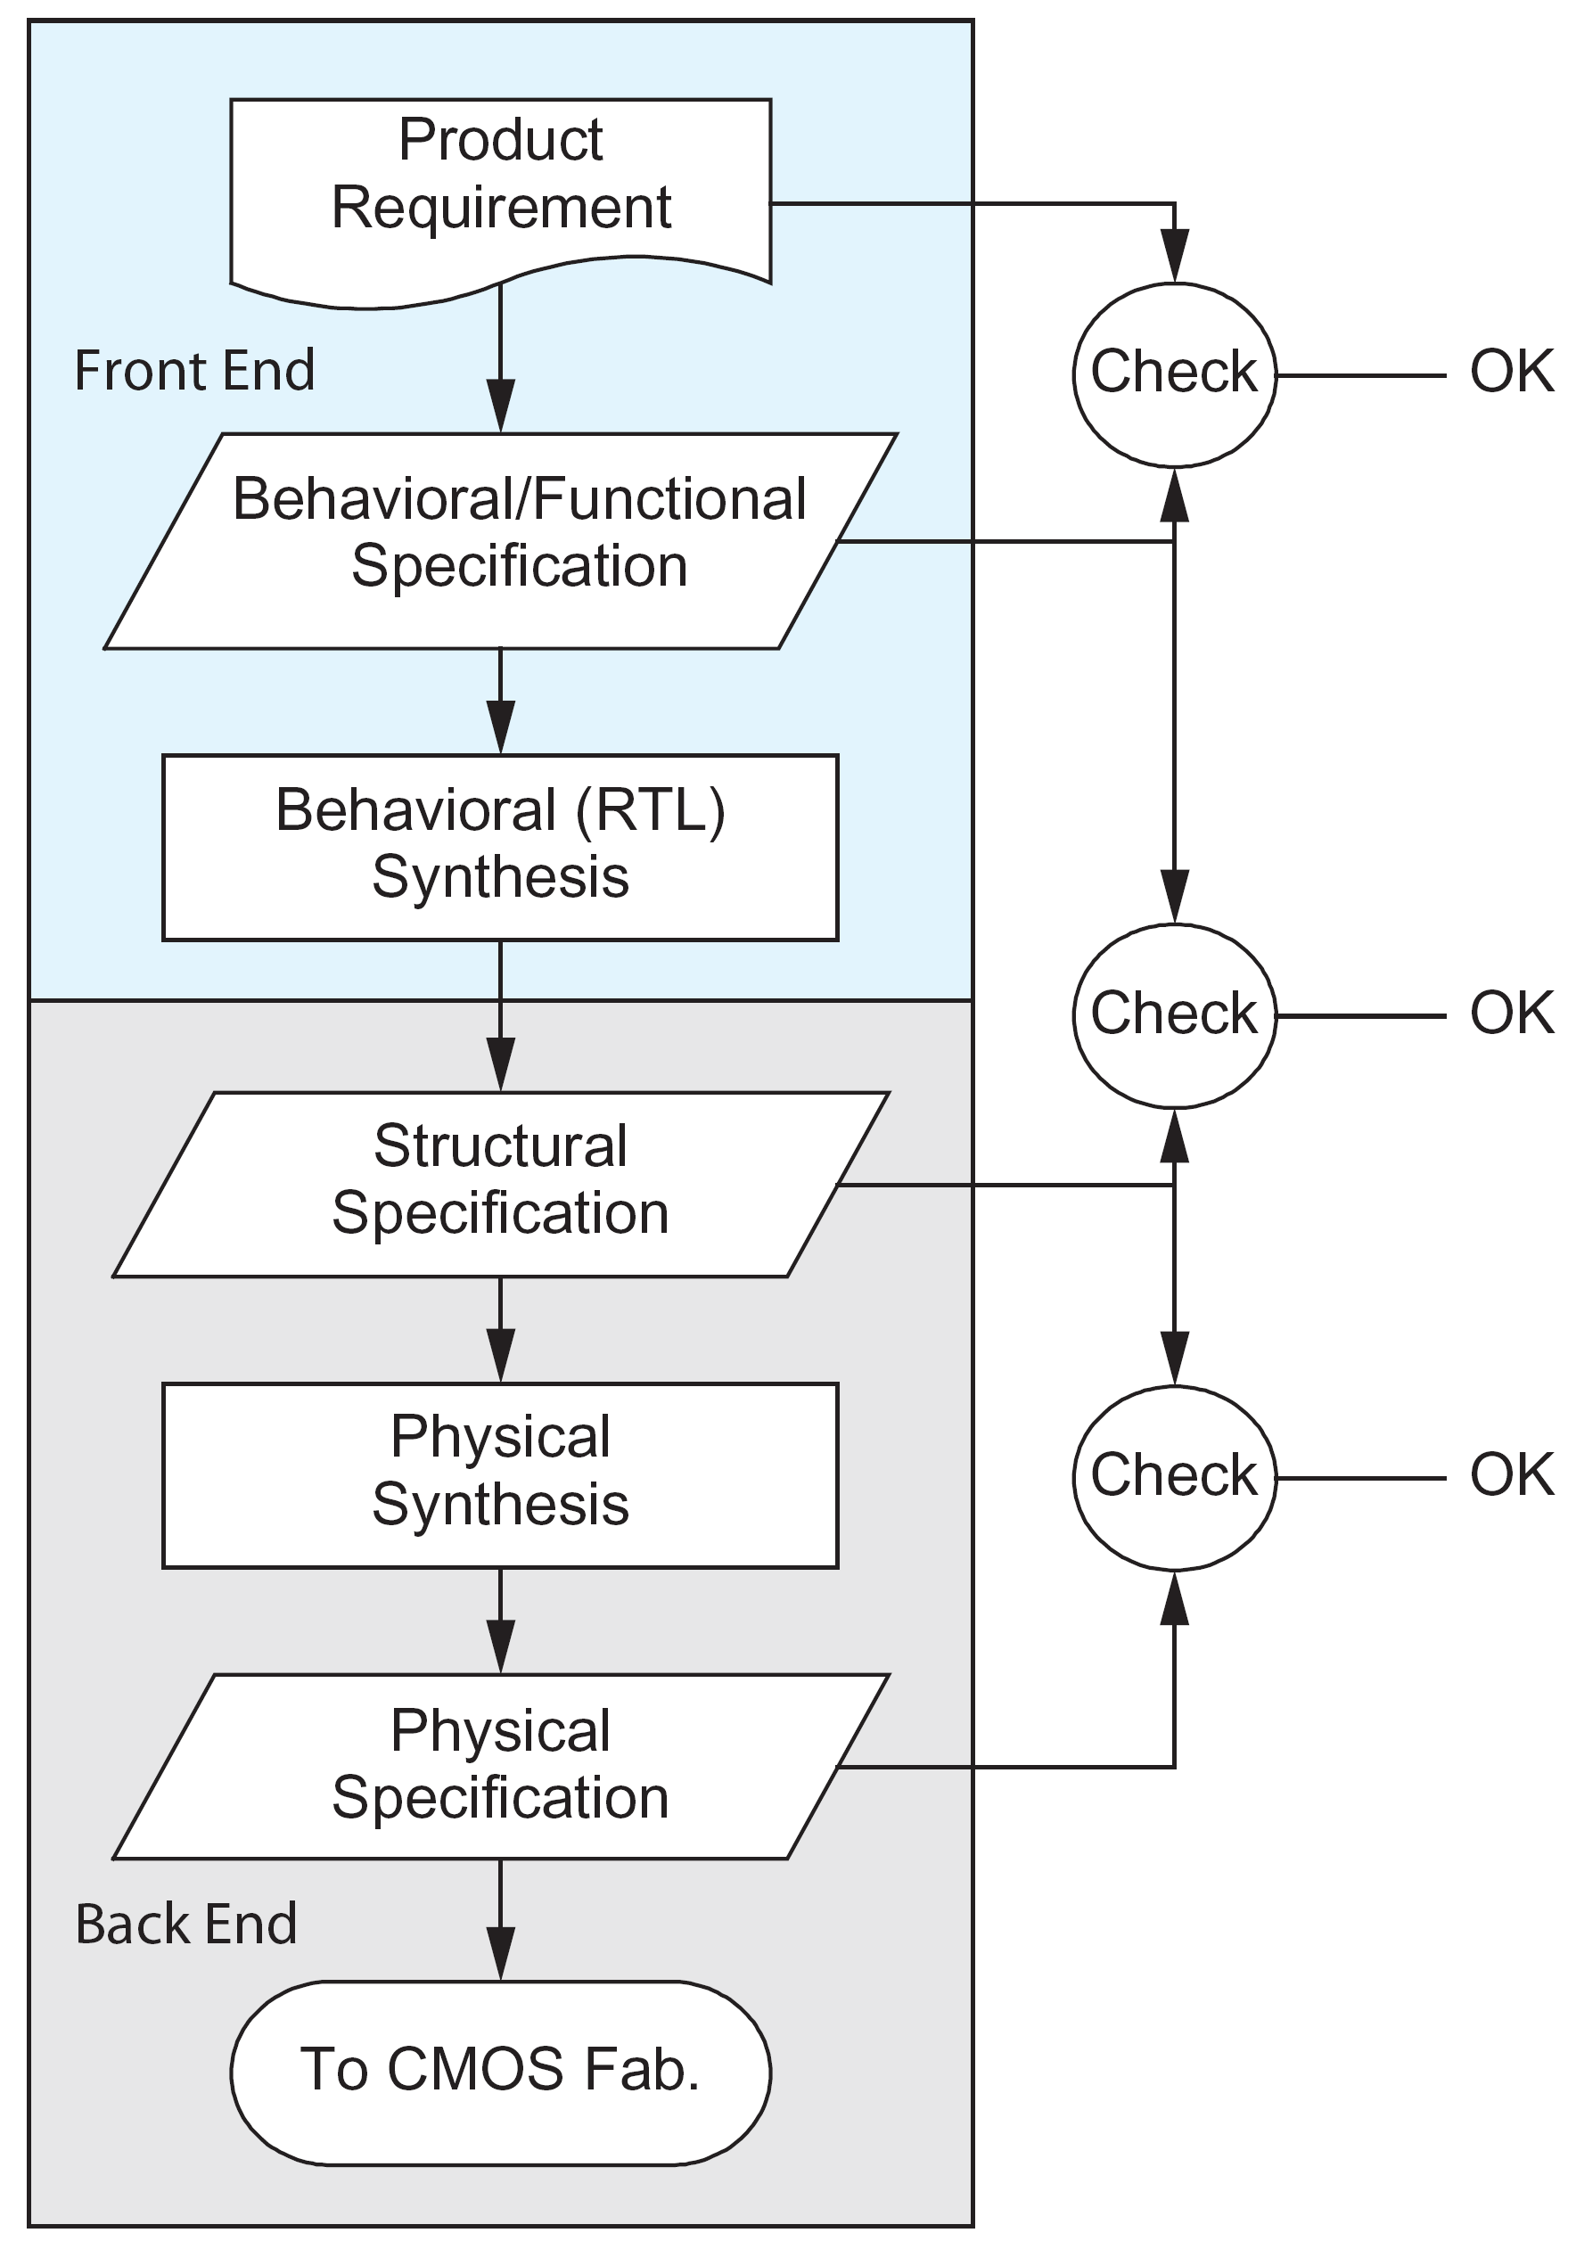
Generalized Design Flow
RTL: Register Transfer Level
FE: Pre-layout
BE: Post-layout

Slide 9
Example of Design Flow
Scan
RTL designer
VCS
Conformal
RC
DC
No layout yet
Notes:
Specification: Text description. Or, using System Description Language
Wrong netlists: Due to ambiguities in RTL or poorly written RTL.

Slide 10
Example of Design Flow: Continued
From Previous Page
ICC
Routing layers/pitches
Notes:
Design Exchange Format (DEF) is an open specification for representing physical layout of an integrated circuit in an ASCII format. It represents the netlist and circuit layout. DEF is used in conjunction with Library Exchange Format (LEF) to represent complete physical layout of an integrated circuit while it is being designed.

Slide 11
Python
A widely used and increasingly popular programming language for data analysis

Slide 12
Tkinter
Tkinter:
Standard Graphical User Interface (GUI) package in Python
Based on Tk interface
Tk: An open-source toolkit for building GUI. Based on TCL
TCL: Tool Command Language
A high-level general-purpose programming language
Commonly used in design tools

Slide 13
Motivation
Electronic Design Automation (EDA) is crucial for digital design
Example of EDA companies:
Cadence, Synopsys and Mentor Graphics
Extensive list of software tools:
To simulate digital circuits
To analyze the output data
These tools generally provide graphical user interfaces (GUI):
To analyze the design data
Still there is a vast amount of data in text format:
So, there is the need for graphical representation

Slide 14
Problem Statements
Software tools (ex: Microsoft Excel):
Easily convert text files from UNIX files to tabular/graphical format:
If the text files are in tabular or regular format to begin with.
The design data from different EDA tools or from same EDA tool has mostly irregular and different text formats:
Different line width
Different repetitive structures
Digital designers spend a significant amount of effort:
In reading the text files to understand the contents
To analyze the data which eventually impacts the design completion time

Slide 15
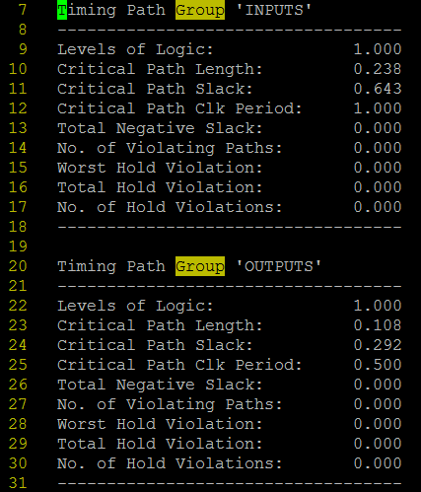
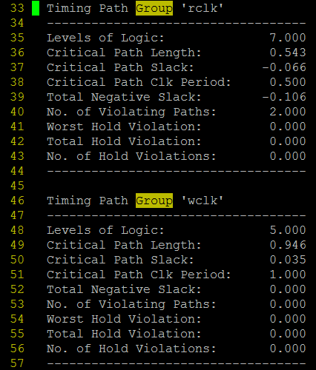
Example Data (UNIX location: /u/ataur/FIFO_DIC_II_FALL_2016/scripts/QOR_Report_File)

Slide 16
Proposed Solutions
Use Python and Tkinter to graphically represent text based data
In plots and tables
Ability to sort and filter based on user inputs
Modular coding so that can be easily expanded
The GUIs will enable:
Faster time to market
Overall higher performance and lower power consuming products

Slide 17
Learning outcomes
Successful completion of the project will have the following learnings:
Familiarity with the main steps in the IC design of everyday mobile devices
Know what does speed or Gigahertz mean in digital products
Know what are the different formats of data in real life digital designs
Know how to use Python and Tkinter for GUI development
Know how to develop and configure GUIs based on customer needs

Slide 18
Project Deliverables
Python codes:
To represent text based data in plots and tables
To filter, sort and search data based on user given options
To upload the data in various formats on web servers
Codes:
Would be modular
Such that can be re-used in future projects

Slide 19
Thank you ☺
Looking forward to working together and have fun with GUIs !!

