Slide 1

THESIS PROJECT • GROUP 1
Cloud-Based Human Resource
Management System
A full-stack HR platform deployed on AWS — React, FastAPI & PostgreSQL
BELTEI International University
Cloud Computing • Phnom Penh, Cambodia

Slide 2


02
OVERVIEW
Introduction & Problem
The Challenge
Our Solution
HR records kept in scattered spreadsheets and paper files
A centralized, cloud-hosted HRMS that manages employees, attendance, leave and payroll — securely accessible from anywhere, with the database and backups handled by the cloud.
No secure, role-based access — anyone can see everything
Data lost when a single computer fails; no backups
Staff cannot access HR services remotely
Centralized • Secure • Always available

Slide 3




03
GOALS
Project Objectives
Centralize HR data
Enforce security
Single source of truth for employees, departments, attendance, leave & payroll.
Authenticated access with role-based permissions for Admin, HR and Employees.
Enable remote access
Reliable cloud data
A responsive web app reachable from any browser, anywhere.
Managed PostgreSQL with automatic backups and easy recovery.

Slide 4

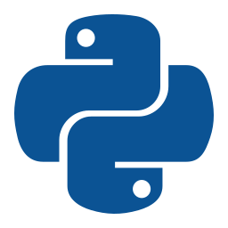
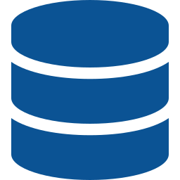
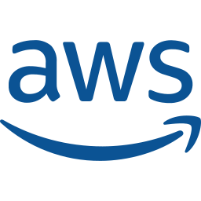
04
TOOLS
Technology Stack
FRONTEND
BACKEND
DATABASE
CLOUD & INFRA
React 18 + Vite
Python · FastAPI
PostgreSQL
AWS + Docker
Single-page app, React Router, role-aware UI
REST API, JWT auth, auto Swagger docs
Relational store, hosted on AWS RDS
EC2 app server, RDS database, Compose

Slide 5


05
HOW IT FITS TOGETHER
System Architecture
HTTPS
SQL :5432
Browser
EC2 App Server
AWS RDS
React SPA
FastAPI (Docker)
PostgreSQL
Each layer is containerized and isolated. The database accepts connections only from the app server's security group — never directly from the internet.

Slide 6


06
WHY IT IS CLOUD
Key Cloud Concepts
Cloud Storage
Remote Access
Backup & Recovery
Data lives on AWS RDS managed storage, not a local disk.
Reachable from any browser over the internet.
RDS automated daily backups + point-in-time restore.
Cloud DB Management
Data Security
Managed PostgreSQL — patched, monitored, scalable.
bcrypt passwords, JWT + RBAC, private DB network.

Slide 7





07
WHAT IT DOES
Features & Modules
Employees & Departments
Attendance
Leave Management
Full CRUD, search, department headcount.
Employee check-in / check-out, HR views all records.
Requests with HR approve / reject workflow.
Payroll
Auth & Roles
Dashboard
Generate payslips: base + allowances − deductions.
JWT login with Admin / HR / Employee access.
Role-aware summary of the whole system.

Slide 8




08
DATA SECURITY
Security & Access Control
Role-Based Access
Defense in Depth
Admin
Full control — manage HR/Admin accounts, delete records
Passwords hashed with bcrypt — never stored in plain text
Stateless JWT tokens authenticate every API request
HR
Manage employees, approve leave, run payroll
Server-side role checks on every protected endpoint
Employee
Self-service: attendance, leave requests, payslips
Database isolated in a private AWS security group

Slide 9

09
LIVE IN THE CLOUD
Deployment on AWS
1
2
3
4
Provision RDS
Launch EC2
Ship the code
Go live
PostgreSQL database created on Amazon RDS (Free Tier).
t3.micro app server with Docker & a locked-down security group.
Pulled from GitHub, built with Docker Compose on the server.
App points at RDS, seeds data, served on port 80.
Status: LIVE — the app runs on AWS at a public IP, backed by a managed RDS database with automated backups.

Slide 10
CONCLUSION
A complete, secure HRMS —
built and deployed on the cloud.
Full-stack app: React + FastAPI + PostgreSQL
Five cloud concepts demonstrated end-to-end
Role-based security across Admin, HR & Employee
Thank You
Questions & Live Demo
Live on AWS EC2 + RDS with automated backups
Group 1 • BELTEI International University

