Slide 1
Visualização e Iluminação
VI-RT Ray Mesh Intersection
Luís Paulo Peixoto dos Santos

Slide 2
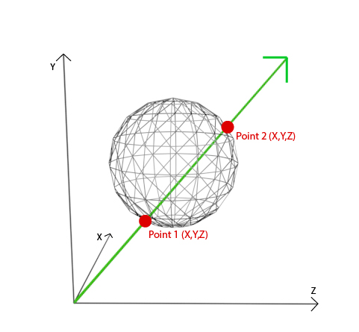
Ray Mesh Intersection

Slide 3
Primitive-Geometry
typedef struct Primitive {
Geometry *g;
int material_ndx;
} Primitive;
typedef struct Intersection {
public:
Point p;
Vector gn; // geometric normal
Vector sn; // shading normal
Vector wo;
float depth;
BRDF *f;
int FaceID;}
class Geometry {
public:
Geometry () {}
~Geometry () {}
bool intersect (Ray r, Intersection *isect) {
return false; }
BB bb; };

Slide 4
The Mesh class
class Mesh: public Geometry {
private:
bool TriangleIntersect (Ray r, Face f, Intersection *isect);
public:
int numFaces;
std::vector<Face> faces;
int numVertices;
std::vector<Point> vertices;
int numNormals;
std::vector<Vector> normals;
bool intersect (Ray r, Intersection *isect);
Mesh(): numFaces(0), numVertices(0), numNormals(0) {}
};

Slide 5
Face and Ray
typedef struct Face {
int vert_ndx[3]; // indices to vector of vertices (in Mesh)
Vector geoNormal; // geometric normal
bool hasShadingNormals; // are there per vertex shading normals ??
int vert_normals_ndx[3]; // indices to veritices normals
BB bb; // face bounding box
} Face;
class Ray {
public:
Point o; // ray origin
Vector dir; // ray direction
Ray () {}
Ray (Point o, Vector d): o(o),dir(d) {}
~Ray() {}
};

Slide 6
Mesh intersect
bool Mesh::intersect (Ray r, Intersection *isect) {
bool intersect = false;
Intersection min_isect, curr_isect;
float min_depth=MAXFLOAT;
// intersect the ray with the mesh BB
if (!bb.intersect(r)) return false;
for (auto face_it=faces.begin() ; face_it != faces.end() ; face_it++) {
if (! TriangleIntersect(r, *face_it, &curr_isect)) continue;
intersect = true;
if (curr_isect.depth < min_depth) { // this is closer
min_depth = curr_isect.depth;
min_isect = curr_isect;
} }
return intersect; }

Slide 7
AABB intersect
typedef struct BB {
Point min, max;
bool intersect (Ray r) { ... }
} BB;
For ray / axis aligned bounding box (AABB) intersection see:
PBRT book, 3rd edition, sec 3.1.2, pags 125..128 + 214,217,221 www.pbrt.org
Shirley, P., Wald, I., Marrs, A. (2021). Ray Axis-Aligned Bounding Box Intersection. Ray Tracing Gems II. Apress, Berkeley, CA. https://doi.org/10.1007/978-1-4842-7185-8_2

Slide 8
Triangle intersect
bool Mesh::TriangleIntersect (Ray r, Face f, Intersection *isect) {
if (!f.bb.intersect(r)) return false;
...
}
For ray / triangle intersection see:
PBRT book, 3rd edition, sec 3.6.2, pags 157.. www.pbrt.org
M¨oller, T., and B. Trumbore. 1997. Fast, minimum storage ray–triangle intersection. Journal of Graphics Tools 2(1), 21–28 https://en.wikipedia.org/wiki/M%C3%B6ller%E2%80%93Trumbore_intersection_algorithm
Woop, S., C. Benthin, and I. Wald. 2013. Watertight ray/triangle intersection. Journal of Computer Graphics Techniques (JCGT) 2(1), 65–82.

Slide 9
Intersection Information
typedef struct Intersection {
public:
Point p; float depth;
Vector gn; BRDF *f;
Vector sn; int FaceID;
Vector wo; }
wo is the light outgoing direction: wo = -1.f * ray.dir
make sure the normal (gn and sn) points to the same side of the surface as wo There is a method in class Vector to help with this:
normal = normal.Faceforward(wo);

Slide 10
Intersection Information
typedef struct Intersection {
public:
Point p; float depth;
Vector gn; BRDF *f;
Vector sn; int FaceID;
Vector wo; }
gn=n.Faceforward(wo);
w_{o}
ray.dir
p
n

