Slide 1
Visualização e Iluminação
VI-RT Scene Loading
Luís Paulo Peixoto dos Santos

Slide 2
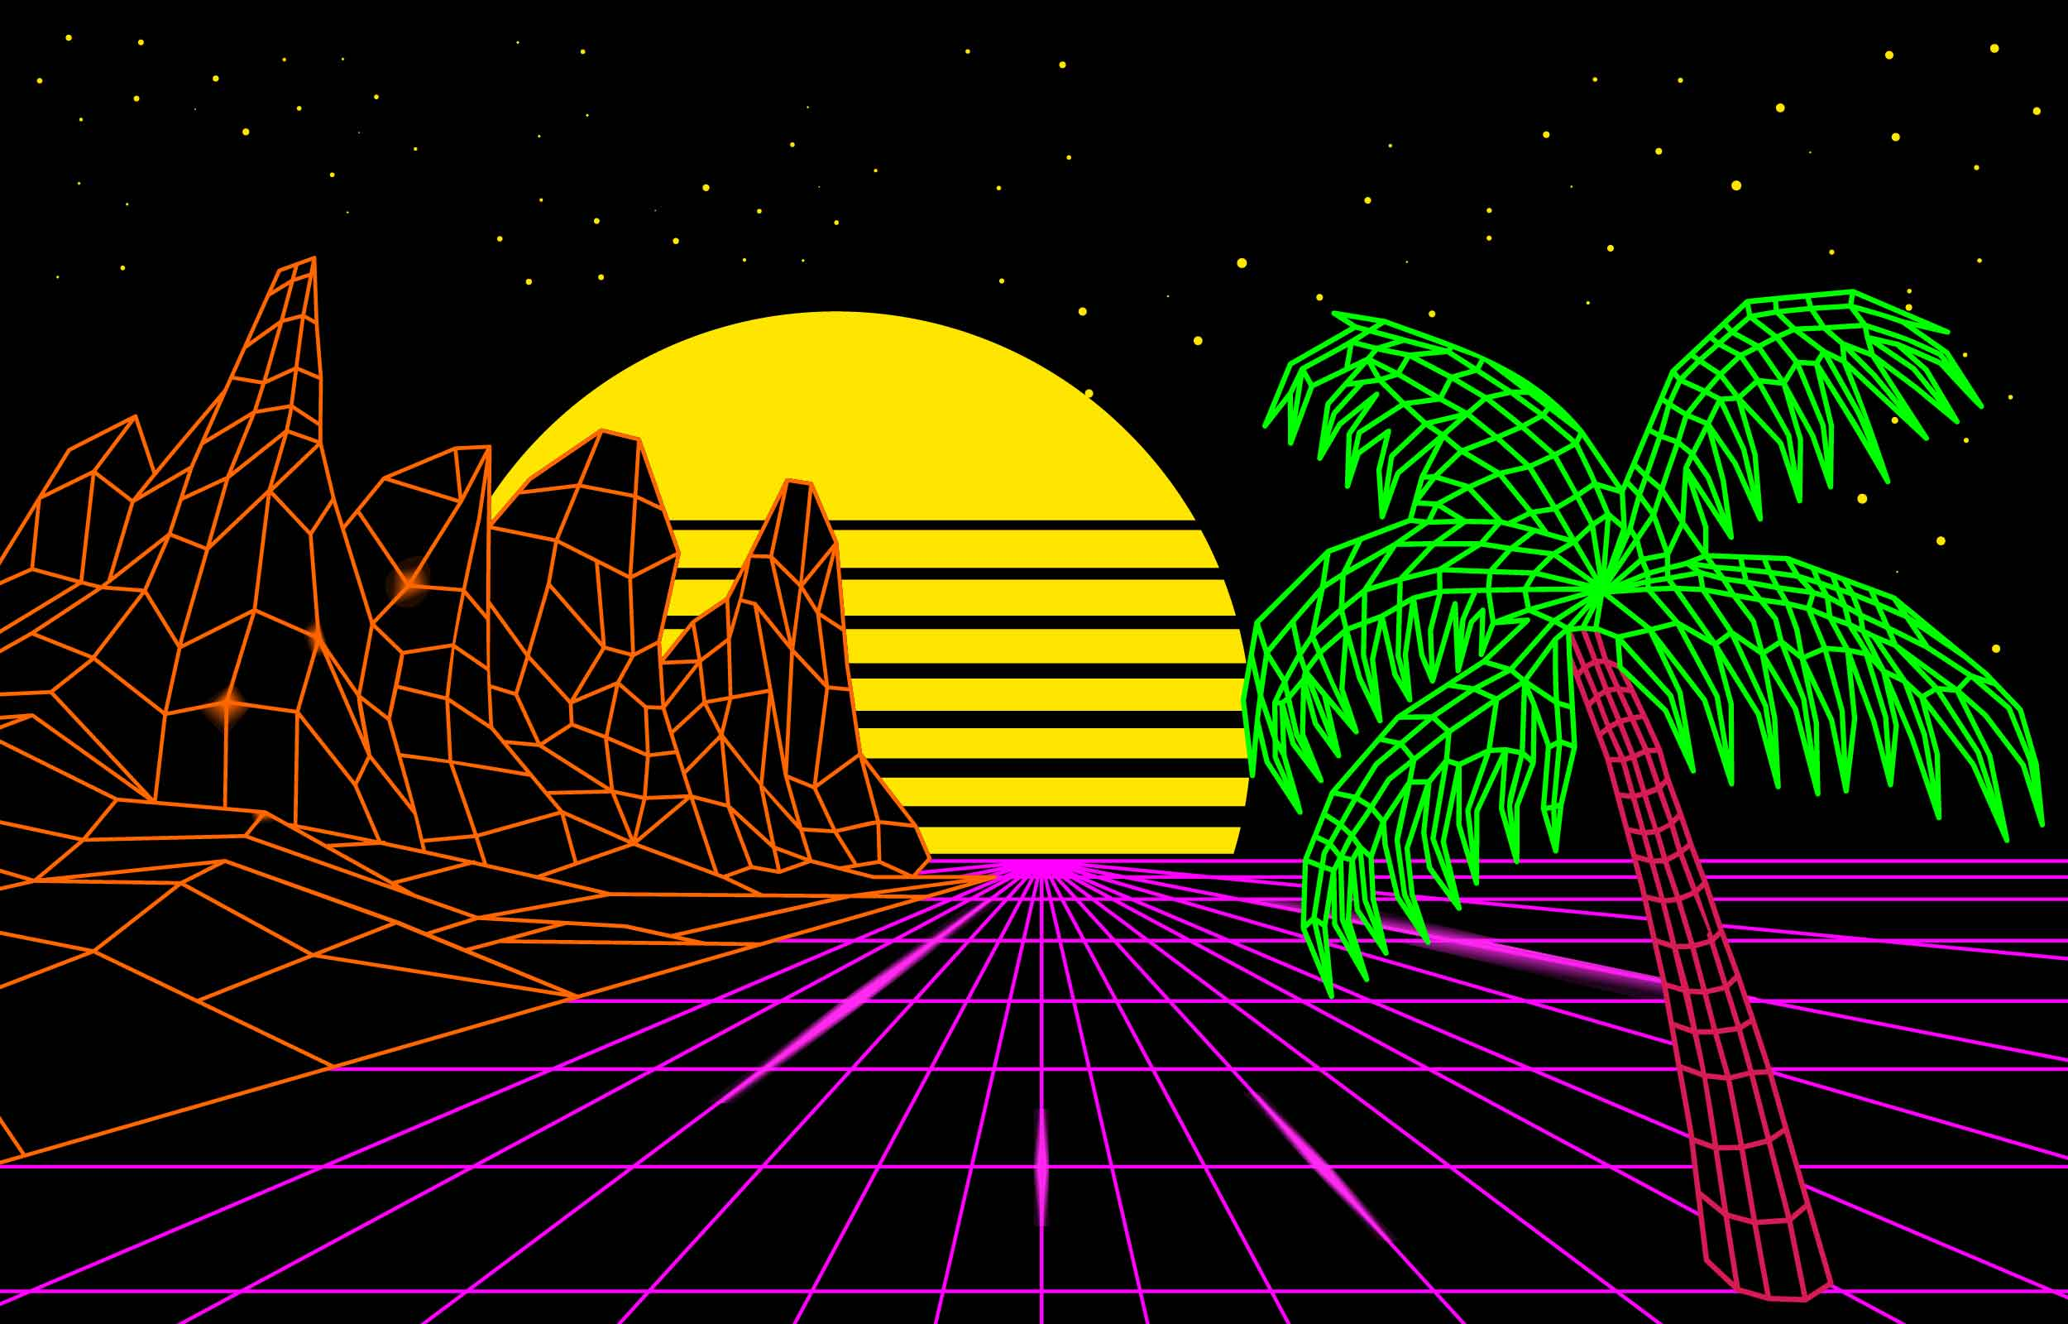
Scene loading
[Vecteezy.com]

Slide 3

Mesh Representation
{ Geometry g;
BRDF f;
BB bb;
} Prim
{ vector<Prim> prims;
vector <Lights> lights;
} Scene
gn = e0 $⊗$ e1
e0 = v1 – v0
vertices
e1 = v2 – v0
float XYZ[3];
{
<Face> faces;
<Point> vertices;
<Vector> normals;
} Mesh
float XYZ[3];
float XYZ[3];
float XYZ[3];
vnormals
float XYZ[3];
{
int vert[3];
float gn[3];
int vn[3];
} Face
float XYZ[3];
float XYZ[3];
faces
float XYZ[3];

Slide 4












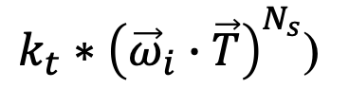
X-Phong Representation
$$L\left({\vec{ω}}_{o}←x←{\vec{ω}}_{i}\right)=$$
$$k_{a}∗L_{a}+$$
$$+ L\left(x←{\vec{ω}}_{i}\right) ∗($$
$$k_{d}∗\left({\vec{ω}}_{i}∙\vec{N}\right)+$$
$$k_{s}∗{\left({\vec{ω}}_{i}∙\vec{R}\right)}^{N_{s}}+$$
$k_{t}∗{\left({\vec{ω}}_{i}∙\vec{T}\right)}^{N_{s}}$)
class Phong:: public BRDF {
RGB Ka;
RGB Kd;
RGB Ks;
float Ns;
RGB Kt;
}
$$\vec{N}$$
$${\vec{ω}}_{i}$$
$${\vec{ω}}_{o}$$
$$\vec{R}$$
$$x$$
$$\vec{T}$$
$$−\vec{N}$$

Slide 5
Wavefront .obj file
# List of geometric vertices, with x, y, z coordinates
v 0.123 0.234 0.345
v ... ...
# List of texture coordinates:(u, [v, w]) in [0 ... 1]
vt 0.500 [1 [0]]
vt ... ...
# List of vertex normals in (x,y,z) form
vn 0.707 0.000 0.707
vn ... ...
https://en.wikipedia.org/wiki/Wavefront_.obj_file

Slide 6
Wavefront .obj file
# which materials definition file to use
mtllib [external .mtl file name]
# which material to use in the subsequent objects
usemtl [material name]
https://en.wikipedia.org/wiki/Wavefront_.obj_file

Slide 7
Wavefront .obj file
# group subsequent faces onto an object
o [object name]
# Polygonal face element: f v1/vt1/vn1 v2/vt2/vn2 v3/vt3/vn3 ...
# arguments are the vertices’ indices according to their order in the file
f 1 2 3
f 3/1 4/2 5/3
f 6/4/1 3/5/3 7/6/5
f 6//3 2//1 7//2
# Note that for us, at this stage, an object is ALWAYS a MESH
# The faces following the ‘o’ command are the mesh triangles
https://en.wikipedia.org/wiki/Wavefront_.obj_file

Slide 8
Wavefront .mtl file
newmtl my_mtl
Ka 0.0435 0.0435 0.0435
Kd 0.1086 0.1086 0.1086
Ks 0.0000 0.0000 0.0000
Tf 0.9885 0.9885 0.9885
Ns 10.0000
http://paulbourke.net/dataformats/mtl/

Slide 9
class Scene – load OBJ
class Scene {
std::vector <Primitive *> prims;
std::vector <BRDF *> BRDFs;
public:
std::vector <Light *> lights;
int numPrimitives, numLights, numBRDFs;
Scene (): numPrimitives(0), numLights(0), numBRDFs(0) {}
bool Load (const std::string &fname);
...
}

Slide 10
TINY OBJ LOADER – Reading OBJ
#define TINYOBJLOADER_IMPLEMENTATION
#include "tiny_obj_loader.h"
using namespace tinyobj;
bool Scene::Load (const std::string &fname) {
ObjReader myObjReader;
int FaceID = 0;
ObjReader myObj;
// this loader triangulates the faces
if (!myObj.ParseFromFile(fname)) return false;
...
https://github.com/tinyobjloader/tinyobjloader

Slide 11
TINY OBJ LOADER – materials
...
const vector<material_t> materials = myObj.GetMaterials();
for (auto it = materials.begin() ; it != materials.end() ; it++) {
Phong *mat = new Phong;
// Ka
mat->Ka.R = it->ambient[0];
mat->Ka.G = it->ambient[1];
mat->Ka.B = it->ambient[2];
// Kd, Ns, Ks, Kt
...
BRDFs.push_back (mat);
numBRDFs++;
}
https://github.com/tinyobjloader/tinyobjloader

Slide 12
TINY OBJ LOADER – meshes and vertices
...
// access the vertices
const tinyobj::attrib_t attrib = myObj.GetAttrib();
float *vtcs = attrib.vertices;
// access the shapes (each shape is one mesh)
const vector<shape_t> shps = myObj.GetShapes();
https://github.com/tinyobjloader/tinyobjloader

Slide 13
TINY OBJ LOADER -mesh
// iterate over shapes (meshes)
for (auto shp = shps.begin() ; shp != shps.end() ; shp++) {
Primitive *p = new Primitive;
Mesh *m = new Mesh;
p->g = m;
// assume all faces in the mesh have the same material
p->material_ndx = shp->mesh.material_ids[0];
// the primitive's geometry bounding box is computed on the fly
// initially set BB.min and BB.max to be the first vertex
const int V1st = shp->mesh.indices.begin()->vertex_index * 3;
m->bb.min.set(vtcs[V1st], vtcs[V1st+1], vtcs[V1st+2]);
m->bb.max.set(vtcs[V1st], vtcs[V1st+1], vtcs[V1st+2]);
...
https://github.com/tinyobjloader/tinyobjloader

Slide 14
TINY OBJ LOADER - mesh
...
// add faces and vertices
std::set<rehash> vert_rehash;
for (auto v_it=shp->mesh.indices.begin(); v_it!=shp-> mesh.indices.end() ;) {
Face *f = new Face;
Point myVtcs[3];
// process 3 vertices
for (int v=0 ; v<3 ; v++) {
const int objNdx = v_it->vertex_index;
myVtcs[v].set(vtcs[objNdx*3], vtcs[objNdx*3+1], vtcs[objNdx*3+2]);
if (v==0) {
f->bb.min.set(myVtcs[0].X, myVtcs[0].Y, myVtcs[0].Z);
f->bb.max.set (myVtcs[0].X, myVtcs[0].Y, myVtcs[0].Z);
} else face->bb.update(myVtcs[v]);
... next: add face and vertex to mesh
https://github.com/tinyobjloader/tinyobjloader

Slide 15
TINY OBJ LOADER - mesh
// add faces and vertices
std::set<rehash> vert_rehash;
for (auto v_it=shp->mesh.indices.begin(); v_it!=shp-> mesh.indices.end() ;) {
...
for (int v=0 ; v<3 ; v++) {
...
// add vertex to mesh if new
rehash new_vert={objNdx, 0};
auto known_vert = vert_rehash.find(new_vert);
if (known_vert == vert_rehash.end()) { // new vertice, add it to the mesh
new_vert.ourNdx = m->numVertices;
vert_rehash.insert(new_vert);
m->vertices.push_back(myVtcs[v]); m->numVertices++;
// register in the face
f->vert_ndx[v] = new_vert.ourNdx; m->bb.update(myVtcs[v]);
} else f->vert_ndx[v] = known_vert->ourNdx;
v_it++; // next vértice within this face (there are 3)
} // end vertices
... next add face to mesh

Slide 16
TINY OBJ LOADER - mesh
// add faces and vertices
std::set<rehash> vert_rehash;
for (auto v_it=shp->mesh.indices.begin(); v_it!=shp-> mesh.indices.end() ;) {
...
// add face to mesh: compute the geometric normal
Vector v1 = myVtcs[0].vec2point(myVtcs[1]);
Vector v2 = myVtcs[0].vec2point(myVtcs[2]);
f->edge1 = v1; f->edge2 = v2;
Vector normal = v1.cross(v2);
f->geoNormal.set(normal.normalize());
f->FaceID = FaceID++;
// add face to mesh
m->faces.push_back(*f); m->numFaces++;
} // end iterate vértices in the mesh (shape)
// add primitive to scene
prims.push_back(p); numPrimitives++;
} // end iterate over shapes
return true;
}

