Slide 1
Visualização e Iluminação
VI-RT
Perspective Camera
Image
Luís Paulo Peixoto dos Santos

Slide 2
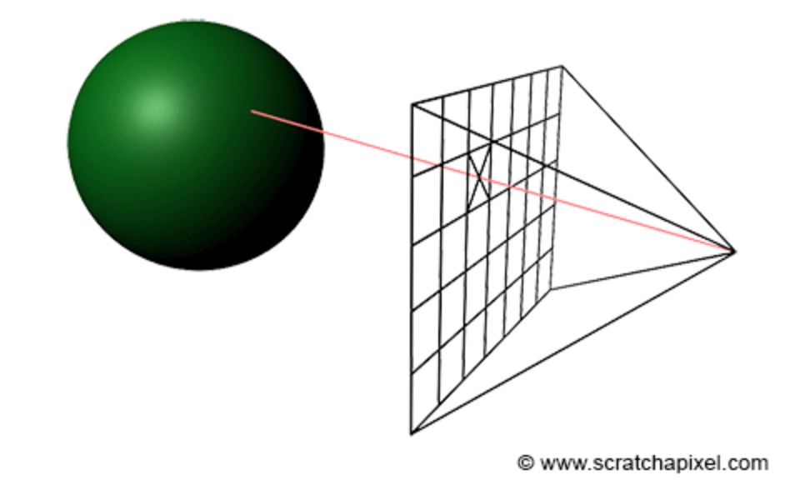
PersPective Camera

Slide 3
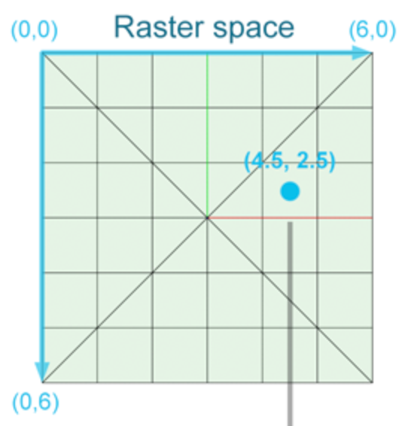
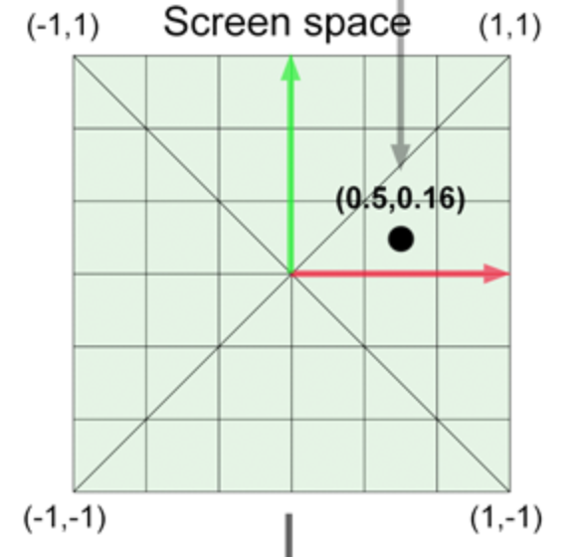
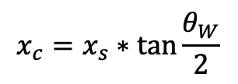


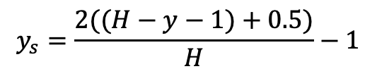
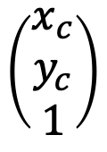
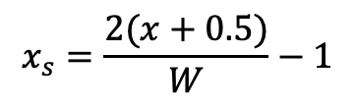
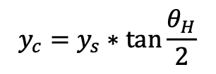
Raster -> Screen -> Camera Space
Image Resolution = (W,H)
$$x_{s}=\frac{2(x+0.5)}{W}−1$$
$$y_{s}=\frac{2((H−y−1)+0.5)}{H}−1$$
$$\frac{θ_{H}}{2}$$
$$\frac{θ_{W}}{2}$$
$$x_{c}=x_{s}∗\tan{\frac{θ_{W}}{2}}$$
$$\left(\begin{matrix}x_{c} \\ y_{c} \\ 1\end{matrix}\right)$$
$$y_{c}=y_{s}∗\tan{\frac{θ_{H}}{2}}$$

Slide 4
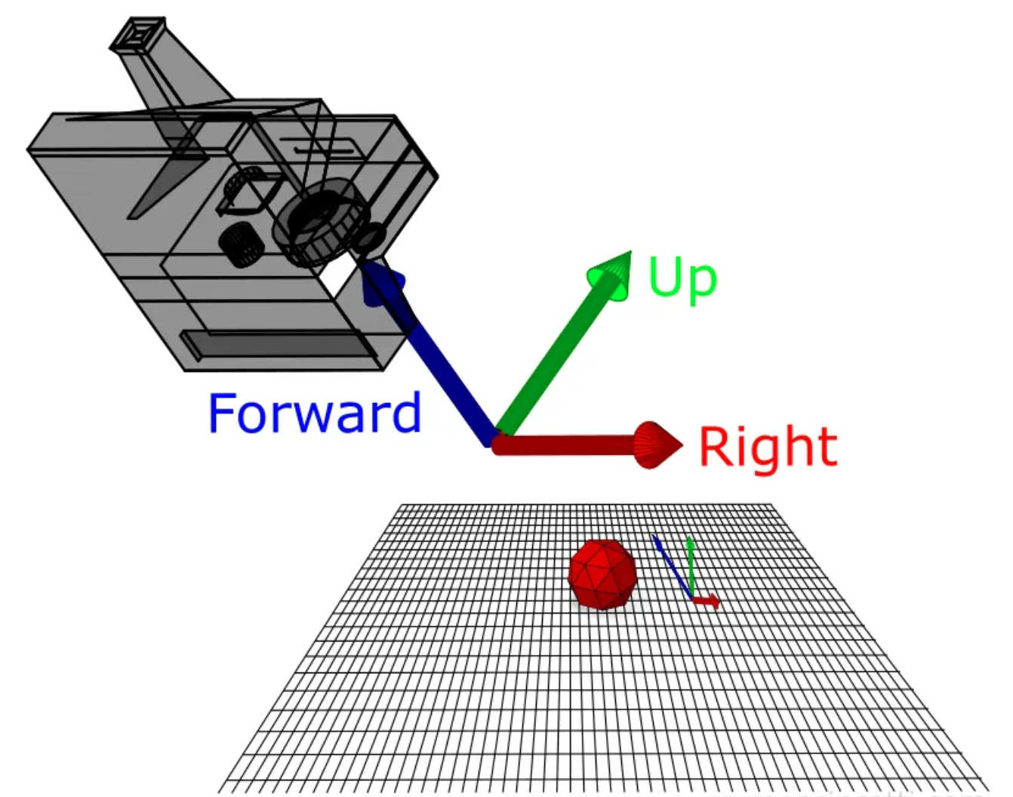



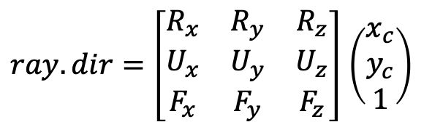
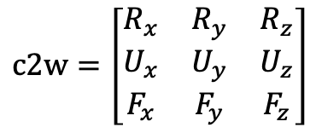

Camera Setup
Eye
$$F=normalize(At−Eye)$$
At
R$=normalize(cross(F,U))$
$$U=normalize(cross(R,F))$$
$$c2w=\left[\begin{matrix}R_{x} & R_{y} & R_{z} \\ U_{x} & U_{y} & U_{z} \\ F_{x} & F_{y} & F_{z}\end{matrix}\right]$$
$ray.dir=\left[\begin{matrix}R_{x} & R_{y} & R_{z} \\ U_{x} & U_{y} & U_{z} \\ F_{x} & F_{y} & F_{z}\end{matrix}\right]$ $\left(\begin{matrix}x_{c} \\ y_{c} \\ 1\end{matrix}\right)$
$$ray.o=eye$$

Slide 5
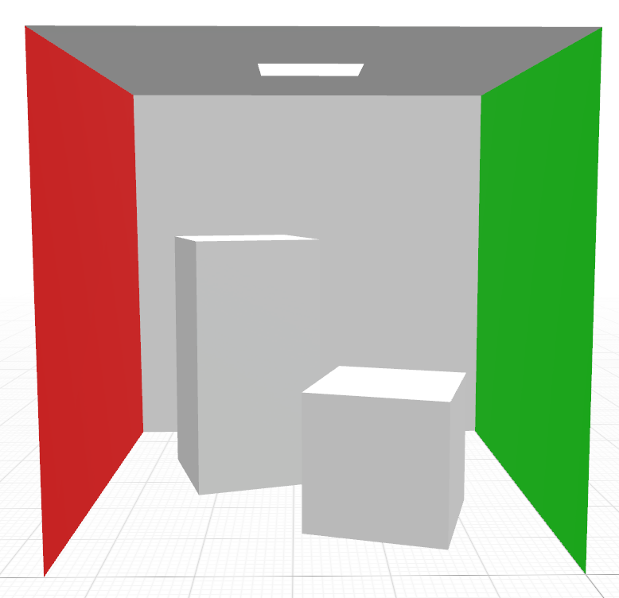







cornell_box.obj
floor $\sim \left(0,0,0\right)→(560,0,560)$
ceiling $\sim \left(0,550,0\right)→(560,550,560)$
back $\sim \left(0,0,560\right)→(560,550,560)$
front $\sim \left(0,0,0\right)→(560,550,0)$
green $\sim \left(0,0,0\right)→(0,550,560)$
red $\sim \left(560,0,0\right)→(560,550,560)$
light $\sim \left(213,548,227\right)→(343,548,332)$

Slide 6
Code – perspective.[cpp,hpp]
The Perspective class will implement a perspective camera, according to what has just been defined
Initial files for this class are provided (github)

Slide 7
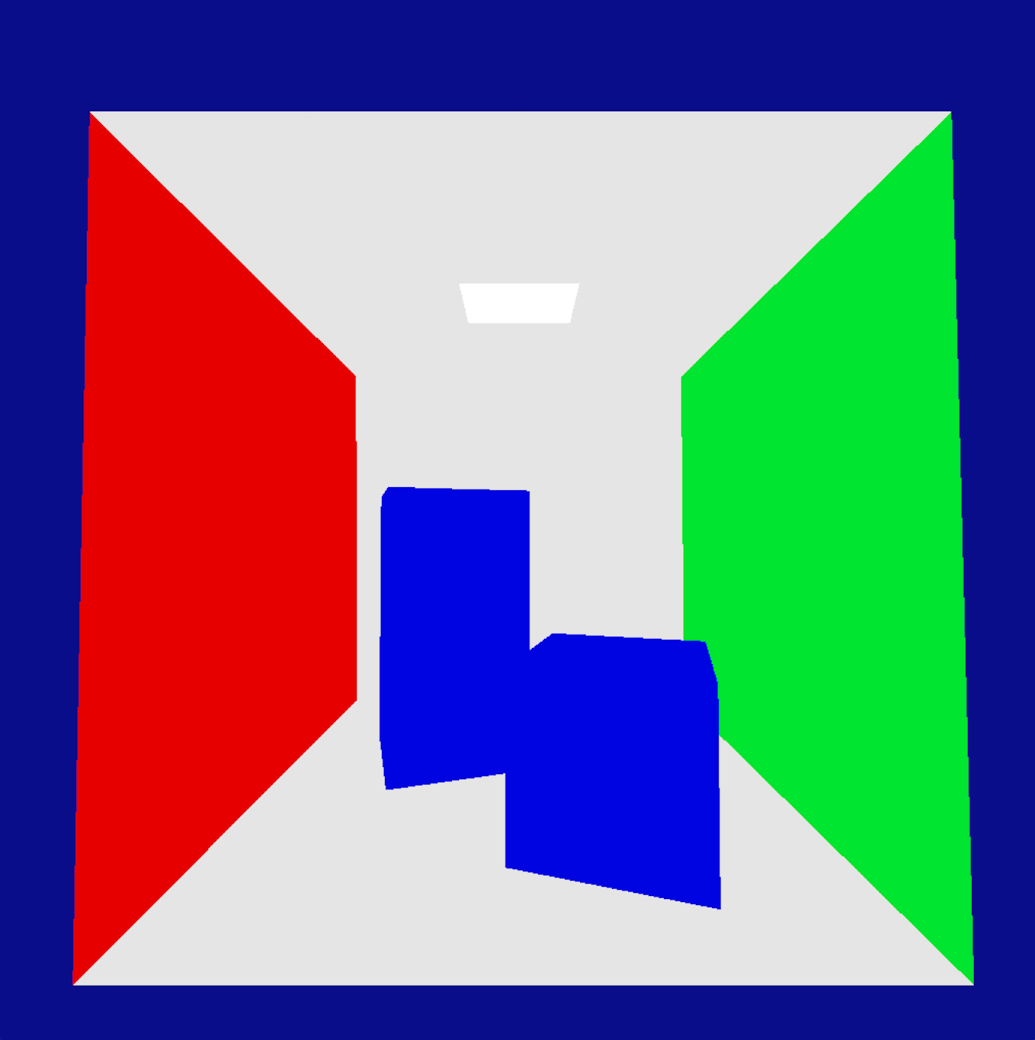



Parameterization for the Cornell Box
W = H = 1024
fovW $=90$
fovH = fovW * H/W
eye $=\left(280,275,−330\right)$
at $=\left(280,265, 0\right)$

Slide 8
Code – Image.hpp , ImagePPM.[cpp,hpp]
It is proposed that on an initial approach images are saved as .ppm files (this is one of the simplest bitmap image formats.
Details and code on .ppm files can be found at: https://www.scratchapixel.com/lessons/digital-imaging/simple-image-manipulations/reading-writing-images.html
Initial files for these classes are provided (github)
[see next slide for further details]

Slide 9
Images and Tone Mapping
Our renderer produces floating point values for each channel (R, G and B) of each pixel. These are positive real numbers
The ppm file format only supports unsigned char values for each channel, in the set {0, 1, 2, … , 255}
The operation of compressing the large values on an image to much smaller values, such that they can be displayed, is referred to as Tone Mapping
ImagePPM.cpp includes the simplest (and less effective) tone mapper, such that your images can be saved. Everything should be OK if your lights accumulated power does not exceed 1.0 per channel.
More on this later on the semester

