Slide 1
Microservice Messaging in .NET Core (Chapter 5)
Διαβαστής Βασίλειος (ΜΠΣΠ2309)
Παπακώστας Παναγιώτης (ΜΠΣΠ2330)
Σαραντίδης Λυκούργος (ΜΠΣΠ2340)

Slide 2
Agenda
- Introduction
- Why Use Messaging?
- Overview of MassTransit & RabbitMQ
- Microservices Architecture
- Provider & Consumer
- Message Flow
- Configuration & Setup
- Conclusion

Slide 3
Introduction to Microservice Messaging
Microservices need a way to communicate asynchronously for scalability and reliability.

Slide 4
Why Use Messaging in Microservices?
Asynchronous communication helps to decouple services, improve scalability, and ensure resilience.

Slide 5
Overview of MassTransit
MassTransit is a .NET-based framework for handling message-based communication in microservices.

Slide 6
Overview of RabbitMQ
RabbitMQ is an open-source message broker that facilitates message routing between microservices.

Slide 7
Microservices Architecture
Focuses on implementing message-based communication using MassTransit and RabbitMQ. The implementation of microservice messaging includes the following projects (contained within MessageMicroservices solution):
InvoiceMicroservice (producer)
PaymentMicroservice (consumer)

Slide 8
Provider Microservice Overview
The Provider sends messages based on events or triggers within the system.
InvoiceMicroservice: a microservice which publishes a message about the newly created invoices (producer).

Slide 9
Consumer Microservice Overview
The Consumer subscribes to messages and processes them asynchronously.
PaymentMicroservice: a microservice which receives the message that an invoice was created (consumer). Serves as a quick example of a downstream microservice that reacts to the creation of an invoice.

Slide 10
Communication Flow: Provider to Consumer
Messages are sent from the Provider to RabbitMQ, where the Consumer picks them up.

Slide 11
RabbitMQ Setup & Configuration
Configure RabbitMQ as the message broker with queues and exchanges.

Slide 12
MassTransit Setup & Configuration
Set up MassTransit to publish and consume messages using RabbitMQ as the broker.

Slide 13
Message Contracts
Define message contracts for strong typing and better collaboration between services.

Slide 14
Event-Driven Architecture Overview
Microservices react to events, improving the overall responsiveness of the system.

Slide 15
Use Case: Publish and Subscribe
Demonstrating how the Provider publishes messages and multiple Consumers can subscribe to the same event.

Slide 16
Advantages of Asynchronous Communication
Improves scalability, fault tolerance, and allows services to operate independently.

Slide 17
Potential Pitfalls & Considerations
Challenges include ensuring message delivery, avoiding deadlocks, and managing message duplication.

Slide 18
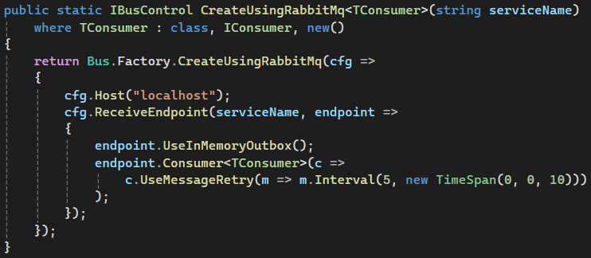
Demo/Example Code
Example code showing how to implement messaging using MassTransit and RabbitMQ.

Slide 19
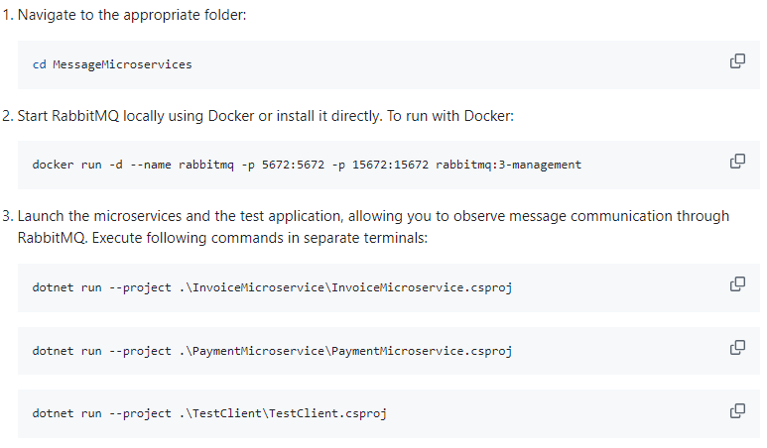
Configuration & Setup

Slide 20
Conclusion
Messaging helps build scalable, resilient microservice systems by decoupling communication.

