Slide 1
Testing Microservices in .NET Core (Chapter 7)
Διαβαστής Βασίλειος (ΜΠΣΠ2309)
Παπακώστας Παναγιώτης (ΜΠΣΠ2330)
Σαραντίδης Λυκούργος (ΜΠΣΠ2340)

Slide 2
Agenda
- Introduction
- Why Contract Testing?
- Overview of Pact
- Writing Consumer & Provider Tests
- Pact Broker
- Pact Example Contract
- Configuration & Setup
- Conclusion

Slide 3
Introduction to Microservice Testing
Testing microservices requires ensuring they communicate correctly, especially in distributed systems.
Focuses on contract testing between microservices using Pact Net framework. The consumer-driven contract testing approach ensures that both services can work together by adhering to predefined communication rules. Communication between microservices is achieved either over HTTP protocol, using REST APIs, or through message queues.

Slide 4
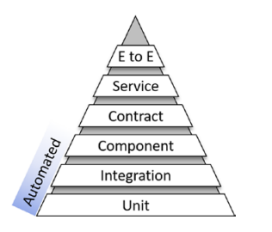
Importance of Contract Testing
Contract testing ensures that services adhere to agreed-upon communication rules and avoid breaking changes.

Slide 5
Overview of Pact
Pact is a consumer-driven contract testing tool that verifies interactions between services.

Slide 6
Overview of xUnit Testing Framework
xUnit is a popular unit testing framework for .NET, used to write and run tests.

Slide 7
Consumer-Driven Contract Testing (1/2)
Consumers define the contract, and the provider is responsible for meeting it. Pact verifies that both sides comply.
Microservices receive a payload of data by either an API call or messaging. Either way, the data needs to be in the expected format. This format is the contract. Contract testing is about verifying that calls from components to microservice are communicating with the agreed-upon data format.

Slide 8
Consumer-Driven Contract Testing (2/2)
Each microservice plays a part in the architecture. Therefore, it must be known as early as possible the format of the data. Of course, requirements change, and so must the code, data format, tests, and any mocks/stubs. During development, it can be malleable as needed to fulfill the business requirements. If there are changes to the contract of a microservice already in production, you will handle the change by versioning the API or the contract itself.

Slide 9
Pact Workflow: Consumer and Provider
The consumer creates a pact, the provider verifies the contract, and both services ensure compliance.

Slide 10
Over HTTP Protocol
Contract-Testing solution contains two microservice projects (OrderSvc-Consumer and DiscountSvc-Provider) and their appropriate test projects.
ConsumerTests contains the following:
DiscountSvcMock: a mock service which will be called from the test, instead of calling the real service
DiscountSvcTests: a test that is reliant on the mock service. Because of the mock service, there is no need to run the service itself. Running the test will leverage Pact Net and the mock microservice, and will generate the contract file (see example).
ProviderTests uses the information from the generated contract file (see example) to call the Discount microservice and confirm that the contract has not broken.

Slide 11
Microservice 1: Consumer Overview
The OrderSvc-Consumer service sends requests and expects specific responses from the Provider.

Slide 12
Microservice 2: Provider Overview
The DiscountSvc-Provider must adhere to the contracts defined by its consumers, ensuring compatibility.

Slide 13
Through Message Queues
MessageMicroservices solution contains two microservice projects (for details see here) and their appropriate test projects:
ConsumerTests
ProducerTests

Slide 14
Creating the Pact Contract
Define the expected interactions between the Consumer and Provider, including request and response formats.

Slide 15
Writing Consumer Pact Tests
Use Pact to define and test the interactions from the Consumer's perspective.

Slide 16
Writing Provider Verification Tests
Ensure that the Provider can meet the contract specified by the Consumer.

Slide 17
Mocking and Stubbing in Tests
Simulate the behavior of services during testing by mocking dependencies.

Slide 18
Pact Broker: Managing Contracts
The Pact Broker stores and manages contracts, ensuring that all services are up to date.

Slide 19
Benefits of Contract Testing
Contract testing catches breaking changes early, improving collaboration and reliability.

Slide 20
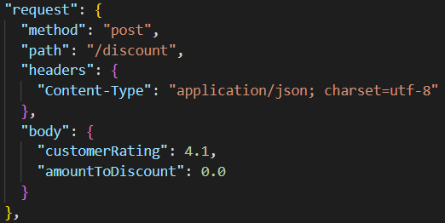
PACT Example Contract (1/2)
Running the test will leverage Pact Net and the mock microservice, and will generate the contract file.

Slide 21
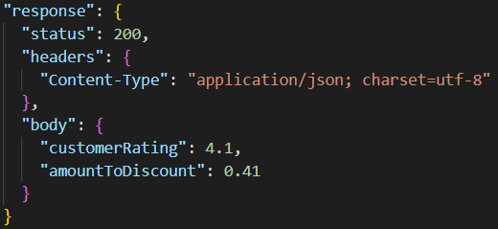
PACT Example Contract (2/2)

Slide 22
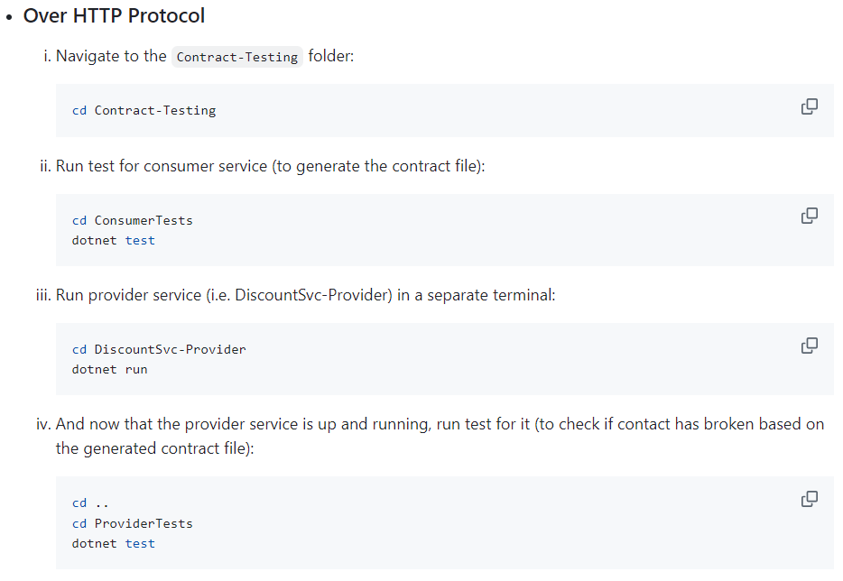
Configuration & Setup (1/2)

Slide 23
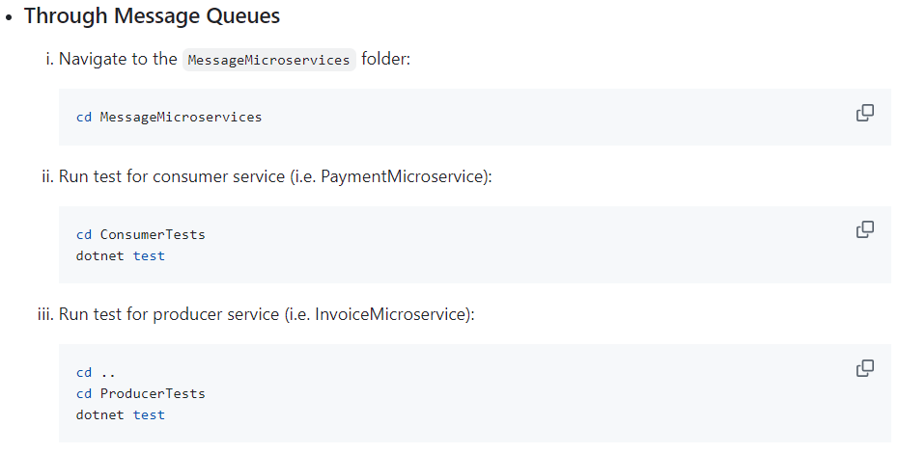
Configuration & Setup (1/2)

Slide 24
Conclusion
Contract testing ensures reliable communication between microservices, reducing integration issues.

