Slide 1



Information criteria in time series forecasting
Case studies WS 23/24
by Alexander Langnau, Ly Le, Jonathan Karras and Sudhir Rathore

Slide 2
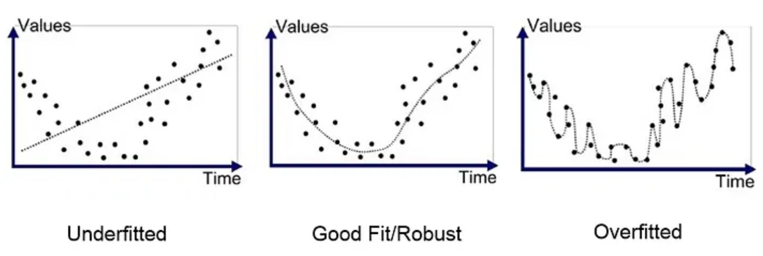
Motivation
How to find good models?
Which evaluation metrics do we have to consider?

Slide 3
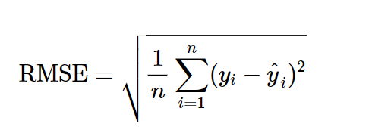
Motivation
Increasing the capacity/complexitiy always increases the in-sample fit (reduces the RMSE)
This can lead to overfitting, since the model will start to fit noise
Thus, very complex models may underperform on new, unseen data (out-of-sample)

Slide 4
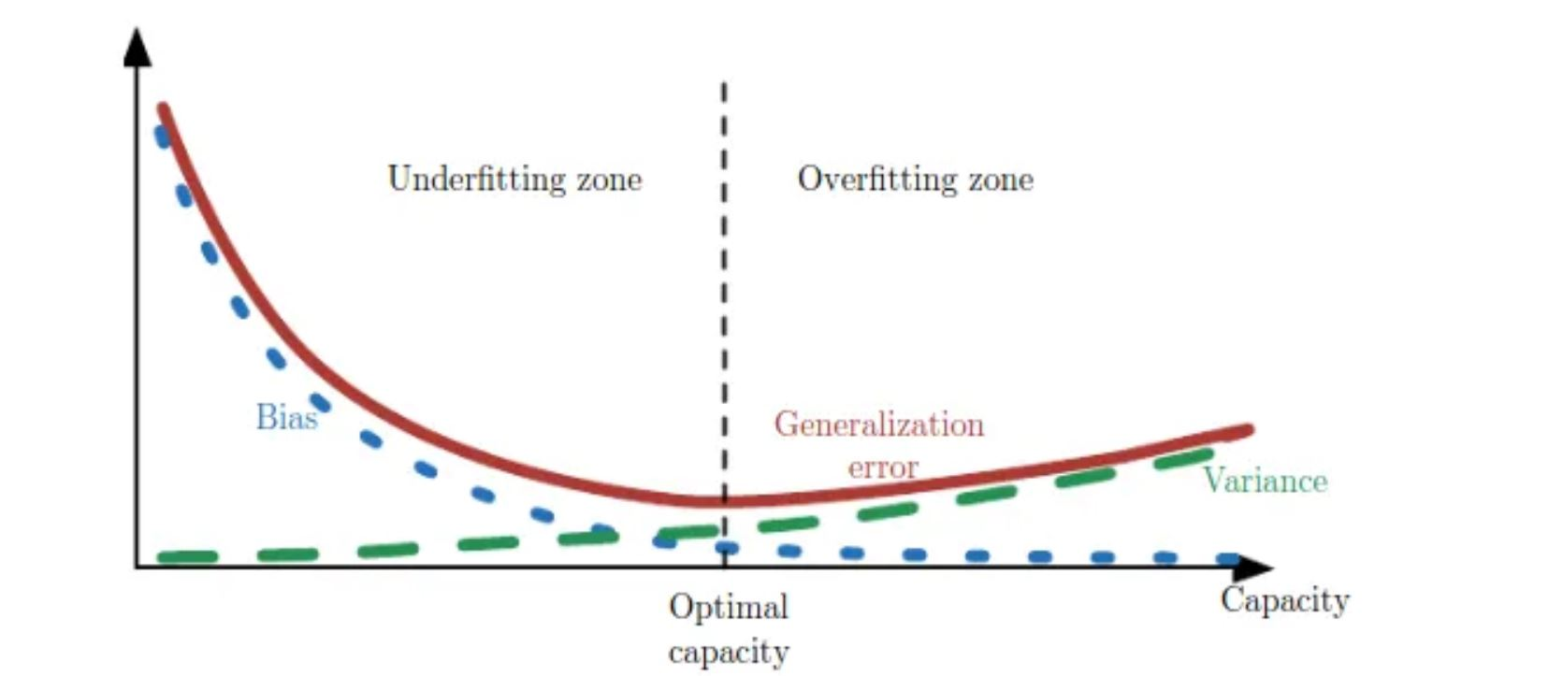
Motivation
We ideally want a model, that doesn´t overfit or underfit
Looking at the in-sample fit is not enough!
We want models, that perform well on unseen data (out-of-sample)
Source: Vidhya (2019)

Slide 5
Motivation
How to tackle this problem? → Model selection methods
Machine Learning:
Train/test split
Cross validation
Rolling forecast (time series data)
Information criteria

Slide 6
Motivation
Information criteria are measures to balance between goodness-of fit and complexitiy by including a penalty term for the complexity
Criteria = Model fit + Complexity penalty
Model fit: In sample SSE/RMSE → prefers more complex models
Complexity penalty: Differs by criteria → prefers less complex models

Slide 7
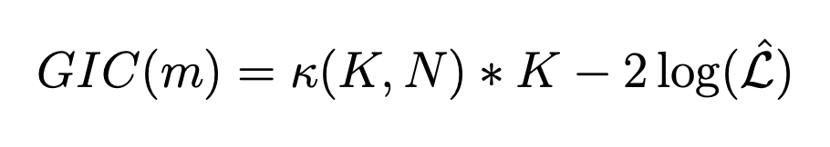
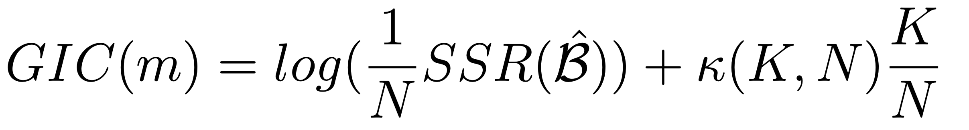
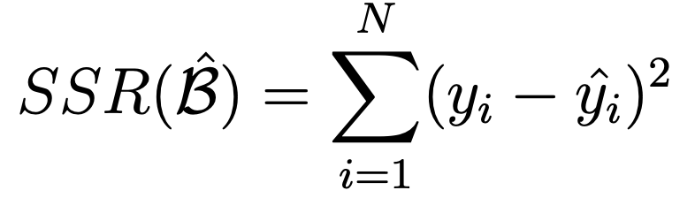
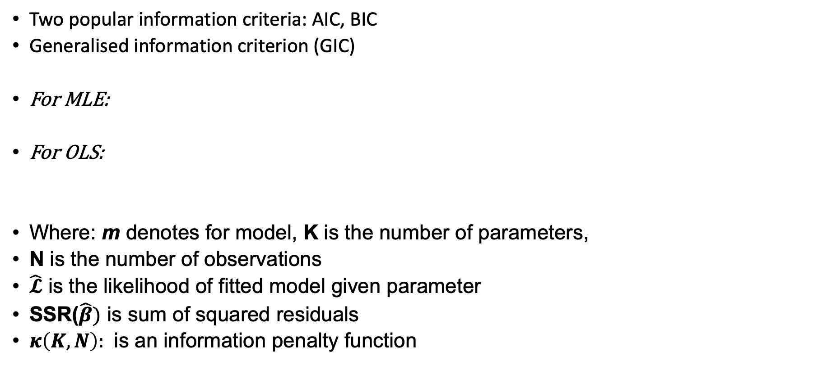
Information criteria
Two popular information criteria: AIC, BIC
﻿Generalised information criterion (GIC)
For MLE:
For OLS:
Where: m denotes for model, K is the number of parameters,
N is the number of observations
$\hat{𝓛}$ is the likelihood of fitted model given parameter
SSR($\hat{β})$ is sum of squared residuals
$κ\left(K,N\right):$﻿ is an information penalty function

Slide 8
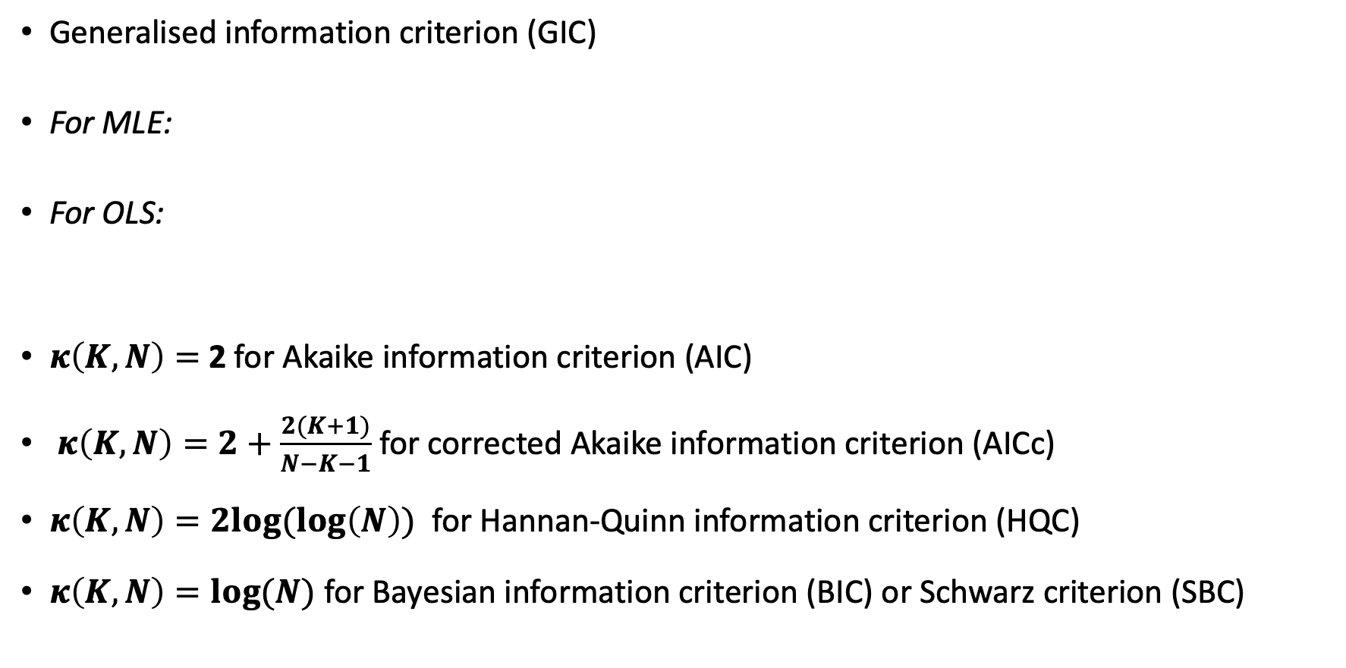
Information criteria
﻿Generalised information criterion (GIC)
For MLE:
For OLS:
$κ\left(K,N\right)=$ 2 ﻿for Akaike information criterion (AIC)
﻿ $κ\left(K,N\right)=2+\frac{2(K+1)}{N−K−1}$ for corrected Akaike information criterion (AICc)
$κ\left(K,N\right)=2log⁡(\log\left(N\right))$ for Hannan-Quinn information criterion (HQC)
$κ\left(K,N\right)=log⁡(N)$﻿ for Bayesian information criterion (BIC) or Schwarz criterion (SBC)

Slide 9
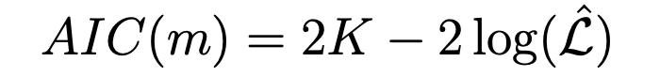
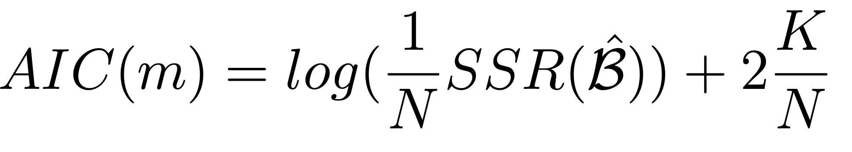
Akaike information criterion (AIC)
An estimator of prediction error => estimate quality of statistical models
Derived from frequentist probability, aims minimize information loss
For Maximum Likelihood Estimation
For OLS Regression
For Gaussian distribution two formulas can be used interchangeably

Slide 10
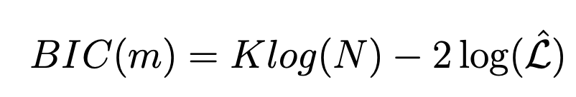
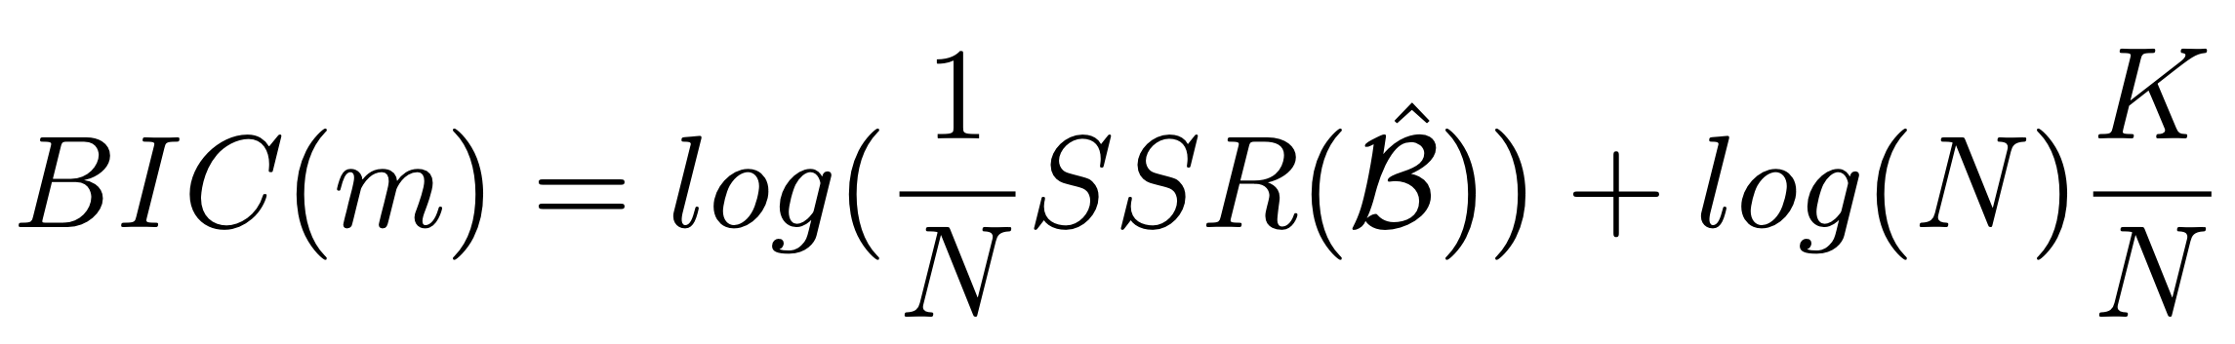
Bayesian information criterion (BIC)
A criterion for model selection among a finite set of models
Derived from Bayesian probability and inference, discourages overly complex models
For Maximum Likelihood Regression
For OLS Regression
For Gaussian distribution two formulas can be used interchangeably

Slide 11
AIC and BIC for model selection
Difference between AIC and BIC: The complexity penalty
Smaller an IC the better corresponding model is
→ Choose the model with smallest AIC (or BIC)
BIC has a bigger penalty for model complexity when data points increase
→ requires a simpler model
AIC penalizes complex models less
→ more emphasis on model performance and guarantees the prediction error is minimized
BIC is more conservative compared to AIC

Slide 12
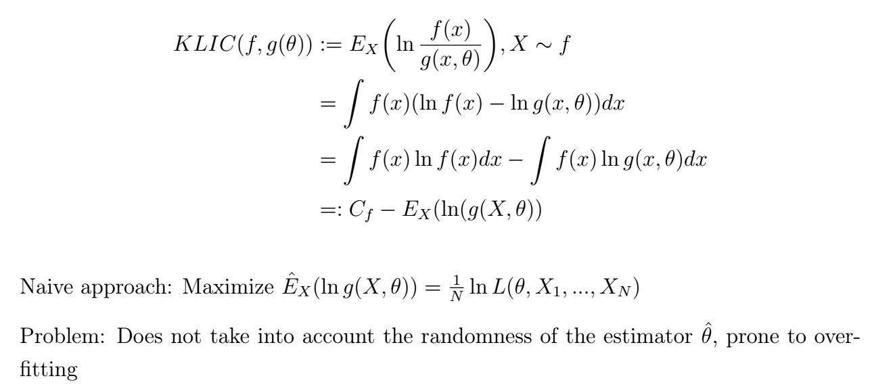
Kullback-Leibler-Information-Criterion

Slide 13
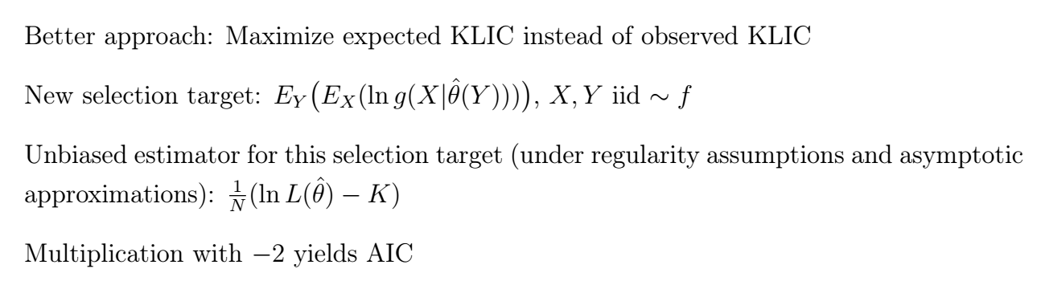
Kullback-Leibler-Information-Criterion

Slide 14
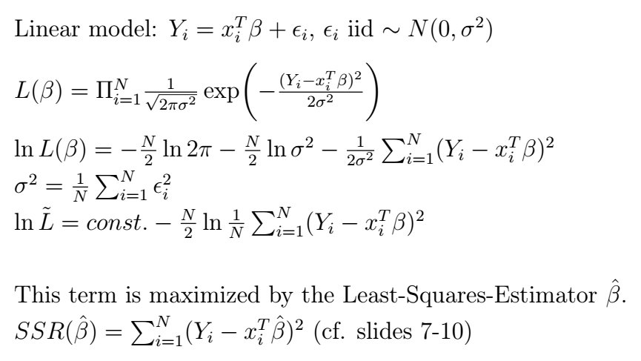
Gaussian Linear Models

Slide 15
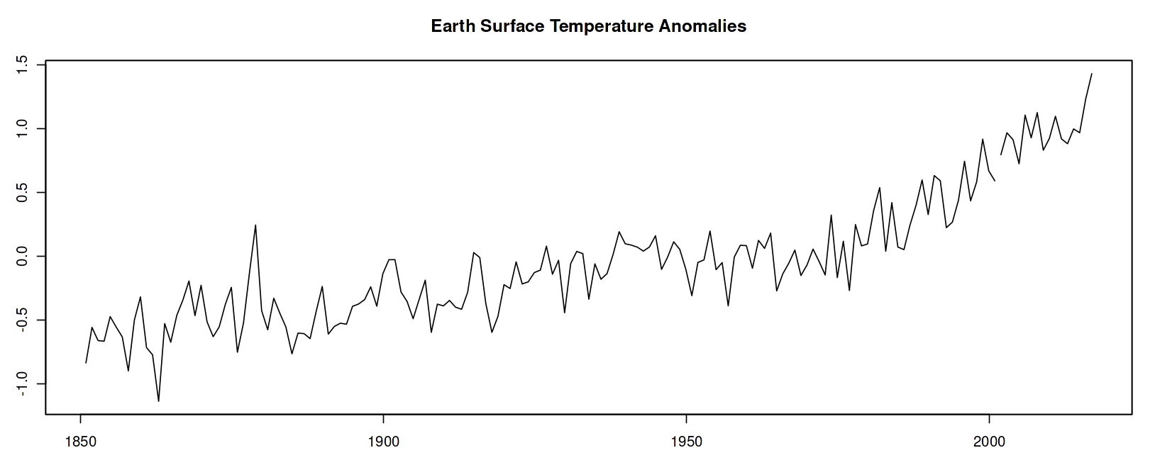
Model Selection - Example

Slide 16
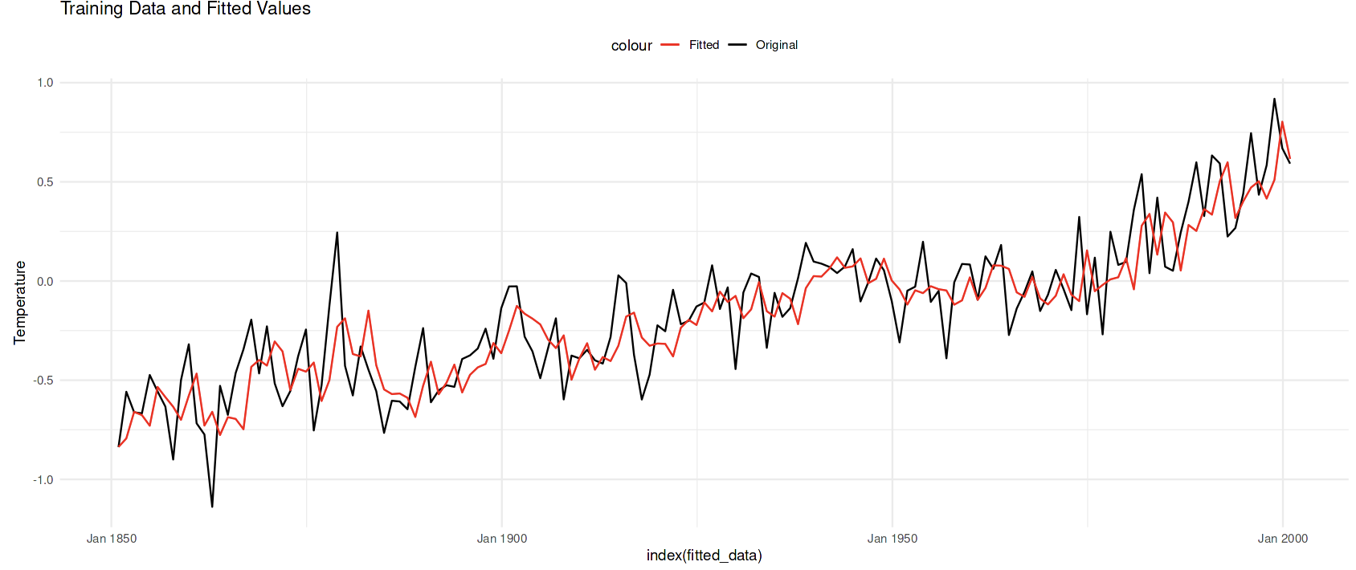
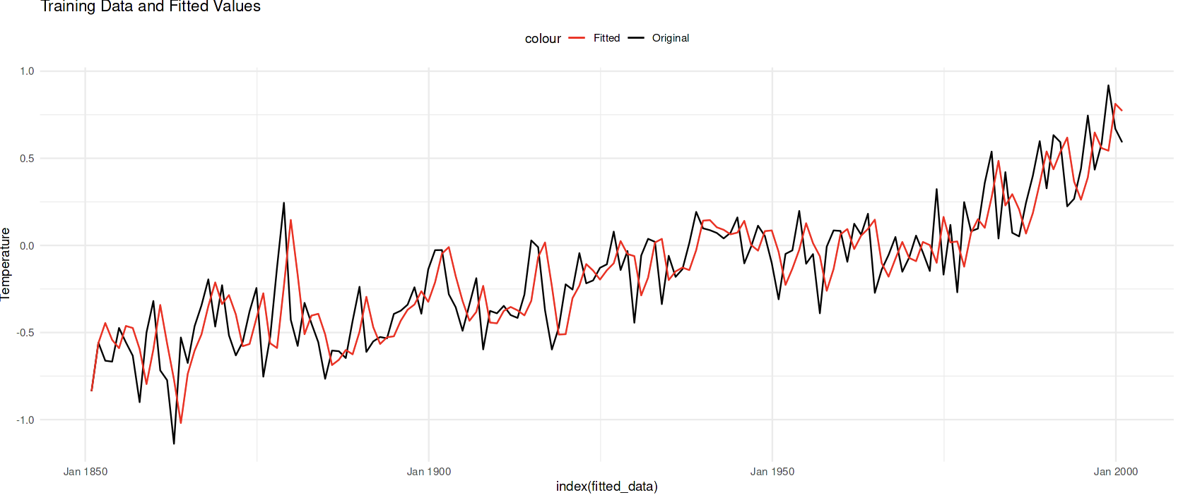
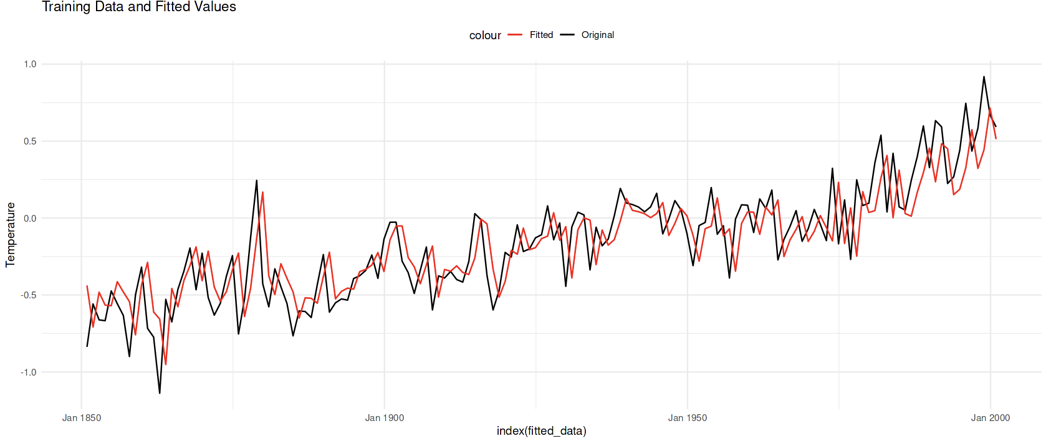
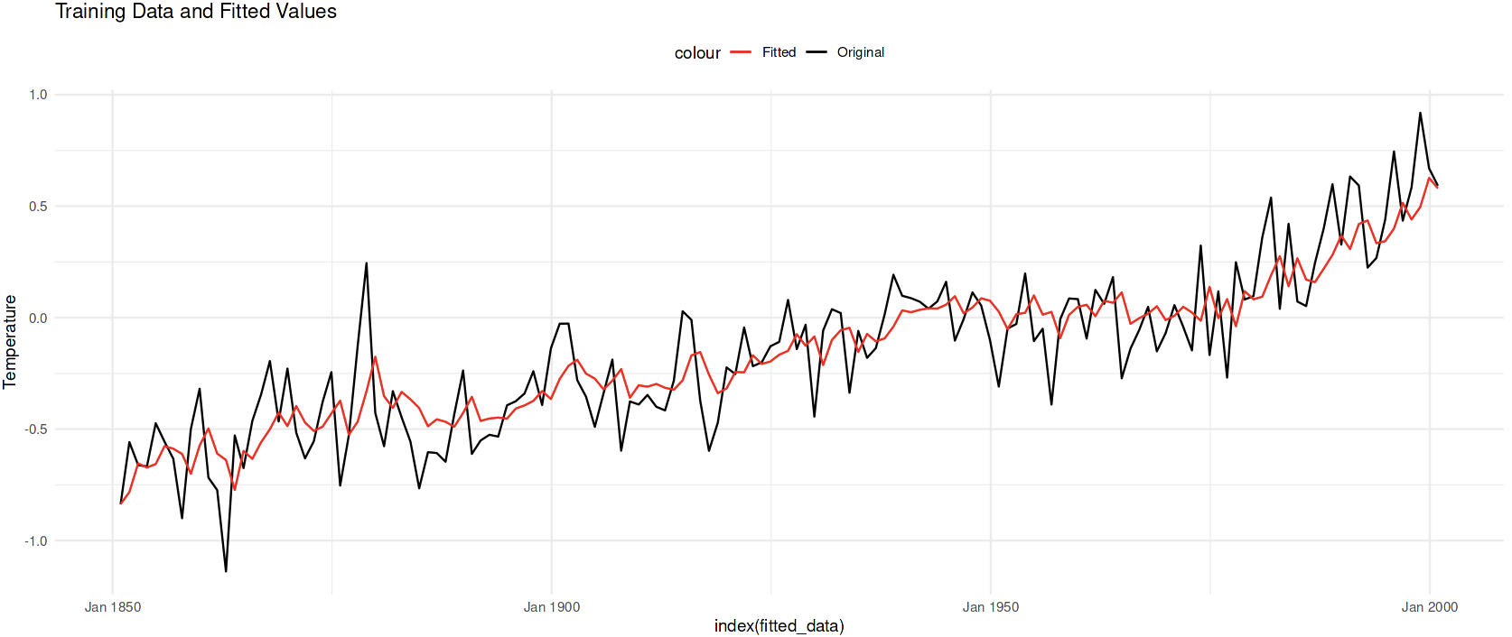
Model Fitting
Model 1: ARIMA Order (1,1,3)
Model 3: ARIMA Order (1,2,1)
Model 2: ARIMA Order (1,0,0)
Model 4: ARIMA Order (1,1,1)

Slide 17
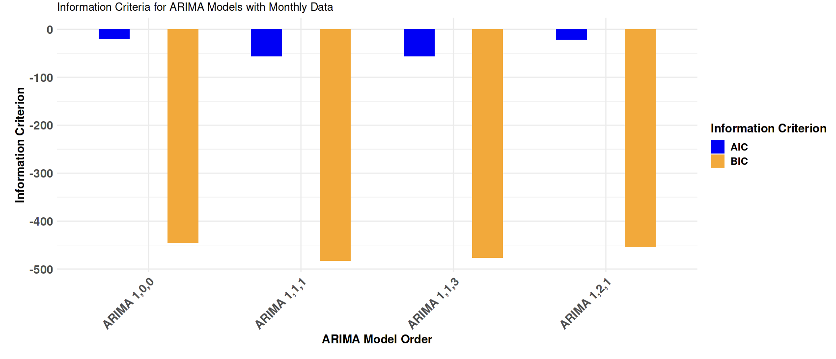
Information Criteria plot for Models

Slide 18
Model 1: ARIMA Order (1,1,3)
AIC: -55.8
BIC: -476.5
RMSE: 0.193
Model 3: ARIMA Order (1,2,1)
AIC: -21.04077
BIC: -453.7
RMSE: 0.215
Model 2: ARIMA Order (1,0,0)
AIC: -19.05
BIC: -444.6
RMSE: 0.221
Model 4: ARIMA Order (1,1,1)
AIC: -60.61
BIC: -482.2 RMSE: 0.191

Slide 19
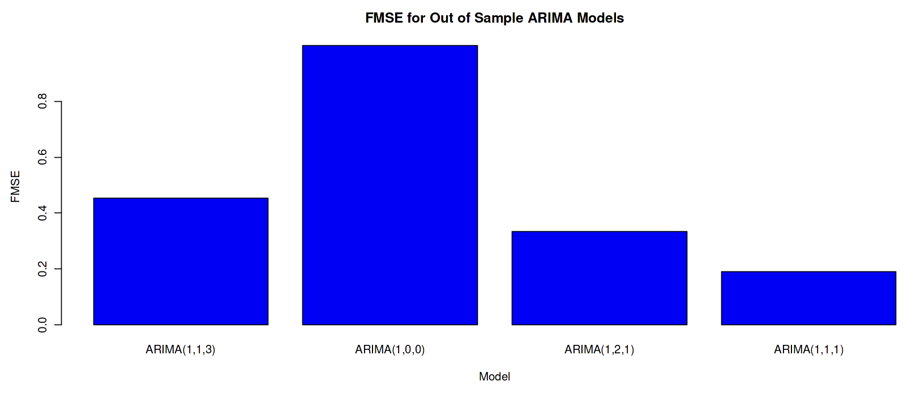
FMSE for Out of Sample Data

Slide 20
Final Points
AIC:
It is designed to strike a balance between how well a model fits the data (goodness of fit) and how complex the model is.
It penalizes overly complex models, favoring simpler ones.
A smaller ΔAIC suggests that the model with the lower AIC is significantly better at explaining the data
BIC:
BIC tends to select models with fewer parameters and is more conservative in model selection.

Slide 21
Sources:
Vidhya (2019): https://medium.com/analytics-vidhya/chapter-5-machine-learning-basics-26c64412b42e
https://userpage.fu-berlin.de/soga/data/r-data/Earth_Surface_Temperature.RData
K.P. Burnham & D.R. Anderson (2002): Model Selection and Multimodel Inference - A Practical Information-Theoretic Approach, 2nd ed. Springer, New York.
H. Akaike (1974): A New Look at the Statistical Model Identification. IEEE Transactions on Automatic Control, 19 (6), 716-723.
P. Stoica & Y. Selen (2004): Model-order selection: a review of information criterion rules. IEEE Signal Processing Magazine, 21 (4), 36-47.

