Slide 1
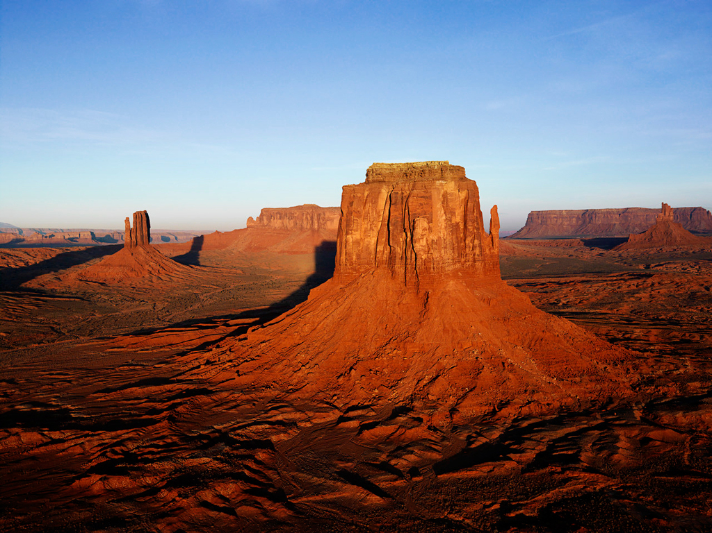
Picture With Caption Layout
More information.

