Slide 1

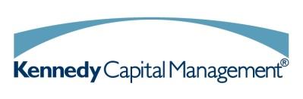

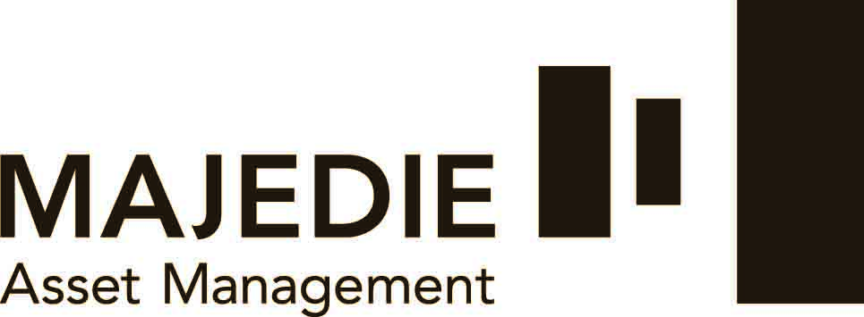

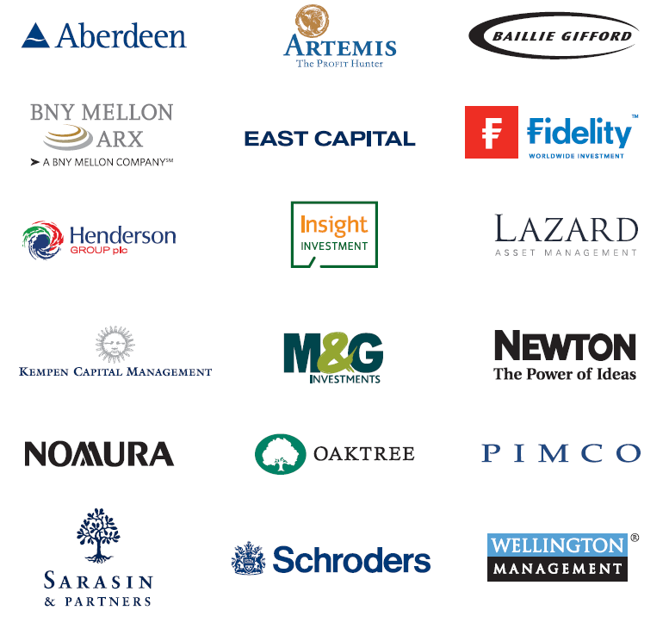
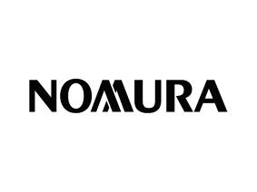


A high-quality open architecture platform
We offer our clients exposure to leading third-party asset managers
Some of our top asset managers include
Open Architecture
Our open architecture platform ensures that we remain fundamentally objective in evaluating fund managers
Clients gain access to institutional-quality managers, usually unavailable to private investors
Due Diligence
We enforce a stringent global due diligence process to evaluate managers quantitatively and qualitatively
Fund managers are regularly reviewed and if necessary replaced to ensure the needs of our clients always come first
A Unique Manager Blend
Our exclusive multi manager funds use proprietary tool to blend these managers, aiming to deliver consistent returns with lower volatility
1

