Slide 1



Funny Gorilla诙猩猩-IT培训
Your success is our success
GIT Introduction

Slide 2

Version Control System
Version Control System (VCS) is a software that helps software developers to work together and maintain a complete history of their work. Listed below are the functions of a VCS:
Allows developers to work simultaneously.
Does not allow overwriting each other’s changes.
Maintains a history of every version.

Slide 3
GIT Introduction

Slide 4
Local vs Remote

Slide 5
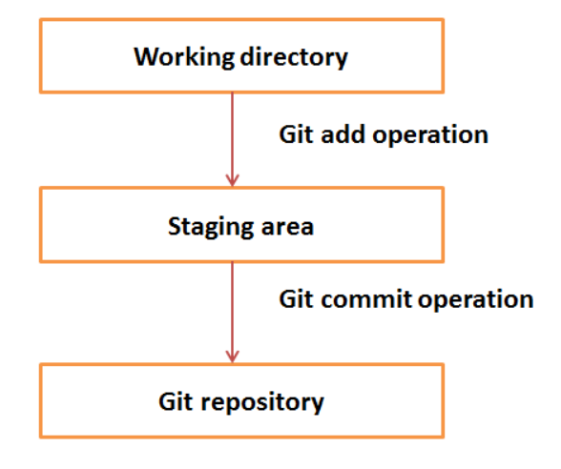
Local Git

Slide 6
GIT Commands - local
//Create local git repository
git init
//add new file to staging
git add fileName
//commit new file into repository
git commit -m "from Arthur first"

Slide 7
Branch
Appendix A: Introduction to Git

Slide 8
//-- list branch
git branch -- local branch
//-- create a branch
git branch [name-of-your-new-branch]
//-- checkout a bran – work with a branch
git checkout [name-of-your-new-branch]

Slide 9
Demo – Local repository
Appendix A: Introduction to Git

Slide 10
GitHub - remote

Slide 11
GIT Commands – remote
//Clone from remote
git clone http://github.com/arthurguau/GITTraining.git
//set remote
git remote add origin http://github.com/arthurguau/GITTraining.git
//pull – get latest from remote
git pull
//push to remote
git push origin myBranch
//list remote branch
git branch -r

Slide 12
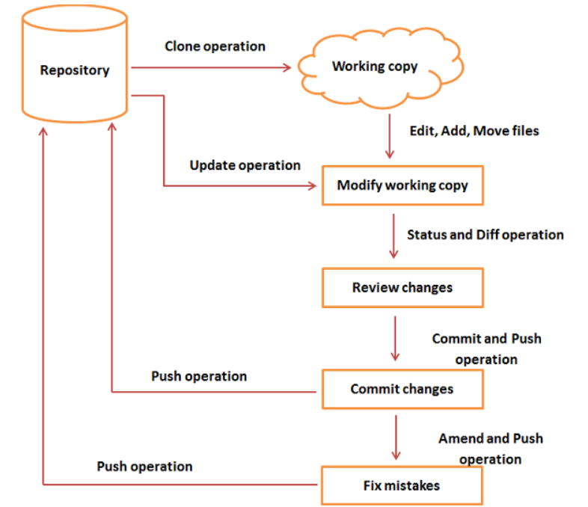

Summary - GIT Workflow

Slide 13

Your success is our success
Contact
Mail: info@funnygorilla.com.au
Linkedin: https://mt.linkedin.com/in/songqing-gu-2ba9034b/de
Web Chat: FunnyGorilla
Phone: 0420891343

