Slide 1
CSCI 434 Project
Florence Wang, Lynelle Chen, and Alison Mueller

Slide 2
Objective
Monitoring and Analyzing computer network traffic, particularly from popular internet websites such as Colonial Williamsburg, Instagram, and Target.
Extracting features from website traffic data and build models to classify the specific website from which the traffic originated.
The classification is done automatically, without access to the website URL or data payload that is typically encrypted.

Slide 3



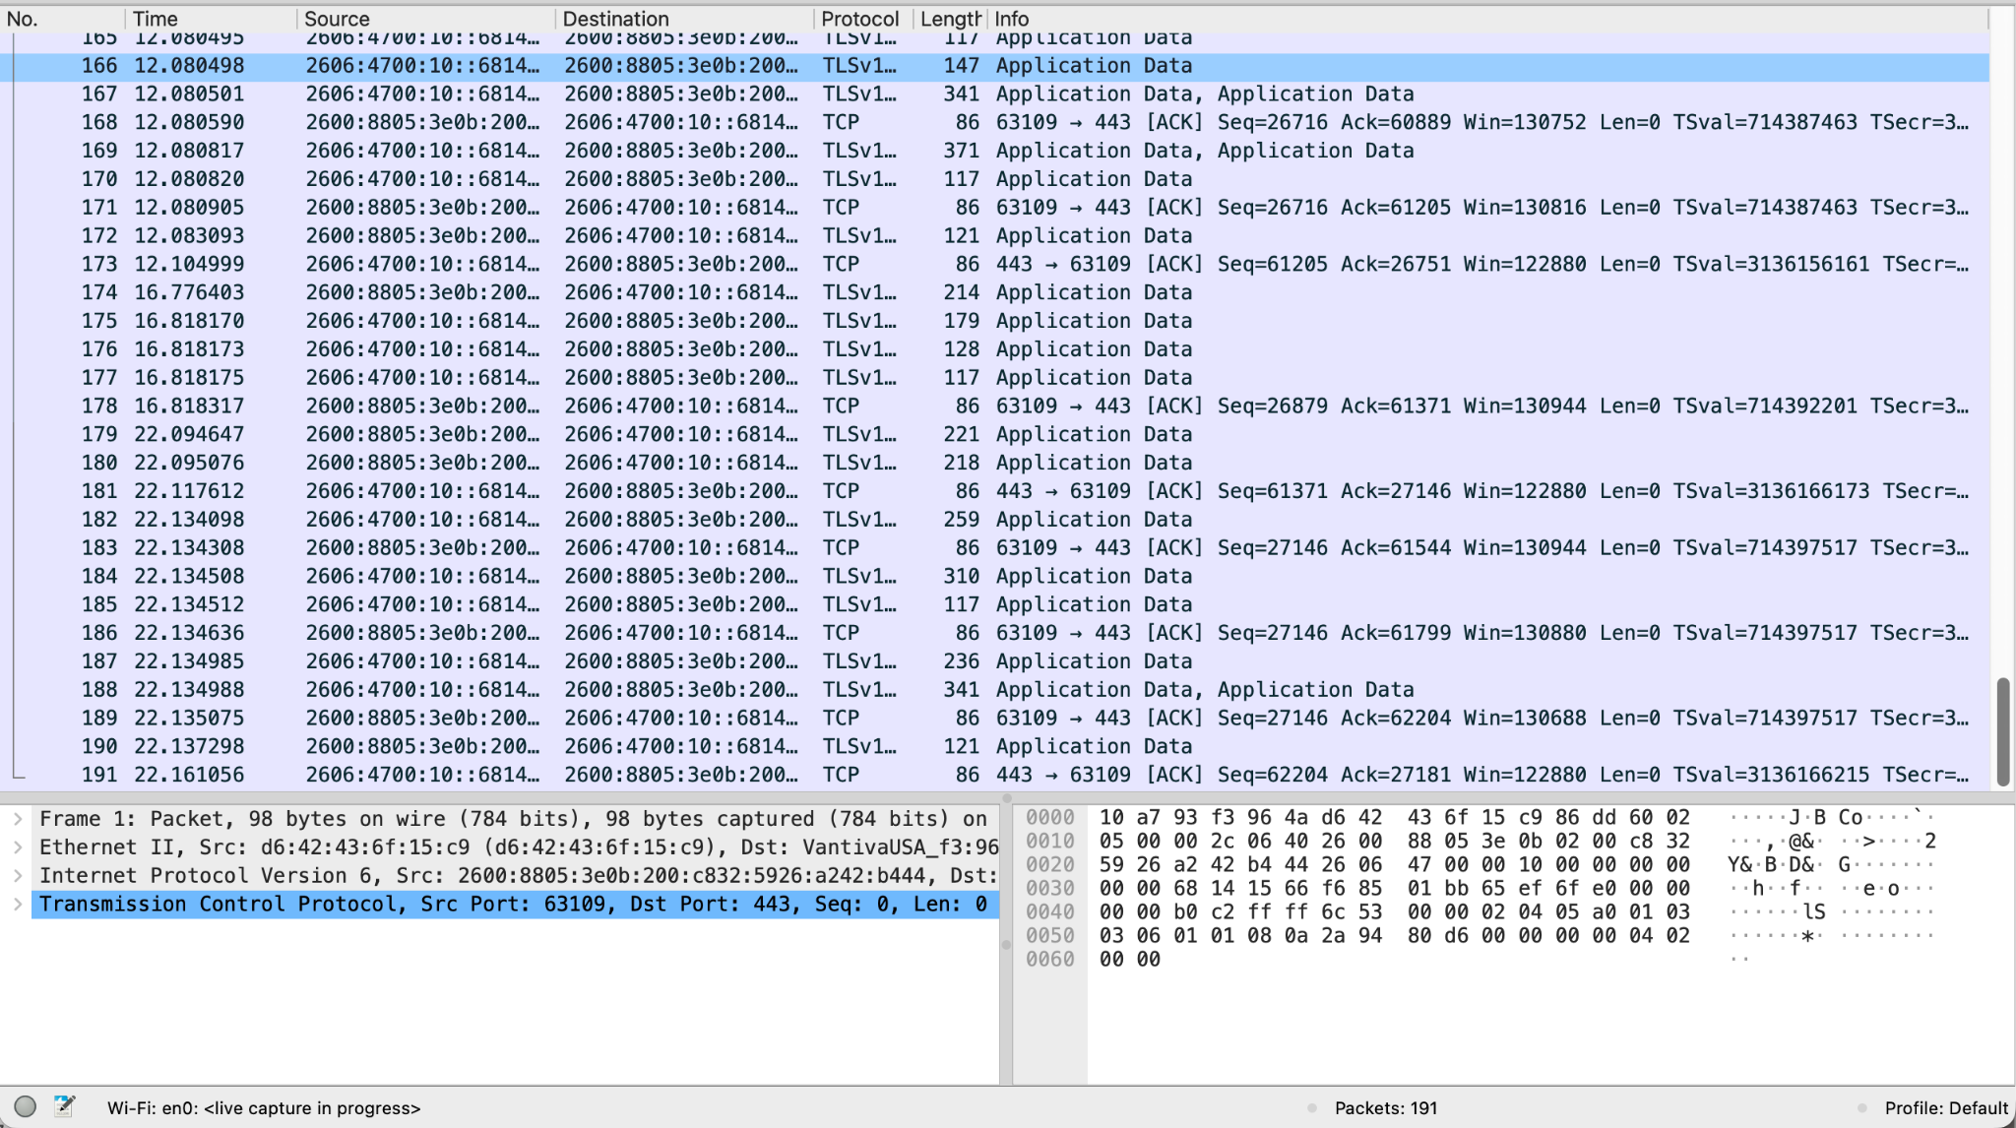
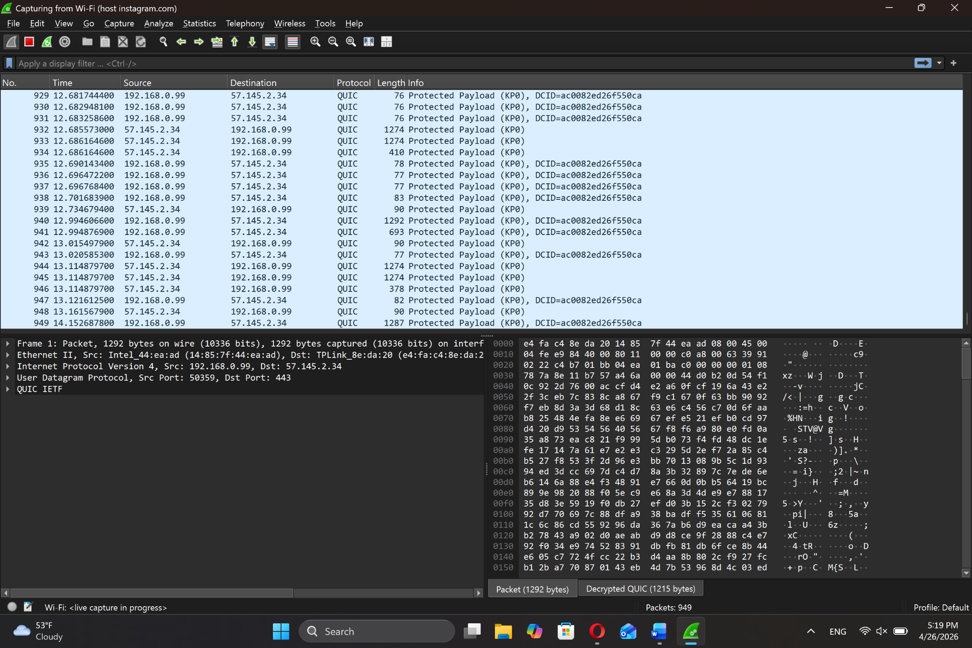
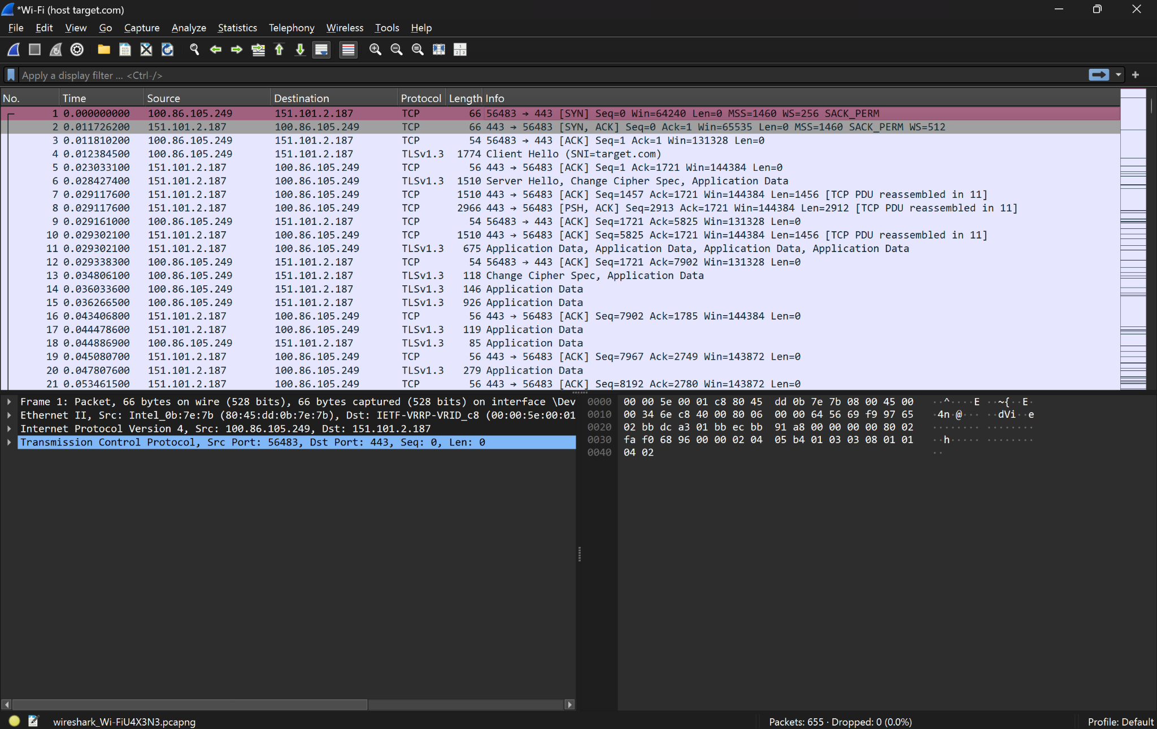
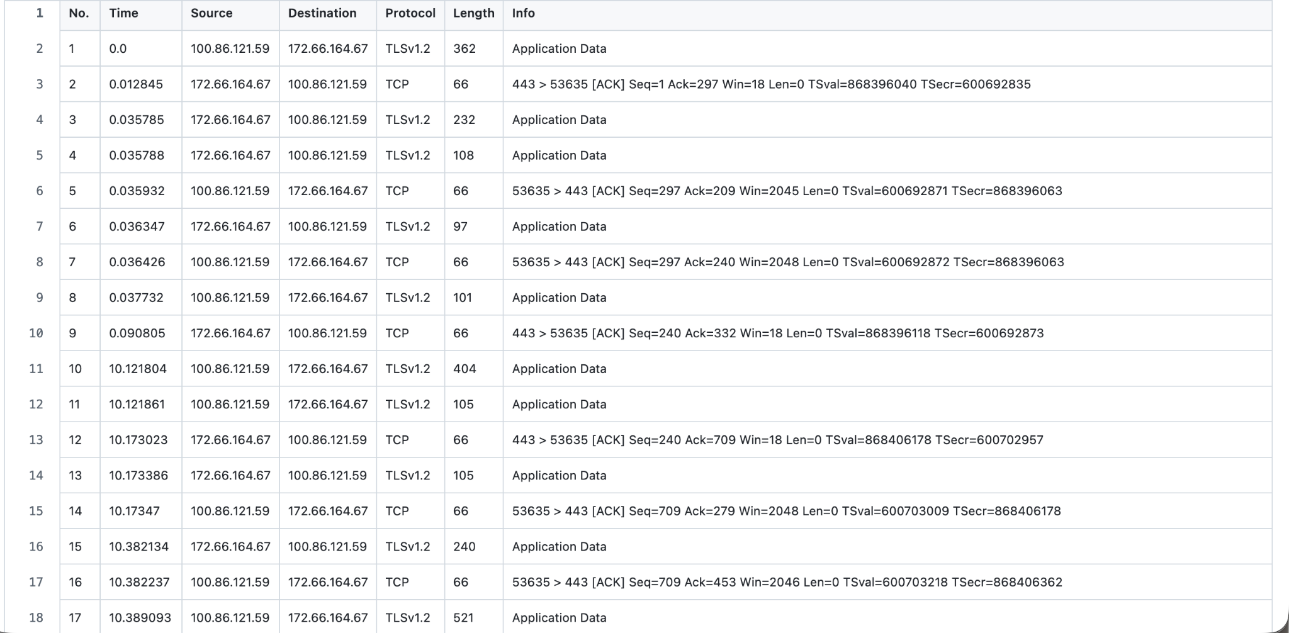
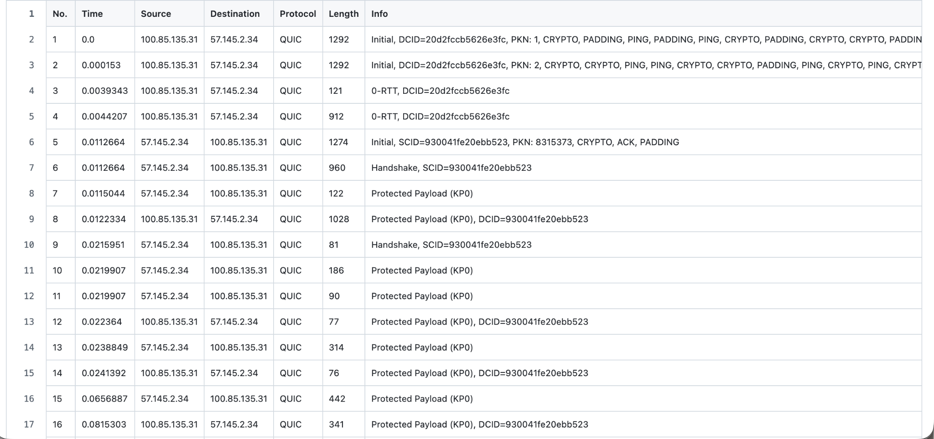
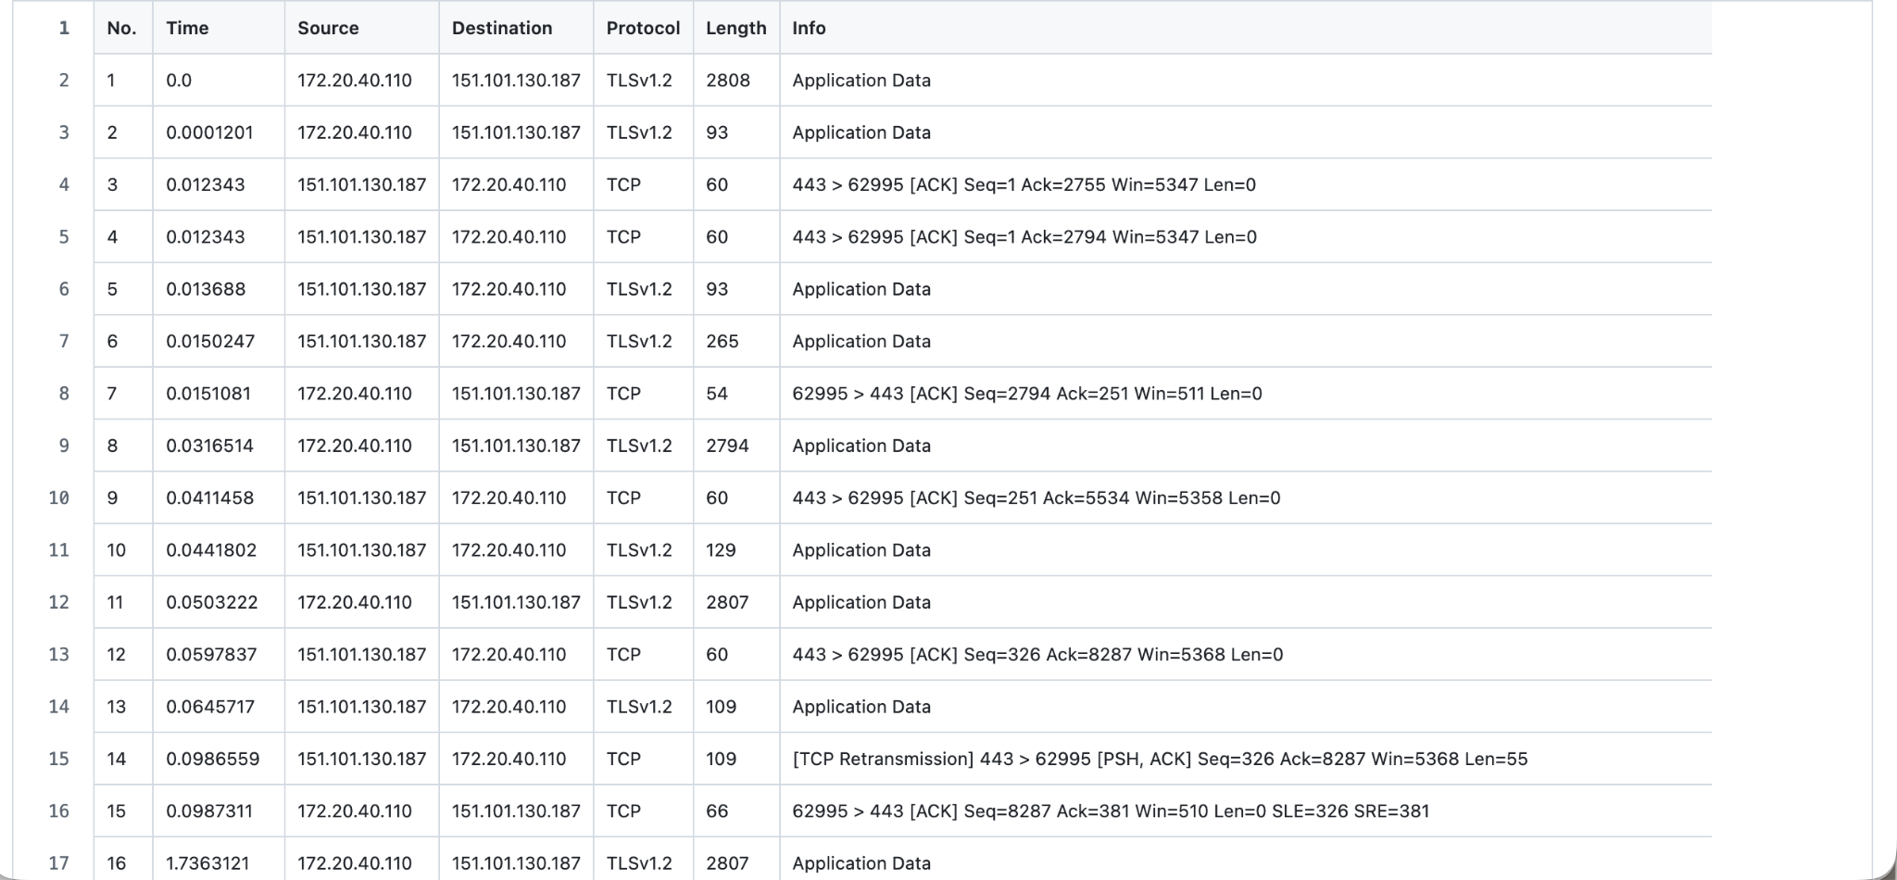
Data Collection
Colonial Williamsburg
Target
Instagram
Visited Website
Wireshark Collected Data
Exported Data

Slide 4
Extracted Features
Packet Count
Total Length
Average Packet Interval
Max Packet Interval
Min Packet Interval
Most Common Packet Interval
Average Packet Length
Max Packet Length
Min Packet Length
Most Common Packet Length
Average Payload Length
Average Header Length
Dataset size: 40 for each network type

Slide 5
Classification Models
Baseline: Logistic Regression (Multiclass)
Random Forest
SVM (Support Vector Machine)
Neural Network

Slide 6
Random Forest
Ensemble machine learning algorithm
Combines multiple varying decision trees to reach a more accurate result
Mechanisms:
Bagging (bootstrap aggregation) of training data subsets
Feature Randomness
Majority Voting
Advantages:
Less overfitting
Good at handling a large number of features / high dimension data
Limitations:
As an aggregation of decision trees, black box and complex to understand how features are weighed
Requires significant memory and compute

Slide 7
Support Vector Machine (Multiclass)
Extension of binary SVM (we used SVC)
Breaks down into multiple binary classification tasks
One vs One classifier of every possible pair
Mechanisms:
Data subsetting for each classifier pair
Voting system with vote done by each classifier
Advantages:
Better at handling lopsided datasets
Scales well when handled as binary model
Limitations:
Scales poorly with classes
More time required to compute predictions

Slide 8
Neural Network
Supervised learning model
Mechanisms:
Output layer that consists of the same number of neurons as the number of classes
Activation function
Loss function
Advantages:
Can model highly complex nonlinear relationships
Feature learning and flexibility
Scalability with increased number of classes
Limitations:
Computationally expensive
Black box
Local Minima / Maxima
Data demand

Slide 9
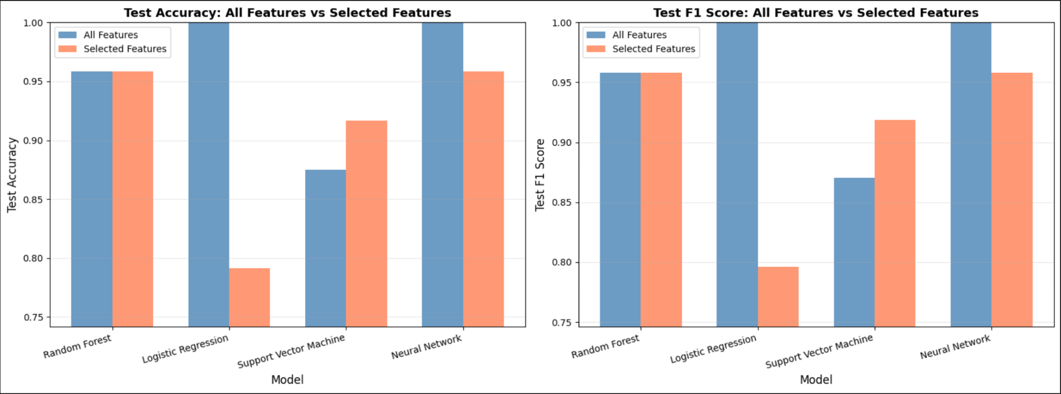
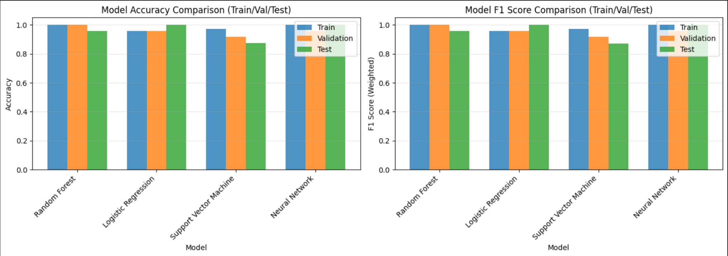




Result
Evaluation Results (Train/Validation/Test: 6:2:2)
Model | Accuracy | Macro F1 Score
Logistic Regression | 1.00 | 1.00
Random Forest | 0.96 | 0.96
Support Vector Machine (SVM) | 0.88 | 0.88
Neural Network | 1.00 | 1.00
Note: TP = True positive; FP = False positive; TN = True negative; FN = False negative.

Slide 10
Discussion
Logistic regression performing very well implies that the data are linearly separable (classes are neatly separated across lines, easier to guess based on the features).
The websites we chose were designed for different purposes. Their traffic patterns were likely quite distinct from each other.
For a practical application, a more diverse dataset should be used to train our models, and we should reevaluate how each model performs.
This could allow us to extend the application of our model, for example, predicting website category instead of the website itself.
Notes:
https://news.mit.edu/2017/explained-neural-networks-deep-learning-0414

Slide 11
Other challenges
Small dataset
High number of features (could contribute to overfitting)
Differences in network connection during data collection
Future Improvements
Increase number of records collected for each website
Decrease number of features (remove least important features)
Use the same network connection, at the same time of day, for data collection
Notes:
https://stackoverflow.com/questions/37776333/why-too-many-features-cause-over-fitting

