Slide 1
Quantitative genetics in structured populations
Goals:
1) Estimate the amount of genetic and environmental variation in the population.
2) Estimate the genetic and environmental effects on an individual.
3) Predict the phenotype of individuals using genome, pedigree, and environment.
Intermediate problems:
1) Genetic decompositions.
2) Estimating covariance matrices.

Slide 2
Where I am:
Similar performance on allele frequency calling.
Improved ROC for polymorphic sites.
Test with VG?
Improved accuracy calculating genetic covariance matrices from genotypic likelihoods.
Including unique estimate of several matrices
Improved accuracy calculating genetic covariance from use of individual specific priors.

Slide 3
TO DO LIST
Formally derive covariance matrices.
Estimate variances/covariances.
Get the BLUP right.
Implement model of DFE.
Implement population structure in simulations.
Check against GCTA in simulations.
Check against GCTA on human data.

Slide 4
Potential future projects.
1) Phenotypic prediction
Ancient DNA
Works well with genetic likelihood data
2) Genetic architecture
3)Historic inbreeding
ROH?
4) Selection tests

Slide 5
Genetic architecture
Effects of inbreeding.
Total amount of dominance variation
Epistatic effects verse genetic distance
Is GCTA really recovering narrow sense heritability?
What is going on with linkage?
LDAK vs GCTA

Slide 6
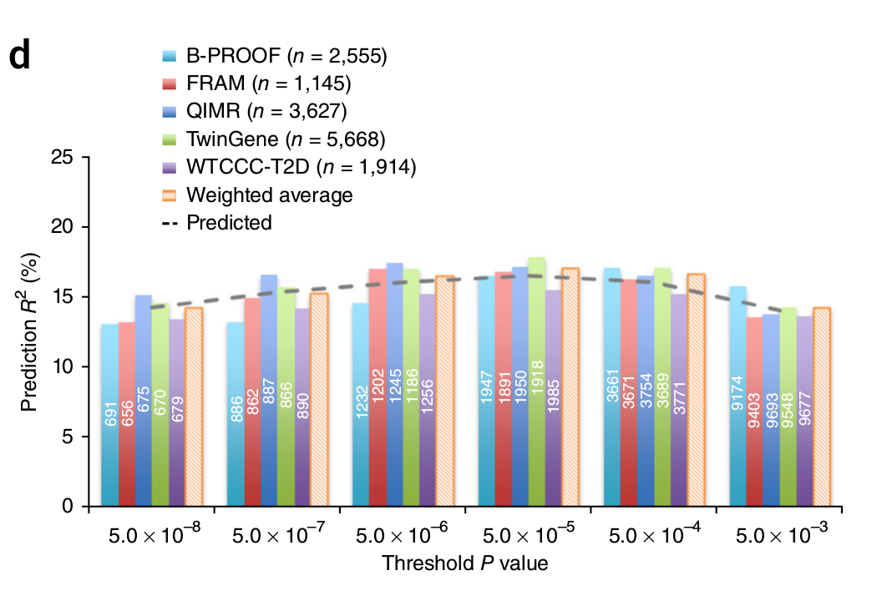
Phenotypic prediction
Wood et. al 2014, Nature Genetics.

Slide 7
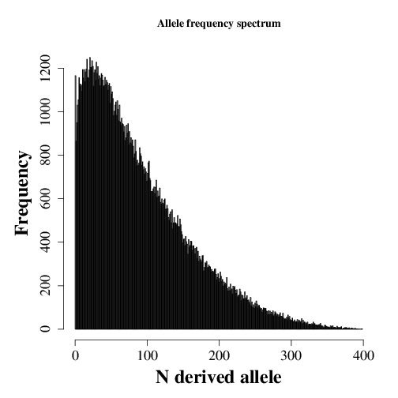
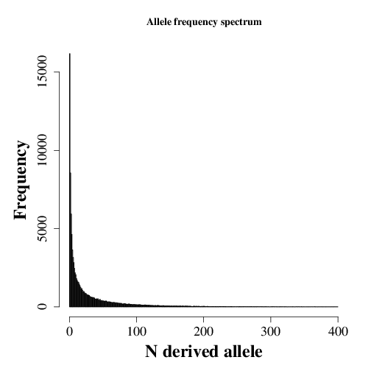

Slide 8
