Slide 1










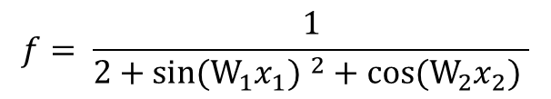









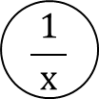


























$$\frac{π}{2}$$
$$0$$
$$x_{1}$$
$$W_{1}x_{1}$$
$$sin⁡(W_{1}x_{1})$$
$${sin⁡(W_{1}x_{1}) }^{2}$$
$$∗$$
sin(x)
$${ x}^{2}$$
$$\frac{π}{2}$$
$$0$$
$$0$$
$$−\frac{1}{9}$$
$$W_{1}$$
$$(2∗0)∗\left(−\frac{1}{9}\right)=0$$
$$1$$
$$0$$
$$cos\left(\frac{π}{2}\right)∗0=0$$
$${sin⁡(W_{1}x_{1}) }^{2}+cos⁡(W_{2}x_{2})$$
+
$$x+2$$
$$\frac{π}{2}$$
$$1∗\frac{1}{9}=\frac{1}{9}$$
$$1$$
$$\left(−\frac{1}{9}\right)\text{∗1}=−\frac{1}{9}$$
$$x_{2}$$
$$W_{2}x_{2}$$
$$cos⁡(W_{2}x_{2})$$
$$∗$$
cos(x)
$$\frac{π}{2}$$
$$1$$
$$−\frac{1}{9}$$
$$W_{2}$$
$$−sin\left(\frac{π}{2}\right)∗(−\frac{1}{9})=\frac{1}{9}$$
$$1$$
$\frac{π}{2}∗\frac{1}{9}=$ $\frac{π}{18}$
$$f= \frac{ 1 }{2+{sin⁡(W_{1}x_{1}) }^{2}+cos⁡(W_{2}x_{2}) }$$
$$\frac{ 1 }{ x }$$
$$2+{sin⁡(W_{1}x_{1}) }^{2}+cos⁡(W_{2}x_{2})$$
$$\frac{1}{3}$$
$$3$$
$1∗(−\frac{1}{3^{2}})$ = $−\frac{1}{9}$
$$1$$
Forward
Backward
f(x)= $\frac{ 1 }{ x }$ $\frac{ df }{ dx }=−\frac{ 1 }{ x ²}$
f(x)= $sin\left(x\right) \frac{ df }{ dx }=cos(x)$
f(x)= $2+x \frac{ df }{ dx }=1$
f(x)= $cos\left(x\right) \frac{ df }{ dx }=−sin(x)$
f(x,y)= $x+y \frac{ df }{ dx }=1 \frac{ df }{ dy }=1$
f(x)= $W_{1}x_{1} \frac{ df }{ dx }=W_{1}$
f(x)= x² $\frac{ df }{ dx }=2x$
f(x)= $W_{2}x_{2} \frac{ df }{ dx }=W_{2}$

Slide 2




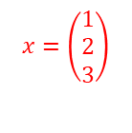

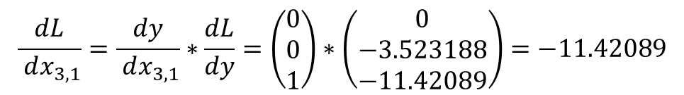

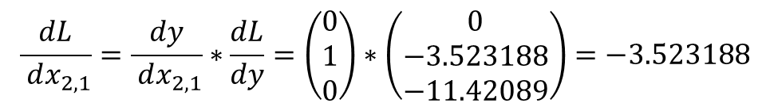

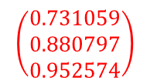
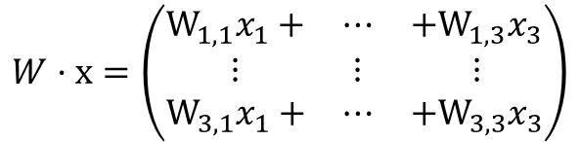
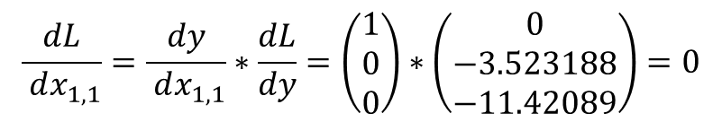
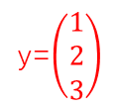



$$\left(\begin{matrix}0 \\ −3.523188 \\ −11.42089\end{matrix}\right)∗\left(\begin{matrix}1 \\ 1 \\ 1\end{matrix}\right)=\left(\begin{matrix}0 \\ −3.523188 \\ −11.42089\end{matrix}\right)$$
$$x=\left(\begin{matrix}1 \\ 2 \\ 3\end{matrix}\right)$$
y=$\left(\begin{matrix}1 \\ 2 \\ 3\end{matrix}\right)$
$$\left(\begin{matrix}0.731059 \\ 0.880797 \\ 0.952574\end{matrix}\right)$$
x
$$∗$$
Sigmoid
||x||²
$$2.2176476$$
2*$\left(\begin{matrix}0.731059 \\ 0.880797 \\ 0.952574\end{matrix}\right)=\left(\begin{matrix}1.462117 \\ 1.761594 \\ 1.905148\end{matrix}\right)$
$$1$$
W
$\left(\begin{matrix}1.462117 \\ 1.761594 \\ 1.905148\end{matrix}\right)∗$[$\left(\begin{matrix}1 \\ 2 \\ 3\end{matrix}\right)$*(1- $\left(\begin{matrix}1 \\ 2 \\ 3\end{matrix}\right)$)]= $\left(\begin{matrix}0 \\ −3.523188 \\ −11.42089\end{matrix}\right)$
$$w=\left(\begin{matrix}1 & 0 & 0 \\ 0 & 1 & 0 \\ 0 & 0 & 1\end{matrix}\right)$$
$$\left(\begin{matrix}0 \\ −3.523188 \\ −11.42089\end{matrix}\right)∗\left(\begin{matrix}1 & 2 & 3 \\ 1 & 2 & 3 \\ 1 & 2 & 3\end{matrix}\right)=\left(\begin{matrix}0 & 0 & 0 \\ −3.5 & −7.0 & −10.6 \\ −11.4 & −22.9 & −34.3\end{matrix}\right)$$
$$W·x=\left(\begin{matrix}W_{1,1}x_{1}+ & ⋯ & +W_{1,3}x_{3} \\ ⋮ & ⋮ & ⋮ \\ W_{3,1}x_{1}+ & ⋯ & +W_{3,3}x_{3}\end{matrix}\right)$$
$$\frac{ dL }{ dx_{1,1}}=\frac{ dy }{ dx_{1,1}}∗\frac{dL}{dy}=\left(\begin{matrix}1 \\ 0 \\ 0\end{matrix}\right)∗\left(\begin{matrix}0 \\ −3.523188 \\ −11.42089\end{matrix}\right)=0$$
$$\frac{ dL }{ dx_{2,1}}=\frac{ dy }{ dx_{2,1}}∗\frac{dL}{dy}=\left(\begin{matrix}0 \\ 1 \\ 0\end{matrix}\right)∗\left(\begin{matrix}0 \\ −3.523188 \\ −11.42089\end{matrix}\right)=−3.523188$$
f(x)= Sig(x)=h $\frac{ df }{ dx }=h(1−h)$
$$\frac{ dL }{ dx_{3,1}}=\frac{ dy }{ dx_{3,1}}∗\frac{dL}{dy}=\left(\begin{matrix}0 \\ 0 \\ 1\end{matrix}\right)∗\left(\begin{matrix}0 \\ −3.523188 \\ −11.42089\end{matrix}\right)=−11.42089$$
f(x)=||x||²=$x_{1,1}^{2}$+ $x_{2,1}^{2}$+ $x_{3,1}^{2} \frac{ df }{ dx_{i,1} }={2x}_{i,1}$

