Slide 1
CTF校队新手入门
June. 19th 2021

Slide 2
The Hacker Attitude
1. The world is full of fascinating problems waiting to be solved.
2. No problem should ever have to be solved twice.
3. Boredom and drudgery are evil.
4. Freedom is good.
5. Attitude is no substitute for competence.

Slide 3
Forensics
隐写术

Slide 4
Components
File Formats
EXIF data
Wireshark & PCAPs
Steganography
Disk Imaging

Slide 5
References
《Linux基础 — Linux Tools Quick Tutorial》
https://linuxtools-rst.readthedocs.io/zh_CN/latest/base/index.html
《Kali Tools Listing》
https://tools.kali.org/tools-listing
《The Python Tutorial》
https://docs.python.org/3/tutorial/
《计算机科学导论》

Slide 6
Tools
binwalk, dd, foremost
winhex, 01editor, binary ninja
StegSolver
Audacity
cloacked-pixel
https://www.filesignatures.net/index.php?page=search

Slide 7
从零开始的火星文生活
一年一度的 Hackergame 就要到了，L 同学打算叫上 Q 同学一起去参加，却一连几天都见不到 Q 同学的人影。然而在比赛开始的前一天晚上却收到了来自 Q 同学的邮件：
Subject: 绝密！不要外传！！！
Body: 详情见附件
From: Q
L 同学打开附件一看，傻眼了，全都是意义不明的汉字。机智的 L 同学想到 Q 同学平时喜欢使用 GBK 编码，也许是打开方式不对。结果用 GBK 打开却看到了一堆夹杂着日语和数字的火星文……
L 同学彻底懵逼了，几经周折，TA 找到了科大最负盛名的火星文专家 (你)。依靠多年的字符编码解码的经验，你可以破译 Q 同学发来的火星文是什么意思吗？
注：正确的 flag 全部由 ASCII 字符组成！

Slide 8
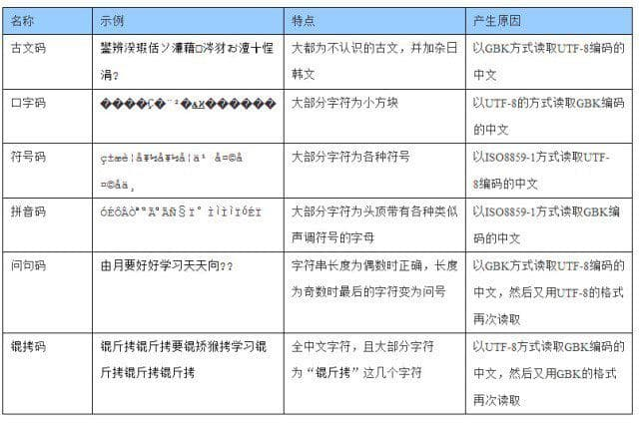
从零开始的火星文生活

Slide 9
从零开始的火星文生活
Save with Encoding -> GBK
Reopen with Encoding -> UTF-8
Save with Encoding -> ISO8859-1
Reopen with Encoding -> GBK

Slide 10

来自一教的图片
小 P 在一教做傅里叶光学实验时，在实验室电脑的模拟程序里发现了这么一张的图片：
数理基础并不扎实的小 P 并不知道什么东西
成像会是这个样子：又或许什么东西都不是，
毕竟这只是模拟 ... 但可以确定的是，
这些看似奇怪的花纹里确实隐藏着一些信息，
或许是地下金矿的藏宝图也未可知。

Slide 11
来自一教的图片
import numpy as np
import cv2 as cv
from matplotlib import pyplot as plt
img = cv.imread('./4f_system_middle.bmp', 0)
f = np.fft.fft2(img)
logf = 20*np.log(np.abs(f))
plt.imshow(logf, 'gray')

Slide 12
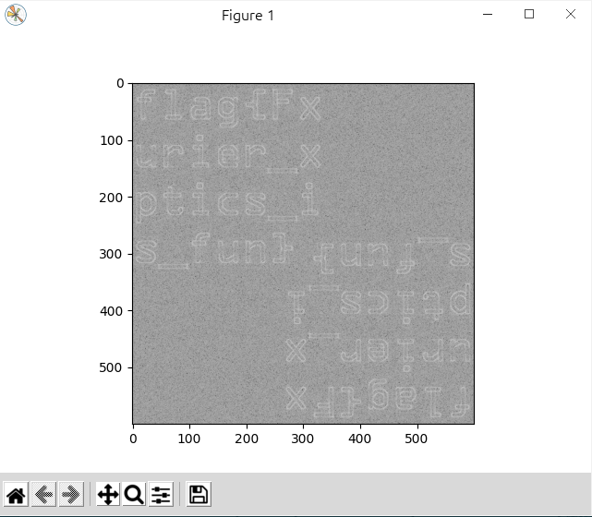
来自一教的图片

Slide 13
Cryptography
密码学

Slide 14
Components
XOR
Traditional Cipher
Hashing Functions
Block Cipher
Stream Cipher
Asymmetric Cipher

Slide 15
Traditional Cipher
Caesar Cipher
Substitution Cipher
Vigenère Cipher

Slide 16
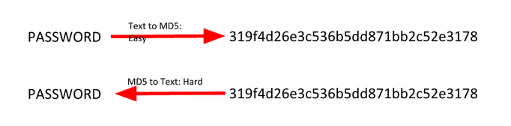
Hashing Functions
SHA-1, SHA-2, SHA128, SHA256, SHA512…
MD4, MD5 (insecurity)
CRC32
Hash Collisions

Slide 17
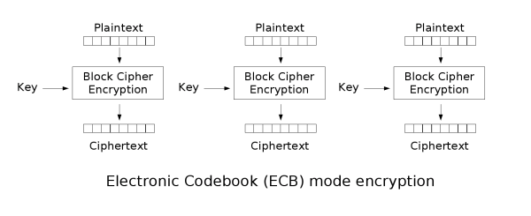
Block Cipher
Example ECB mode:
Padding Oracle Attack

Slide 18
Stream Cipher
Synchronous Stream Cipher
Self-synchronizing Stream Cipher
CFB is an example of CTAK
Key Reuse
Bit-flipping Attack

Slide 19
Asymmetric Cipher
Public Key Cryptography: RSA
The Public Key is made up of (n, e)
The Private Key is made up of (n, d)
The message is represented as m and is converted into a number
The encrypted message or ciphertext is represented by c
p and q are prime numbers which make up n
e is the public exponent
n is the modulus and its length in bits is the bit length (i.e. 1024 bit RSA)
d is the private exponent
The totient λ(n) is used to compute d and is equal to the lcm(p-1, q-1), another definition for λ(n) is that λ(pq) = lcm(λ(p), λ(q))

Slide 20
RSA
(m^{e})^{d} ≡ m (mod n)
Weak public key factorization
Wiener's attack
Hastad's attack (Small public exponent attack)
Small q (q < 100,000)
Common factor between ciphertext and modulus attack
Fermat's factorisation for close p and q
…

Slide 21
References
《离散数学及其应用》
《编码：隐匿在计算机软硬件背后的语言》
《现代密码学——原理与协议》

Slide 22
Tools
https://gchq.github.io/CyberChef/
http://www.factordb.com/
https://www.md5online.org/md5-decrypt.html
https://pypi.org/project/pycrypto/

Slide 23
cookin the ramen
Apparently we made cookin the books too hard, here's some ramen to boil as a warmup: .--- ...- ...- . ....- ...- ... ..--- .. .-. .-- --. -.-. .-- -.- -.-- -. -... ..--- ..-. -.-. ...- ...-- ..- --. .--- ... ..- .. --.. -.-. .... -- ...- -.- . ..- -- - . -. ...- -. ..-. --- -.-- --.. - .-.. .--- --.. --. --. ...-- ... -.-. -.- ..... .--- ..- --- -. -.- -..- -.- --.. -.- ...- ..- .-- - -.. .--- -... .... ..-. --. --.. -.- -..- .. --.. .-- ...- ... -- ...-- --.- --. ..-. ... .-- --- .--. .--- .....

Slide 24
The Obligatory RSA Challenge
Would you believe last year someone complained because we didn't have any RSA challenges?

Slide 25
Web
网页

Slide 26
Components
SQL Injection
Command Injection
Directory Traversal
Cross Site Request Forgery
Cross Site Scripting
Server Side Request Forgery

Slide 27
References
《白帽子讲web安全》
《代码审计：企业级Web代码安全架构》
《计算机网络：自顶向下方法》
《数据库系统概念》

Slide 28
Tools
Burp Suite, Fiddler
Wireshark
菜刀，蚁剑
gobuster, dirbuster

Slide 29
Basic Injection
See if you can leak the whole database using what you know about SQL Injections. link
Don't know where to begin? Check out CTFlearn's SQL Injection Lab
https://web.ctflearn.com/web4/
https://ctflearn.com/lab/sql-injection-part-1

Slide 30
Basic Injection
' or '1' ='1

Slide 31
Calculat3 M3
Here! http://web.ctflearn.com/web7/ I forget how we were doing those calculations, but something tells me it was pretty insecure.
https://web.ctflearn.com/web7/

Slide 32
Calculat3 M3
expression: ;ls

Slide 33
Reverse Engineering
逆向工程

Slide 34
Components
Assembly / Machine Code
C Programming Language
Disassemblers
Decompilers

Slide 35
References
《计算机组成原理》
《汇编语言》
《C++ Primer Plus》
《CTF竞赛权威指南（Pwn篇）》

Slide 36
Tools
Binary Ninja, IDA pro
JD-gui, jadx-gui
file, strings, checksec

Slide 37
Secret App
I hid my flag in a secret app but I forgot what my username and password are.

Slide 38
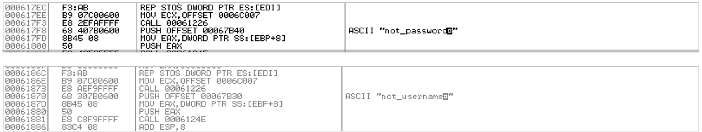
Secret App

Slide 39
Who am I?
I hid my flag in this program but it seems to have forgot who it is?

Slide 40
Who am I?
for ( i = 0; i < 9; ++i )
*(_BYTE *)(i + a1 + 10) = byte_4F7B40[i] ^ 0x78;
return 0;
>>> hex = [0x3c,0x19,0x0f,0x1f,0x3b,0x2c,0x3e,0x03,0x10,0x2d,0x27,0x4c,0x35,0x55,0x4b,0x01,0x4b,0x47,0x05]
>>> flag = "".join([chr(d ^ 0x78) for d in hex])

Slide 41
Binary
二进制

Slide 42
Components
Registers, stack, calling conversion, heap
Buffer overflow
ROP, ROL
Binary Security

Slide 43
References
《深入理解计算机系统》
《现代操作系统》
https://ctf-wiki.org/pwn/readme/
https://2ourc3.github.io/

Slide 44
Lazy Game Challenge
I found an interesting game made by some guy named "John_123". It is some betting game. I made some small fixes to the game; see if you can still pwn this and steal $1000000 from me!
To get flag, pwn the server at: nc thekidofarcrania.com 10001

Slide 45
Lazy Game Challenge
> -10000000
Sorry you didn't made it ! Play Again !... Better Luck next Time !. 8Sorry you lost some money !.. Your balance has been updated !. Current balance : : 10000500$

Slide 46
No Step On Snek
I heard you guys like python pwnables
nc umbccd.io 4000

Slide 47
No Step On Snek
Make your move: make_move(os.listdir('/home/challuser'))
['.bashrc', '.profile', '.bash_logout', 'nosteponsnek.py', 'flag.txt']
Make your move: make_move(open('flag.txt', 'rt').read())
DawgCTF{bUt_iT'5_c@ll3d_1nput}

