Slide 1
计网期末project答辩
金扬、黄梓通、刘乐奇

Slide 2

Ⅰ
Introduction
Ⅱ
Basic Test
CONTENTS
Ⅲ
Bonus Check
Ⅳ
Contribution Rate

Slide 3
Introduction
Ⅰ

Slide 4

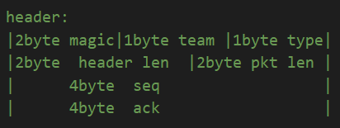
Introduction
No additional classes
No extension of header
Use dict() to handle concurrency
No change on all basic testing scripts.

Slide 5
Introduction
Handshaking
Our handshaking is based on the WHOHAS, IHAVE and GET pkt.
The connection will be built in receiver when it sent GET pkt and in sender when it received GET pkt.
Before building the connection, we will check if this channel is busy, i.e., if there is any chunk is receiving. If not, the connection will be built; otherwise, nothing happened.
Search my chunks. I don’t have!
C
WHOHAS
WHOHAS
A
B
Search my chunks. I have!
IHAVE
Search my connections, no channel with B.
Build up connection with B
Not reach max connection.
Build up connection with A
GET

Slide 6
Introduction
pkt_time_stamp is used to trace RRT, RTO and trigger time out retransmit
Timer
last_recv_time is used to trace if the opposite is crashed.
Receiver
Sender
GET
DATA seq:=1
pkt_time_stamp[seq]:=time.time()
last_recv_time:=time.time()
ACK ack:=1
last_recv_time:=time.time()
DATA seq:=2
pkt_time_stamp[seq]:=time.time()
last_recv_time:=time.time()
ACK ack:=2
last_recv_time:=time.time()
DATA seq:=3
pkt_time_stamp[seq]:=time.time()
last_recv_time:=time.time()
ACK ack:=3
last_recv_time:=time.time()

Slide 7
Introduction
Out of Order Pkt & Fast Retransmit
Receiver
Sender
DATA seq:=12
Pkt in order
received_chunk [downloading_hash] += DATA_payload
ACK ack:=12
DATA seq:=13
Out of order pkt received!
Store it
DATA seq:=14
received_pkt_list[seq]:=DATA_payload
ACK ack:=12
DATA seq:=14
Still not in order
received_pkt_list[seq]:=DATA_payload
ACK ack:=12
Still not in order
DATA seq:=14
received_pkt_list[seq]:=DATA_payload
ACK ack:=12
Pkt re-order!
3 redundant ack!
Fast retransmit
DATA seq:=13
received_chunk [downloading_hash] ⬅ received_pkt_list

Slide 8
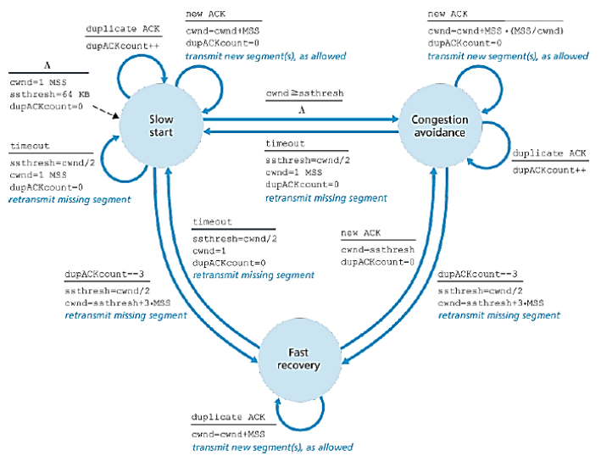
Introduction
Congestion Control
Sincerely follow the FSM

Slide 9
Introduction
Concurrency
Use dict()
The key is in Tuple[sender_addr, receiver_addr], where both sender_addr and receiver_addr are in Tuple[ip, port] with ip: str and port: int
When received a pkt, we first check the key and then process as needed. Since the pkt from different sender or receiver has the different key, we can distinguish the pkt to different channel.

Slide 10
Basic Test
Ⅱ

Slide 11
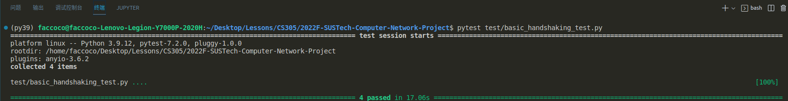
Basic Test
Handshaking

Slide 12
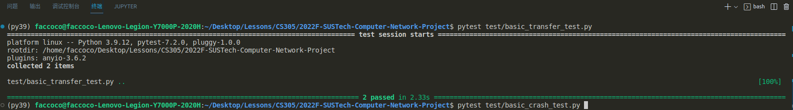
Basic Test
Transfer

Slide 13
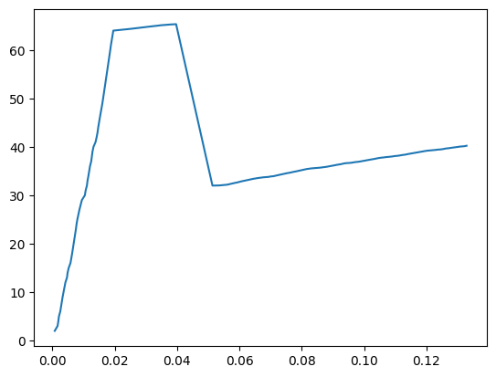
Basic Test
cwnd plot

Slide 14

Basic Test
Concurrency

Slide 15
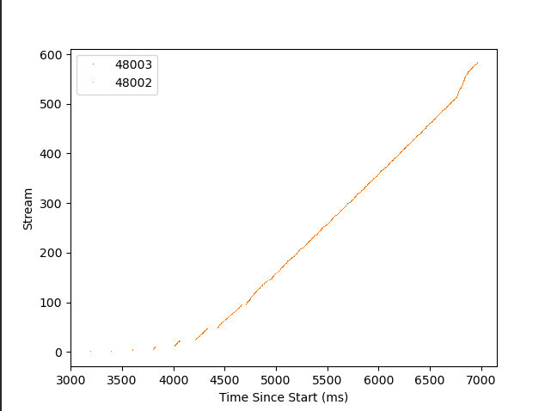
Basic Test
Concurrency Visualization Plot

Slide 16
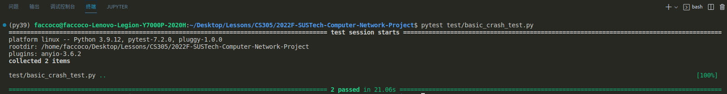
Basic Test
Crash

Slide 17
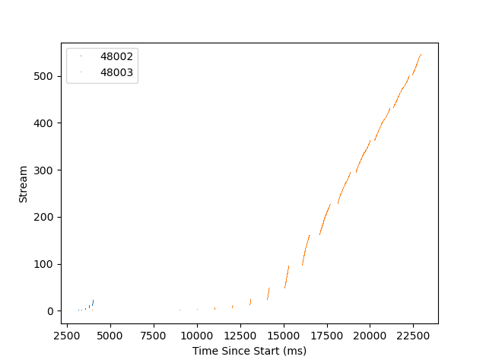
Basic Test
Concurrency Visualization Plot

Slide 18
Bonus Check
Ⅲ

Slide 19
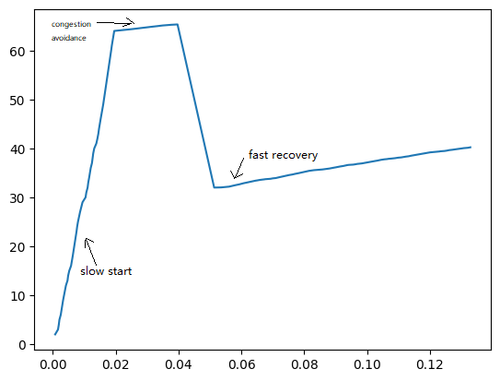
Bonus Check
Fast Recovery

Slide 20
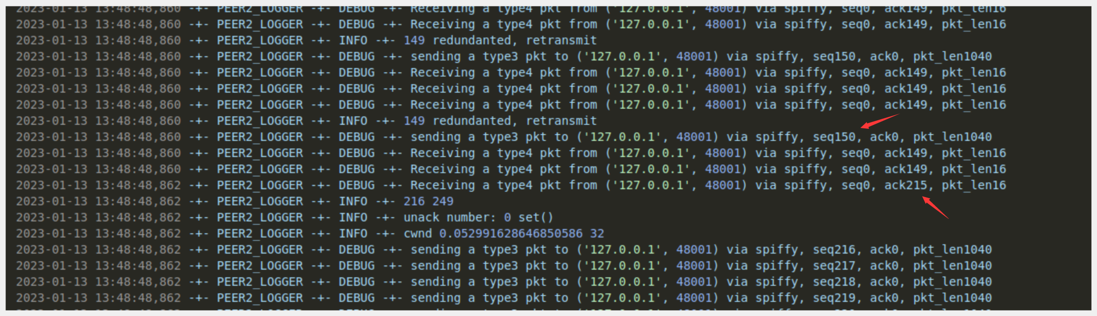
Bonus Check
SR
Receiver在接收到seq num=150的DATA pkt时，前面失序的DATA pkt重新变成有序，下一个发出的ACK pkt的ack num应是目前已经收到DATA pkt的最大seq num

Slide 21
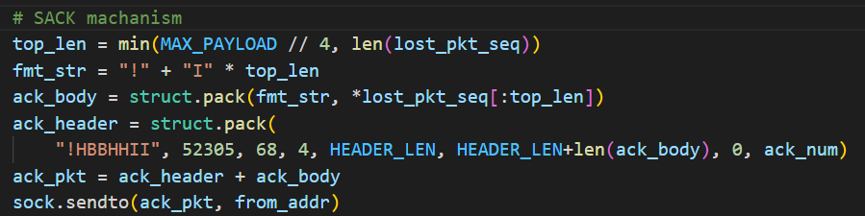
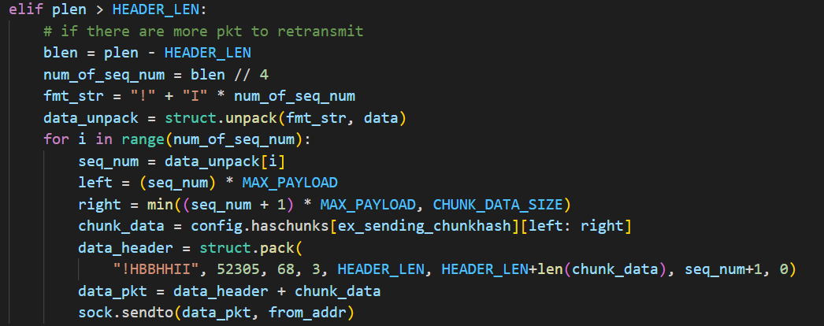
Bonus Check
Variant of SACK
如果失序，则Receiver在发ACK pkt时会在payload中添加所有未收到的失序DATA pkt的seq num
Sender在收到ACK pkt时会检查payload中有无信息，并在有信息时一次性多传失序的DATA pkt

Slide 22
Contribution Rate
Ⅳ

Slide 23
Contribution Rate
金扬：33.3%
黄梓通： 33.3%
刘乐奇： 33.3%

Slide 24

Thanks

