Slide 1
计算机组成原理
Chapter 1
复习

Slide 2
第一个知识点：
计算机包括哪些成分？
Control
(sequences datapath, memory…)
Processor(CPU)
Datapath
(performs operations on data)
Computer
Memory
Input
Devices
Output

Slide 3
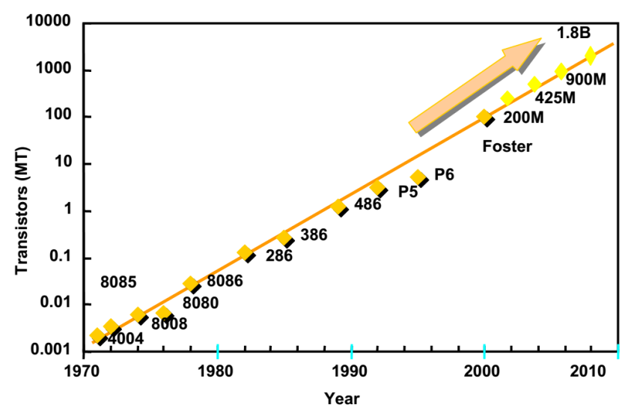
第二个知识点：
Moore’s Law
The number of transistors that can be integrated on a die would double every 18 to 24 months .

Slide 4
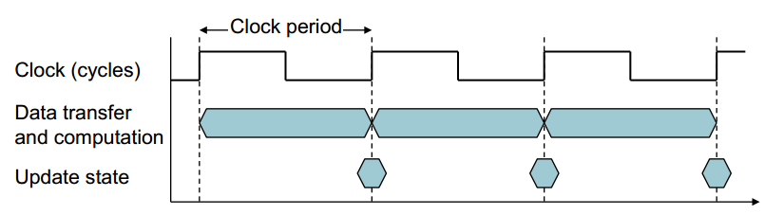
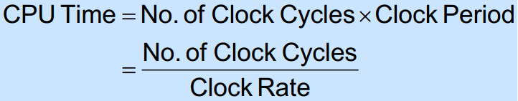
第三个知识点：
CPU clocking
Operation of digital hardware governed by a constant-rate clock

Slide 5
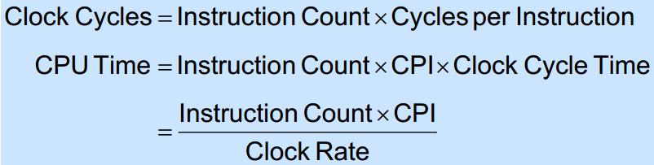
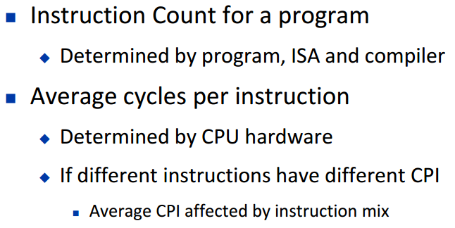
第四个知识点：
Instruction Count and CPI

Slide 6
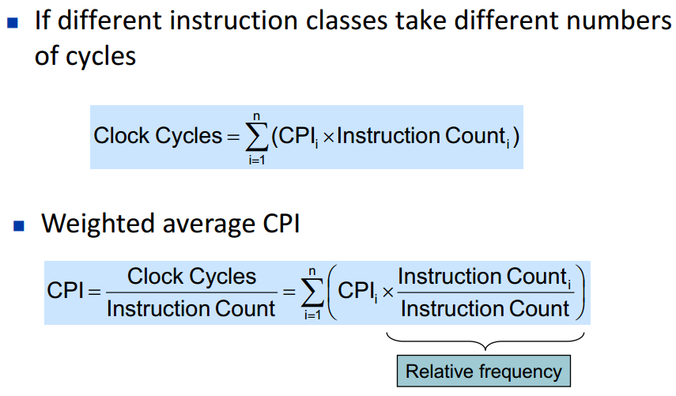

Slide 7
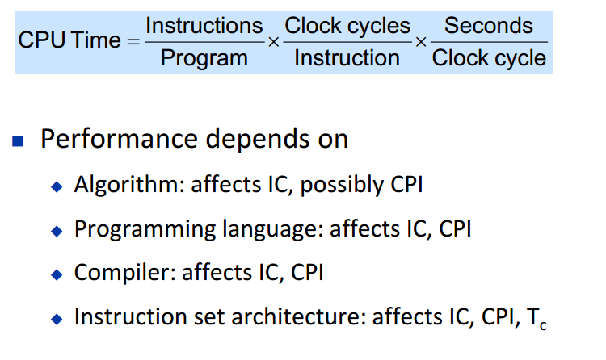
Performance Summary

Slide 8
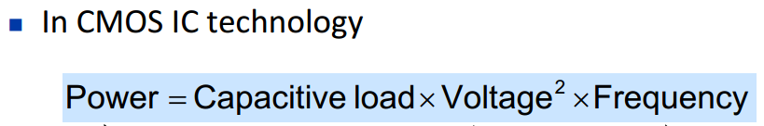
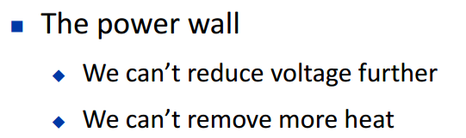
第五个知识点：
Dynamic Power

Slide 9
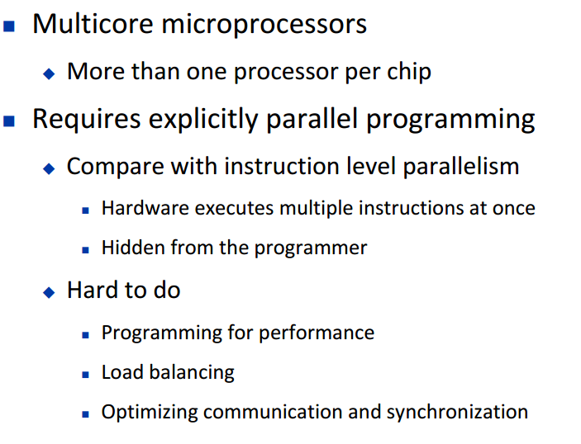
第六个知识点：
Multiprocessors

Slide 10
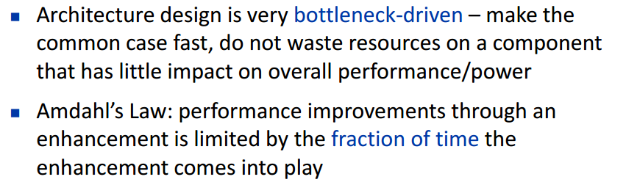
第七个知识点：
Amdahl’s Law
改进后的执行时间 = 受改进影响的执行时间/改进量 + 不受影响的执行时间

Slide 11
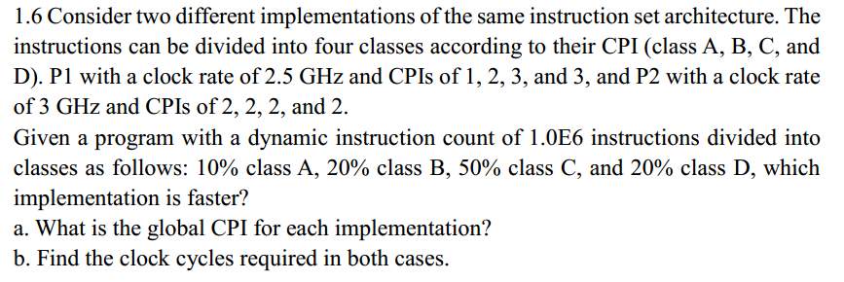
Global CPI= clock cycles/count of instructions
=∑ (Number of instructions × CPI)/ count of instructions
b. Clock cycles=∑ (Number of instructions × CPI)

Slide 12
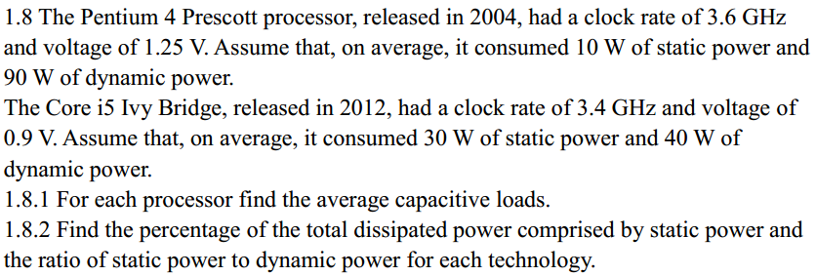
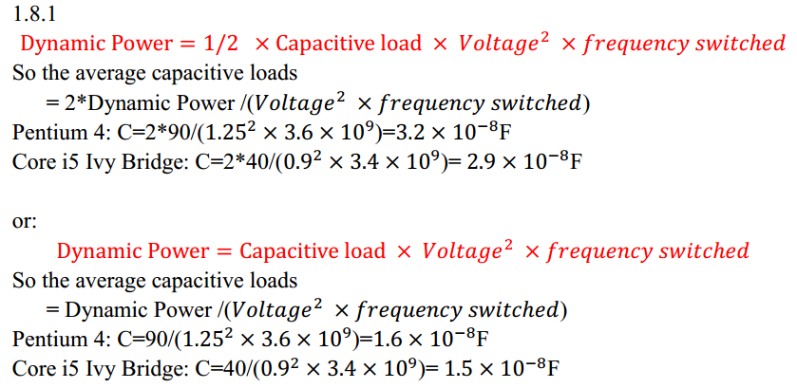
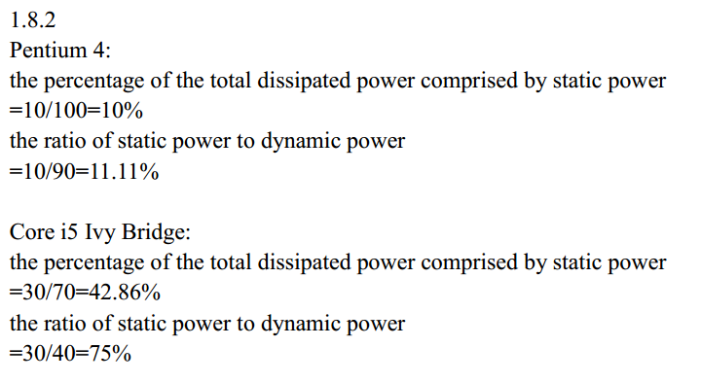

Slide 13
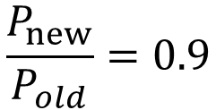
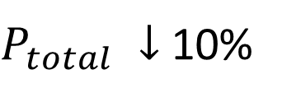
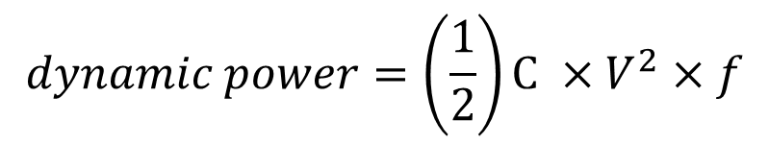

1.8.3 If the total dissipated power is to be reduced by 10%, how much should the voltage be reduced to maintain the same leakage current? Note: power is defined as the product of voltage and current.
Analysis:
$$\frac{P_{new}}{P_{old}}=0.9$$
$$P_{total}=static power+dynamic power$$
$P_{total} ↓$ 10%
$$static power=V×I$$
$$dynamic power=\left(\frac{1}{2}\right)C ×V^{2}×f$$
Pentium 4: 1.18V
Without 1/2
Core i5 Ivy Bridge: 0.83V

Slide 14
