Slide 1
计算机组成原理
Chapter 2
复习
A

Slide 2
第一个知识点：
MIPS design principle
1. Simplicity favors regularity
2. Smaller is faster
3. Make the common case fast
4. Good design demands good compromises

Slide 3
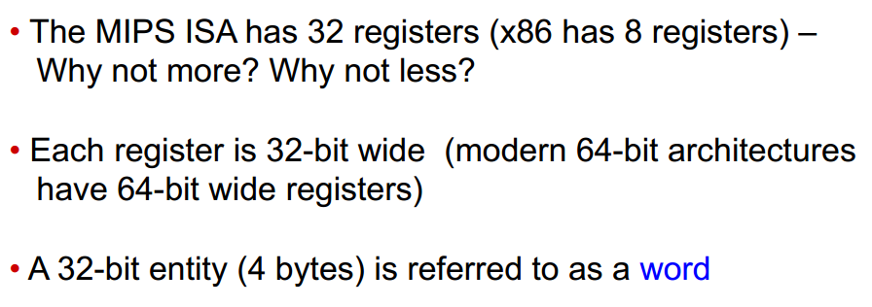
第二个知识点：
Registers
32个寄存器的作用…

Slide 4
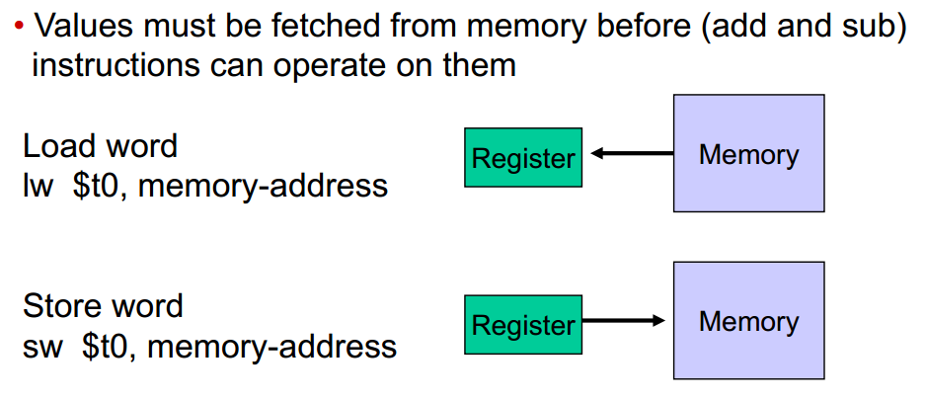
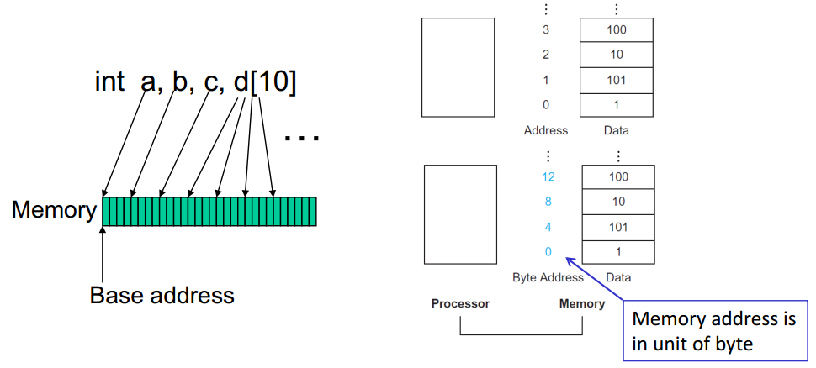
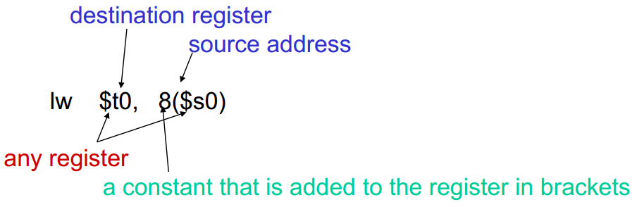
第三个知识点：
Memory Operands

Slide 5
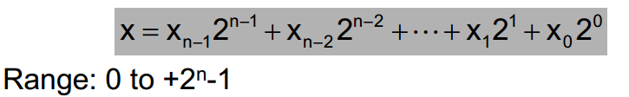
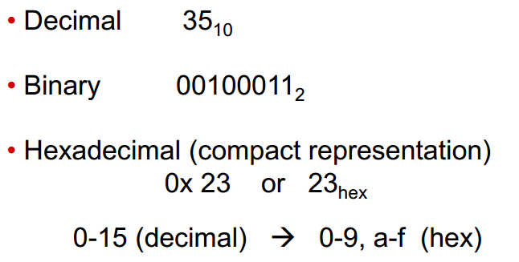
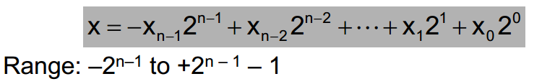
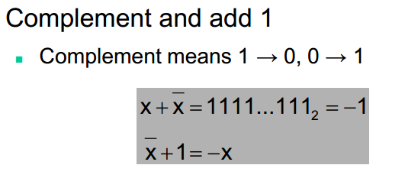
第四个知识点：
Numeric Representations
无符号数
有符号数
负数： 取反+1
Sign Extension:
正数前补0
负数前补1

Slide 6
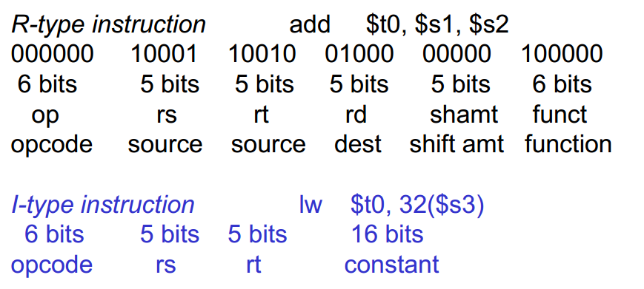
第五个知识点：
Instruction Formats

Slide 7
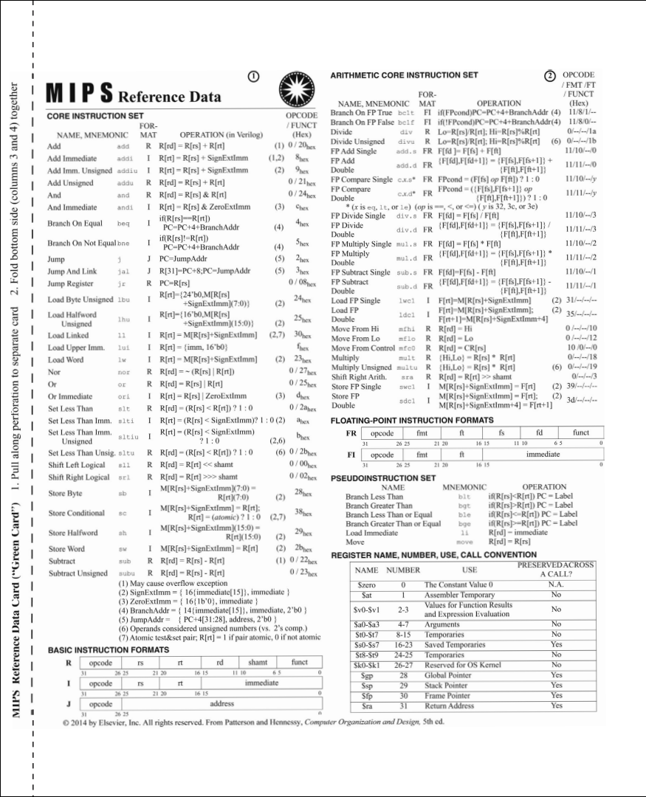
第五个知识点：
Instruction Formats
opcode
The field that denotes the operation and format of an instruction.
rs
The first register source operand.
rt
The second register source operand.
rd
The register destination operand. It gets the result of the operation.
shamt
Shif amount.
funct
Function. This feld, ofen called the function code, selects the specifc variant of the operation in the op field.

Slide 8
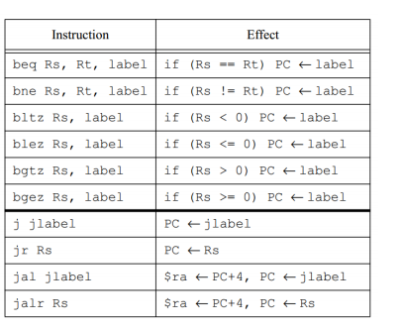
第六个知识点：
Control Instructions

Slide 9
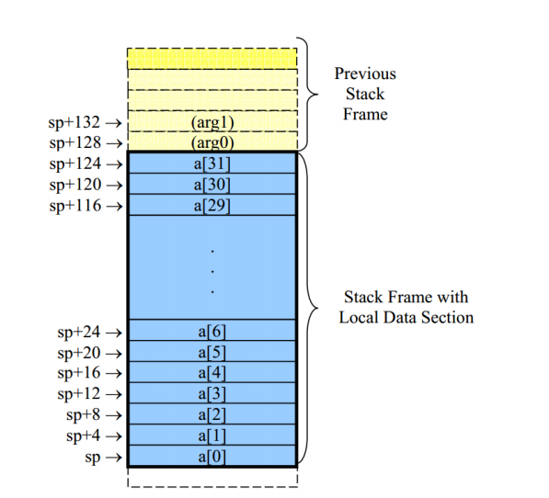
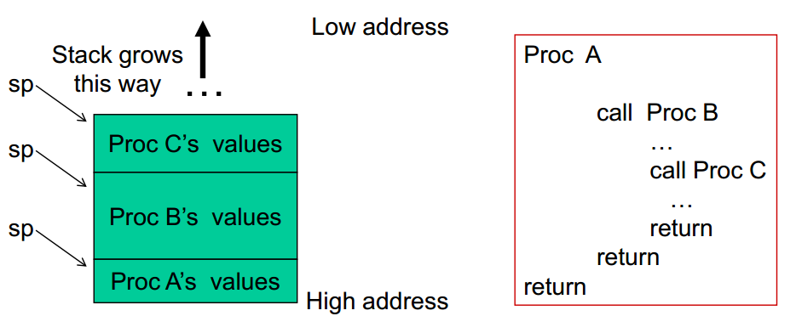
第七个知识点：
Stack

Slide 10
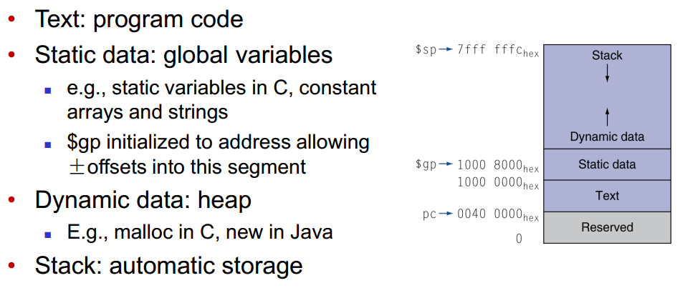
第八个知识点：
Memory Layout

Slide 11
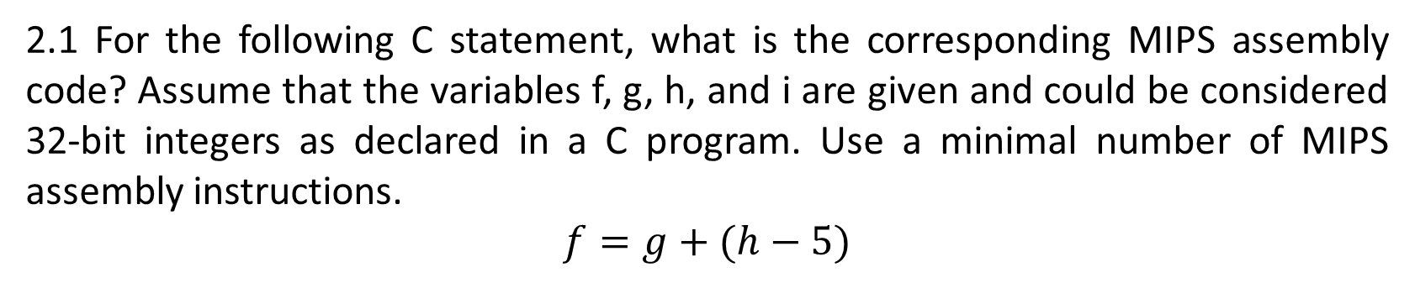
2.1 For the following C statement, what is the corresponding MIPS assembly code? Assume that the variables f, g, h, and i are given and could be considered 32-bit integers as declared in a C program. Use a minimal number of MIPS assembly instructions.
$$f=g+(h−5)$$
addi f, h, -5
add f, f, g

Slide 12
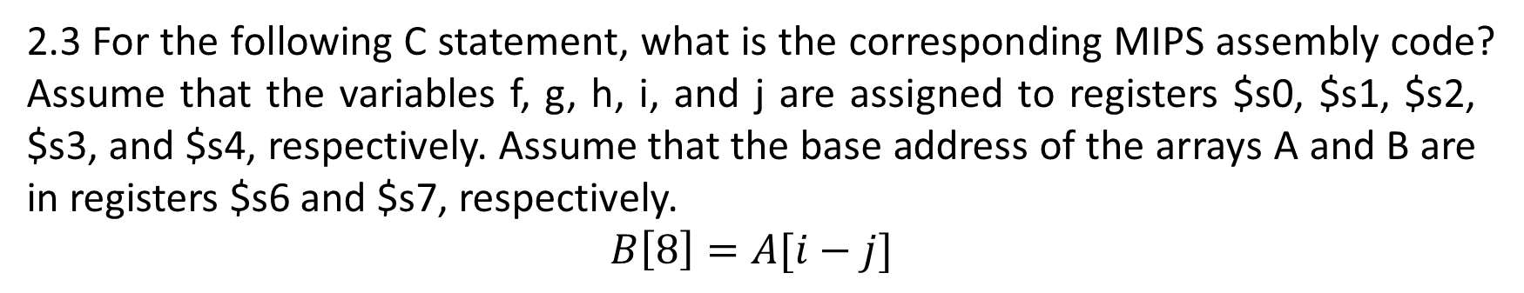
2.3 For the following C statement, what is the corresponding MIPS assembly code? Assume that the variables f, g, h, i, and j are assigned to registers $s0, $s1, $s2, $s3, and $s4, respectively. Assume that the base address of the arrays A and B are in registers $s6 and $s7, respectively.
$$B\left[8\right]=A[i−j]$$
sub $t0, $s3, $s4
sll $t0, $t0, 2
add $t0, $t0, $s6
lw $t1, 0($t0)
sw $t1, 32($s7)
lw $t0, $s6($t0)

Slide 13
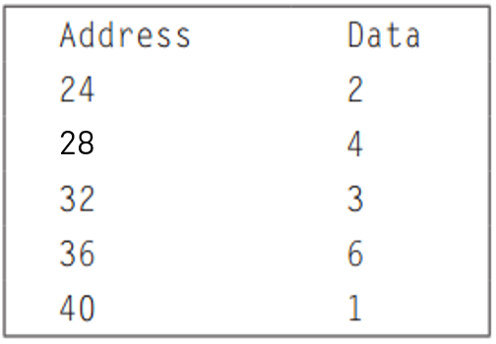
2.6 The table below shows 32-bit values of an array stored in memory.
2.6.1 For the memory locations in the table above, write C code to sort the data from lowest to highest, placing the lowest value in the smallest memory location shown in the figure. Assume that the data shown represents the C variable called Array, which is an array of type int, and that the first number in the array shown is the first element in the array. Assume that this particular machine is a byte-addressable machine and a word consists of four bytes.
2.6.2 For the memory locations in the table above, write MIPS code to sort the data from lowest to highest, placing the lowest value in the smallest memory location. Use a minimum number of MIPS instructions. Assume the base address of Array is stored in register $s6.

Slide 14
lw $t0, 0($s6)
lw $t1, 4($s6)
lw $t2, 16($s6)
sw $t2, 0($s6)
sw $t0, 4($s6)
lw $t0, 12($s6)
sw $t0, 16($s6)
sw $t1, 12($s6)
temp = Array [0];
temp2 = Array [1];
Array [0] = Array [4];
Array [1] = temp;
Array [4] = Array [3];
Array [3] = temp2;

Slide 15
2.12 Assume that registers $s0 and $s1 hold the values 0x80000000 and 0xD0000000, respectively.
2.12.1 What is the value of $t0 for the following assembly code?
add $t0, $s0, $s1
2.12.2 Is the result in $t0 the desired result, or has there been overflow?
2.12.3 For the contents of registers $s0 and $s1 as specified above, what is the value of $t0 for the following assembly code?
sub $t0, $s0, $s1
2.12.4 Is the result in $t0 the desired result, or has there been overflow?
2.12.5 For the contents of registers $s0 and $s1 as specified above, what is the value of $t0 for the following assembly code?
add $t0, $s0, $s1
add $t0, $t0, $s0
2.12.6 Is the result in $t0 the desired result, or has there been overflow?

Slide 16
0x 80000000 = 1000 0000 0000 0000 0000 0000 0000 0000
Negative number
0x D0000000 = 1101 0000 0000 0000 0000 0000 0000 0000
Negative number
0101 0000 0000 0000 0000 0000 0000 0000 = 0x 50000000
Positive number
Overflow!
Overflow is usually when the sign of the result doesn't make sense compared to the operands. 0x80000000 and 0xD0000000 are both negative numbers. When you add two negative numbers you should get a negative number back. But instead you get 0x50000000, which is in fact a positive number. So yes, an overflow has occurred.

Slide 17
0x 80000000 = 1000 0000 0000 0000 0000 0000 0000 0000
Negative number
0x D0000000 = 1101 0000 0000 0000 0000 0000 0000 0000
Negative number
1011 0000 0000 0000 0000 0000 0000 0000 = 0x B0000000
Negative number
No Overflow!
0x 80000000 = 1000 0000 0000 0000 0000 0000 0000 0000
0x D0000000 = 1101 0000 0000 0000 0000 0000 0000 0000
0101 0000 0000 0000 0000 0000 0000 0000
Overflow!
1000 0000 0000 0000 0000 0000 0000 0000
1101 0000 0000 0000 0000 0000 0000 0000=0x D0000000

Slide 18
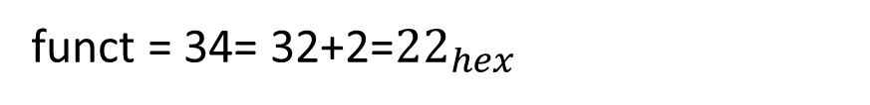
2.16 Provide the type, assembly language instruction, and binary representation of instruction described by the following MIPS fields:
op=0, rs=3, rt=2, rd=3, shamt=0, funct=34
Type: r-type
funct = 34= 32+2=${22}_{hex}$
Assembly language instruction: sub $v1, $v1, $v0
Binary representation:
op rs rt rd shamt funct
000000 00011 00010 00011 00000 100010
0x00621822

