Slide 1
计算机组成原理
Chapter 2
复习
B

Slide 2
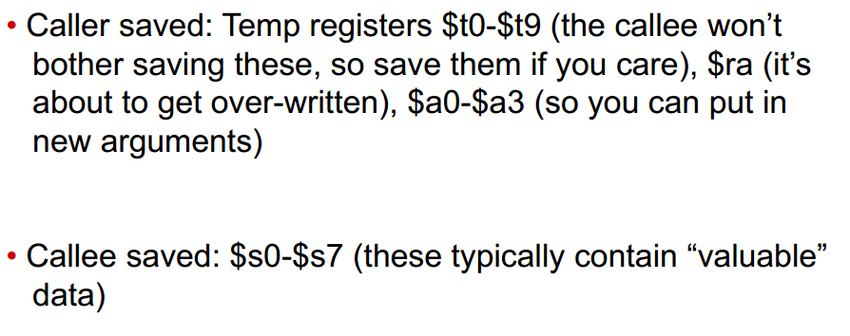
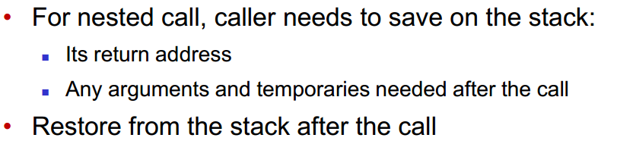
第九个知识点：
Procedure call
Leaf procedure
Non-leaf procedure

Slide 3
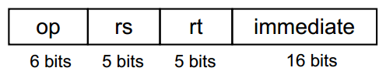
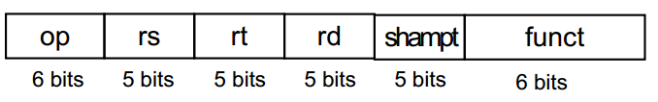
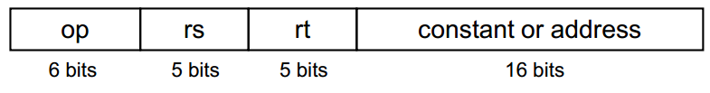

第十个知识点：
MIPS addressing mode
Immediate addressing
Example: addi $s0, $s1, 2
Register addressing
Example: add $s0, $s1, $s2
Base/Displacement addressing
Example: lw $s0, 0(s1)
Branch addressing
(PC-relative addressing)
Example: bne $s0, $s1, EXIT
Jump addressing
(Pseudo-direct addressing)
Example: jal FACT

Slide 4
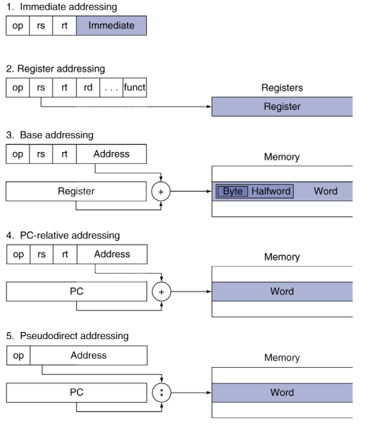

Slide 5
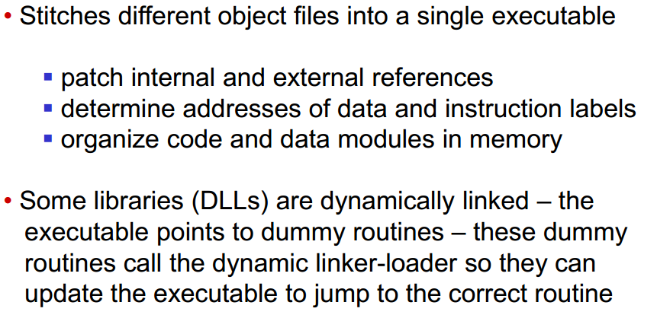
第十一个知识点：
Assembler and Linker
Role of assembler:
1. Convert pseudo-instruction into actual hardware instructions
2. Convert assembly instructions into machine instructions
Role of linker:

Slide 6
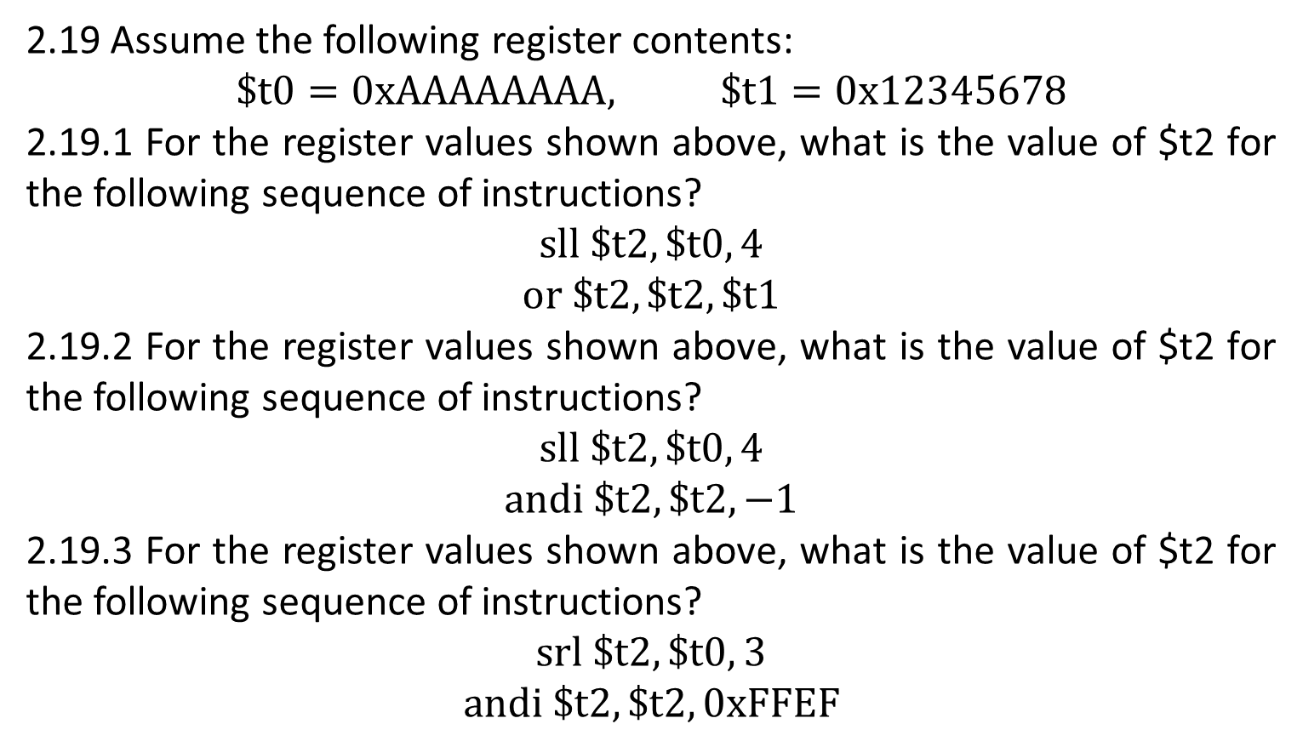
2.19 Assume the following register contents:
$$\$t0=0xAAAAAAAA, \$t1=0x12345678$$
2.19.1 For the register values shown above, what is the value of $t2 for the following sequence of instructions?
$$sll \$t2, \$t0, 4$$
$$or \$t2, \$t2, \$t1$$
2.19.2 For the register values shown above, what is the value of $t2 for the following sequence of instructions?
$$sll \$t2, \$t0, 4$$
$$andi \$t2, \$t2, −1$$
2.19.3 For the register values shown above, what is the value of $t2 for the following sequence of instructions?
$$srl \$t2, \$t0, 3$$
$$andi \$t2, \$t2, 0xFFEF$$

Slide 7

$$0xAAAAAAAA={1010 1010 1010 1010 1010 1010 1010 1010}_{2}$$
$$0x12345678={ 0001 0010 0011 0100 0101 0110 0111 1000}_{2}$$
2.19.1
$sll \$t2, \$t0, 4$ → $\$t2= {1010 1010 1010 1010 1010 1010 1010 0000}_{2}$
$${ 0001 0010 0011 0100 0101 0110 0111 1000}_{2}$$
$or \$t2, \$t2, \$t1$ →
$$\$t2= {1011 1010 1011 1110 1111 1110 1111 1000}_{2}$$
$$=0xBABEFEF8$$

Slide 8

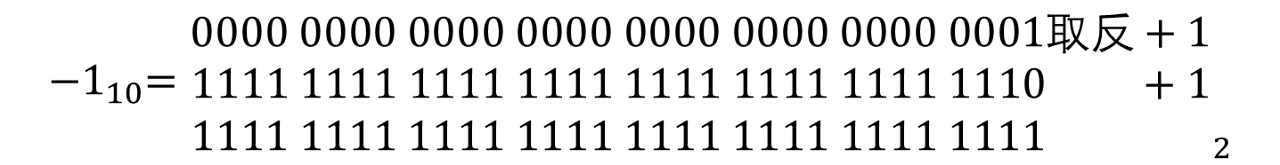
$$0xAAAAAAAA={1010 1010 1010 1010 1010 1010 1010 1010}_{2}$$
$$0x12345678={ 0001 0010 0011 0100 0101 0110 0111 1000}_{2}$$
2.19.2
$$andi \$t2, \$t2, −1$$
$${−1}_{10}={\begin{aligned}0000 0000 0000 0000 0000 0000 0000 0001取反+1 \\ 1111 1111 1111 1111 1111 1111 1111 1110 +1 \\ 1111 1111 1111 1111 1111 1111 1111 1111 \end{aligned}}_{2}$$
$sll \$t2, \$t0, 4$ → $\$t2= {1010 1010 1010 1010 1010 1010 1010 0000}_{2}$
$andi \$t2, \$t2, −1$ →
$$\$t2=1010 1010 1010 1010 1010 1010 1010 0000$$
$$= 0xAAAAAAA0$$

Slide 9

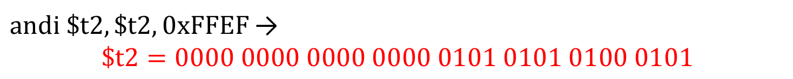
$$0xAAAAAAAA={1010 1010 1010 1010 1010 1010 1010 1010}_{2}$$
$$0x12345678={ 0001 0010 0011 0100 0101 0110 0111 1000}_{2}$$
2.19.3
$$0xFFEF={0000 0000 0000 0000 1111 1111 1110 1111}_{2}$$
$srl \$t2, \$t0, 3$ → $\$t2={0001 0101 0101 0101 0101 0101 0101 0101}_{2}$
$andi \$t2, \$t2, 0xFFEF$ →
$$\$t2=0000 0000 0000 0000 0101 0101 0100 0101$$
$$=0x00005545$$

Slide 10
2.26 Consider the following MIPS loop:
LOOP: slt $t2, $0, $t1
beq $t2, $0, DONE
subi $t1, $t1, 1
addi $s2, $s2, 2
j LOOP
DONE:
2.26.1 Assume that the register $t1 is initialized to the value 10. What is the value in register $s2 assuming $s2 is initially zero?
2.26.2 For each of the loops above, write the equivalent C code routine. Assume that the registers $s1, $s2, $t1, and $t2 are integers A, B, i, and temp, respectively.
2.26.3 For the loops written in MIPS assembly above, assume that the register $t1 is initialized to the value N. How many MIPS instructions are executed?
2.26.1 The loop will be executed 10 times, so the result is $2×10=20$

Slide 11

2.26.2
i=10
do {
B += 2;
i = i -1;
} while (i > 0)
2.26.3
LOOP: slt $t2, $0, $t1
beq $t2, $0, DONE
subi $t1, $t1, 1
addi $s2, $s2, 2
j LOOP
DONE:
$5×N+2$

Slide 12
2.31 Implement the following C code in MIPS assembly. What is the total number of MIPS instructions needed to execute the function?
int fib(int n){
if (n==0)
return 0;
else if (n == 1)
return 1;
else
return fib(n−1) + fib(n−2);

Slide 13
fib:
addi $sp, $sp, -12
sw $ra, 8($sp)
sw $s0, 4($sp)
sw $a0, 0($sp)
bgt $a0, $zero, ELSE1
add $v0, $zero, $zero
int fib(int n){
if (n==0)
return 0;
else if (n == 1)
return 1;
else
return fib(n−1) + fib(n−2);
bgt $a0, $zero, ELSE1
add $v0, $zero, $zero
j rtn
ELSE1:
addi $t0, $t0, 1
bne $t0, $a0, ELSE2
add $v0, $zero, $t0
addi $t0, $t0, 1
bne $t0, $a0, ELSE2
add $v0, $zero, $t0
j rtn
ELSE2:
addi $a0, $a0, -1
jal fib
add $s0, $zero, $v0
addi $a0, $a0, -1
jal fib
add $v0, $v0, $s0
addi $a0, $a0, -1
jal fib
add $s0, $zero, $v0
addi $a0, $a0, -1
jal fib
add $v0, $v0, $s0
rtn:
lw $a0, 0($sp)
lw $s0, 4($sp)
lw $ra, 8($sp)
addi $sp, $sp, 12
jr $ra
需要存起来的寄存器？
$ra, $s0, $a0

Slide 14
fib:
addi $sp, $sp, -12
sw $ra, 8($sp)
sw $s0, 4($sp)
sw $a0, 0($sp)
When N=0, 12 instructions, when N=1, 14 instructions.
观察$a0的变化：
bgt $a0, $zero, ELSE1
add $v0, $zero, $zero
j rtn
N=2
$a0： 2 1 0 2
N=3：
$a0： 3 2 1 0 2 1 3
N=4：
$a0： 4 3 2 1 0 2 1 3 2 1 0 2 4
N=5
$a0： 5 4 3 2 1 0 2 1 3 2 1 0 2 4 3 2 1 0 2 1 3 5
N=6
$a0： 6 5 4 3 2 1 0 2 1 3 2 1 0 2 4 3 2 1 0 2 1 3 5 4 3 2 1 0 2 1 3 2 1 0 2 4 6
ELSE1:
addi $t0, $t0, 1
bne $t0, $a0, ELSE2
add $v0, $zero, $t0
j rtn
ELSE2:
addi $a0, $a0, -1
jal fib
add $s0, $zero, $v0
fib(2)
fib(1)
addi $a0, $a0, -1
jal fib
add $v0, $v0, $s0
fib(3)
fib(2)
rtn:
lw $a0, 0($sp)
lw $s0, 4($sp)
lw $ra, 8($sp)
addi $sp, $sp, 12
jr $ra
fib(4)
fib(3)
fib(5)
fib(4)

Slide 15
fib:
addi $sp, $sp, -12
sw $ra, 8($sp)
sw $s0, 4($sp)
sw $a0, 0($sp)
When N=0, 12 instructions, when N=1, 14 instructions.
bgt $a0, $zero, ELSE1
add $v0, $zero, $zero
When N≥2, $f\left(N\right)=f\left(N−1\right)+f\left(N−2\right)+18$ instructions
j rtn
ELSE1:
addi $t0, $t0, 1
bne $t0, $a0, ELSE2
add $v0, $zero, $t0
N=2: 44 instructions
N=3: 76 instructions
N=4: 138 instructions
N=5: 232 instructions
N=6: 388 instructions
j rtn
ELSE2:
addi $a0, $a0, -1
jal fib
add $s0, $zero, $v0
addi $a0, $a0, -1
jal fib
add $v0, $v0, $s0
rtn:
lw $a0, 0($sp)
lw $s0, 4($sp)
lw $ra, 8($sp)
addi $sp, $sp, 12
jr $ra

Slide 16
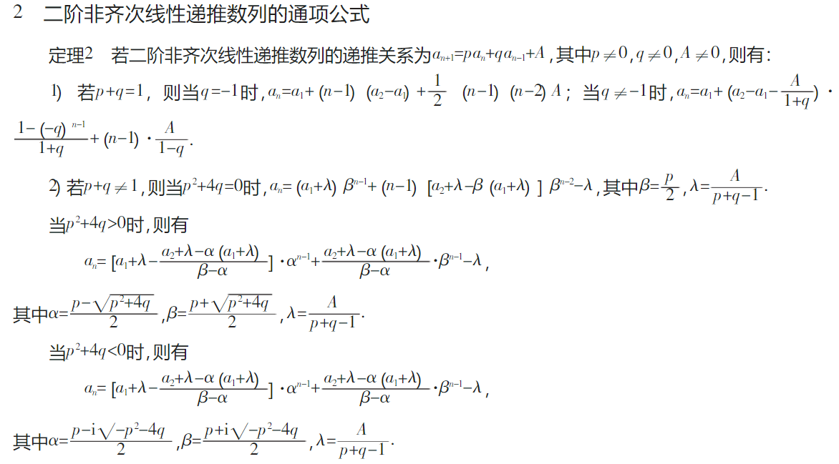

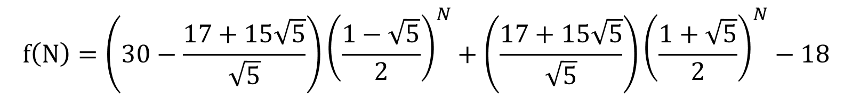
$f\left(N\right)=f\left(N−1\right)+f\left(N−2\right)+18$
$$f\left(N\right)=\left(30−\frac{17+15\sqrt{5}}{\sqrt{5}}\right){\left(\frac{1−\sqrt{5}}{2}\right)}^{N}+\left(\frac{17+15\sqrt{5}}{\sqrt{5}}\right){\left(\frac{1+\sqrt{5}}{2}\right)}^{N}−18$$

Slide 17
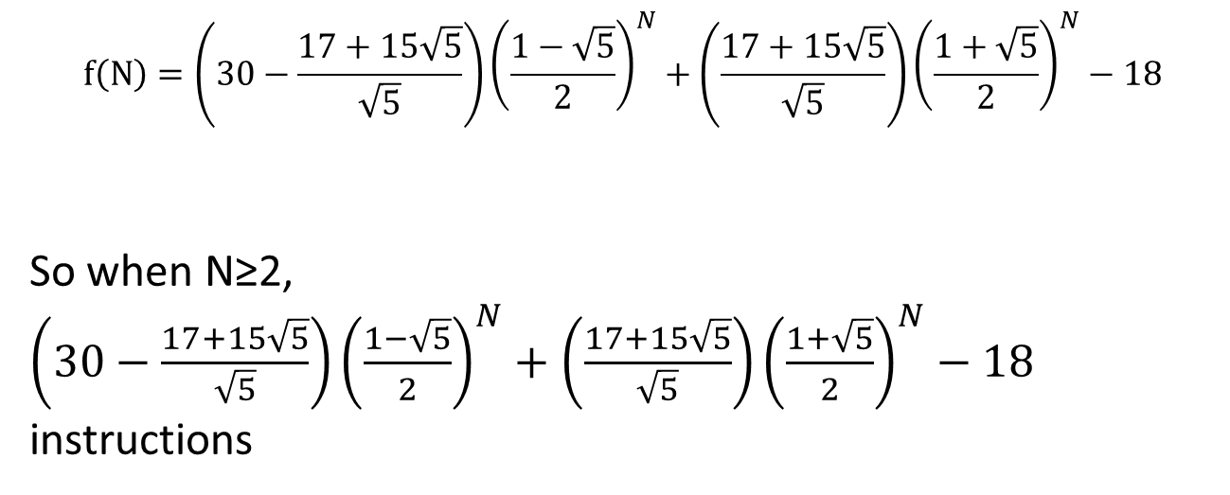
fib:
addi $sp, $sp, -12
sw $ra, 8($sp)
sw $s0, 4($sp)
sw $a0, 0($sp)
When N=0, 12 instructions, when N=1, 14 instructions.
bgt $a0, $zero, ELSE1
add $v0, $zero, $zero
When N≥2, $f\left(N\right)=f\left(N−1\right)+f\left(N−2\right)+18$ instructions
j rtn
ELSE1:
addi $t0, $t0, 1
bne $t0, $a0, ELSE2
add $v0, $zero, $t0
$$f\left(N\right)=\left(30−\frac{17+15\sqrt{5}}{\sqrt{5}}\right){\left(\frac{1−\sqrt{5}}{2}\right)}^{N}+\left(\frac{17+15\sqrt{5}}{\sqrt{5}}\right){\left(\frac{1+\sqrt{5}}{2}\right)}^{N}−18$$
So when N≥2,
$\left(30−\frac{17+15\sqrt{5}}{\sqrt{5}}\right){\left(\frac{1−\sqrt{5}}{2}\right)}^{N}+\left(\frac{17+15\sqrt{5}}{\sqrt{5}}\right){\left(\frac{1+\sqrt{5}}{2}\right)}^{N}−18$ instructions
j rtn
ELSE2:
addi $a0, $a0, -1
jal fib
add $s0, $zero, $v0
addi $a0, $a0, -1
jal fib
add $v0, $v0, $s0
rtn:
lw $a0, 0($sp)
lw $s0, 4($sp)
lw $ra, 8($sp)
addi $sp, $sp, 12
jr $ra

