Slide 1
计算机组成原理
Chapter 3
复习

Slide 2

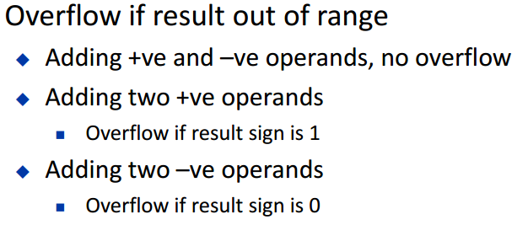

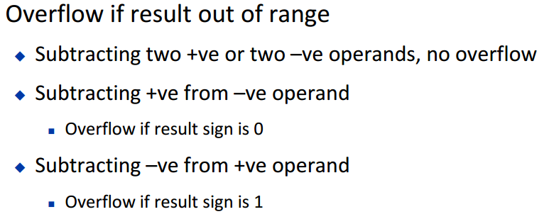
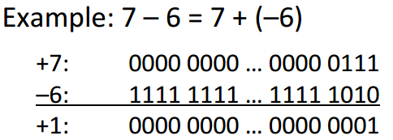
第一个知识点：
Dealing with overflow
Addition and subtraction

Slide 3
第二个知识点：
Saturation arithmetic
Saturation arithmetic is a version of arithmetic in which all operations such as addition and multiplication are limited to a fixed range between a minimum and maximum value.
For example, if the valid range of values is from 0 to 100, the following operations produce the following values:
60 + 30 = 90
60 + 43 = 100
(60 + 43) − (75 + 75) = 0
10 × 11 = 100
99 × 99 = 100
30 × (5 − 1) = 100
30 × 5 − 30 × 1 = 70

Slide 4
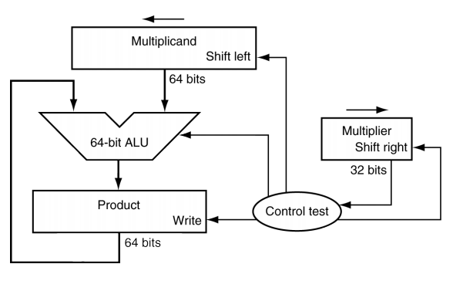
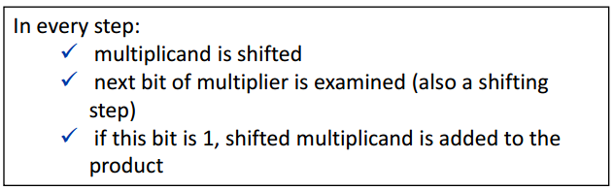
第三个知识点：
Multiplication

Slide 5
Length = n
Length = 2n
Length = 2n
Initial values
Multiplier=multiplier
Multiplicand = 0…0 Multiplicand
Product= 0…0
lsb of multiplier =0 or 1
=0
=1
No operation
Prod=Prod+Multiplicand
Lshift Multiplicand
Lshift Multiplicand
Rshift Multiplier
Rshift Multiplier
Iteration number = n

Slide 6
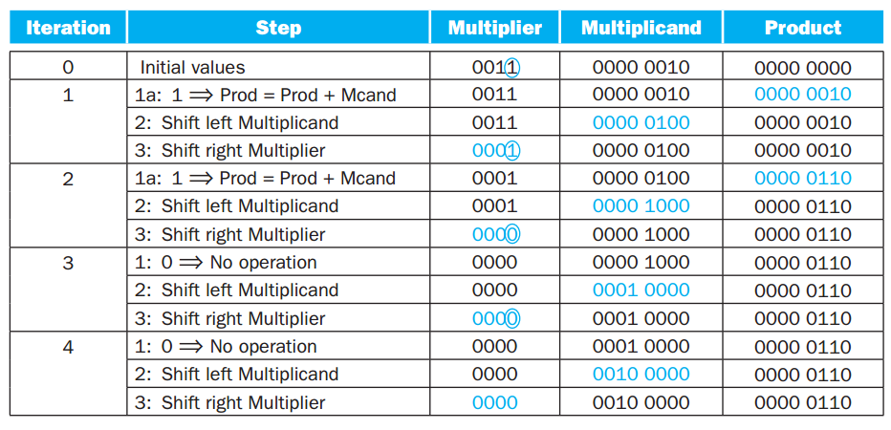

Slide 7
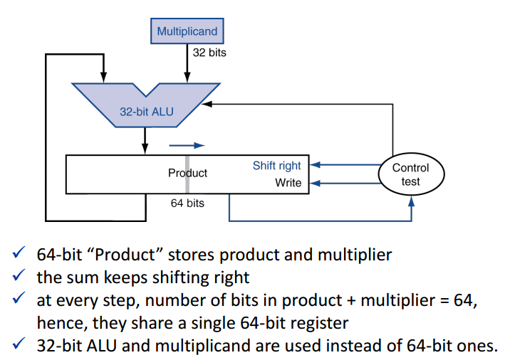
Optimized Multiplier

Slide 8
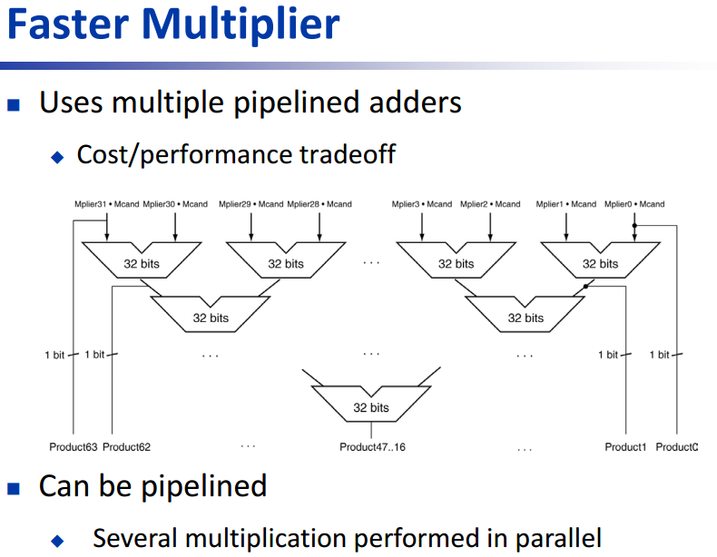

Slide 9
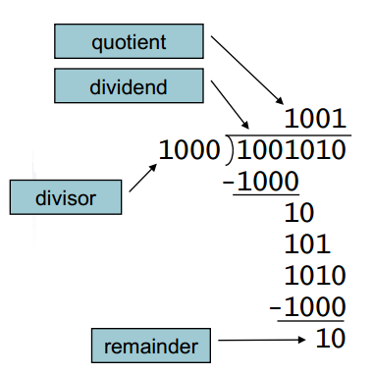
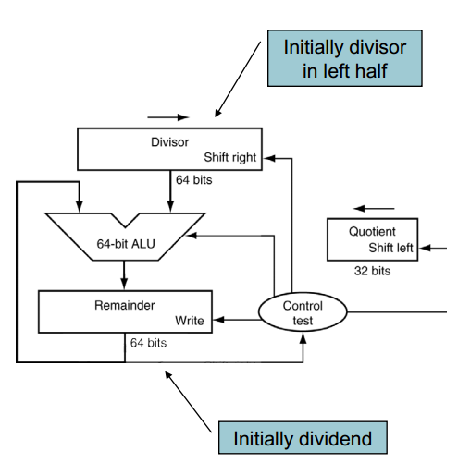
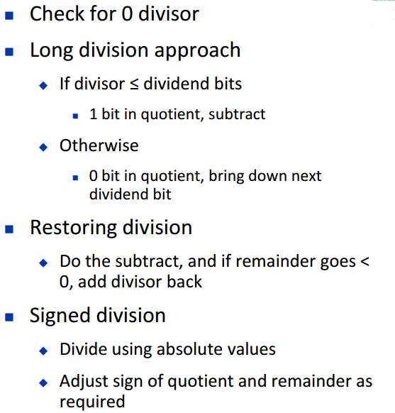
第四个知识点：
Division

Slide 10
Length = 2n
Length = 2n
Length = n
Initial values
Divisor = Divisor 0…0
Remainder = 0…0 Dividend
Quotient= 0…0
Rem= Rem-Div
Rem≥0 or <0
<0
≥0
Rem=Rem+Div
No operation
Lshift Quotient (Q0=0)
Lshift Quotient (Q0=1)
Rshift Divisor
Rshift Divisor
Iteration number = n+1

Slide 11
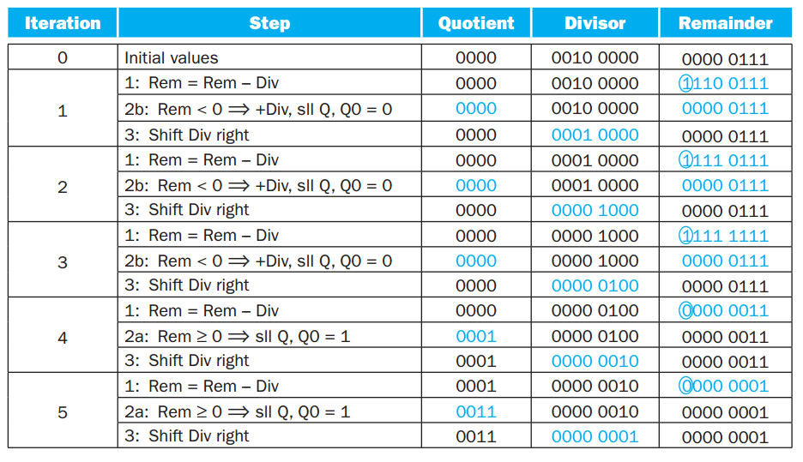

Slide 12
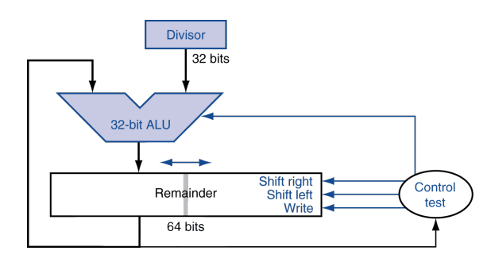
Optimized Divider

Slide 13
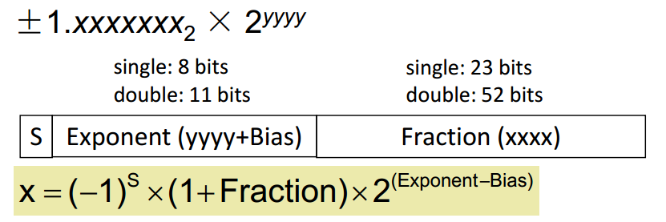
第五个知识点：
Represent Floating Point
Single precision (32-bit)
Double precision (64-bit)
Single: Bias = 127;
Double: Bias = 1023

Slide 14

$$−0.875$$
$$0.875×2= 1.75 …… 1$$
$$0.75×2=1.5 …… 1$$
$$0.5×2=1 …… 1$$
$$−0.111×2^{0}=−1.11×2^{−1}$$

Slide 15

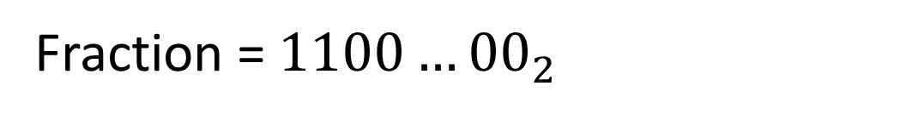
$$−0.875={(−1)}^{1}×{1.11}_{2}×2^{−1}$$
S=1
Fraction = ${1100…00}_{2}$
Exponent = -1 + Bias
Single: 1011111101100…00
Double: 1011111111101100...00

Slide 16
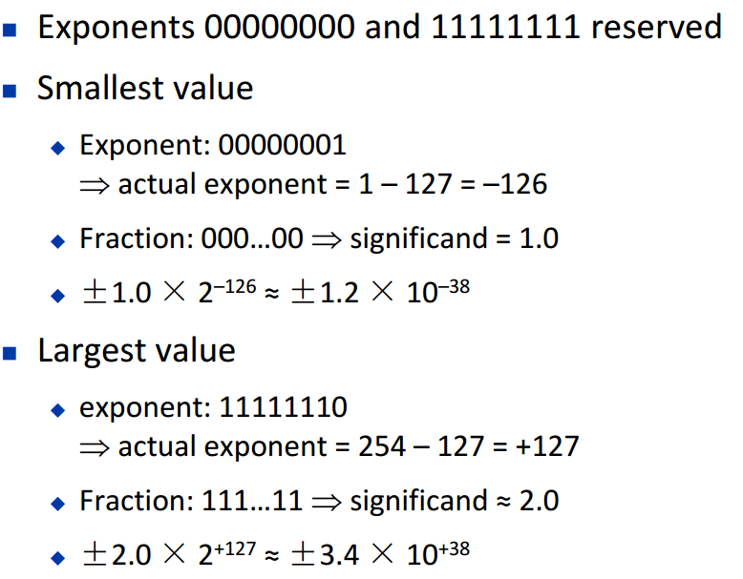
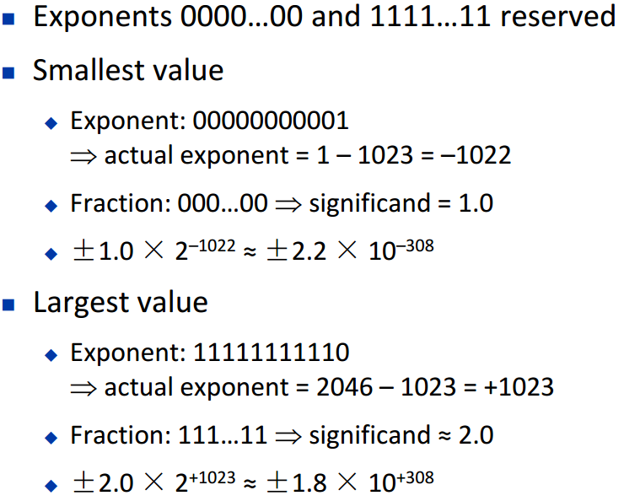
第六个知识点：
Floating Point Range
Single-Precision Range
Double-Precision Range

Slide 17
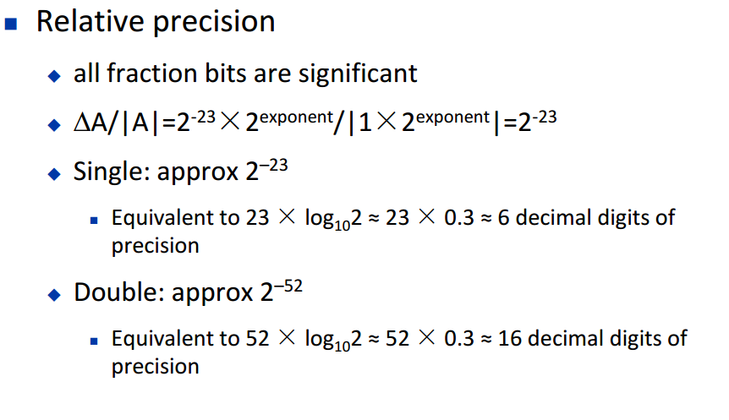
第七个知识点：
Floating-Point Precision

Slide 18
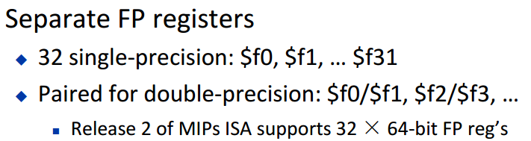
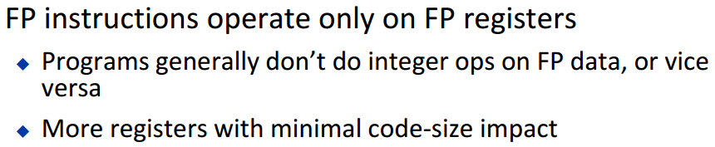
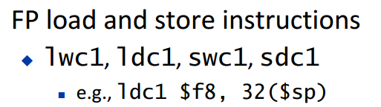
第八个知识点：
Floating-Point Instruction in MIPS

Slide 19
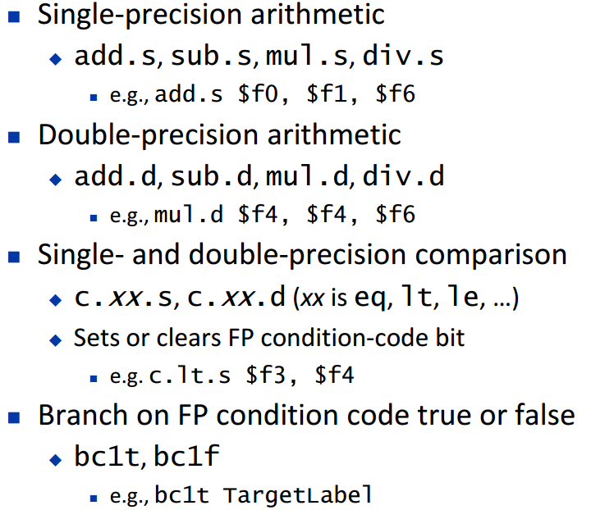

Slide 20
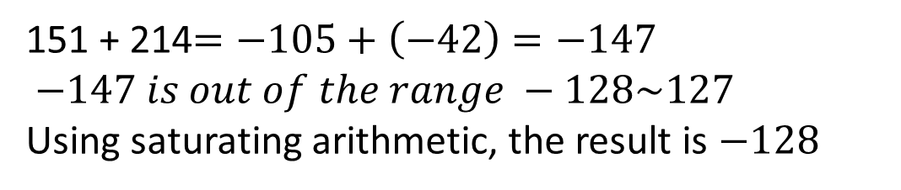


3.9 Assume 151 and 214 are signed 8-bit decimal integers stored in two’s complement format. Calculate 151 + 214 using saturating arithmetic. The result should be written in decimal. Show your work.
$$151= {10010111}_{2}=−\left(01101001\right)=−105$$
$$214= {11010110}_{2}=−\left(00101010\right)=−42$$
signed 8-bit decimal integers
$$00000000\sim 01111111 →0\sim 127$$
$$11111111\sim 10000000 →−1\sim −128$$
$$Range is : −128\sim 127$$
151 + 214$=−105+\left(−42\right)=−147$
$−147 is out of the range −128\sim 127$
Using saturating arithmetic, the result is $−128$

Slide 21
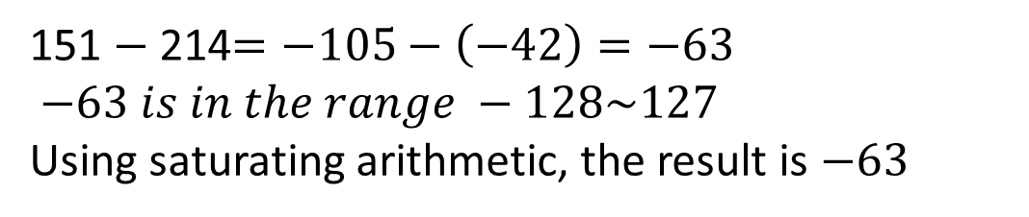
3.10 Assume 151 and 214 are signed 8-bit decimal integers stored in two’s complement format. Calculate 151−214 using saturating arithmetic. The result should be written in decimal. Show your work.
$$151= {10010111}_{2}=−\left(01101001\right)=−105$$
$$214= {11010110}_{2}=−\left(00101010\right)=−42$$
signed 8-bit decimal integers
$$00000000\sim 01111111 →0\sim 127$$
$$11111111\sim 10000000 →−1\sim −128$$
$$Range is : −128\sim 127$$
151 $−$ 214$=−105−\left(−42\right)=−63$
$−63 is in the range −128\sim 127$
Using saturating arithmetic, the result is $−63$

Slide 22


3.12 Using a table similar to that shown in Figure 3.6, calculate the product of the octal unsigned 6-bit integers 62 and 12 using the hardware described in Figure 3.3. You should show the contents of each register on each step.
$${62}_{oct}={110 010}_{2}$$
$${12}_{oct}={001 010}_{2}$$

Slide 23
Step
Action
Multiplier
Multiplicand
Product
0
Initial Vals
001 010
000 000 110 010
000 000 000 000
lsb=0. no op
001 010
000 000 110 010
000 000 000 000
1
Lshift Mcand
001 010
000 001 100 100
000 000 000 000
Rshift Mplier
000 101
000 001 100 100
000 000 000 000
Prod = Prod + Mcand
000 101
000 001 100 100
000 001 100 100
2
Lshift Mcand
000 101
000 011 001 000
000 001 100 100
Rshift Mplier
000 010
000 011 001 000
000 001 100 100
lsb=0. no op
000 010
000 011 001 000
000 001 100 100
3
Lshift Mcand
000 010
000 110 010 000
000 001 100 100
Rshift Mplier
000 001
000 110 010 000
000 001 100 100
Prod = Prod + Mcand
000 001
000 110 010 000
000 111 110 100
4
Lshift Mcand
000 001
001 100 100 000
000 111 110 100
Rshift Mplier
000 000
001 100 100 000
000 111 110 100
lsb=0. no op
000 000
001 100 100 000
000 111 110 100
5
Lshift Mcand
000 000
011 001 000 000
000 111 110 100
Rshift Mplier
000 000
011 001 000 000
000 111 110 100
lsb=0. no op
000 000
011 001 000 000
000 111 110 100
6
Lshift Mcand
000 000
110 010 000 000
000 111 110 100
Rshift Mplier
000 000
110 010 000 000
000 111 110 100

Slide 24
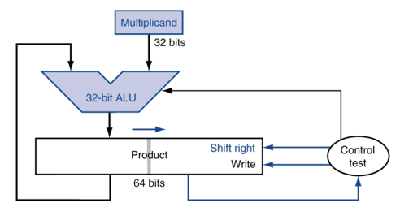


3.13 Using a table similar to that shown in Figure 3.6, calculate the product of the hexadecimal unsigned 8-bit integers 62 and 12 using the hardware described in Figure 3.5. You should show the contents of each register on each step.
$${62}_{hex}={0110 0010}_{2}$$
$${12}_{hex}={0001 0010}_{2}$$

Slide 25
Step
Action
Multiplicand
Product/Multiplier
0
Initial Vals
0110 0010
0000 0000 0001 0010
lsb = 0, no op
0110 0010
0000 0000 0001 0010
1
Rshift Product
0110 0010
`0000 0000 0000 1001
Prod = Prod +Mcand
0110 0010
0110 0010 0000 1001
2
Rshift Product
0110 0010
0011 0001 0000 0100
lsb = 0, no op
0110 0010
0011 0001 0000 0100
3
Rshift Product
0110 0010
0001 1000 1000 0010
lsb = 0, no op
0110 0010
0001 1000 1000 0010
4
Rshift Product
0110 0010
0000 1100 0100 0001
Prod = Prod +Mcand
0110 0010
0110 1110 0100 0001
5
Rshift Product
0110 0010
0011 0111 0010 0000
lsb = 0, no op
0110 0010
0011 0111 0010 0000
6
Rshift Product
0110 0010
0001 1011 1001 0000
lsb = 0, no op
0110 0010
0001 1011 1001 0000
7
Rshift Product
0110 0010
0000 1101 1100 1000
lsb = 0, no op
0110 0010
0000 1101 1100 1000
8
Rshift Product
0110 0010
0000 0110 1110 0100

