Slide 1
计算机组成原理
Chapter 4
复习
A

Slide 2
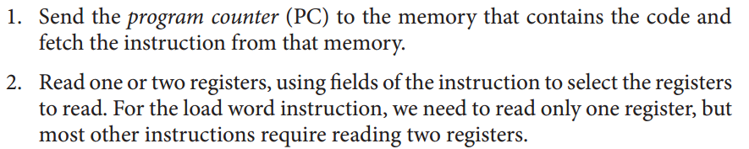
第一个知识点：
A basic MIPS Implementation
For every instruction, the first two steps are identical:
After these two steps, the actions required to complete the instruction depend on the instruction class. Fortunately, for each of the three instruction classes (memory-reference, arithmetic-logical, and branches), the actions are largely the same, independent of the exact instruction.

Slide 3
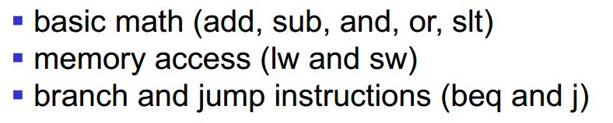
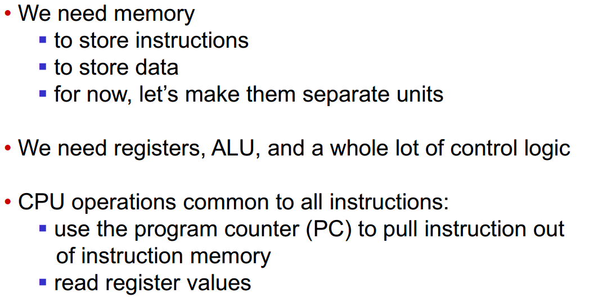
第一个知识点：
A basic MIPS Implementation

Slide 4
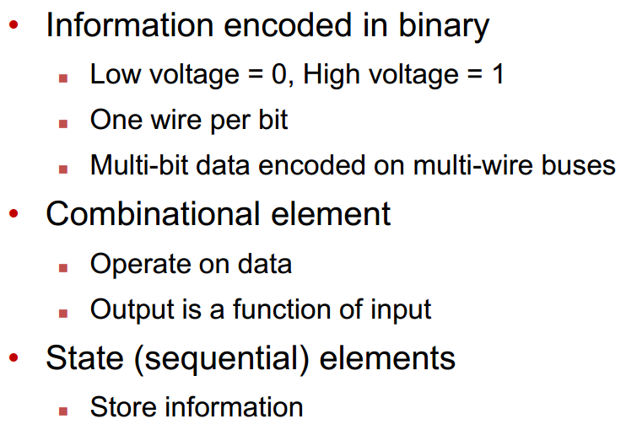
第二个知识点：
Clocking Methodology

Slide 5
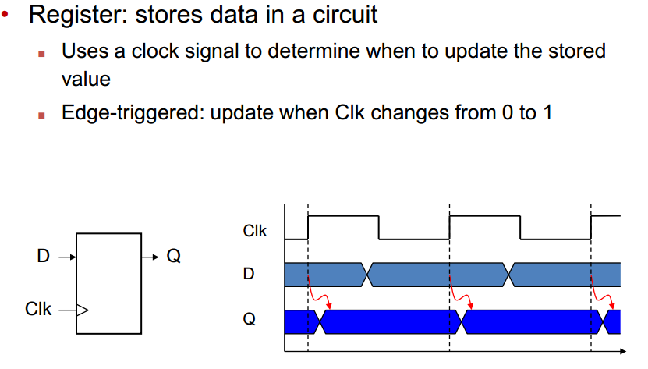
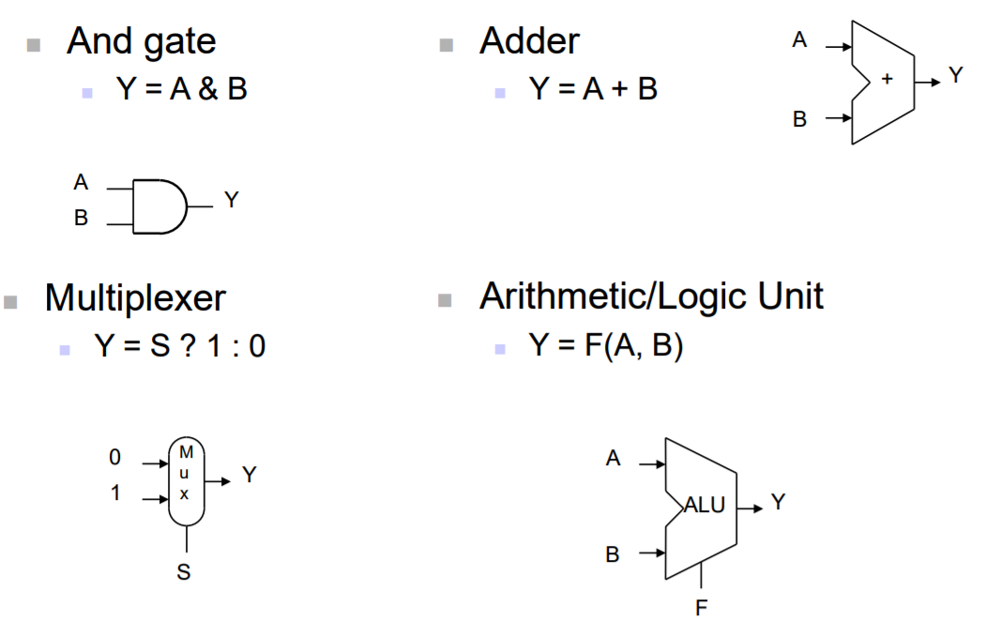
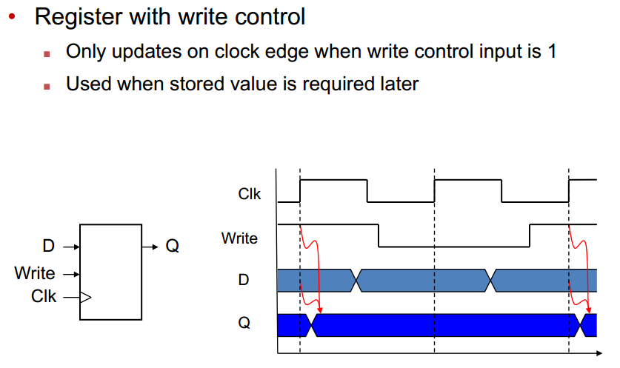
第二个知识点：
Combinational Elements
Sequential Elements

Slide 6
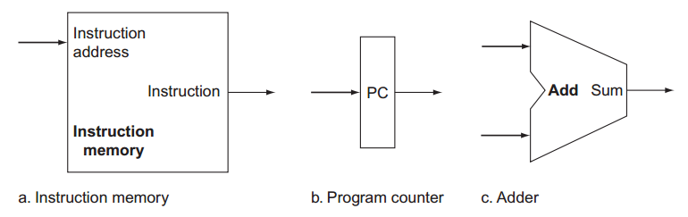
第三个知识点：
Datapath
Two state elements are needed to store and access instructions, and an adder is needed to compute the next instruction address.

Slide 7
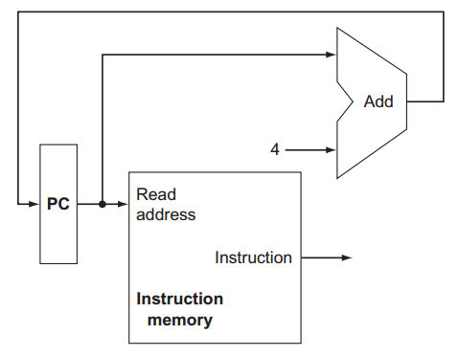
第三个知识点：
Datapath
A portion of the datapath used for fetching instructions and incrementing the program counter.

Slide 8
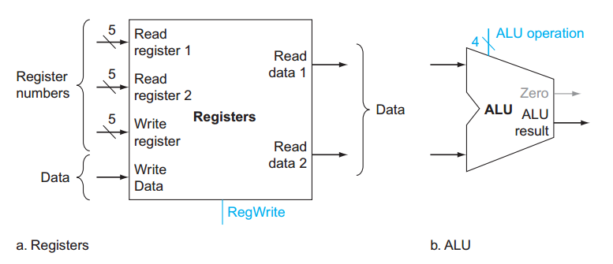
第三个知识点：
R Type
The two elements needed to implement R-format ALU operations are the register file and the ALU

Slide 9
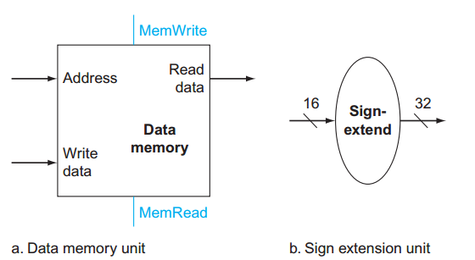
I Type
■ The instruction set architecture specifes that the base for the branch address calculation is the address of the instruction following the branch. Since we compute PC + 4 (the address of the next instruction) in the instruction fetch datapath, it is easy to use this value as the base for computing the branch target address.
■ The architecture also states that the offset field is shifed left 2 bits so that it is a word offset; this shift increases the effective range of the offset field by a factor of 4.

Slide 10
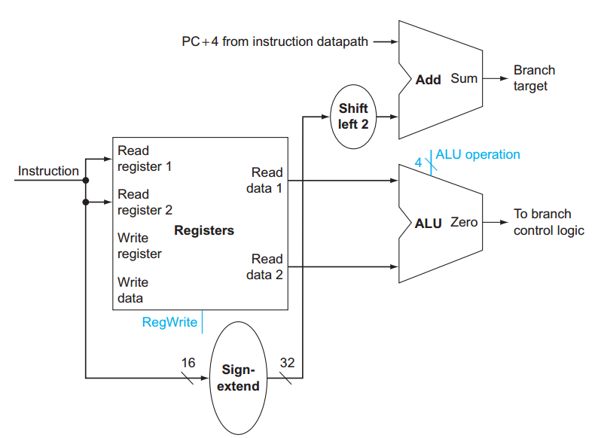
I Type
The datapath for a branch uses the ALU to evaluate the branch condition and a separate adder to compute the branch target as the sum of the incremented PC and the sign-extended, lower 16 bits of the instruction (the branch displacement), shifted left 2 bits.

Slide 11
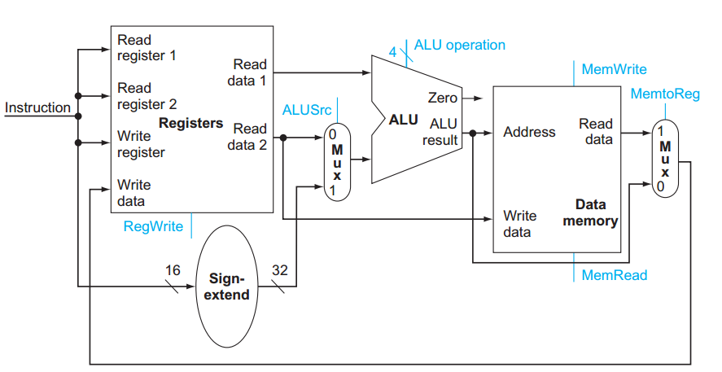
The datapath for the memory instructions and the R-type instructions.

Slide 12
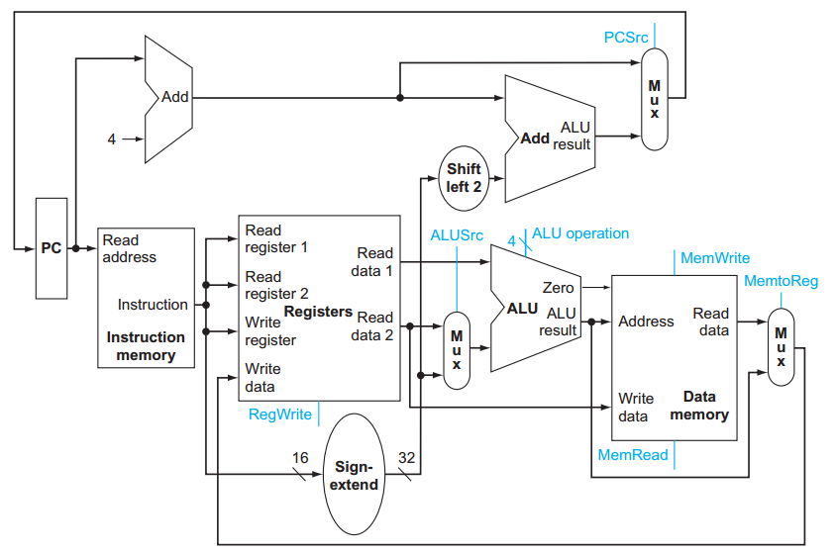
The simple datapath for the core MIPS architecture combines the elements required by different instruction classes.

Slide 13
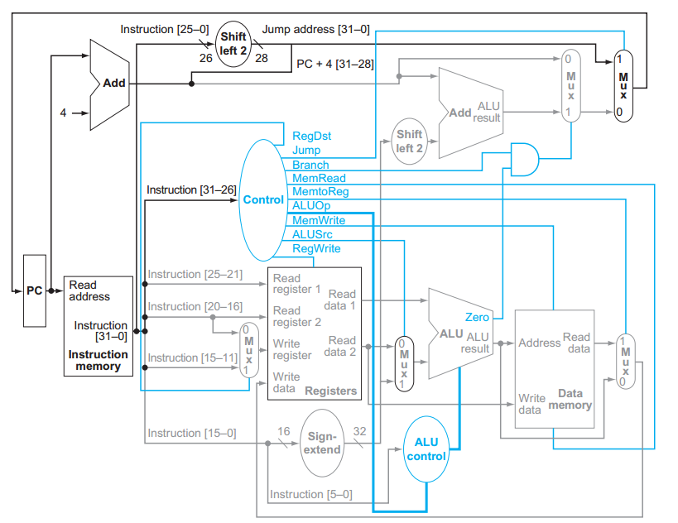
J Type and Control

Slide 14
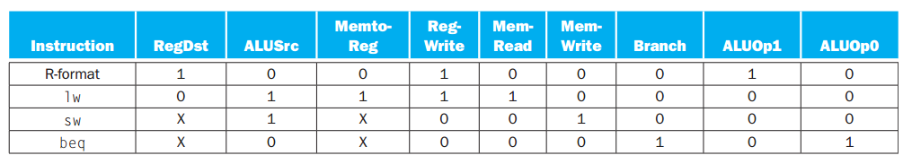
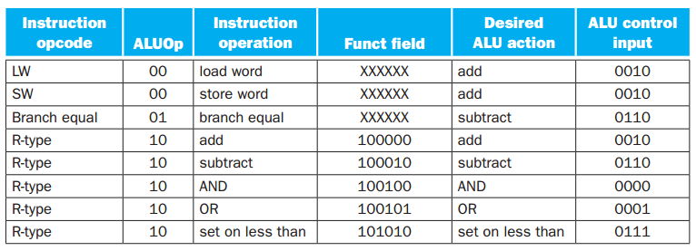
Control

