Slide 1
计算机组成原理
Chapter 5
复习

Slide 2
第一个知识点：
Memory Technologies
ROM
ROM在系统停止供电的时候仍然可以保持数据，而RAM通常都是在掉电之后就丢失数据
半导体存储器
Read Only Memory
SRAM
RAM
SRAM速度非常快，是目前读写最快的存储设备，但是它也非常昂贵，所以只在要求很苛刻的地方使用，譬如CPU的一级缓冲，二级缓冲。
Random Access Memory
DRAM
Flash
DRAM保留数据的时间很短，速度也比SRAM慢，不过它还是比任何的ROM都要快，但从价格上来说DRAM相比SRAM要便宜很多，计算机内存就是DRAM的
FLASH存储器又称闪存，它结合了ROM和RAM的长处，不仅具备电子可擦除可编程(EEPROM)的性能，还不会断电丢失数据同时可以快速读取数据(NVRAM的优势)，U盘和MP3里用的就是这种存储器。

Slide 3
第一个知识点：
Memory Technologies
RAM
SRAMs don’t need to refresh and so the access time is very close to the cycle time. SRAMs typically use six to eight transistors per bit to prevent the information from being disturbed when read. SRAM needs only minimal power to retain the charge in standby mode.
SRAM
Random Access Memory
In a dynamic RAM (DRAM), the value kept in a cell is stored as a charge in a capacitor. A single transistor is then used to access this stored charge, either to read the value or to overwrite the charge stored there. Because DRAMs use only a single transistor per bit of storage, they are much denser and cheaper per bit than SRAM. As DRAMs store the charge on a capacitor, it cannot be kept indefinitely and must periodically be refreshed. That is why this memory structure is called dynamic, as opposed to the static storage in an SRAM cell.
DRAM
Flash Memory
Unlike disks and DRAM, but like other EEPROM technologies, writes can wear out flash memory bits.
Disk Memory

Slide 4
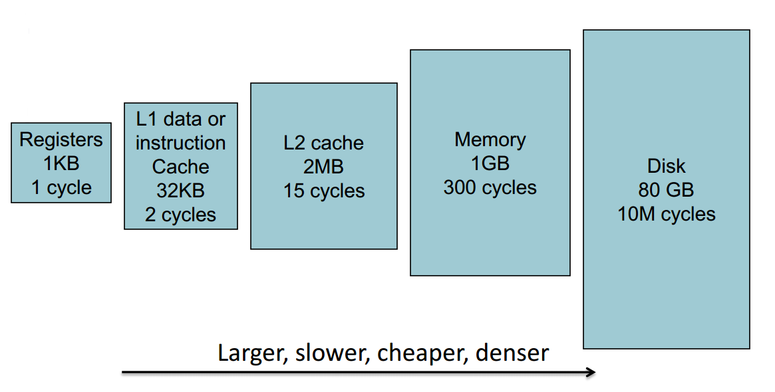
第二个知识点：
Memory Hierarchy
Copy recently accessed (and nearby) items from disk to smaller DRAM memory
Copy more recently accessed (and nearby) items from DRAM to smaller SRAM memory
Store everything on disk memory

Slide 5
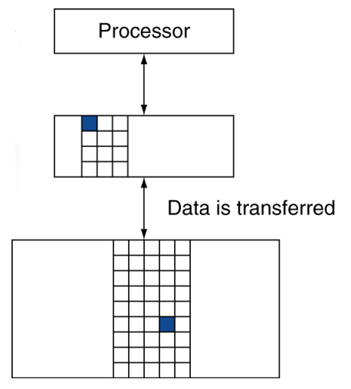
第二个知识点：
terminology
Block (also called line): unit of copying
May be multiple words
The memory in upper level is originally empty
If accessed data is absent
Miss: block copied from lower level
Time taken: miss penalty
Miss ratio: misses/accesses
If accessed data is present in upper level
Hit: access satisfied by upper level
Hit ratio: hits/accesses = 1 – miss ratio
Then accessed data supplied from upper level

Slide 6
第三个知识点：
Locality
Temporal locality
(locality in time): if an item is referenced, it will tend to be referenced again soon.
If you recently brought a book to your desk to look at, you will probably need to look at it again soon.
Spatial locality
(locality in space): if an item is referenced, items whose addresses are close by will tend to be referenced soon.
For example, when you brought out the book on early English computers to fnd out about the EDSAC, you also noticed that there was another book shelved next to it about early mechanical computers, so you also brought back that book and, later on, found something useful in that book. Libraries put books on the same topic together on the same shelves to increase spatial locality.

Slide 7
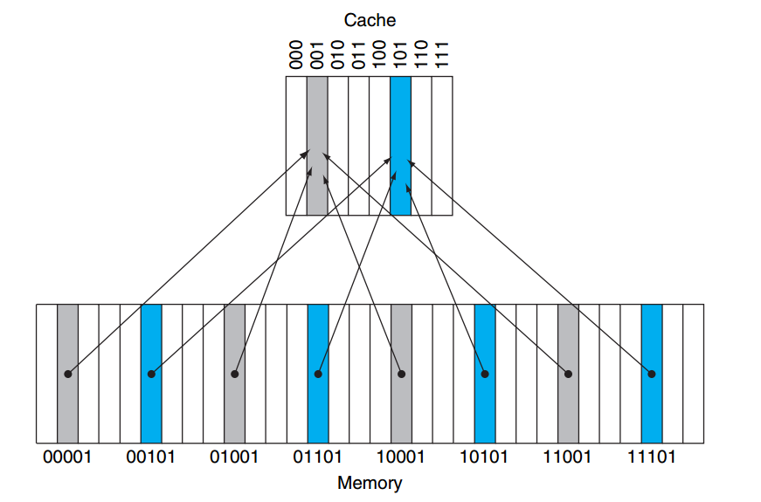
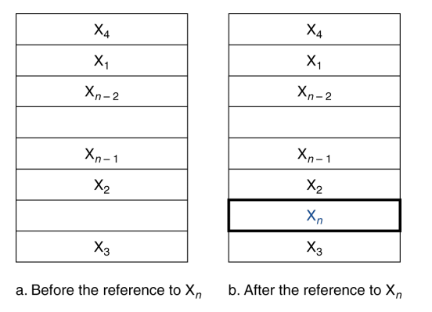
第四个知识点：
Index=(Block address) modulo (#Blocks in cache)
Cache
Direct mapped cache
Number of blocks is power of 2
Use low-order address bits

Slide 8
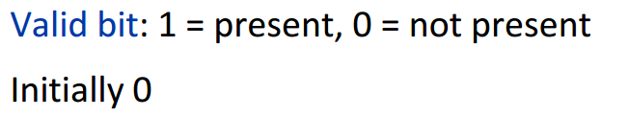
第四个知识点：
Tags and valid bit
The tags contain the address information required to identify whether a word in the cache corresponds to the requested word.
Valid bit to indicate whether an entry contains a valid address.

Slide 9
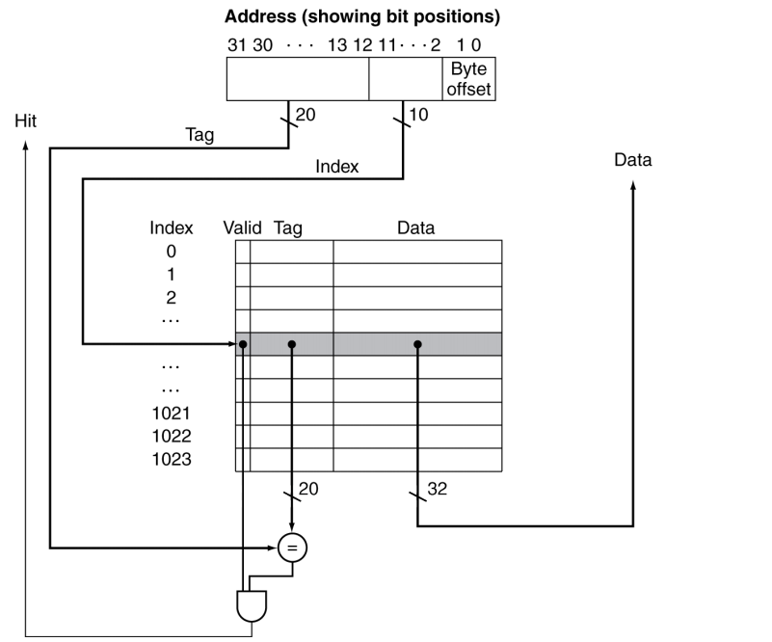
第四个知识点：
Tags and valid bit

Slide 10
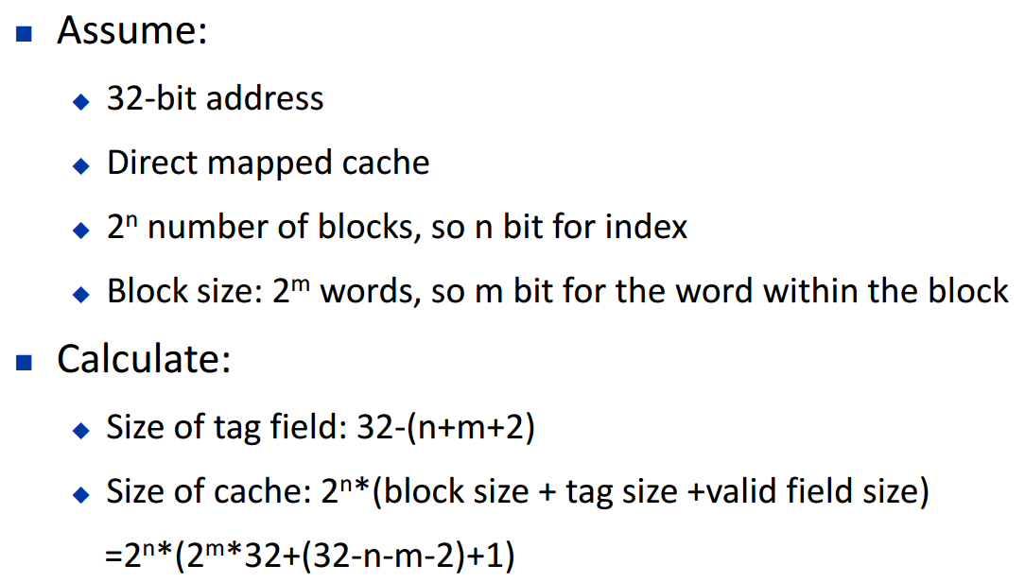
第四个知识点：
Tags and valid bit

Slide 11
第五个知识点：
Write Policy
Allocate on miss: fetch the block
Write through
Write miss?
also update memory
Write around: don’t fetch the block
Too slow?
write buffer
Example: initialization
Write back
Usually fetch the block
On data-write hit, just update the block in cache
Keep track of whether each block is dirty
When a dirty block is replaced?
write it back to memory

Slide 12
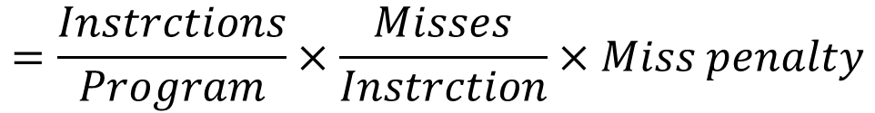

第六个知识点：
Cache Performance
$$Memory Stall Cycles=\frac{Memory accesses}{Program} ×Miss rate×Miss penalty$$
$$=\frac{Instrctions}{Program}×\frac{Misses}{Instrction}×Miss penalty$$
$$Average Access Time \left(AMAT\right)=Hit time+Miss rate×Miss penalty$$
$${CPI}_{stall}= {CPI}_{ideal}+average memory stall cycles$$
$${Miss penalty}_{cycle}=\left\lceil \frac{{Miss penalty}_{time}}{cycle time}\right\rceil$$

Slide 13
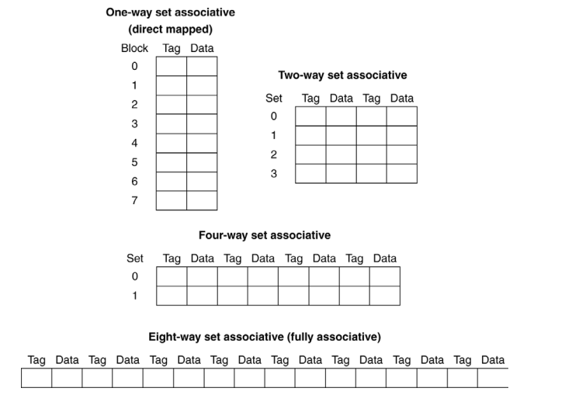
第七个知识点：
Associative Cache

Slide 14

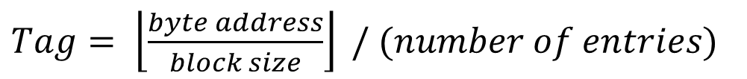

第七个知识点：
How to calculate block number and tag?
Transfer memory address to binary
Module
$$number of entries=2^{n}$$
$Tag= \left\lfloor \frac{byte address}{block size}\right\rfloor / (number of entries)$
$Index= \left\lfloor \frac{byte address}{block size}\right\rfloor mod (number of entries)$

Slide 15
第七个知识点：
Replacement policy
Direct mapped
No choice
Least-recently used (LRU)
Choose the one unused for the longest time
Associative cache
Random

Slide 16
第八个知识点：
Multilevel caches
Some high-end systems include L3 cache...
L1 cache hit
L1 cache
L2 cache
L2 cache hit
L1 cache miss
L2 cache miss
Memory

Slide 17
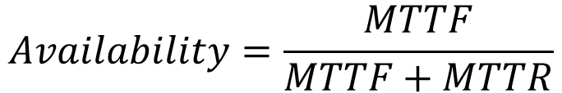
第九个知识点：
Dependable Memory Hierarchy
mean time to failure (MTTF) is a reliability measure.
Service interruption is measured as mean time to repair (MTTR).
Mean time between failures (MTBF) is simply the sum of MTTF + MTTR.
Availability is then a measure of service accomplishment with respect to the alternation between the two states of accomplishment and interruption.
$$Availability=\frac{MTTF}{MTTF+MTTR}$$

Slide 18
第九个知识点：
Dependable Memory Hierarchy
Three ways to improve MTTF:
Fault avoidance: Preventing fault occurrence by construction.
Fault tolerance: Using redundancy to allow the service to comply with the service specifcation despite faults occurring.
Fault forecasting: Predicting the presence and creation of faults, allowing the component to be replaced before it fails.
Reduce MTTR: fault detection, fault diagnosis and fault repair

Slide 19
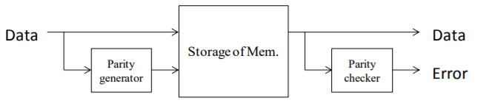
第十个知识点：
Hamming code
Hamming distance: Number of bits that are different between two bit patterns.
For example, the distance between 011011 and 001111 is two.
In a parity code, the number of 1s in a word is counted; the word has odd parity if the number of 1s is odd and even otherwise. When a word is written into memory, the parity bit is also written. That is, the parity of the N+1 bit word should always be even.

Slide 20

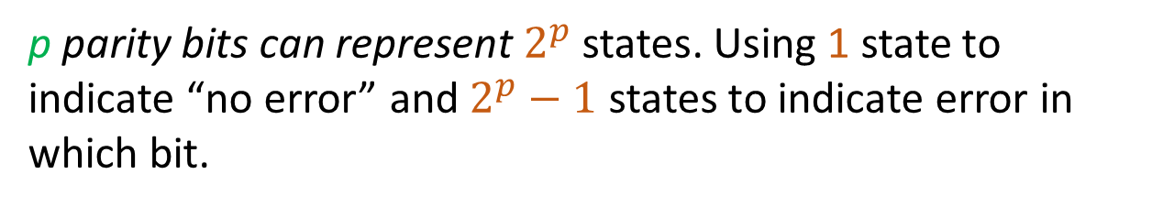
第十个知识点：
Single Error Correcting / Double Error Detecting (SEC/DED)
d | Minimum p
1 | 2
2-4 | 3
5-11 | 4
12-26 | 5
27-57 | 6
58-120 | 7
Let p be total number of parity bits and d number of data bits in p+d bit word.
p parity bits can represent $2^{p}$ states. Using 1 state to indicate “no error” and $2^{p}−1$ states to indicate error in which bit.
Conveniently, eight byte data blocks can get SEC/DED with just one more byte, which is why many DIMMs are 72 bits wide.
$$2^{p}≥p+d+1$$

Slide 21
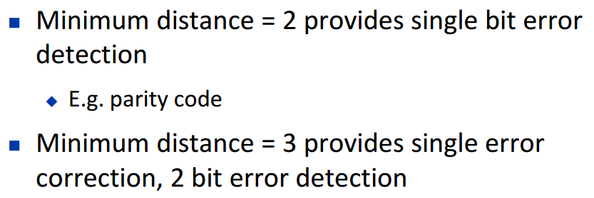
第十个知识点：
Single Error Correcting / Double Error Detecting (SEC/DED)
Hamming codes have a minimum distance of 3, which means that the decoder can detect and correct a single error, but it cannot distinguish a double bit error of some codeword from a single bit error of a different codeword. Thus, some double-bit errors will be incorrectly decoded as if they were single bit errors and therefore go undetected, unless no correction is attempted.

Slide 22
第十个知识点：
Single Error Correcting / Double Error Detecting (SEC/DED)
To remedy this shortcoming, Hamming codes can be extended by an extra parity bit. This way, it is possible to increase the minimum distance of the Hamming code to 4, which allows the decoder to distinguish between single bit errors and two-bit errors. Thus the decoder can detect and correct a single error and at the same time detect (but not correct) a double error.

Slide 23
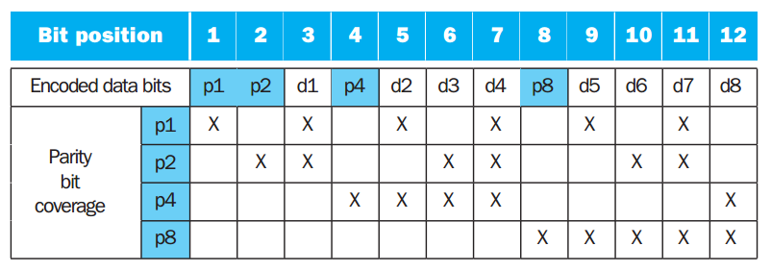
第十个知识点：
Single Error Correcting / Double Error Detecting (SEC/DED)

Slide 24
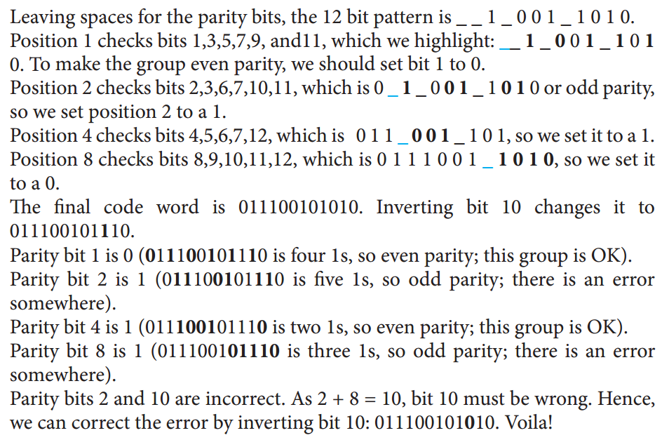
第十个知识点：
Single Error Correcting / Double Error Detecting (SEC/DED)
Assume one byte data value is 10011010. First show the Hamming ECC code for that byte, and then invert bit 10 and show that the ECC code finds and corrects the single bit error.

Slide 25
第十一个知识点：
Virtual Memory
The main memory can act as a “cache” for the secondary storage, usually implemented with magnetic disks. This technique is called virtual memory.
Motivation:
To allow effcient and safe sharing of memory among multiple programs
To allow a single user program to exceed the size of primary memory.
A virtual memory block is called a page, and a virtual memory miss is called a page fault.

Slide 26
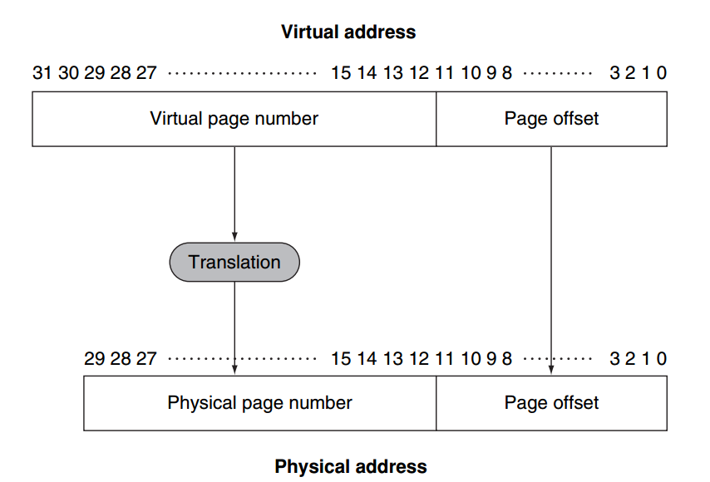
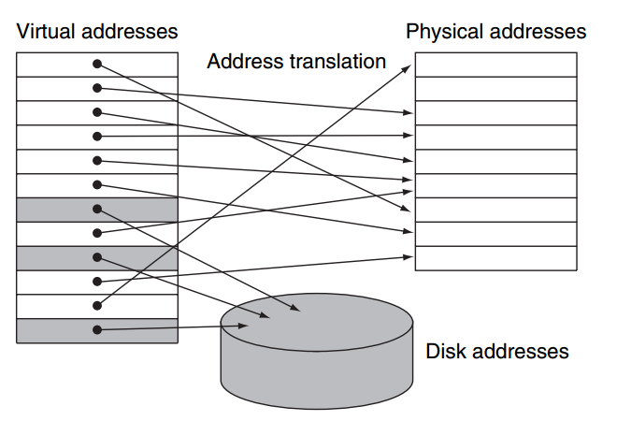
第十一个知识点：
Virtual Memory
On page fault, the page must be fetched from disk.
In virtual memory, blocks of memory (called pages) are mapped from one set of addresses (called virtual addresses) to another set (called physical addresses).
Try to minimize page fault rate
1. Fully associative placement
2. Smart replacement algorithms

Slide 27
第十二个知识点：
Page Tables
In virtual memory systems, we locate pages by using a table that indexes the memory; this structure is called a page table, and it resides in memory.
Array of page table entries (PTE), indexed by virtual page number
To indicate the location of the page table in memory, the hardware includes a register that points to the start of the page table.
page table register
If page is present in memory
1. PTE stores the physical page number
2. Plus other status bits (referenced, dirty, …)
If page is not present
PTE can refer to location in swap space on disk

Slide 28
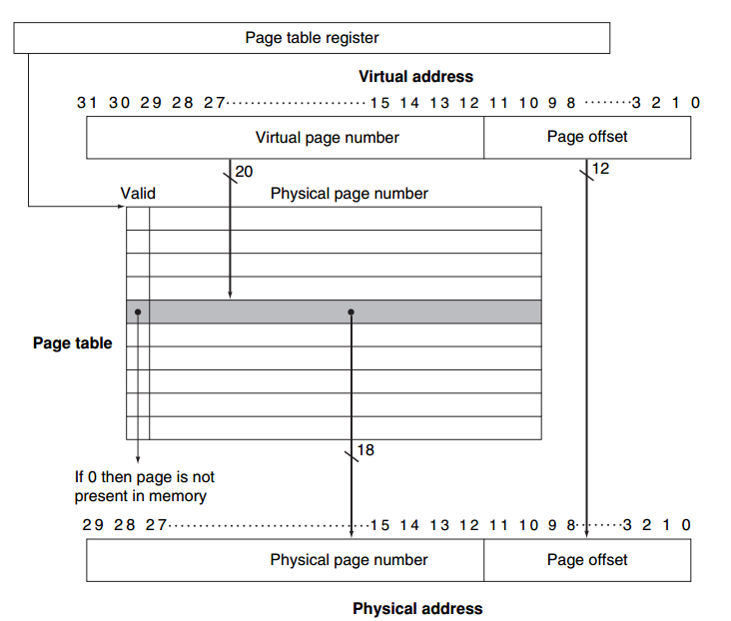
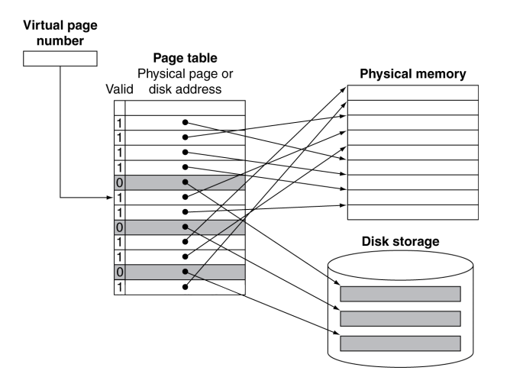
第十二个知识点：
Page Tables

Slide 29
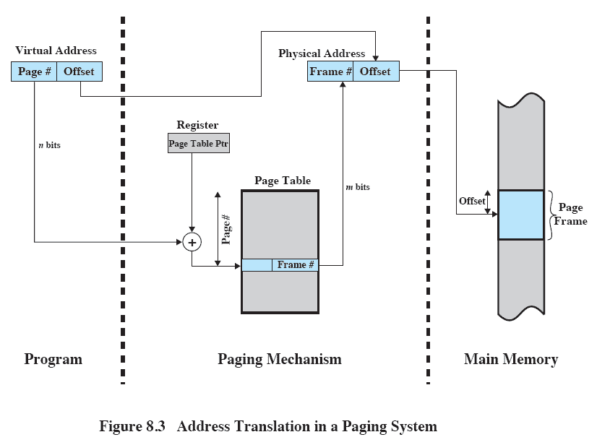
第十二个知识点：
Page Tables

Slide 30
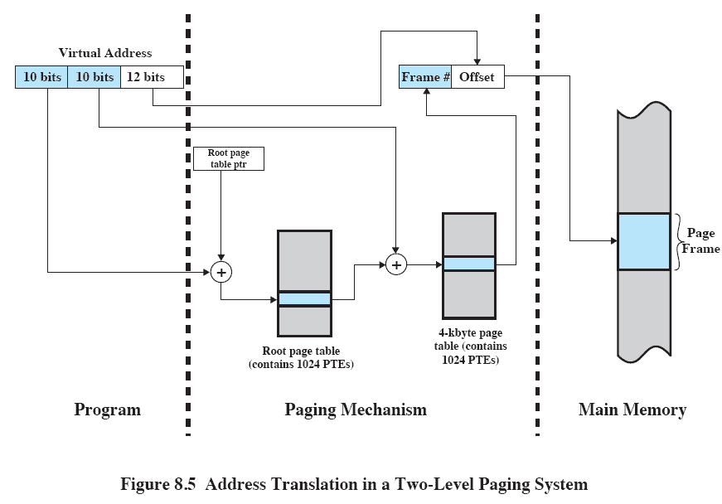
第十二个知识点：
Page Tables
(Multilevel)

Slide 31
第十二个知识点：
Page Tables
To reduce page fault rate, prefer least-recently used (LRU) replacement  Reference bit (aka use bit) in PTE set to 1 on access to page  Periodically cleared to 0 by OS  A page with reference bit = 0 has not been used recently
Disk writes take millions of cycles
◆ Block at once, not individual locations
◆ Use write-back, because write through is impractical
◆ Dirty bit in PTE set when page is written

Slide 32
第十二个知识点：
Page Tables
With a 32-bit virtual address, 4 KiB pages, and 4 bytes per page table entry, we can compute the total page table size:
$$4 KiB pages=4×1024 Bytes pages=4096 Bytes pages$$
$$Number of bit for page offset= \log_{2}{4096}=12$$
$$Number of bit for virtual page number=32−12=20$$
$$Number of page table entries= 2^{20}$$
$$Size of page table= 2^{20} page table entries×2^{2}\frac{Bytes}{page table entries}=4 MiB$$

Slide 33
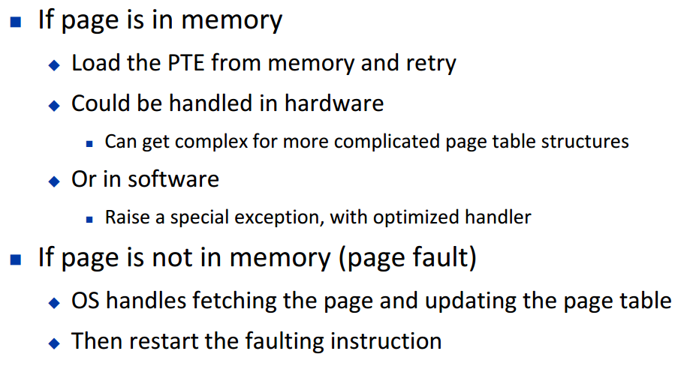
第十三个知识点：
Translation-lookaside buffer (TLB)
Since the page tables are stored in main memory, every memory access by a program can take at least twice as long: one memory access to obtain the physical address and a second access to get the data.
Modern processors include a special cache that keeps track of recently used translations. This special address translation cache is traditionally referred to as a translation-lookaside bufer (TLB)

Slide 34
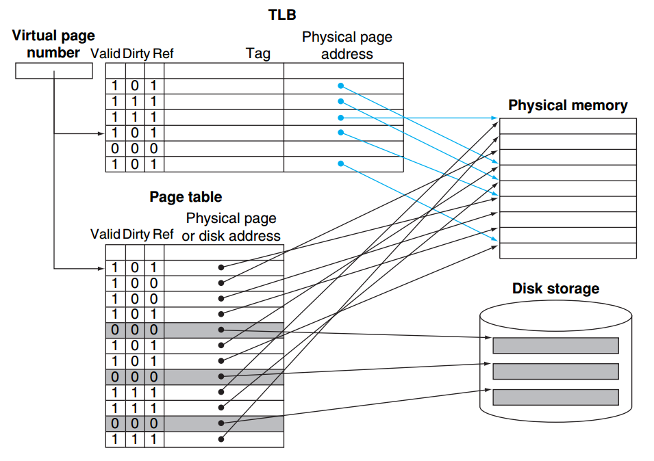
第十三个知识点：
Translation-lookaside buffer (TLB)
The TLB acts as a cache of the page table for the entries that map to physical pages only.

Slide 35
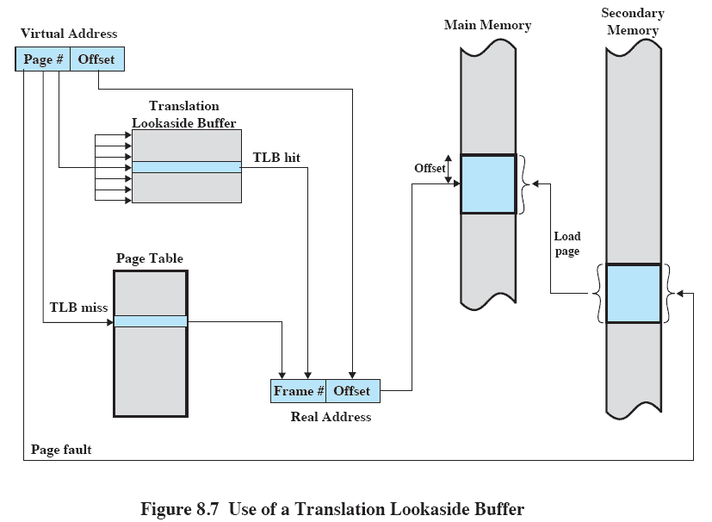
第十三个知识点：
Translation-lookaside buffer (TLB)

Slide 36
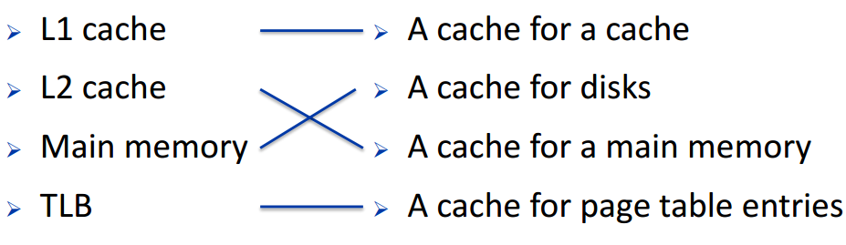
第十四个知识点：
Different kind of cache

Slide 37
第十五个知识点：
Memory Hierarchy
◆ Block placement  Finding a block  Replacement on a miss  Write policy
Direct mapped(one choice for placement)
Block Placement
n-way set associative (n choices within a set)
Fully associative (any location)

Slide 38
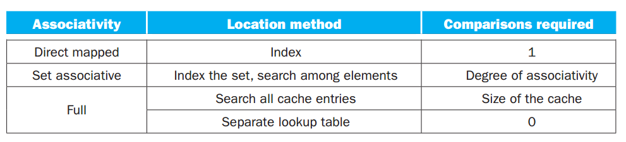
第十五个知识点：
Memory Hierarchy
Finding a block
Virtual memory
1. Full table lookup makes full associativity feasible
2. Benefit in reduced miss rate
Cache and TLB
Set-associative, some cache uses direct map

Slide 39
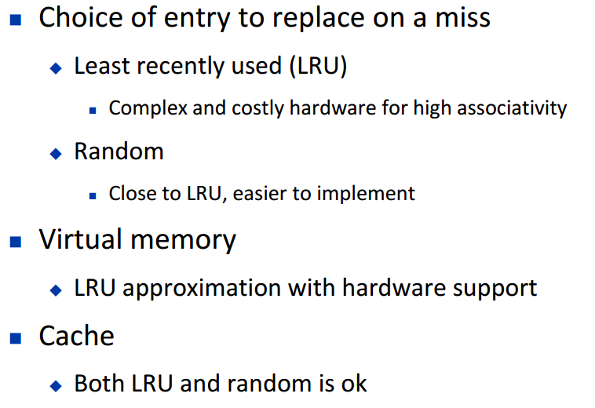
第十五个知识点：
Memory Hierarchy
Replacement

Slide 40
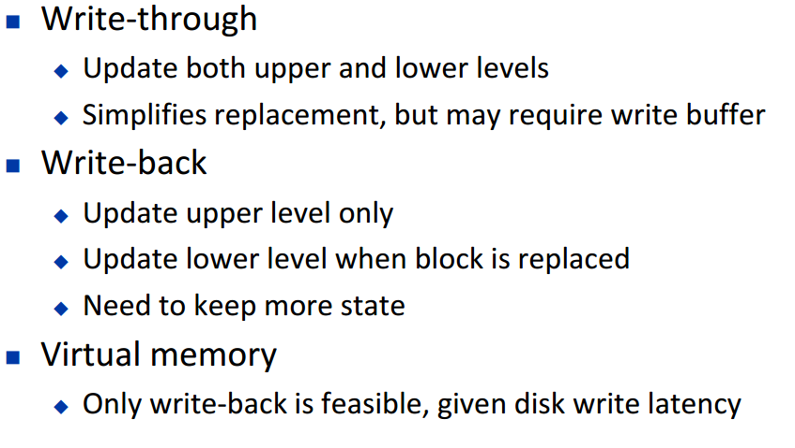
第十五个知识点：
Memory Hierarchy
Write policy

Slide 41
第十六个知识点：
Source of misses
Compulsory misses (aka cold start misses)
These are cache misses caused by the first access to a block that has never been in the cache.
Capacity misses
These are cache misses caused when the cache cannot contain all the blocks needed during execution of a program. Capacity misses occur when blocks are replaced and then later retrieved.
Conflict misses (aka collision misses)
These are cache misses that occur in set-associative or direct-mapped caches when multiple blocks compete for the same set. Confict misses are those misses in a direct-mapped or set-associative cache that are eliminated in a fully associative cache of the same size.

Slide 42
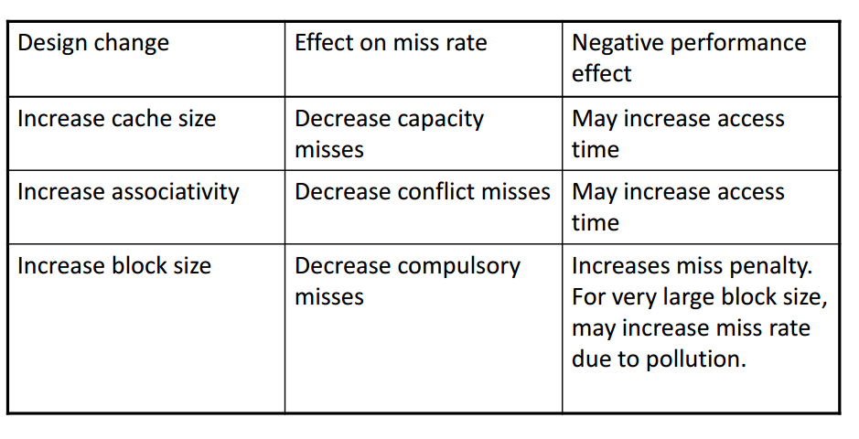
第十七个知识点：
Cache Design Trade-offs

Slide 43
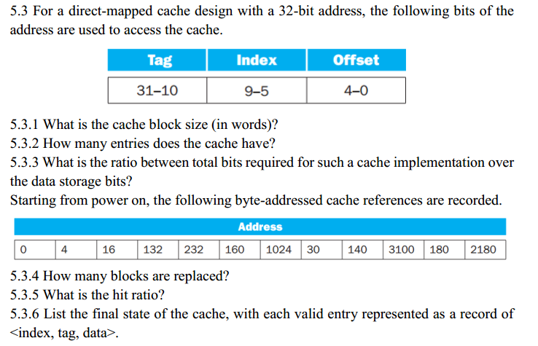
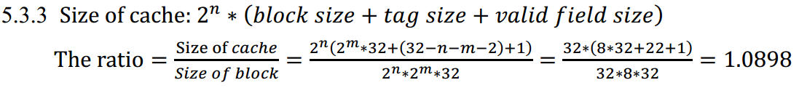
Homework
5.3.1 Since offset field is 5 bits, then block size is 32 bytes =8 words
5.3.2 Number of entries = $2^{5}=32$

Slide 44
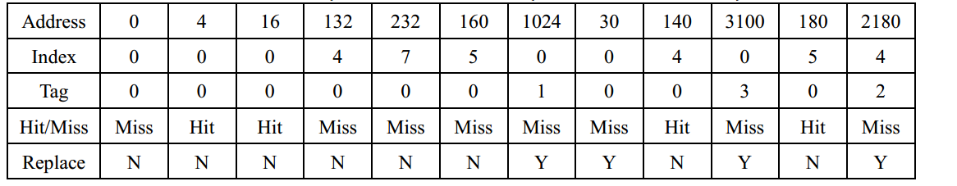
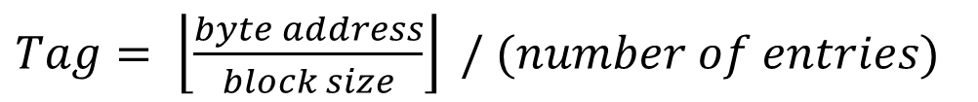
Homework
$Tag= \left\lfloor \frac{byte address}{block size}\right\rfloor / (number of entries)$
$Index= \left\lfloor \frac{byte address}{block size}\right\rfloor mod (number of entries)$
$${132}_{dec}={00000000000000000000000 00100 00100}_{binary}$$
$${3100}_{dec}={00000000000000000000011 00000 11100}_{binary}$$
5.3.4
4 blocks are replaced.
5.3.5
Hit ratio = 4/12 =0.33

Slide 45
Homework
5.3.6
<index tag data >
<00000 0000000000000000000011 Mem[3072]-Mem[3103] >
<00100 0000000000000000000010 Mem[2176]-Mem[2207] >
<00101 0000000000000000000000 Mem[160]-Mem[191] >
<00111 0000000000000000000000 Mem[224]-Mem[255] >

