Slide 1
计算机组成原理
Chapter 6
复习

Slide 2
第一个知识点：
Important terms
Multiprocessor
A computer system with at least two processors. This computer is in contrast to a uniprocessor, which has one, and is increasingly hard to find today.
Task-level parallelism or Process-level parallelism
Utilizing multiple processors by running independent programs simultaneously.
Parallel processing program
A single program that runs on multiple processors simultaneously.
Cluster
A set of computers connected over a local area network that function as a single large multiprocessor.

Slide 3
Multicore microprocessor
A microprocessor containing multiple processors (“cores”) in a single integrated circuit. Virtually all microprocessors today in desktops and servers are multicore.
Shared memory multiprocessor (SMP)
A parallel processor with a single physical address space.
True or false: To benefit from a multiprocessor, an application must be concurrent.

Slide 4
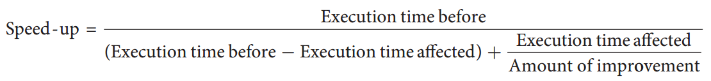
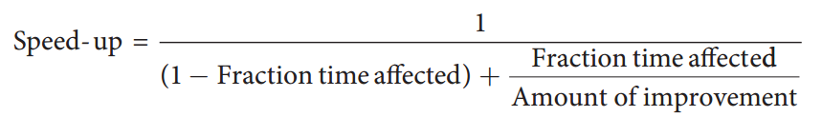
第二个知识点：
Amdahl's Law
$$Execution time after improvement=\frac{Execution time affected by improvement}{Amount of improvement}+Execution time unaffected$$

Slide 5
Strong scaling
Speedup achieved on a multiprocessor without increasing the size of the problem.
Weak scaling
Speedup achieved on a multiprocessor while increasing the size of the problem proportionally to the increase in the number of processors.
Strong scaling means measuring speed-up while keeping the problem size fixed.
Weak scaling means that the problem size grows proportionally to the increase in the number of processors.
True or false: Strong scaling is not bound by Amdahl's Law.

Slide 6
第三个知识点：
SISD, MIMD, SIMD, SPMD, and Vector
SISD or Single Instruction stream, Single Data stream.
A uniprocessor.
True or false: As exemplified in the x86, multimedia extensions can be thought of as a vector architecture with short vectors that supports only contiguous vector data transfers.
MIMD or Multiple Instruction streams, Multiple Data streams.
A multiprocessor.
SIMD or Single Instruction stream, Multiple Data streams.
The same instruction is applied to many data streams, as in a vector processor.
SPMD Single Program, Multiple Data streams.
The conventional MIMD programming model, where a single program runs across all processors.

Slide 7
第四个知识点：
Multithreading
A related concept to MIMD, especially from the programmer’s perspective, is hardware multithreading. While MIMD relies on multiple processes or threads to try to keep multiple processors busy, hardware multithreading allows multiple threads to share the functional units of a single processor in an overlapping fashion to try to utilize the hardware resources effciently.
Fine-grained multithreading
A version of hardware multithreading that implies switching between threads after every instruction.
If one thread stalls, others are executed
Coarse-grained multithreading
A version of hardware multithreading that implies switching between threads only after significant events, such as a last-level cache miss.

Slide 8
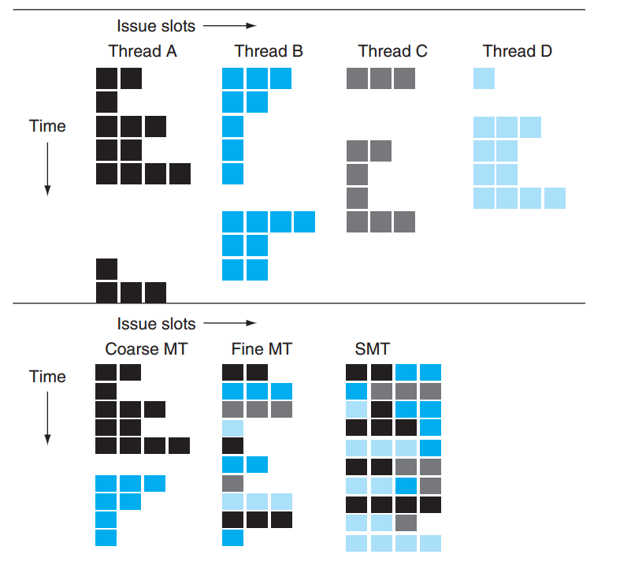
Simultaneous multithreading (SMT)
A version of multithreading that lowers the cost of multithreading by utilizing the resources needed for multiple issue, dynamically scheduled microarchitecture.
True or false: Both multithreading and multicore rely on parallelism to get more effciency from a chip.
True or false: Simultaneous multithreading (SMT) uses threads to improve resource utilization of a dynamically scheduled, out-of-order processor.

Slide 9
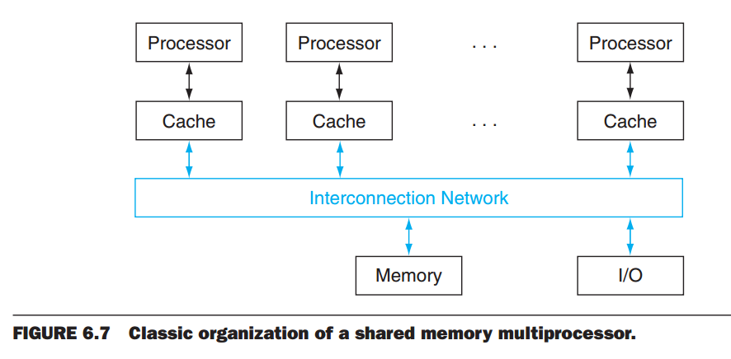
第五个知识点：
Shared Memory Multiprocessors
How to efficiently programming on multiprocessor?
Don’t want to rewrite old programs in single processor.
Share memory among multiple cores.
True or false: Shared memory multiprocessors cannot take advantage of task-level parallelism.

Slide 10
Good luck to you!

