Slide 2
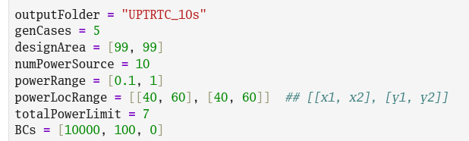
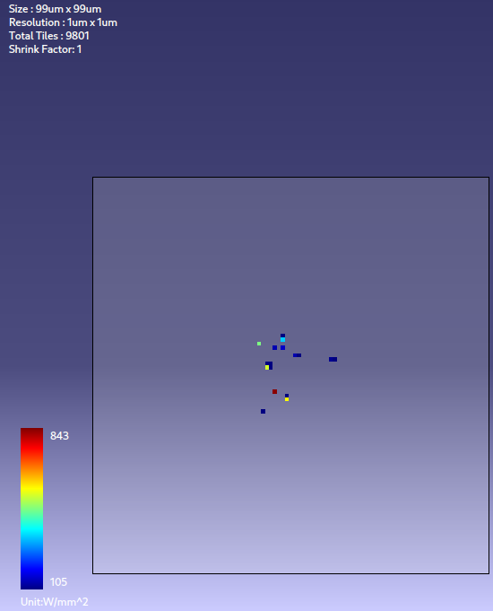
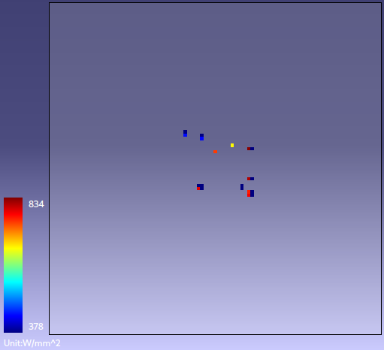
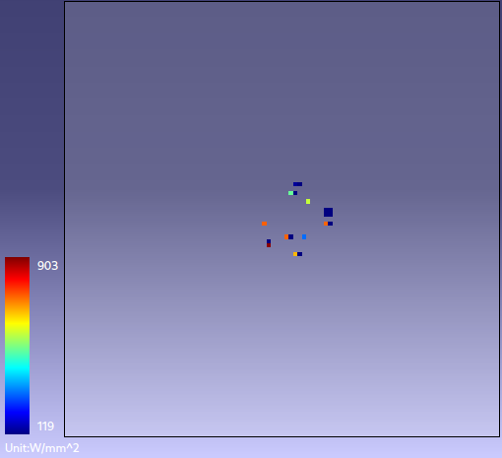
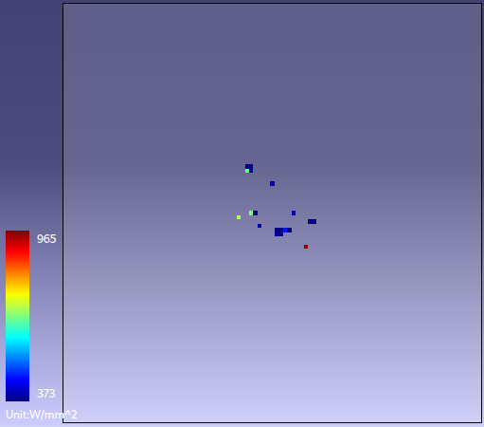
Test Cases Generator
Fix param.:
designArea, resolution, BCs, ambT
Variables:
#Unit_Source, Power range, Location range
## Each UC is in this range
What power map looks like

Slide 3
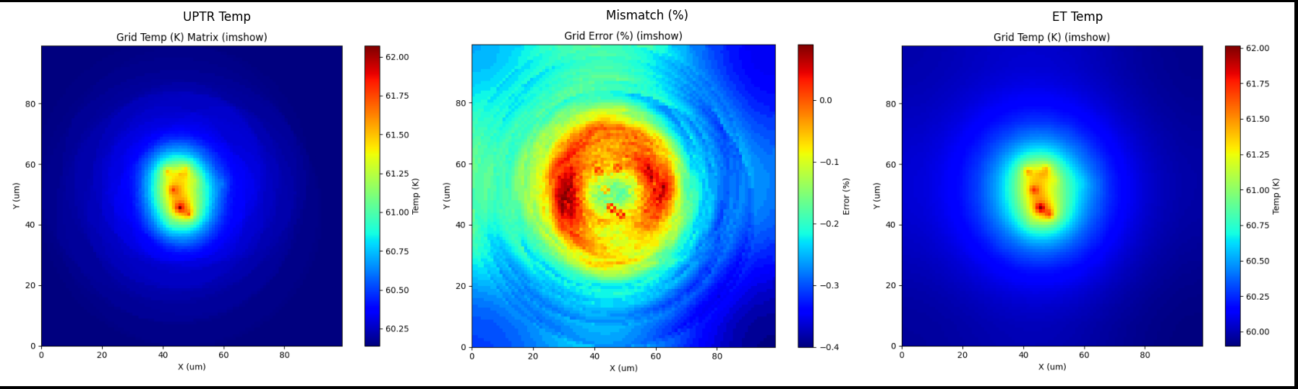
10 power sources in 99x99 design area (Sources are located at center region) HTC = [10000, 100, 0], ambient Temp.: 25
Thermal profile estimated by UPTR formula
Error: (UPTR-ET)/ET in %
Point-to-point check
Max error < 0.5 %
Thermal profile simulated by RHSC-ET

Slide 4
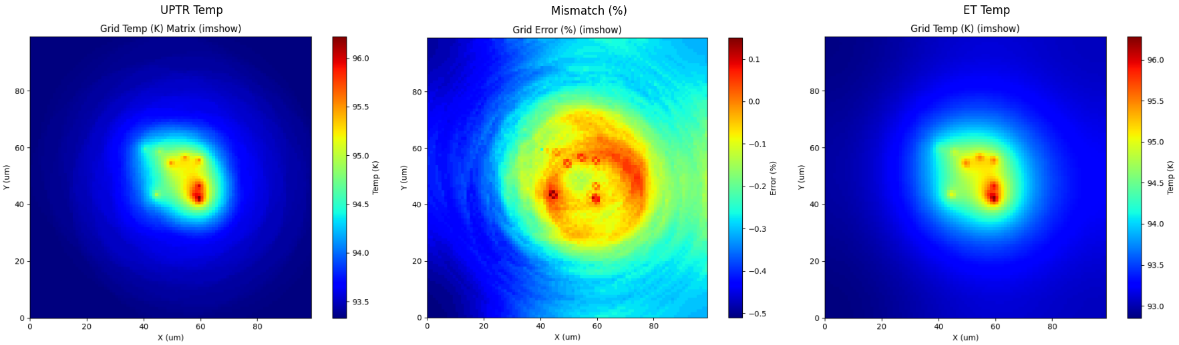
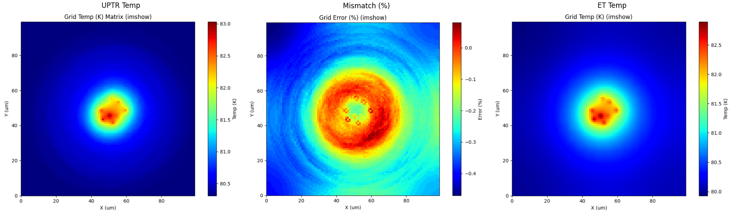
Max error < 0.6 %
Max error < 0.5 %

Slide 5
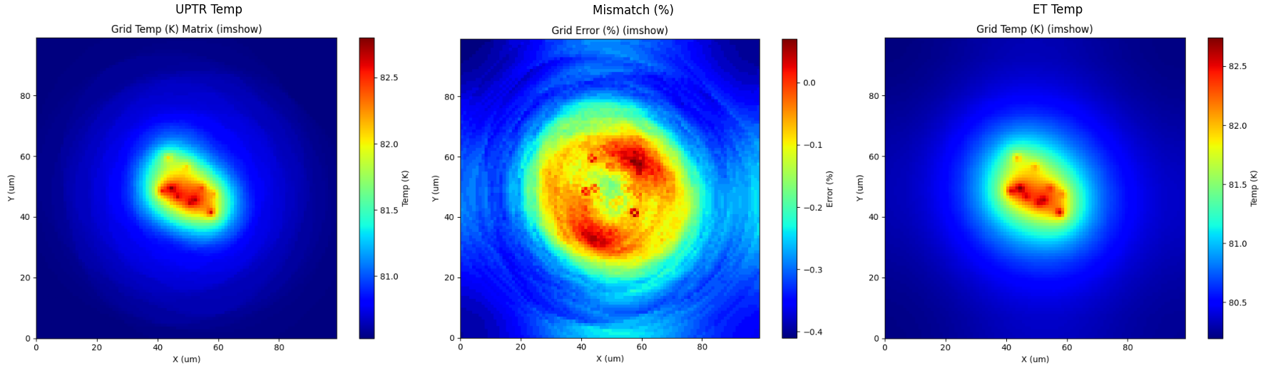
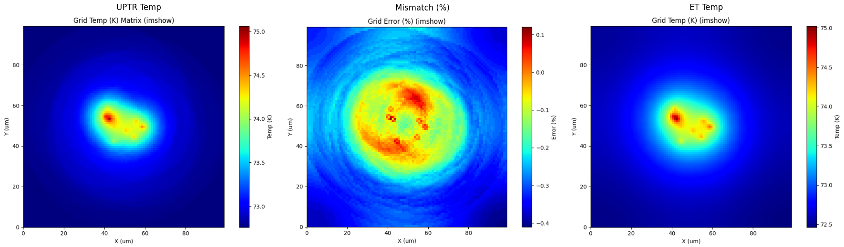
Max error < 0.5 %
Max error < 0.5 %

