Slide 1
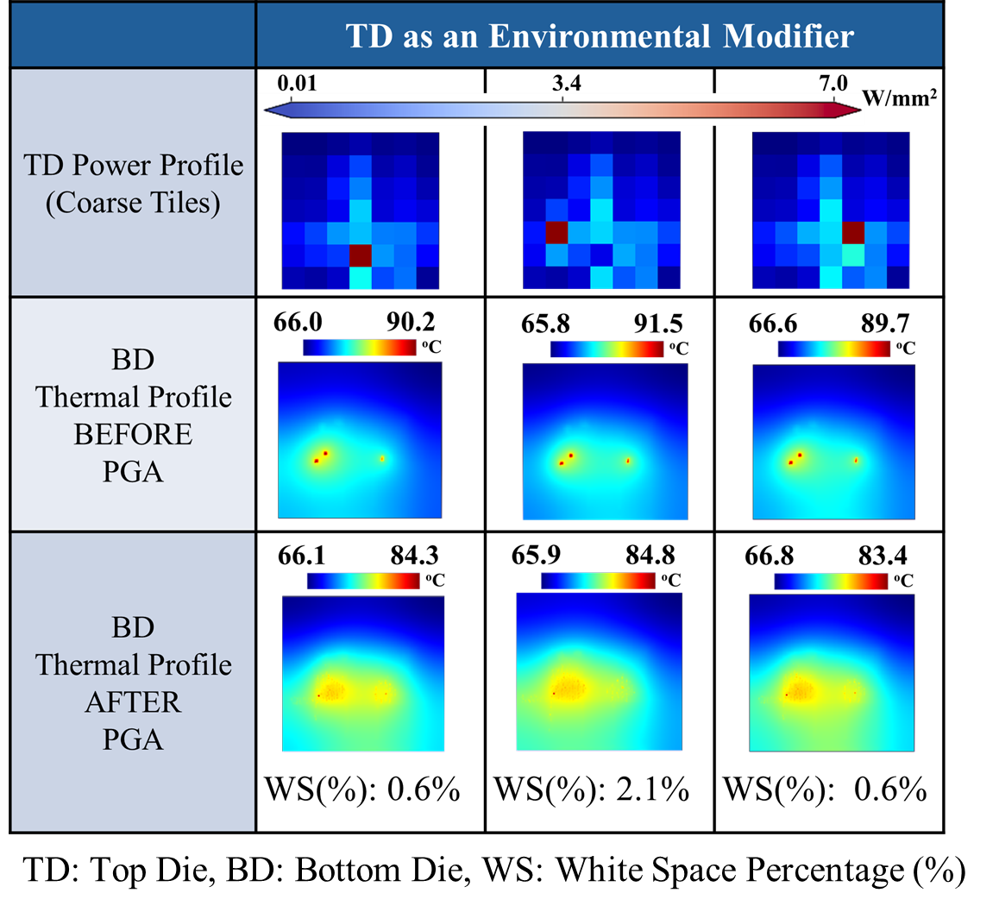
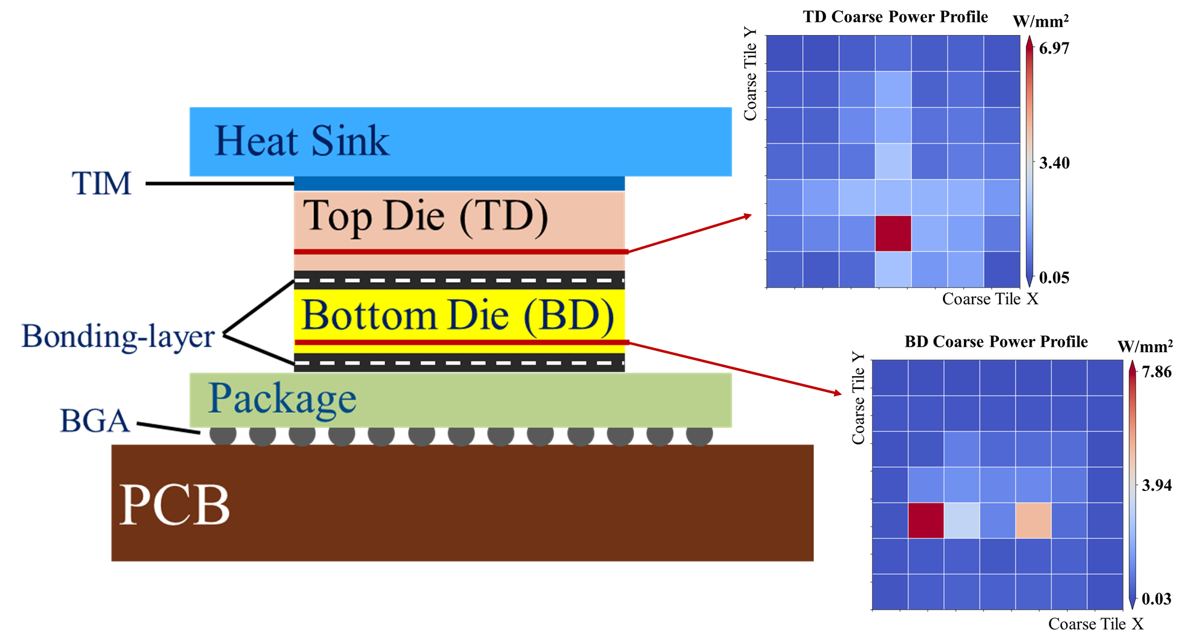
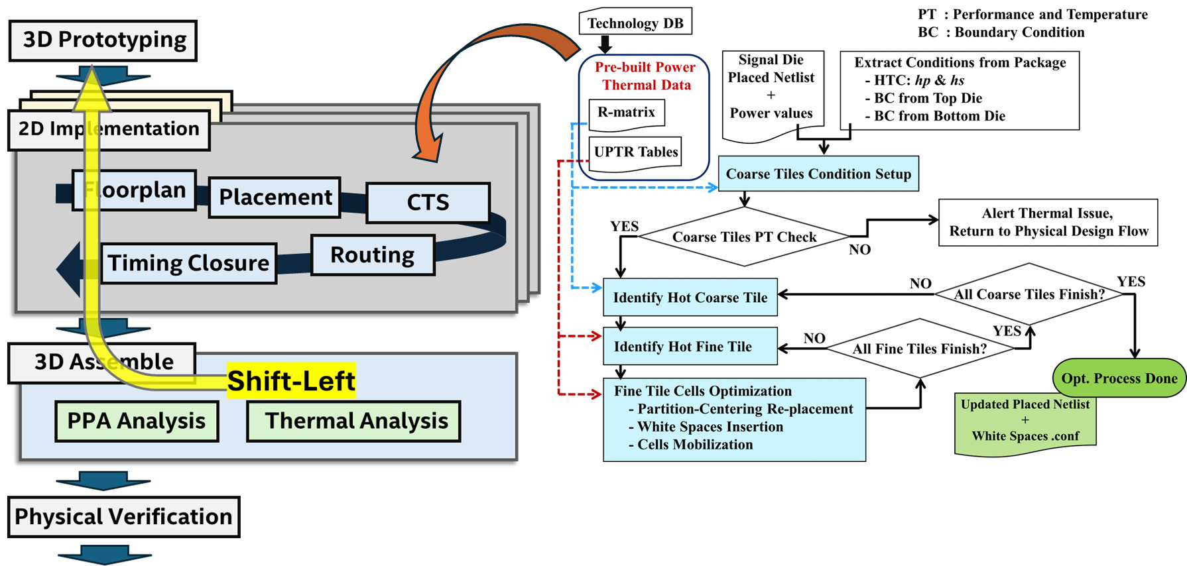
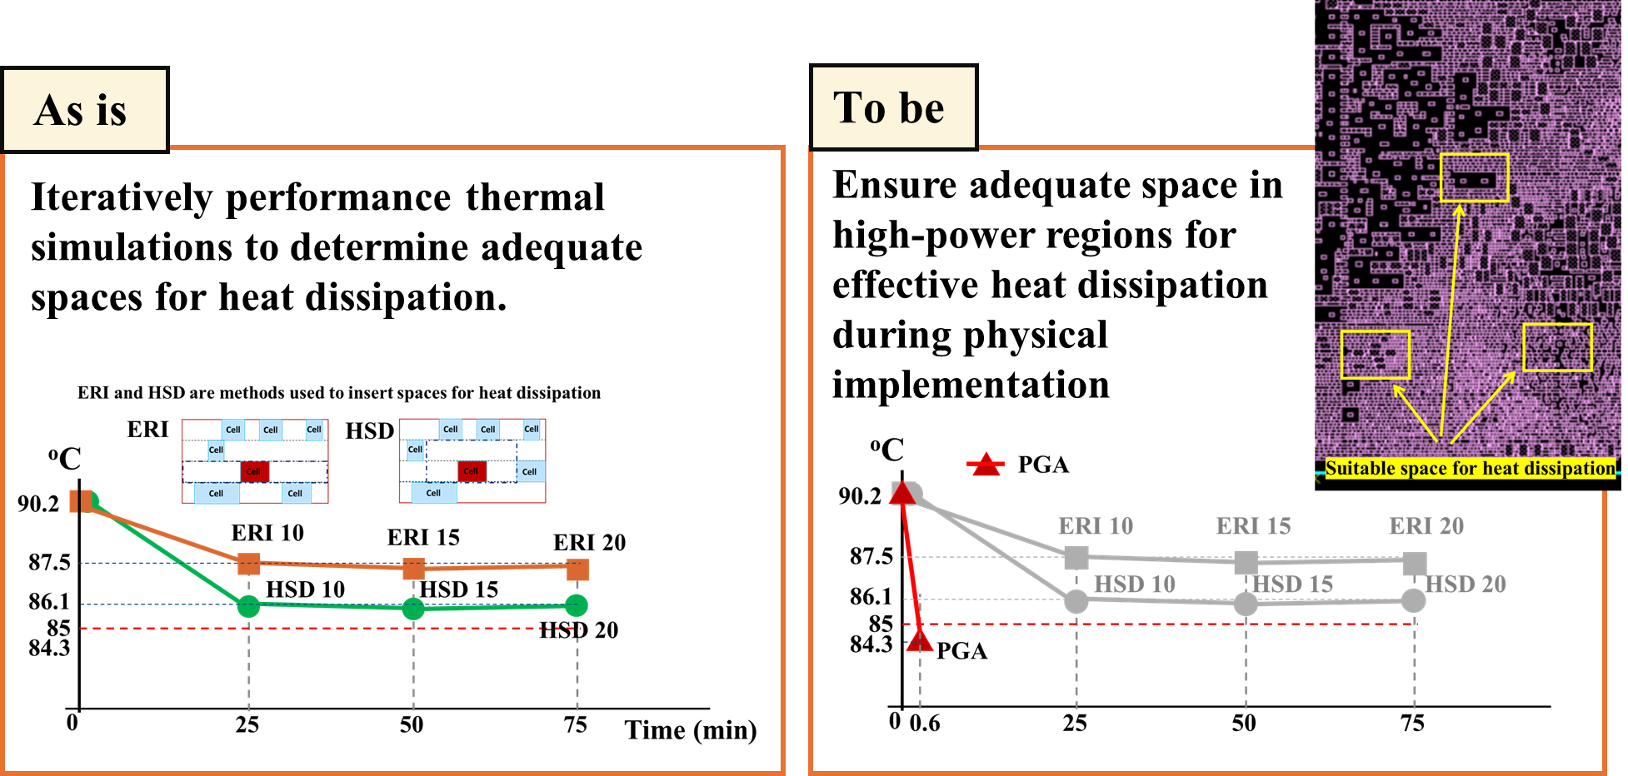
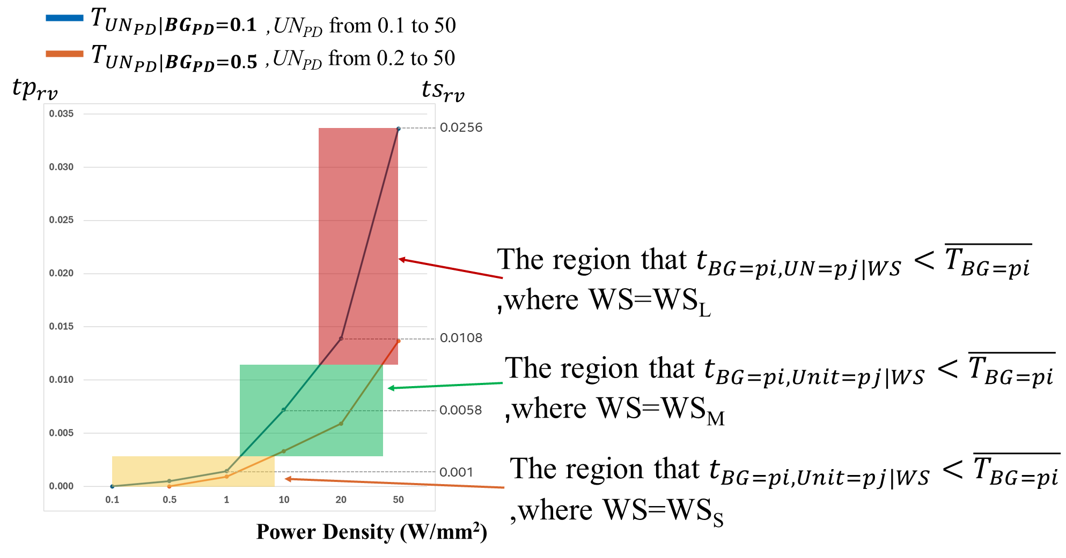
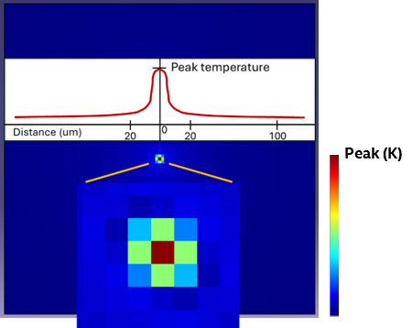
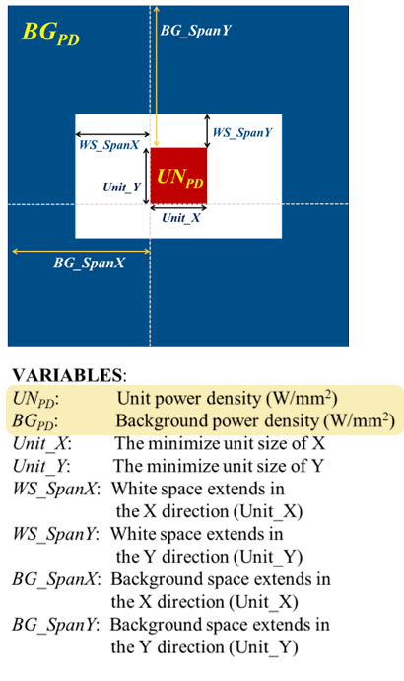
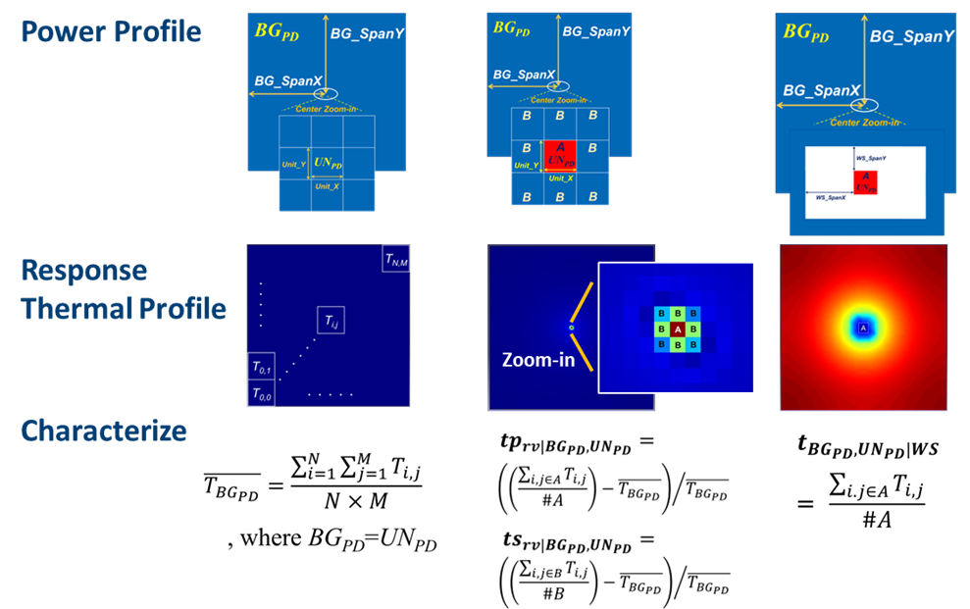
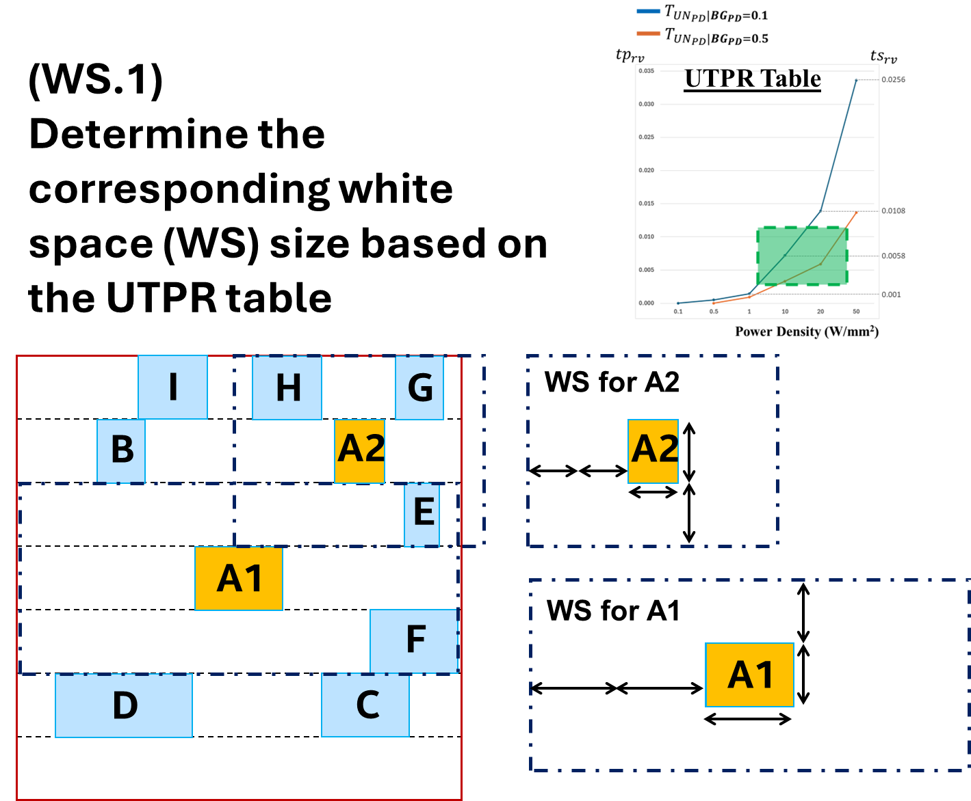
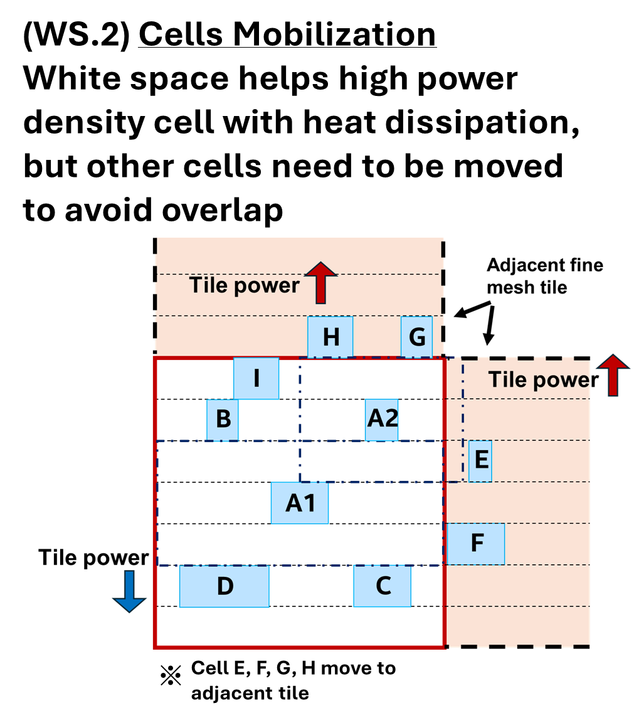
A Novel Power-gradient-aware Cell Placement Methodology Considering 3D-IC Stacking Thermal Boundary to Achieve Timing and Thermal Co-optimization
Motivation & Introduction
Thermal management has become a pressing issue in 3D-IC design
High power density caused by complex functionality
Stacking dies complicates heat dissipation
Designers want to have earlier insights on the effectiveness of thermal management during chip design
Guide cell placement to address potential power-induced thermal issues without doing thermal simulation
Experiments
Adjusting white space size via lookup tables based on environmental conditions
By inserting appropriately sized WSs based on power distribution analysis, the simulation loop is broken.
Methodology I
Unit power thermal response (UPTR) table (Technology dependent)
Characterize unit power response on thermal behavior considering various geometries
Power-gradient-aware (PGA) cell placement
Identify hotspot location by coarse and fine grid analyses
Lookup white space insertion with partition-centering cell replacement
Methodology II & Conclusions
Hotspot has lateral locality and local similarity
Temperature peaks at the heat source drop drastically
UPTR Plot Example
Pre-characterized power-thermal models
Enable quick identification of hotspot cells.
Determine necessary white space for heat dissipation.
Foundry process design kits
Include thermal techfile and RC techfile.
Allow creation of customized models based on specific needs.
Early design phase considerations
Ensure adequate space for heat dissipation.
Avoid iterative thermal simulations.
WS: White Space
WS_{L}: Large size
WS_{M}: Medium size
WS_{S}: Small size
Notes:
字型大小:48/36/28

