Slide 1
VitaWise
"Vitality meets Wisdom in Tech"
GO!

Slide 2
Preface
I would like to thank Ghofrane Dkhili,
for giving this idea and the team for executing it

Slide 3
Table of Contents
Overview
Topic
Assignment
Credits
Here you can describe the topic of the section
Here you can describe the topic of the section
Here you can describe the topic of the section

Slide 4
Table of Contents
Introduction
Topic
Assignment
Credits
Brief overview of VitaWise's mission and vision
Here you can describe the topic of the section
Here you can describe the topic of the section

Slide 5
Table of Contents
The Problematic
Introduction
Assignment
Credits
Critic of what exists & Explanation of the gap between user needs and existing health monitoring solutions
Brief overview of VitaWise's mission and vision
Here you can describe the topic of the section

Slide 6
Table of Contents
The Problematic
The Solution:
Introduction
Credits
Critic of what exists & Explanation of the gap between user needs and existing health monitoring solutions
Description of key features such as real-time monitoring, automatic alerts, and user-friendly interface
Brief overview of VitaWise's mission and vision

Slide 7
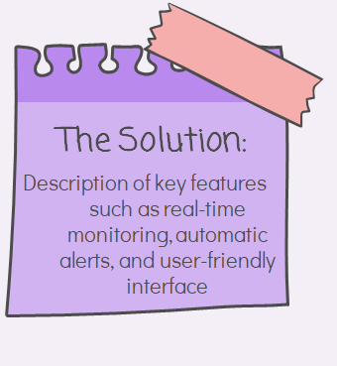
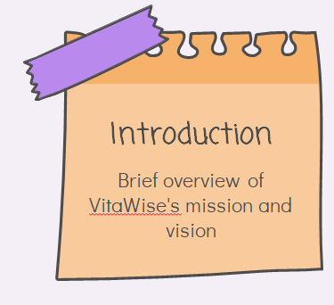
Table of Contents
The Problematic
The Solution:
Introduction
Credits
Critic of what exists & Explanation of the gap between user needs and existing health monitoring solutions
Description of key features such as real-time monitoring, automatic alerts, and user-friendly interface
Brief overview of VitaWise's mission and vision

Slide 8
Table of Contents
The Problematic
The Solution:
Introduction
Credits
Why VitaWise?
Critic of what exists & Explanation of the gap between user needs and existing health monitoring solutions
Description of key features such as real-time monitoring, automatic alerts, and user-friendly interface
Description of how VitaWise enhances user experience and empowers individuals to take control of their health
Brief overview of VitaWise's mission and vision

Slide 9
Table of Contents
The Solution:
The Problematic
Introduction
Credits
Our Product:
Why VitaWise?
Critic of what exists & Explanation of the gap between user needs and existing health monitoring solutions
Description of how VitaWise enhances user experience and empowers individuals to take control of their health
Description of how VitaWise Watch revolutionizes personal health monitoring
Description of key features such as real-time monitoring, automatic alerts, and user-friendly interface
Brief overview of VitaWise's mission and vision

Slide 10
Table of Contents
The Solution:
The Problematic
Introduction
Credits
Conclusion:
Our Product:
Why VitaWise?
Critic of what exists & Explanation of the gap between user needs and existing health monitoring solutions
Description of how VitaWise Watch revolutionizes personal health monitoring
Description of key features such as real-time monitoring, automatic alerts, and user-friendly interface
Description of how VitaWise enhances user experience and empowers individuals to take control of their health
Call to action for viewers to learn more or get involved
Brief overview of VitaWise's mission and vision

Slide 11
01
Introduction
01
Introduction
02
03
Enhancing Health Monitoring Through Technology

Slide 12
Our Mission and Vision:
01
Introduction
02
The project aims to automate the monitoring of patients' vital signs, including heart rate, blood pressure, and body temperature.
The goal is to streamline the work of nurses and ensure continuous monitoring of patients.
03

Slide 13
In simple terms, we work to:
Automate
Monitor
01
Introduction
02
03
Creation of a home health monitoring system.
Make sure everyone has a trustworthy system capable of alerting others in case of emergencies.

Slide 14
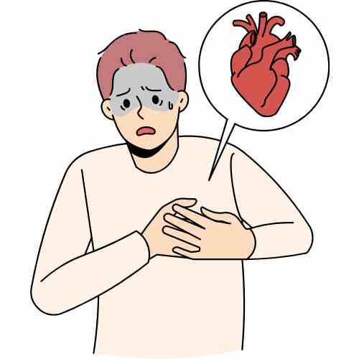
The concepts exists yes, but are you the beneficiary?
01
The problematic
02
03
Current wearable devices for monitoring heart rate and other parameters lack consideration for specific user needs.

Slide 15
The concepts exists yes, but are you the beneficiary?
01
The problematic
02
03
Current wearable devices for monitoring heart rate and other parameters lack consideration for specific user needs.
They also fall short in aiding physicians in remote health monitoring.

Slide 16
The concepts exists yes, but are you the beneficiary?
01
The problematic
02
03
Current wearable devices for monitoring heart rate and other parameters lack consideration for specific user needs.
They also fall short in aiding physicians in remote health monitoring.
These devices do not prioritize user-centric design or facilitate remote patient monitoring by healthcare professionals.

Slide 17
02
The Solution:
01
The Solution:
02
03
Bridging the Gap, Empowering Lives

Slide 18
So in this section we need to emphasis…
Fashionable
Helpful
Insightful
01
Table of contents
02
03
A watch that would fit your style
Something specific to user needs
Accurate data that reflects your quality of life

Slide 19
Two main focuses:
01
Table of contents
02
03
The user and their every day needs.
Health care employees and how we can integrate them!

Slide 20
Our watches:
01
For the user
02
03
Affordable
Real-time monitoring
You will find a watch that fits your specific budget
We use high-quality sensors for temperature, blood pressure, etc.
User-Friendly
Emergency-proof
Easy to use and navigate
The alert system will always push through no matter the situation

Slide 21
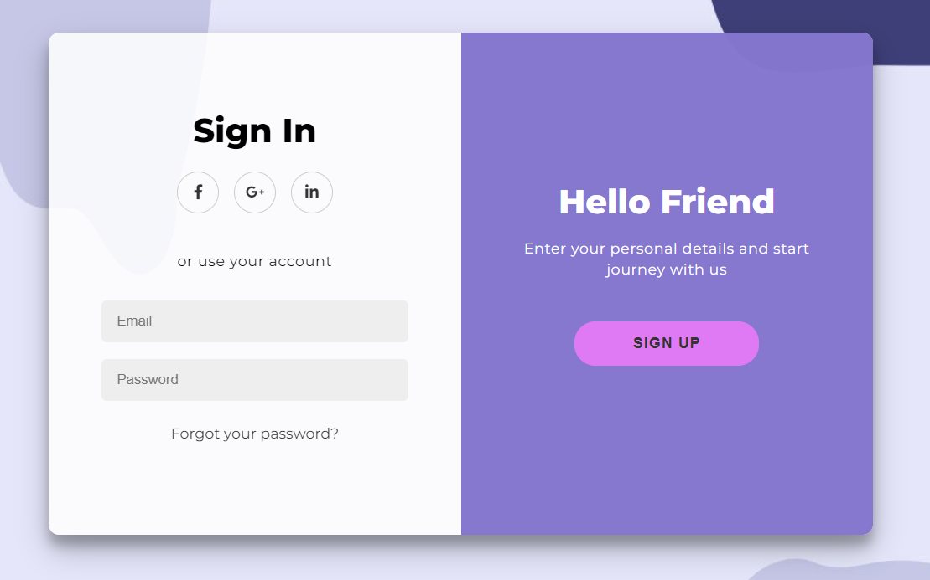
To showcase the user-friendly aspect:
01
The user:
02
03

Slide 22
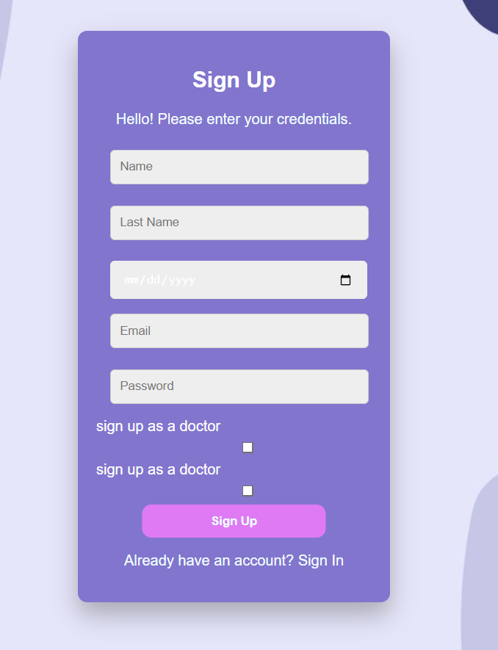
user

Slide 23

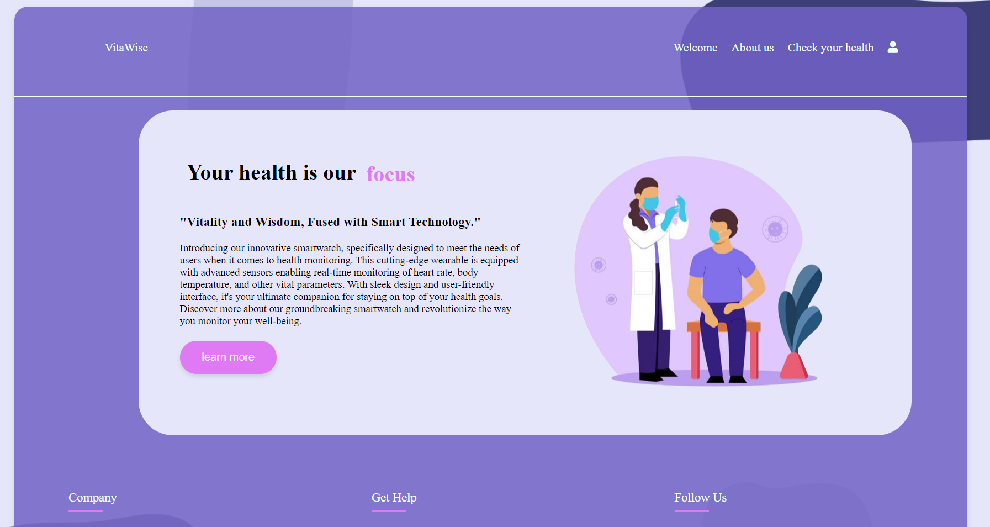
A Picture Is Worth a Thousand Words

Slide 24
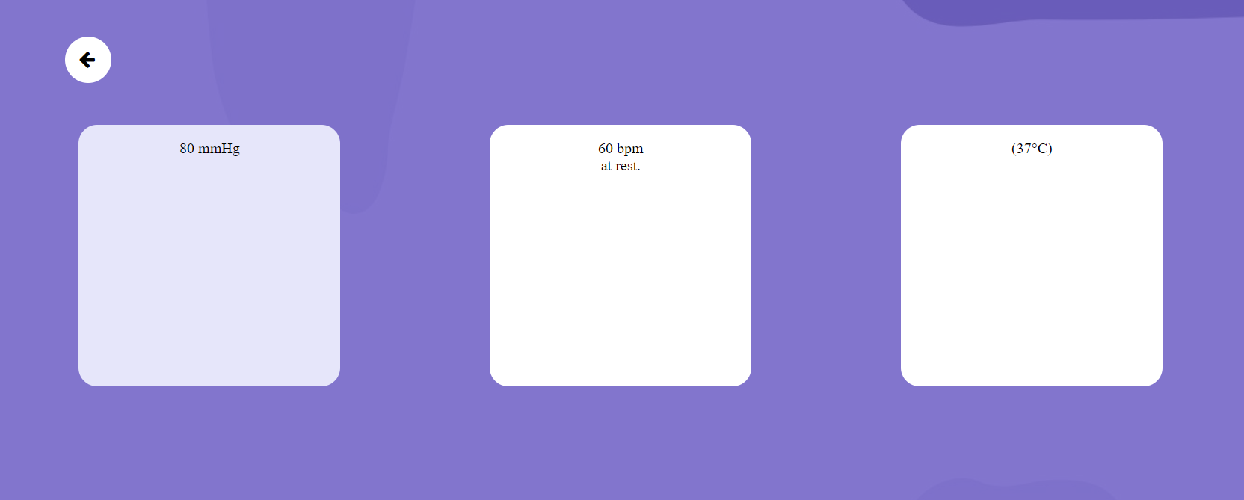
This Is the interface:
01
The user:
02
03

Slide 25
user

Slide 26
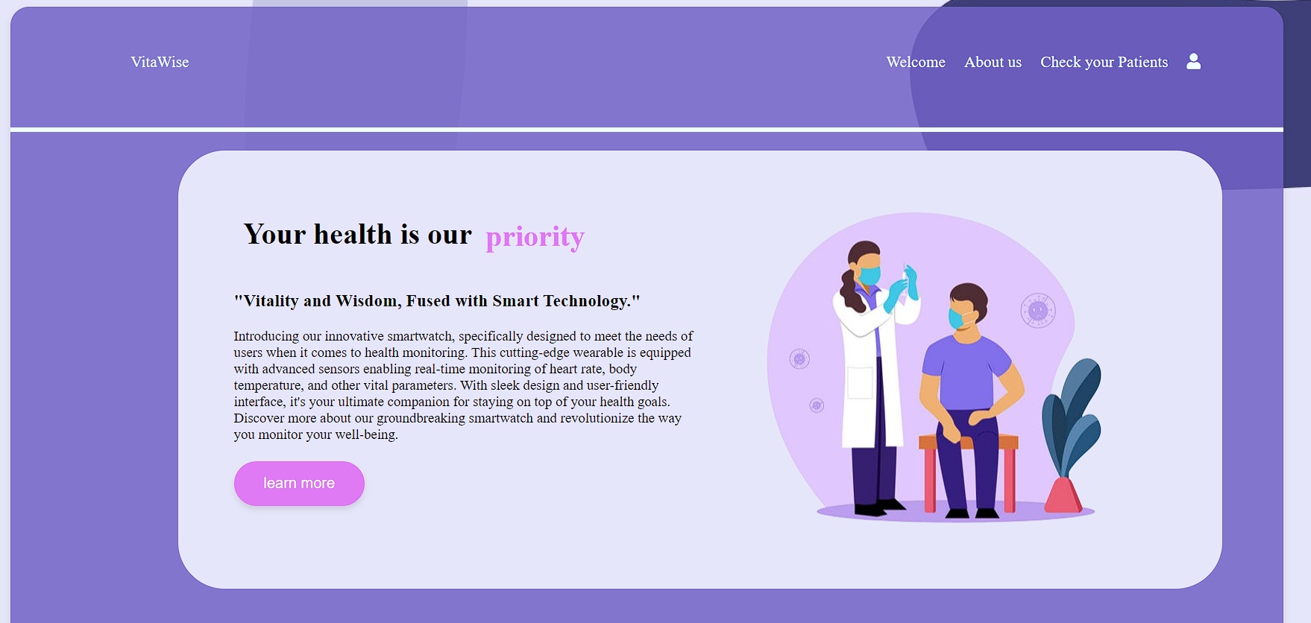
A Picture Is Worth a Thousand Words

Slide 27
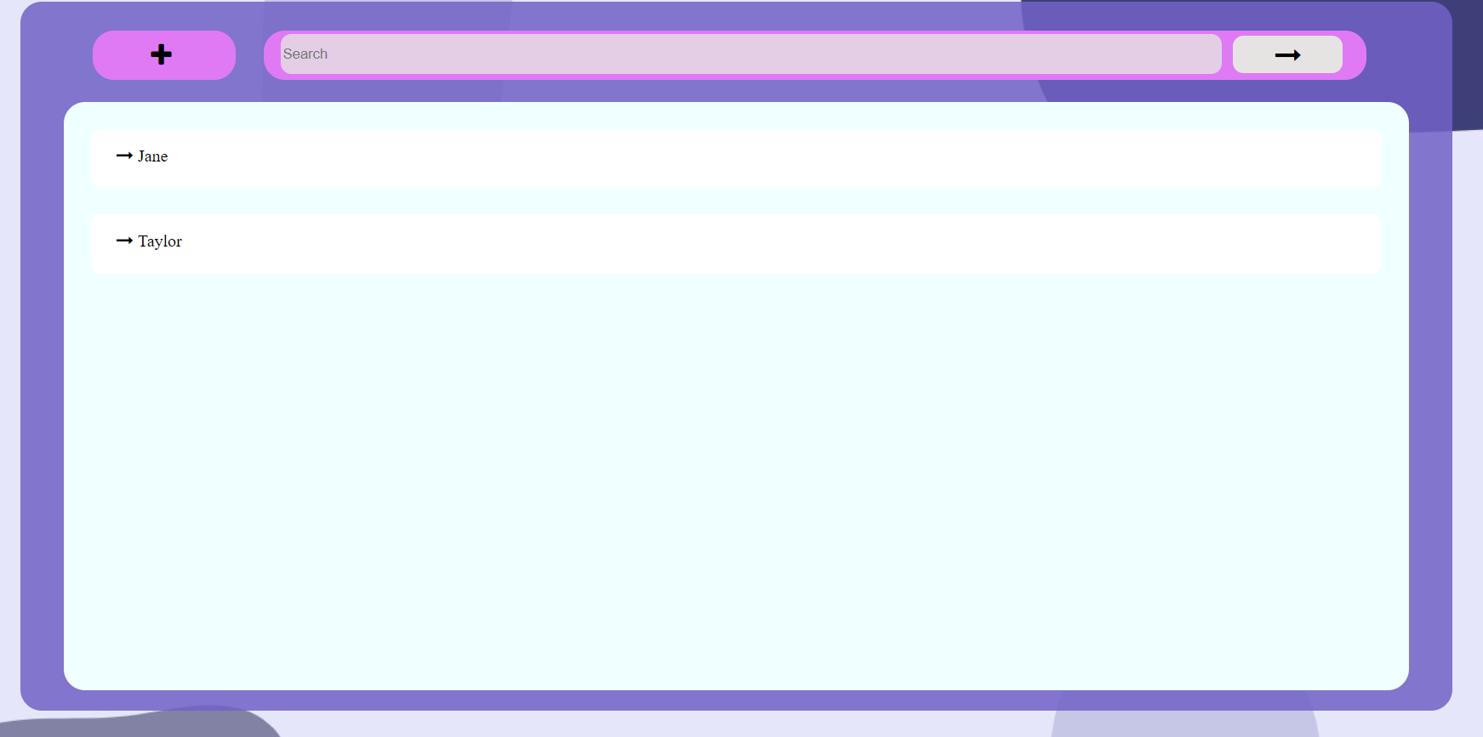
Awesome words
01
Table of contents
02
03

Slide 28
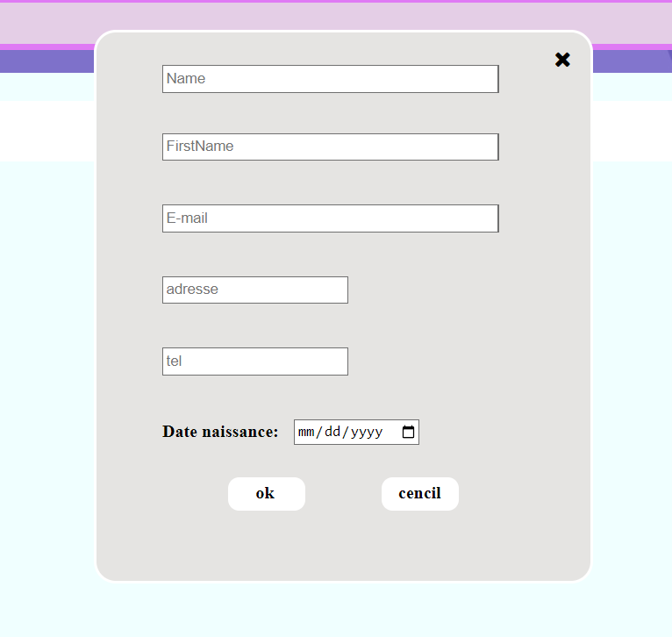
Percentages
01
The doctor:
02
03
35%
Mars
Despite being red, Mars is actually a very cold place
80%
Venus
Venus has a beautiful name but is a very hot place

Slide 29
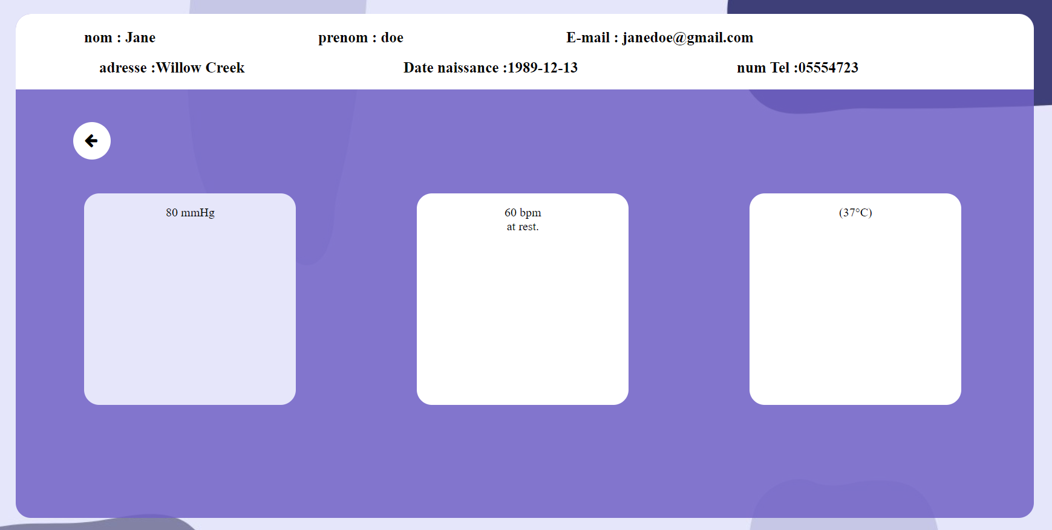
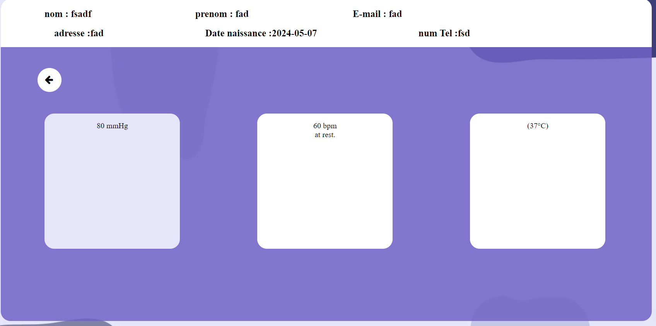
Awesome words
01
Table of contents
02
03

Slide 30
03
Why VitaWise?
01
Why us?
02
03

Slide 31
Review of Concepts
01
Whyy??
02
03
Affordable
Real-time monitoring
\Patient centric interface
Emergency proof
Doctor centric interface
User-freindly

Slide 32
Additional features:
01
HMM..
02
03
Add your own doctor
Receive a weekly/monthly review
Get in contact with your doctor easily.

Slide 33
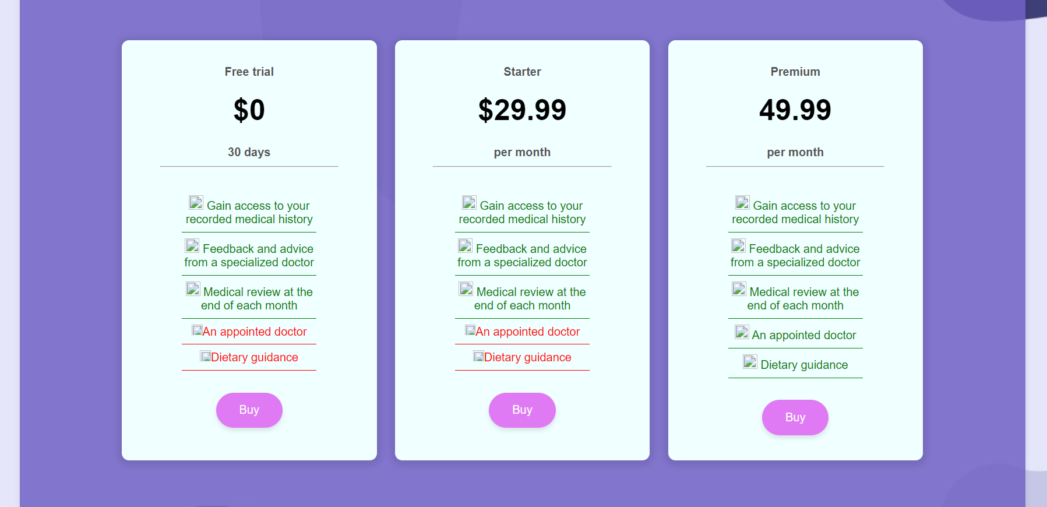
Lastly our subscription:
01
Our products
02
03
 | Mass | Diameter | Surface Gravity
Mercury | 0.06 | 0.38 | 0.38
Mars | 0.11 | 0.53 | 0.38
Saturn | 95.2 | 9.4 | 1.16

Slide 34
We Have a website
01
Our products
02
03

Slide 35
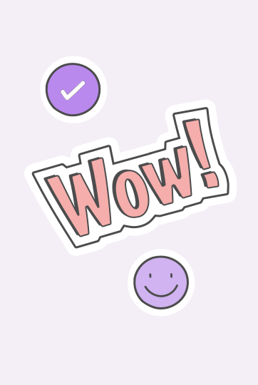
And we are building a Mobile app
01
Our products
02
03

Slide 36
This presentation has been brought to you by:
01
Conclusion
02
03
Lyne Ghribi
A special thanks to Bochra Mbarek for presenting the doctor part.
A special thanks to Ghofrane Dkhili for presenting the user part.

Slide 37
Thanks
01
Conclusion
02
03
For your attention.
And a special thanks to the rest of the team members.

