Slide 1
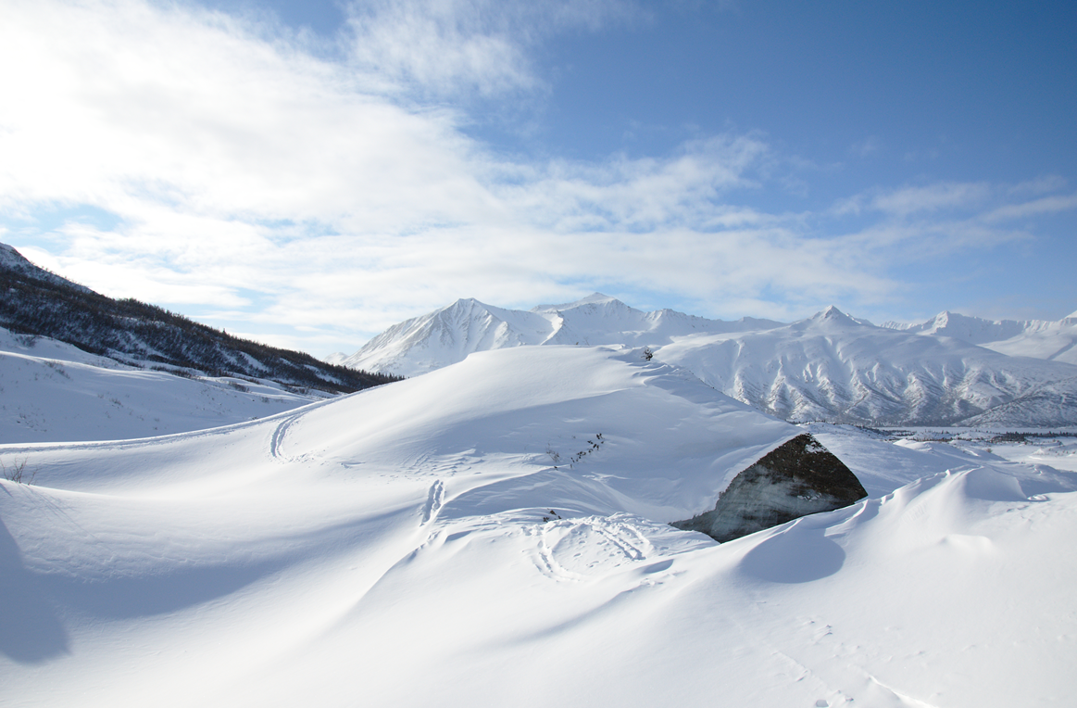
Welcome to WaterCoach, the training mode of a FEWS application
The WaterCoach Display has several buttons, use of these buttons will be logged in the WaterCoach log file:
During the training, you are in control of the clock in the WaterCoach Display with the pause/play and next buttons;
At all times, relevant tips and all answers are available behind the Hints and Answers buttons;
Information from incoming and outgoing calls are available behind the Calls button;
Open previous received messages again via the Inbox dropdown menu;
Issue a forecast with the Forecast button;
Dictionary: Find some background information via the Dictionary dropdown menu;
Help and Exit: With the Help button you can visit the wiki-page with more information on the WaterCoach;
You can close the WaterCoach Display by using the Exit button, any remaining open message windows (like this one) will be closed as well.
The Forecaster Notes Display plays an important role in the WaterCoach application:
All text messages (including the hints and answers) will appear in the Forecaster Notes Display;
Messages that are larger than 1 line, can be expended by hoovering over them with the mouse;
Alternatively, you can open the full message in the Message details, via the context menu, from here you can also open hyperlinks;
You may submit your answers to the questions by creating a new message in the Forecaster Notes Display;
All messages you make in the Forecaster Notes will be logged to a text file in the folder; \ScenarioScriptDatabase\aprfc_wc\Sep-2012\script1\log\;
To get started:
Pause the clock with the pause button in the WaterCoach Display;
When you're ready for the next message, hit the next button in the WaterCoach Display;
Close this window when you’re done reading it. Can can get it back from the inbox dropdown menu;

Slide 2
Welcome to Alaska!
This Water Coach scenario is based on a real event in the Matsu forecast group in September 2012
Q: Please zoom in to Matsu and identify the catchments and their topology. Use the layer icon to display topography layers

Slide 3
Catchment and forecast locations
(Fill out the answers to the numbered questions in the table in the ‘Forecast’ button of the Water Coach display)
Q1: How many catchments (segments) are there in the Matsu Forecastgroup?
Q2: How many of them have 4 elevation bands (lower, upper, lower glacier, upper glacier?
Q3: Looking at the location icons in the Map Display and Data Viewer, what is the meaning of the colors?

Slide 4
Spatial Display - Rainfall Forecasts
(Fill out the answers to the numbered questions in the table in the ‘Forecast’ button of the Water Coach display)
Q: Identify different precipitation grids for the given period.
Q4: Looking at all of Matsu, compare the different rainfall forecast models, can you determine the value and time of the 'worst' 6-hour period of forecast rainfall?

Slide 5
Topology of forecast basins
(Fill out the answers to the numbered questions in the table in the ‘Forecast’ button of the Water Coach display)
Q5: What is the downstream segment of segment ‘Talkeetna’?
Q6: How many upstream segments does segment ‘Susitna at Sunshine’ have?

Slide 6

Call from local radio station:
Hey there!
“We have heard a big rain event is coming in . Can you confirm? Any warnings for the RR Bridge at Talkeetna?”
“O, you need 15 min to check?”
“Ok, call me back no later,
we go live in 20 min”

Slide 7
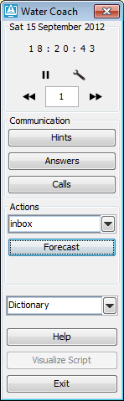
Before calling back by pressing ‘Calls’, make sure you:
enter your answer in the Q7 cell of the ‘Forecast’ menu before 18:30!
Publish your forecast by pressing the ‘publish’ button in the ‘forecast’ menu

Slide 8
Call to local radio station:
“Thanks for calling back in time!
“O, really?”
“Ok, thanks for your info!”

