Slide 1

Introducing a New Group of Optimal Entanglement Witnesses
Arianna Meinking, Oscar Scholin, Eritas Yang, Becca Verghese, Ben Hartley, Laney Goldman, Paco Navarro, Theresa W. Lynn
Department of Physics
Notes:
Hi all, I’m Arianna Meinking, with the Quantum Optics Group at Harvey Mudd College. Today, I want to talk to you about measuring entanglement - specifically using a technique called ‘entanglement witnessing’.

Slide 2





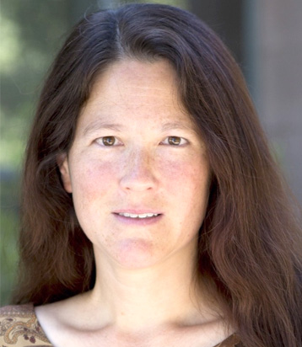
Acknowledgements
Ben Hartley
W Characterization, W’ Proposal
Oscar Scholin
W’ Choice Optimization
Paco Navarro
Current lab
Eritas Yang
W Characterization, W’ Proposal
Becca Verghese
W Characterization,
W’ Proposal
Theresa W. Lynn
Advisor
Work accompanied by experimental tests by:
Alec Roberson
Richard Cheng
Lev Gruber
Funding Sources:
HMC Physics Summer Research Fund
Donnelly Experimental Learning Fund
Vandiver Summer Research Fund
Notes:
Before I end, I would like to say a thank you to my amazing teammates, and the Quantum Optics crew of past years. Thank you to Eritas and Becca for formulating the W’ groups, and then you Oscar for making the two-step process possible. I would like to thank Paco for being such a lovely teammate despite the tests of the W”. I would like to thank Prof Lynn for providing a welcoming lab environment, mentorship, and making all of this research possible with her fantastic ideas. Are there any questions?

Slide 3
Goal: high chance of witnessing two-qubit entanglement if present from a small fraction of measurements required for full state tomography

Slide 4

Quantum Communication via … Entanglement!
Users
Alice
Company
$$ρ_{entangled}$$
Bob
Notes:
Before we get into all that, I wanted to talk a little bit about why we care about entangled pairs in the first place. This room is full of people that want to work hard to understand lots of qubits, and their entanglement. For our lab, we aren’t concerned with many-qubit entanglement, just two-qubit entanglement. Imagine some quantum dystopia (or utopia, if you like) full of companies that want to send encrypted information across long distances

Slide 5
Quantum Communication via … Entanglement!
Users
>10 km!
Alice
Company
$$ρ_{entangled}$$
Bob
Notes:
Before we get into all that, I wanted to talk a little bit about why we care about entangled pairs in the first place. This room is full of people that want to work hard to understand lots of qubits, and their entanglement. For our lab, we aren’t concerned with many-qubit entanglement, just two-qubit entanglement. Imagine some quantum dystopia (or utopia, if you like) full of companies that want to send encrypted information across long distances

Slide 6
Quantum Communication via … Entanglement!
Users
>10 km!
Alice
Company
$$ρ_{entangled}$$
Bob
Liu, X., Hu, J., Li, ZF, et al. Nature 10.1038 (2021)
Notes:
Before we get into all that, I wanted to talk a little bit about why we care about entangled pairs in the first place. This room is full of people that want to work hard to understand lots of qubits, and their entanglement. For our lab, we aren’t concerned with many-qubit entanglement, just two-qubit entanglement. Imagine some quantum dystopia (or utopia, if you like) full of companies that want to send encrypted information across long distances
160 hr measurement time!

Slide 7
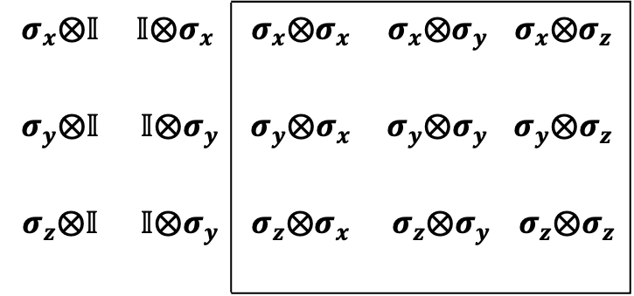
A Solution: Entanglement Witnessing
Quantum Tomography
$$σ_{x}⨂𝕀$$ | $$𝕀⨂σ_{x}$$ | $$σ_{x}⨂σ_{x}$$ | $$σ_{x}⨂σ_{y}$$ | $$σ_{x}⨂σ_{z}$$
$$σ_{y}⨂𝕀$$ | $$𝕀⨂σ_{y}$$ | $$σ_{y}⨂σ_{x}$$ | $$σ_{y}⨂σ_{y}$$ | $$σ_{y}⨂σ_{z}$$
$$σ_{z}⨂𝕀$$ | $$𝕀⨂σ_{y}$$ | $$σ_{z}⨂σ_{x}$$ | $$σ_{z}⨂σ_{y}$$ | $$σ_{z}⨂σ_{z}$$
4 measurements each!
9 Pauli combos → 36 measurements!
included
Notes:
It could be useful to do a full quantum tomography. To get an idea about whether a state is entangled, we need to measure all the possible correlation pairs. That looks like 9 combinations - since we need to measure each qubit in sx, sy, and sz to get the expectation value of all of these operators. Then we get all of these combinations, with the single qubit measurements included, which we do have in our local correlation scenario. Each of these combinations (in the lab) requires four measurements to complete. Altogether, that’s 36 measurements. For our purposes, let’s just consider the pauli matrix version - that is, 9 total data points for a full quantum tomography. So the question that we need to ask is this: what is the most effective way to determine entanglement in a two-qubit state with the fewest measurements possible? Our answer to this question is ‘entanglement witnessing’. Entanglement witnesses are a way to get around doing all the measurements required for a full quantum tomography while still getting a pretty good idea about whether a random mixed state is entangled.

Slide 8
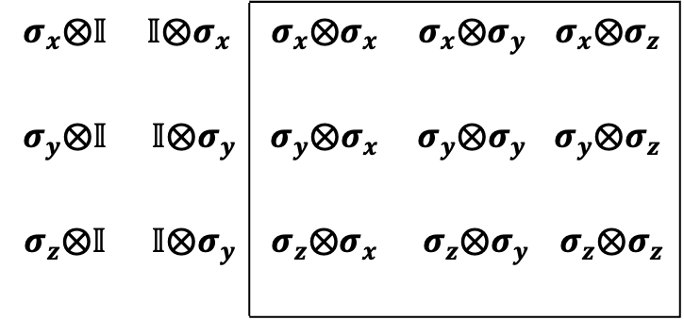
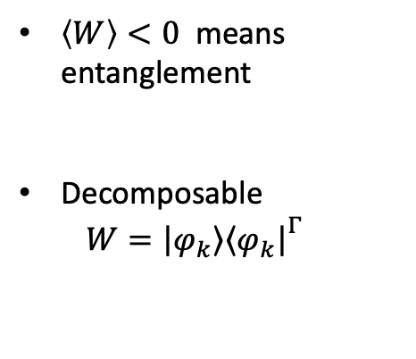
A Solution: Entanglement Witnessing
Entanglement Witnesses
$$σ_{x}⨂𝕀$$ | $$𝕀⨂σ_{x}$$ | $$σ_{x}⨂σ_{x}$$ | $$σ_{x}⨂σ_{y}$$ | $$σ_{x}⨂σ_{z}$$
$$σ_{y}⨂𝕀$$ | $$𝕀⨂σ_{y}$$ | $$σ_{y}⨂σ_{x}$$ | $$σ_{y}⨂σ_{y}$$ | $$σ_{y}⨂σ_{z}$$
$$σ_{z}⨂𝕀$$ | $$𝕀⨂σ_{y}$$ | $$σ_{z}⨂σ_{x}$$ | $$σ_{z}⨂σ_{y}$$ | $$σ_{z}⨂σ_{z}$$
$\left\langle W\right\rangle <0$ means entanglement
Decomposable
$W={\left|\left.φ_{k}\right\rangle \right.\left\langle \left.φ_{k}\right|\right.}^{Γ}$
Riccardi et al., PRA 101, 062319 (2020)
Notes:
Entanglement witnesses allow us to do only a subset of these measurements, and determine if our state is entangled. To be precise, we call an operator an entanglement witness if our witness has a negative expectation value implies entanglement. This isn’t an if and only if relationship. Just because a state is entangled doesn’t mean that the expectation value of a witness is necessarily negative. We would like it to be negative for all entangled states, but this isn’t assured. The tradeoff in skipping some measurements from our tomography is that sometimes we get false negatives - a witness finds that our state is not entangled when it really is. We jumped off our investigation of witnesses based on a group of entanglement witnesses defined by Dr. Alberto Riccardi and colleagues in 2019. In their paper, they use a type of witness called “optimal decomposable witnesses”. These witnesses are defined as so. Decomposable refers to the ‘factorability’ of the witnesses: we can define them as some outer product of a state phi sub k, which we take the partial transpose of with respect to our second entangled photon, like so. They define “Optimal” witnesses as witnesses that detect entanglement in more states than any other in that subset of witnesses.

Slide 9
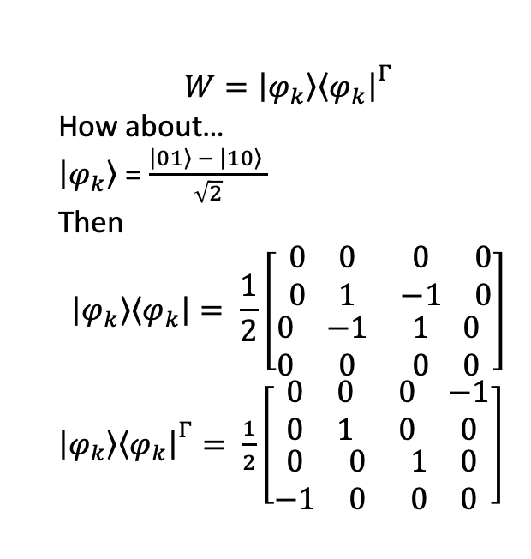
A Solution: Entanglement Witnessing
Entanglement Witnesses
$$W={\left|\left.φ_{k}\right\rangle \right.\left\langle \left.φ_{k}\right|\right.}^{Γ}$$
How about…
$\left|\left.φ_{k}\right\rangle \right.$ = $\frac{\left|\left.01\right\rangle \right.− \left|\left.10\right\rangle \right.}{\sqrt{2}}$
Then
$$\left|\left.φ_{k}\right\rangle \right.\left\langle \left.φ_{k}\right|\right.= \frac{1}{2}\left[\begin{matrix}\begin{matrix}0 & 0 \\ 0 & 1\end{matrix} & \begin{matrix}0 & 0 \\ −1 & 0\end{matrix} \\ \begin{matrix}0 & −1 \\ 0 & 0\end{matrix} & \begin{matrix}1 & 0 \\ 0 & 0\end{matrix}\end{matrix}\right]$$
${\left|\left.φ_{k}\right\rangle \right.\left\langle \left.φ_{k}\right|\right.}^{Γ}= \frac{1}{2}\left[\begin{matrix}\begin{matrix}0 & 0 \\ 0 & 1\end{matrix} & \begin{matrix}0 & −1 \\ 0 & 0\end{matrix} \\ \begin{matrix}0 & 0 \\ −1 & 0\end{matrix} & \begin{matrix}1 & 0 \\ 0 & 0\end{matrix}\end{matrix}\right]$
$$σ_{x}⨂𝕀$$ | $$𝕀⨂σ_{x}$$ | $$σ_{x}⨂σ_{x}$$ | $$σ_{x}⨂σ_{y}$$ | $$σ_{x}⨂σ_{z}$$
$$σ_{y}⨂𝕀$$ | $$𝕀⨂σ_{y}$$ | $$σ_{y}⨂σ_{x}$$ | $$σ_{y}⨂σ_{y}$$ | $$σ_{y}⨂σ_{z}$$
$$σ_{z}⨂𝕀$$ | $$𝕀⨂σ_{y}$$ | $$σ_{z}⨂σ_{x}$$ | $$σ_{z}⨂σ_{y}$$ | $$σ_{z}⨂σ_{z}$$
Riccardi et al., PRA 101, 062319 (2020)
Notes:
Entanglement witnesses allow us to do only a subset of these measurements, and determine if our state is entangled. To be precise, we call an operator an entanglement witness if, when we add some combination of those 9 correlations I showed earlier, our witness has a negative expectation value implies entanglement. This isn’t an if and only if relationship. Just because a state is entangled doesn’t mean that the expectation value of a witness is necessarily negative. We would like it to be negative for all entangled states, but this isn’t assured. The tradeoff in skipping some measurements from our tomography is that sometimes we get false negatives - a witness finds that our state is not entangled when it really is. We jumped off our investigation of witnesses based on a group of entanglement witnesses defined by Dr. Alberto Riccardi and colleagues in 2019. In their paper, they use a type of witness called “optimal decomposable witnesses”. These witnesses are defined as so. Decomposable refers to the ‘factorability’ of the witnesses: we can define them as some outer product of a state phi sub k, which we take the partial transpose of with respect to our second entangled photon, like so. They define “Optimal” witnesses as witnesses that detect entanglement in more states than any other in that subset of witnesses.

Slide 10
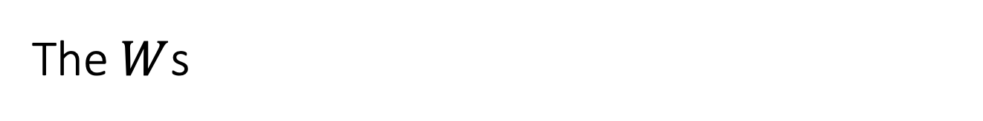
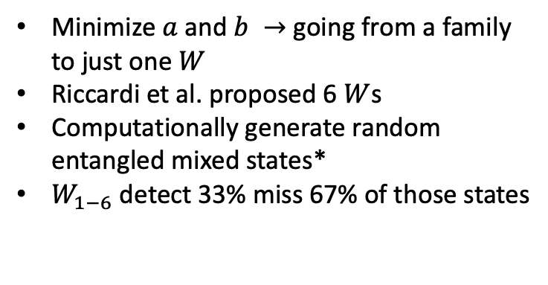
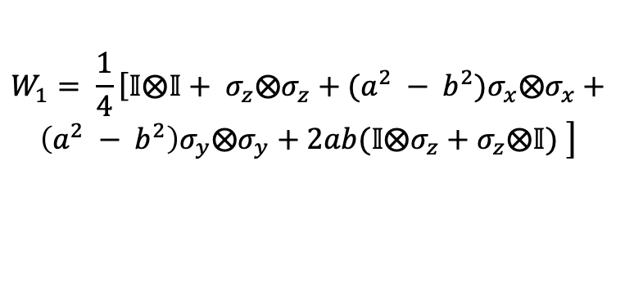
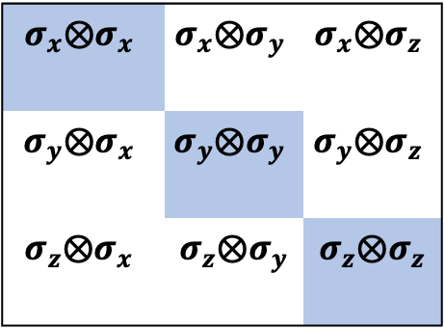
The $W$s
Measurements
$$W_{1}= \frac{1}{4}\left[𝕀⨂𝕀+ σ_{z}⨂σ_{z}+(a^{2} − b^{2})σ_{x}⨂σ_{x}+\right.$$
$$\left.\left(a^{2} − b^{2}\right)σ_{y}⨂σ_{y}+2ab(𝕀⨂σ_{z}+σ_{z}⨂𝕀) \right]$$
$$σ_{x}⨂σ_{x}$$ | $$σ_{x}⨂σ_{y}$$ | $$σ_{x}⨂σ_{z}$$
$$σ_{y}⨂σ_{x}$$ | $$σ_{y}⨂σ_{y}$$ | $$σ_{y}⨂σ_{z}$$
$$σ_{z}⨂σ_{x}$$ | $$σ_{z}⨂σ_{y}$$ | $$σ_{z}⨂σ_{z}$$
Minimize $a$ and $b →$going from a family to just one $W$
Riccardi et al. proposed 6 $W$s
Computationally generate random entangled mixed states*
$W_{1−6}$detect 33% miss 67% of those states
Riccardi et al., PRAppl. 101, 062319 (2020)
*Random state generation following method used in Roik et al., PRAppl. 15.054006(2021)
Notes:
In their paper, Riccardi and colleagues define the group of witnesses that we call the W’s. They look like this - there’s six of these operators. For each of these 6 states, we do our outer product and partial transpose to get some matrix in terms of these two parameters, a and b. That can be written in terms of our pauli-matrix generators like so. From this family of witnesses, we can then minimize these parameters to best witness a given state. This process makes ample use of gradient descent to find our a,b. To do these measurements, you can see that we will need information from these pauli matrix pairs. That’s only 3 measurements, instead of 9! This process works alright. It covers a lot of types of entangled states. The true test is how well this process performs on a bunch of random mixed states, much like we would see in our original encryption problem. We use a method developed by Roik and colleagues to generate these random mixed entangled states. On this scale though, the Ws don’t fare so well. They miss ~67% of entangled states! That is, they report that 67% of random mixed entangled states are not, in fact, entangled. So, essentially, for a third of the measurements (3 of 9 pauli matrix pairs) we get a third of the information about entanglement.
Figure out how to cite Roik, past summer, and riccardi on same slide
Maybe say that we get a proportion – it’s reasonable but not what we would expect necessarily

Slide 11
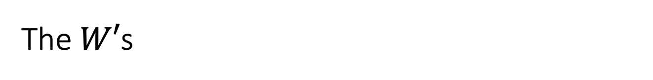
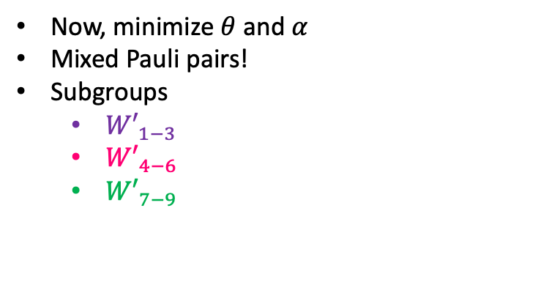
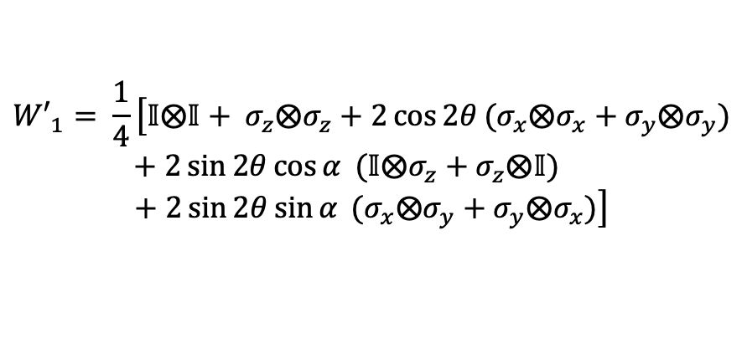
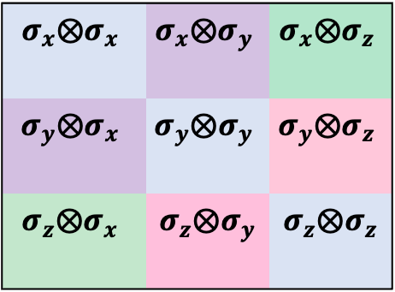
The $W′$s
Measurements
$${W′}_{1}= \frac{1}{4}\left[𝕀⨂𝕀+ σ_{z}⨂σ_{z}+2\cos{2θ}(σ_{x}⨂σ_{x}+σ_{y}⨂σ_{y})\right.$$
$+ 2\sin{2θ}\cos{α} (𝕀⨂σ_{z}+σ_{z}⨂𝕀)$
$$+ \left.2\sin{2θ}\sin{α} (σ_{x}⨂σ_{y}+σ_{y}⨂σ_{x})\right]$$
$$σ_{x}⨂σ_{x}$$ | $$σ_{x}⨂σ_{y}$$ | $$σ_{x}⨂σ_{z}$$
$$σ_{y}⨂σ_{x}$$ | $$σ_{y}⨂σ_{y}$$ | $$σ_{y}⨂σ_{z}$$
$$σ_{z}⨂σ_{x}$$ | $$σ_{z}⨂σ_{y}$$ | $$σ_{z}⨂σ_{z}$$
Now, minimize $θ$ and $α$
Mixed Pauli pairs!
Subgroups
${W′}_{1−3}$
${W′}_{4−6}$
${W′}_{7−9}$
Yang, Verghese, Hartley. HMC Quantum Optics unpublished, https://github.com/Lynn-Quantum-Optics/Summer-Spring-2022-3/blob/main/Summer2022/ summer- 2022- QO_write_up.pdf
Notes:
Our group wanted to see if we could improve upon this method by adding just a few more measurements. The Quantum Optics group introduced what we call the W’ subgroups. These are witnesses very similar to Riccardi’s set. They are all optimal decomposable witnesses, defined by the same outer product and partial transpose. However, our lab decided to allow for cross-correlation in our pauli matrix considerations. Looking at this chart, W’s make use of the other 6 measurements. One may ask, wasn’t the point of this project to avoid doing a full quantum tomography? That perception is totally right. The W and all the W’s make a full quantum tomography - a spanning basis. Rather than do all the measurements included in these sets, we pick subsets of the W’ to do, after doing our W measurements. Those subgroups look like this - each color matches one subgroup.

Slide 12
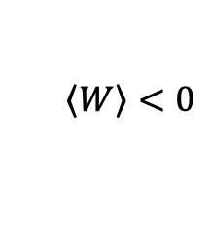


The Two-Step Process
$$\left\langle \left.W\right\rangle <0\right.$$
$$ρ_{ent}?$$
$$W_{1−6}$$
Entangled!
Notes:
Altogether, the process for finding out entanglement looks something like this. We start by doing all the measurements required for the Ws. If those expectation values are negative, we stop, cheer, and say hurrah to the sky because we’ve witnessed entanglement. If not, we don’t despair. We train a neural network on the outputs of our original W measurements. We then let the neural network pick which of the three W’ subgroups we should use, and we do those measurements. If our W’ subgroup has any witness with a negative expectation value, we cheer and sing hurrah. Otherwise, if our W’ AND or W expectation values are all positive, we conclude that we did not detect entanglement. Of course, as we’ve learned, this doesn’t mean the state is not entangled. We have just missed it. So after all that, rather than do a full quantum tomography, we have done 5/9 measurements required for a full sweep. Now the question is, how well did we do?

Slide 13



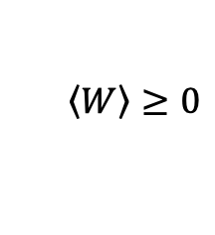
The Two-Step Process
$$\left\langle \left.W\right\rangle <0\right.$$
$$ρ_{ent}?$$
$$W_{1−6}$$
Entangled!
$$\left\langle \left.W\right\rangle ≥0\right.$$
$${W′}_{1−3}$$
$${W′}_{4−6}$$
$${W′}_{7−9}$$
Notes:
Altogether, the process for finding out entanglement looks something like this. We start by doing all the measurements required for the Ws. If those expectation values are negative, we stop, cheer, and say hurrah to the sky because we’ve witnessed entanglement. If not, we don’t despair. We train a neural network on the outputs of our original W measurements. We then let the neural network pick which of the three W’ subgroups we should use, and we do those measurements. If our W’ subgroup has any witness with a negative expectation value, we cheer and sing hurrah. Otherwise, if our W’ AND or W expectation values are all positive, we conclude that we did not detect entanglement. Of course, as we’ve learned, this doesn’t mean the state is not entangled. We have just missed it. So after all that, rather than do a full quantum tomography, we have done 5/9 measurements required for a full sweep. Now the question is, how well did we do?

Slide 14
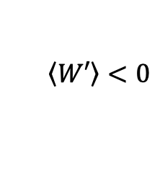
The Two-Step Process
$$\left\langle \left.W\right\rangle <0\right.$$
$$ρ_{ent}?$$
$$W_{1−6}$$
Entangled!
$$\left\langle \left.W\right\rangle ≥0\right.$$
$$\left\langle \left.W′\right\rangle <0\right.$$
$${W′}_{1−3}$$
$${W′}_{4−6}$$
$${W′}_{7−9}$$
Entangled!
Notes:
Altogether, the process for finding out entanglement looks something like this. We start by doing all the measurements required for the Ws. If those expectation values are negative, we stop, cheer, and say hurrah to the sky because we’ve witnessed entanglement. If not, we don’t despair. We train a neural network on the outputs of our original W measurements. We then let the neural network pick which of the three W’ subgroups we should use, and we do those measurements. If our W’ subgroup has any witness with a negative expectation value, we cheer and sing hurrah. Otherwise, if our W’ AND or W expectation values are all positive, we conclude that we did not detect entanglement. Of course, as we’ve learned, this doesn’t mean the state is not entangled. We have just missed it. So after all that, rather than do a full quantum tomography, we have done 5/9 measurements required for a full sweep. Now the question is, how well did we do?

Slide 15
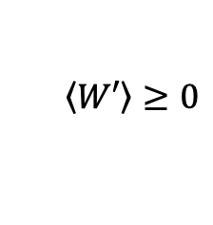
The Two-Step Process
$$\left\langle \left.W\right\rangle <0\right.$$
$$ρ_{ent}?$$
$$W_{1−6}$$
Entangled!
$$\left\langle \left.W\right\rangle ≥0\right.$$
$$\left\langle \left.W′\right\rangle <0\right.$$
$${W′}_{1−3}$$
$${W′}_{4−6}$$
$${W′}_{7−9}$$
Entangled!
$$\left\langle \left.W′\right\rangle ≥0\right.$$
Not detected…
Notes:
Altogether, the process for finding out entanglement looks something like this. We start by doing all the measurements required for the Ws. If those expectation values are negative, we stop, cheer, and say hurrah to the sky because we’ve witnessed entanglement. If not, we don’t despair. We train a neural network on the outputs of our original W measurements. We then let the neural network pick which of the three W’ subgroups we should use, and we do those measurements. If our W’ subgroup has any witness with a negative expectation value, we cheer and sing hurrah. Otherwise, if our W’ AND or W expectation values are all positive, we conclude that we did not detect entanglement. Of course, as we’ve learned, this doesn’t mean the state is not entangled. We have just missed it. So after all that, rather than do a full quantum tomography, we have done 5/9 measurements required for a full sweep. Now the question is, how well did we do?

Slide 16
The Two-Step Process
$$\left\langle \left.W\right\rangle <0\right.$$
$$ρ_{ent}?$$
$$W_{1−6}$$
Entangled!
$$\left\langle \left.W\right\rangle ≥0\right.$$
$$\left\langle \left.W′\right\rangle <0\right.$$
(neural network)
$${W′}_{1−3}$$
$${W′}_{4−6}$$
$${W′}_{7−9}$$
Entangled!
$$\left\langle \left.W′\right\rangle ≥0\right.$$
Not detected…
Yang, Verghese, Scholin, Unpublished
Notes:
Altogether, the process for finding out entanglement looks something like this. We start by doing all the measurements required for the Ws. If those expectation values are negative, we stop, cheer, and say hurrah to the sky because we’ve witnessed entanglement. If not, we don’t despair. We train a neural network on the outputs of our original W measurements. We then let the neural network pick which of the three W’ subgroups we should use, and we do those measurements. If our W’ subgroup has any witness with a negative expectation value, we cheer and sing hurrah. Otherwise, if our W’ AND or W expectation values are all positive, we conclude that we did not detect entanglement. Of course, as we’ve learned, this doesn’t mean the state is not entangled. We have just missed it. So after all that, rather than do a full quantum tomography, we have done 5/9 measurements required for a full sweep. Now the question is, how well did we do?

Slide 17
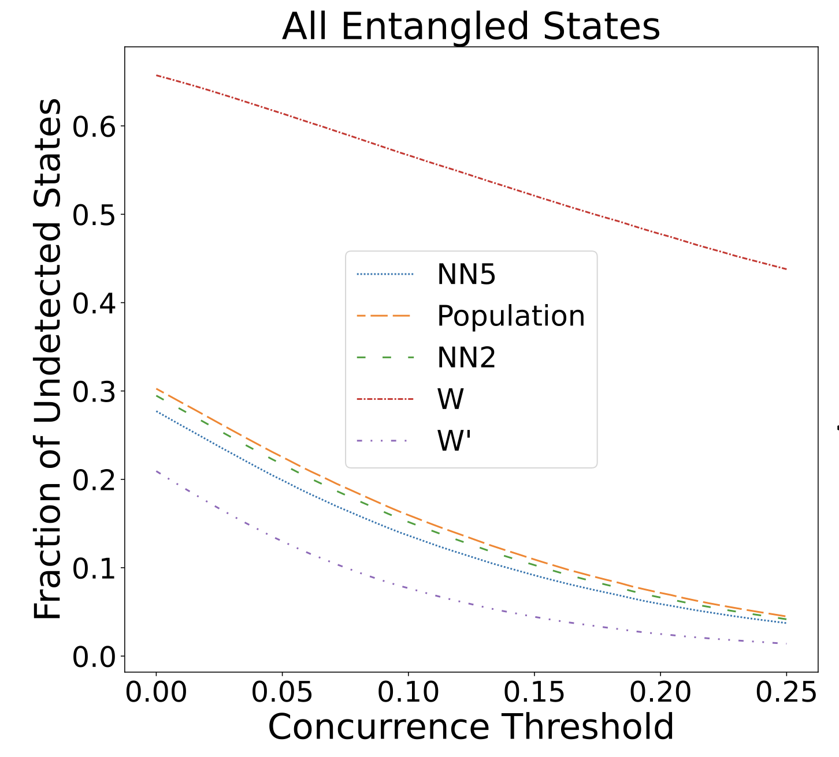
Two-Step Process Performance
Scholin, Zheng, Roberson, Lynn, Unpublished
Notes:
Well, the two-step process turns out to work well. Let’s look at the rightmost plot first. This plot tells us, of the states that are entangled but missed by W, how well the W’s do. For both of these plots, we generated random entangled states in the method laid out by the Roik paper I mentioned earlier. We’ve plotted our results as a function of concurrence. As such, lets focus on the leftmost part of the plot: we want to know right when we see any entanglement at all. we can see the line for the Ws - missing 67% of undetected states at the threshold where we have some entanglement. . That bottom purple-ish line is sort of the ‘best we can do’ with our W’s: that is, it tells us, if we could magically pick the correct subgroup every time, how well would we detect entanglement? You can see that, even with an all-knowing W’ picker, we still don’t see all the states. In fact, we miss about a fifth of them. Now let’s unpack each of these lower lines. This little clump of 3 lines shows the success of our entanglement detection in our three different picking methods. You can see that, again, the 5 layer neural network does the best - missing just under 30% of the randomly generated states. Altogether this result is promising. If we do only 5/9 measurements, we see about ⅔ of entangled states. Still, that bottom purple line is worrying. It suggests that our approach is missing a piece: even if we had the best neural network on the planet, we could not detect more entangled states. This suggests that there is some more optimal way to allocate our measurements, or that we might be able to do just one or two more measurements and get a lot more information. Our new mission: lower the purple line.

Slide 18
Two-Step Process Performance
W
Scholin, Zheng, Roberson, Lynn, Unpublished
Notes:
Well, the two-step process turns out to work well. Let’s look at the rightmost plot first. This plot tells us, of the states that are entangled but missed by W, how well the W’s do. For both of these plots, we generated random entangled states in the method laid out by the Roik paper I mentioned earlier. We’ve plotted our results as a function of concurrence. As such, lets focus on the leftmost part of the plot: we want to know right when we see any entanglement at all. we can see the line for the Ws - missing 67% of undetected states at the threshold where we have some entanglement. . That bottom purple-ish line is sort of the ‘best we can do’ with our W’s: that is, it tells us, if we could magically pick the correct subgroup every time, how well would we detect entanglement? You can see that, even with an all-knowing W’ picker, we still don’t see all the states. In fact, we miss about a fifth of them. Now let’s unpack each of these lower lines. This little clump of 3 lines shows the success of our entanglement detection in our three different picking methods. You can see that, again, the 5 layer neural network does the best - missing just under 30% of the randomly generated states. Altogether this result is promising. If we do only 5/9 measurements, we see about ⅔ of entangled states. Still, that bottom purple line is worrying. It suggests that our approach is missing a piece: even if we had the best neural network on the planet, we could not detect more entangled states. This suggests that there is some more optimal way to allocate our measurements, or that we might be able to do just one or two more measurements and get a lot more information. Our new mission: lower the purple line.

Slide 19
Two-Step Process Performance
W
W’
Scholin, Zheng, Roberson, Lynn, Unpublished
Notes:
Well, the two-step process turns out to work well. Let’s look at the rightmost plot first. This plot tells us, of the states that are entangled but missed by W, how well the W’s do. For both of these plots, we generated random entangled states in the method laid out by the Roik paper I mentioned earlier. We’ve plotted our results as a function of concurrence. As such, lets focus on the leftmost part of the plot: we want to know right when we see any entanglement at all. we can see the line for the Ws - missing 67% of undetected states at the threshold where we have some entanglement. . That bottom purple-ish line is sort of the ‘best we can do’ with our W’s: that is, it tells us, if we could magically pick the correct subgroup every time, how well would we detect entanglement? You can see that, even with an all-knowing W’ picker, we still don’t see all the states. In fact, we miss about a fifth of them. Now let’s unpack each of these lower lines. This little clump of 3 lines shows the success of our entanglement detection in our three different picking methods. You can see that, again, the 5 layer neural network does the best - missing just under 30% of the randomly generated states. Altogether this result is promising. If we do only 5/9 measurements, we see about ⅔ of entangled states. Still, that bottom purple line is worrying. It suggests that our approach is missing a piece: even if we had the best neural network on the planet, we could not detect more entangled states. This suggests that there is some more optimal way to allocate our measurements, or that we might be able to do just one or two more measurements and get a lot more information. Our new mission: lower the purple line.

Slide 20
Two-Step Process Performance
W
Analytical
W’
Scholin, Zheng, Roberson, Lynn, Unpublished
Notes:
Well, the two-step process turns out to work well. Let’s look at the rightmost plot first. This plot tells us, of the states that are entangled but missed by W, how well the W’s do. For both of these plots, we generated random entangled states in the method laid out by the Roik paper I mentioned earlier. We’ve plotted our results as a function of concurrence. As such, lets focus on the leftmost part of the plot: we want to know right when we see any entanglement at all. we can see the line for the Ws - missing 67% of undetected states at the threshold where we have some entanglement. . That bottom purple-ish line is sort of the ‘best we can do’ with our W’s: that is, it tells us, if we could magically pick the correct subgroup every time, how well would we detect entanglement? You can see that, even with an all-knowing W’ picker, we still don’t see all the states. In fact, we miss about a fifth of them. Now let’s unpack each of these lower lines. This little clump of 3 lines shows the success of our entanglement detection in our three different picking methods. You can see that, again, the 5 layer neural network does the best - missing just under 30% of the randomly generated states. Altogether this result is promising. If we do only 5/9 measurements, we see about ⅔ of entangled states. Still, that bottom purple line is worrying. It suggests that our approach is missing a piece: even if we had the best neural network on the planet, we could not detect more entangled states. This suggests that there is some more optimal way to allocate our measurements, or that we might be able to do just one or two more measurements and get a lot more information. Our new mission: lower the purple line.

Slide 21
Two-Step Process Performance
W
Analytical
NN2
W’
Scholin, Zheng, Roberson, Lynn, Unpublished
Notes:
Well, the two-step process turns out to work well. Let’s look at the rightmost plot first. This plot tells us, of the states that are entangled but missed by W, how well the W’s do. For both of these plots, we generated random entangled states in the method laid out by the Roik paper I mentioned earlier. We’ve plotted our results as a function of concurrence. As such, lets focus on the leftmost part of the plot: we want to know right when we see any entanglement at all. we can see the line for the Ws - missing 67% of undetected states at the threshold where we have some entanglement. . That bottom purple-ish line is sort of the ‘best we can do’ with our W’s: that is, it tells us, if we could magically pick the correct subgroup every time, how well would we detect entanglement? You can see that, even with an all-knowing W’ picker, we still don’t see all the states. In fact, we miss about a fifth of them. Now let’s unpack each of these lower lines. This little clump of 3 lines shows the success of our entanglement detection in our three different picking methods. You can see that, again, the 5 layer neural network does the best - missing just under 30% of the randomly generated states. Altogether this result is promising. If we do only 5/9 measurements, we see about ⅔ of entangled states. Still, that bottom purple line is worrying. It suggests that our approach is missing a piece: even if we had the best neural network on the planet, we could not detect more entangled states. This suggests that there is some more optimal way to allocate our measurements, or that we might be able to do just one or two more measurements and get a lot more information. Our new mission: lower the purple line.

Slide 22
Two-Step Process Performance
W
Analytical
NN2
NN5
W’
Scholin, Zheng, Roberson, Lynn, Unpublished
Notes:
Well, the two-step process turns out to work well. Let’s look at the rightmost plot first. This plot tells us, of the states that are entangled but missed by W, how well the W’s do. For both of these plots, we generated random entangled states in the method laid out by the Roik paper I mentioned earlier. We’ve plotted our results as a function of concurrence. As such, lets focus on the leftmost part of the plot: we want to know right when we see any entanglement at all. we can see the line for the Ws - missing 67% of undetected states at the threshold where we have some entanglement. . That bottom purple-ish line is sort of the ‘best we can do’ with our W’s: that is, it tells us, if we could magically pick the correct subgroup every time, how well would we detect entanglement? You can see that, even with an all-knowing W’ picker, we still don’t see all the states. In fact, we miss about a fifth of them. Now let’s unpack each of these lower lines. This little clump of 3 lines shows the success of our entanglement detection in our three different picking methods. You can see that, again, the 5 layer neural network does the best - missing just under 30% of the randomly generated states. Altogether this result is promising. If we do only 5/9 measurements, we see about ⅔ of entangled states. Still, that bottom purple line is worrying. It suggests that our approach is missing a piece: even if we had the best neural network on the planet, we could not detect more entangled states. This suggests that there is some more optimal way to allocate our measurements, or that we might be able to do just one or two more measurements and get a lot more information. Our new mission: lower the purple line.

Slide 23
Two-Step Process Performance
W
5/9 of the measurements witness 2/3 of the states!
Analytical
NN2
NN5
W’
Scholin, Zheng, Roberson, Lynn, Unpublished
Notes:
Well, the two-step process turns out to work well. Let’s look at the rightmost plot first. This plot tells us, of the states that are entangled but missed by W, how well the W’s do. For both of these plots, we generated random entangled states in the method laid out by the Roik paper I mentioned earlier. We’ve plotted our results as a function of concurrence. As such, lets focus on the leftmost part of the plot: we want to know right when we see any entanglement at all. we can see the line for the Ws - missing 67% of undetected states at the threshold where we have some entanglement. . That bottom purple-ish line is sort of the ‘best we can do’ with our W’s: that is, it tells us, if we could magically pick the correct subgroup every time, how well would we detect entanglement? You can see that, even with an all-knowing W’ picker, we still don’t see all the states. In fact, we miss about a fifth of them. Now let’s unpack each of these lower lines. This little clump of 3 lines shows the success of our entanglement detection in our three different picking methods. You can see that, again, the 5 layer neural network does the best - missing just under 30% of the randomly generated states. Altogether this result is promising. If we do only 5/9 measurements, we see about ⅔ of entangled states. Still, that bottom purple line is worrying. It suggests that our approach is missing a piece: even if we had the best neural network on the planet, we could not detect more entangled states. This suggests that there is some more optimal way to allocate our measurements, or that we might be able to do just one or two more measurements and get a lot more information. Our new mission: lower the purple line.

Slide 24
Two-Step Process Performance
W
5/9 of the measurements witness 2/3 of the states!
More work to be done…
Analytical
NN2
NN5
W’
Scholin, Zheng, Roberson, Lynn, Unpublished
Notes:
Well, the two-step process turns out to work well. Let’s look at the rightmost plot first. This plot tells us, of the states that are entangled but missed by W, how well the W’s do. For both of these plots, we generated random entangled states in the method laid out by the Roik paper I mentioned earlier. We’ve plotted our results as a function of concurrence. As such, lets focus on the leftmost part of the plot: we want to know right when we see any entanglement at all. we can see the line for the Ws - missing 67% of undetected states at the threshold where we have some entanglement. . That bottom purple-ish line is sort of the ‘best we can do’ with our W’s: that is, it tells us, if we could magically pick the correct subgroup every time, how well would we detect entanglement? You can see that, even with an all-knowing W’ picker, we still don’t see all the states. In fact, we miss about a fifth of them. Now let’s unpack each of these lower lines. This little clump of 3 lines shows the success of our entanglement detection in our three different picking methods. You can see that, again, the 5 layer neural network does the best - missing just under 30% of the randomly generated states. Altogether this result is promising. If we do only 5/9 measurements, we see about ⅔ of entangled states. Still, that bottom purple line is worrying. It suggests that our approach is missing a piece: even if we had the best neural network on the planet, we could not detect more entangled states. This suggests that there is some more optimal way to allocate our measurements, or that we might be able to do just one or two more measurements and get a lot more information. Our new mission: lower the purple line.

Slide 25
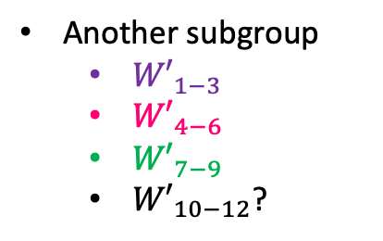
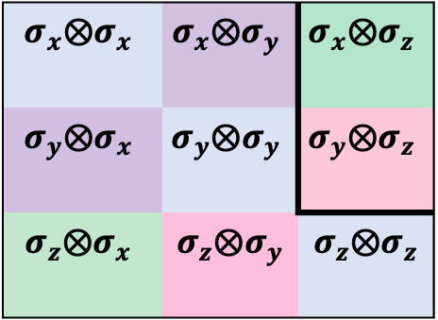
Solving the Problem: Expand the W’ Options? (In Progress)
$$σ_{x}⨂σ_{x}$$ | $$σ_{x}⨂σ_{y}$$ | $$σ_{x}⨂σ_{z}$$
$$σ_{y}⨂σ_{x}$$ | $$σ_{y}⨂σ_{y}$$ | $$σ_{y}⨂σ_{z}$$
$$σ_{z}⨂σ_{x}$$ | $$σ_{z}⨂σ_{y}$$ | $$σ_{z}⨂σ_{z}$$
Another subgroup
${W′}_{1−3}$
${W′}_{4−6}$
${W′}_{7−9}$
${W′}_{10−12}$?
Notes:
Our approach to do this follows the first line of reasoning: what if we just re-arrange our W’ subgroups? Then, we can let our pretty good neural network pick from a wider variety of possible subgroups, not just three we have limited ourselves to. For example, we could try to propose a new measurement group like this: maybe we take one measurement from the W’1-3 and one from W’4-6 to make W”10-12. Then our neural net could tell us which group is best from these 4 groups.

Slide 26
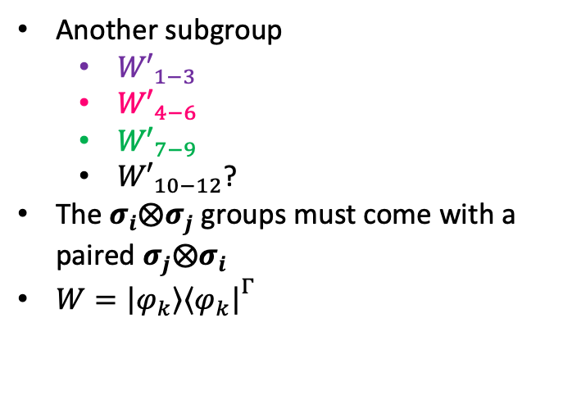
Expanding the W’ Options... Impossible!
Another subgroup
${W′}_{1−3}$
${W′}_{4−6}$
${W′}_{7−9}$
${W′}_{10−12}$?
The $σ_{i}⨂σ_{j}$ groups must come with a paired $σ_{j}⨂σ_{i}$
$W={\left|\left.φ_{k}\right\rangle \right.\left\langle \left.φ_{k}\right|\right.}^{Γ}$
$$σ_{x}⨂σ_{x}$$ | $$σ_{x}⨂σ_{y}$$ | $$σ_{x}⨂σ_{z}$$
$$σ_{y}⨂σ_{x}$$ | $$σ_{y}⨂σ_{y}$$ | $$σ_{y}⨂σ_{z}$$
$$σ_{z}⨂σ_{x}$$ | $$σ_{z}⨂σ_{y}$$ | $$σ_{z}⨂σ_{z}$$

Slide 27
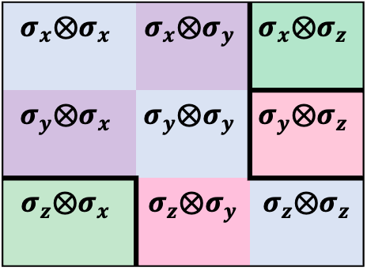
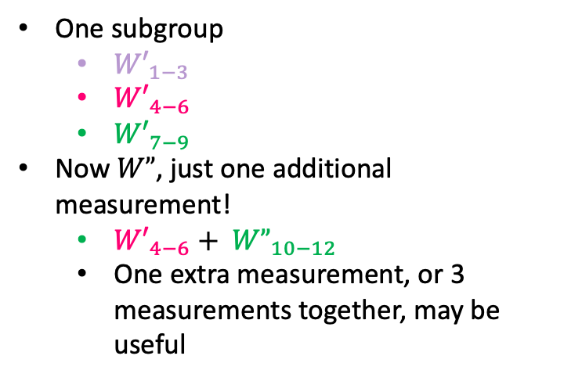
The Three-Step Process
$$σ_{x}⨂σ_{x}$$ | $$σ_{x}⨂σ_{y}$$ | $$σ_{x}⨂σ_{z}$$
$$σ_{y}⨂σ_{x}$$ | $$σ_{y}⨂σ_{y}$$ | $$σ_{y}⨂σ_{z}$$
$$σ_{z}⨂σ_{x}$$ | $$σ_{z}⨂σ_{y}$$ | $$σ_{z}⨂σ_{z}$$
One subgroup
${W′}_{1−3}$
${W′}_{4−6}$
${W′}_{7−9}$
Now $W”$, just one additional measurement!
${{W′}_{4−6}+ W”}_{10−12}$
One extra measurement, or 3 measurements together, may be useful
Notes:
Now, the alternative method to regrouping our W’s involves adding a whole other step of measurement altogether. This would be a ‘three step process’. Since we showed before that W” must require some extra measurements, we can just add these one or two measurements to our process. So we again do our Ws, then our W’. Next, we train another neural network or employ some population method - we create a second picking mechanism. Then, whatever our second choice method spits out is best for our state, we add on. Just one more measurement, we make a W”, and we try that W” on our state. Again, if it’s <0 we sing a kumbaya. If it is greater than 0, we simply conclude that we didn’t detect entanglement. Right now, we don’t know how well this process will work. We have scanned over a subset of possible states to make an entanglement witness, and these turn out that there are lots of possible ways to detect entanglement with a few families of witnesses. We want to know, at the end of the day, whether these witnesses will add substantial new information, or whether we have hit a sort of asymptote in the information we can gain for the measurements we have taken. We’ll call the method “good” if you end up with more information than we had before, and took as few measurements as possible. Of course, we always have the tradeoff: when are we taking too many measurements? Our method, though, provides multiple stopping points to exit from.
We have generated a way to better determine entanglement without taking a full quantum tomography. At the end of my thesis, at least, we would love to be able to say whether the W” are a worthwhile addition.

Slide 28
The Two-Step Process
$$\left\langle \left.W\right\rangle <0\right.$$
$$ρ_{ent}?$$
$$W_{1−6}$$
Entangled!
$$\left\langle \left.W\right\rangle ≥0\right.$$
$$\left\langle \left.W′\right\rangle <0\right.$$
(neural network)
$${W′}_{1−3}$$
$${W′}_{4−6}$$
$${W′}_{7−9}$$
Entangled!
$$\left\langle \left.W′\right\rangle ≥0\right.$$
Not detected…
Yang, Verghese, Scholin, Unpublished
Notes:
Altogether, the process for finding out entanglement looks something like this. We start by doing all the measurements required for the Ws. If those expectation values are negative, we stop, cheer, and say hurrah to the sky because we’ve witnessed entanglement. If not, we don’t despair. We train a neural network on the outputs of our original W measurements. We then let the neural network pick which of the three W’ subgroups we should use, and we do those measurements. If our W’ subgroup has any witness with a negative expectation value, we cheer and sing hurrah. Otherwise, if our W’ AND or W expectation values are all positive, we conclude that we did not detect entanglement. Of course, as we’ve learned, this doesn’t mean the state is not entangled. We have just missed it. So after all that, rather than do a full quantum tomography, we have done 5/9 measurements required for a full sweep. Now the question is, how well did we do?

Slide 29



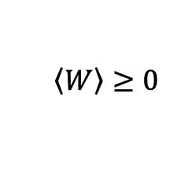

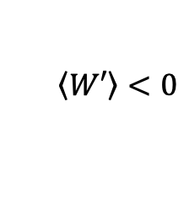
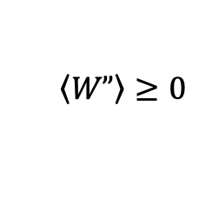
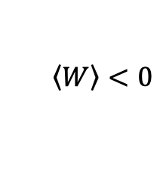
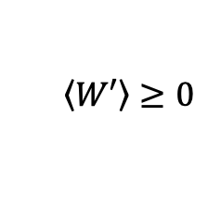

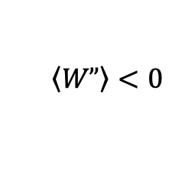

The Three-Step Process
$$\left\langle \left.W\right\rangle <0\right.$$
$$ρ_{ent}?$$
$$W_{1−6}$$
Entangled!
$$\left\langle \left.W\right\rangle ≥0\right.$$
$$\left\langle \left.W′\right\rangle <0\right.$$
(neural network)
$${W′}_{1−3}$$
Entangled!
$${W′}_{4−6}$$
$${W′}_{7−9}$$
$$\left\langle \left.W′\right\rangle ≥0\right.$$
$$\left\langle \left.W”\right\rangle <0\right.$$
(neural network)
$$W”$$
Entangled!
$$\left\langle \left.W”\right\rangle ≥0\right.$$
Not detected…
Notes:
Now, the alternative method to regrouping our W’s involves adding a whole other step of measurement altogether. This would be a ‘three step process’. Since we showed before that W” must require some extra measurements, we can just add these one or two measurements to our process. So we again do our Ws, then our W’. Next, we train another neural network or employ some population method - we create a second picking mechanism. Then, whatever our second choice method spits out is best for our state, we add on. Just one more measurement, we make a W”, and we try that W” on our state. Again, if it’s <0 we sing a kumbaya. If it is greater than 0, we simply conclude that we didn’t detect entanglement. Right now, we don’t know how well this process will work. We have scanned over a subset of possible states to make an entanglement witness, and these turn out that there are lots of possible ways to detect entanglement with a few families of witnesses. We want to know, at the end of the day, whether these witnesses will add substantial new information, or whether we have hit a sort of asymptote in the information we can gain for the measurements we have taken. We’ll call the method “good” if you end up with more information than we had before, and took as few measurements as possible. Of course, we always have the tradeoff: when are we taking too many measurements? Our method, though, provides multiple stopping points to exit from.
We have generated a way to better determine entanglement without taking a full quantum tomography. At the end of my thesis, at least, we would love to be able to say whether the W” are a worthwhile addition.

Slide 30
Key Takeaways
Goal: high chance of witnessing two-qubit entanglement if present from a small fraction of measurements required for full state tomography
Remember…
W’ witness 2/3 states with 5/9 measurements
W’ extension might improve this ratio
Our work!

Slide 31
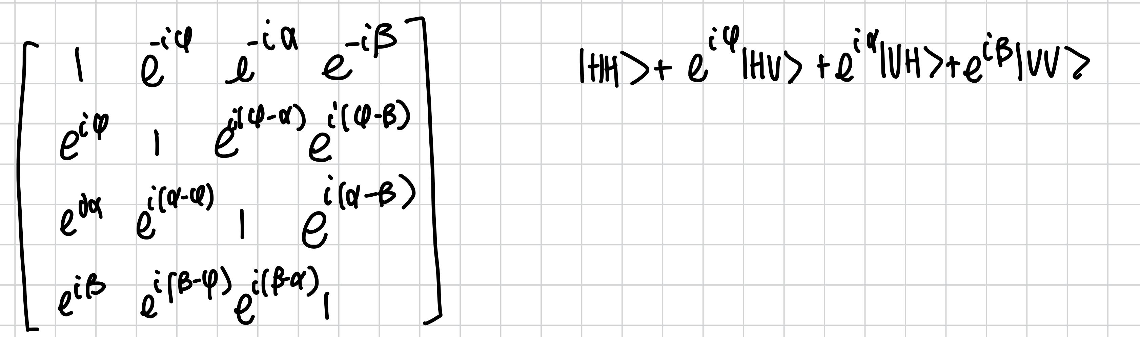
W” impossible (backup)

Slide 32
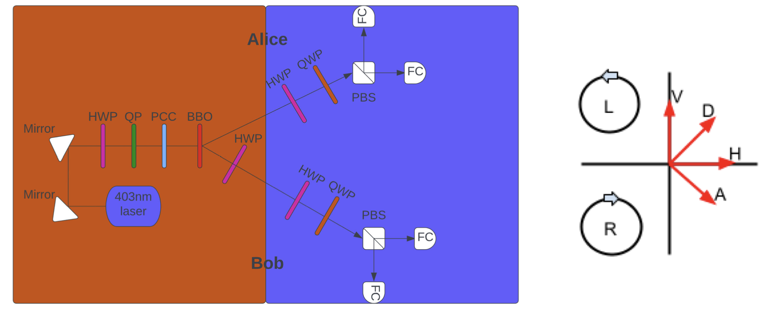
Experimental Apparatus (backup)

Slide 33
References
Alberto Riccardi, Dariusz Chruściński, and Chiara Macchiavello. “Optimal entanglement wit- nesses from limited local measurements”. en. In: Physical Review A 101.6 (June 2020), p. 062319. ISSN: 2469-9926, 2469-9934. DOI: 10.1103/PhysRevA.101.062319. URL: https://link.aps.org/doi/10.1103/ PhysRevA.101.062319 (visited on 05/24/2023).
Eritas Yang, Becca Verghese, and Ben Hartley. “Entanglement Witness Writeup”. In: Unpublished (July 2022). URL: https://github.com/Lynn-Quantum-Optics/Summer-Spring-2022-3/blob/main/Summer2022/ summer- 2022- QO_write_up.pdf.
Jan Roik et al. “Accuracy of Entanglement Detection via Artificial Neural Networks and Human- Designed Entanglement Witnesses”. In: Physical Review Applied 15 (May 2021). Publisher: American Physical Society, p. 054006. DOI: 10.1103/PhysRevApplied.15.054006. URL: https://link.aps. org/doi/10.1103/PhysRevApplied.15.054006 (visited on 05/30/2023).
Oscar Scholin, Richard Zheng, Alec Roberson, Theresa W. Lynn, “Entanglement Witnessing: Neural Network Optimization and Experimental Realization”. Presented at SQUINT 2023.

