Slide 1
VirtualTrainer
Emerson Ashley

Slide 2
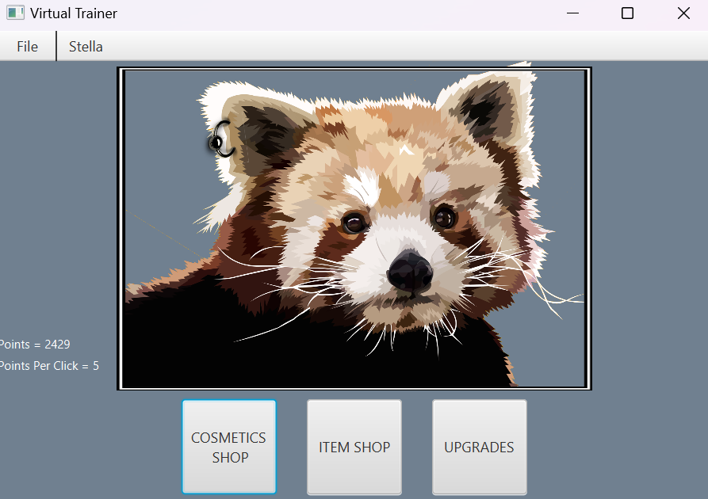
VirtualTrainer
VirtualTrainer is a game made to waste time.
Listen to music
Talk to friends
Relax

Slide 3
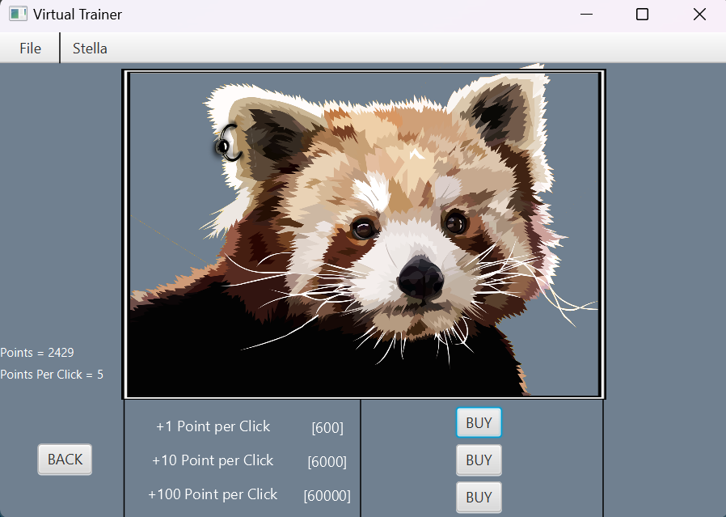
Upgrades
Collect more points
Upgrade PPC
Get even more points!

Slide 4

Items
2x points for 200 clicks
5x points for 80 clicks

Slide 5
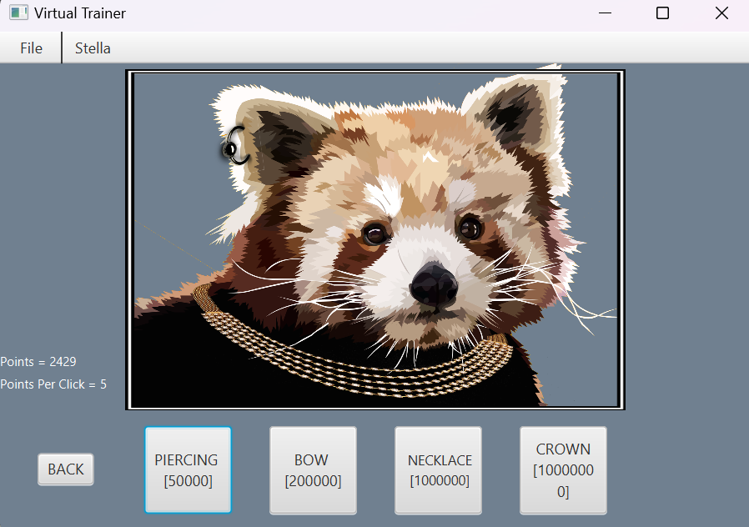
Cosmetics
Get stacking cosmetics
Work your way up to the top

Slide 6
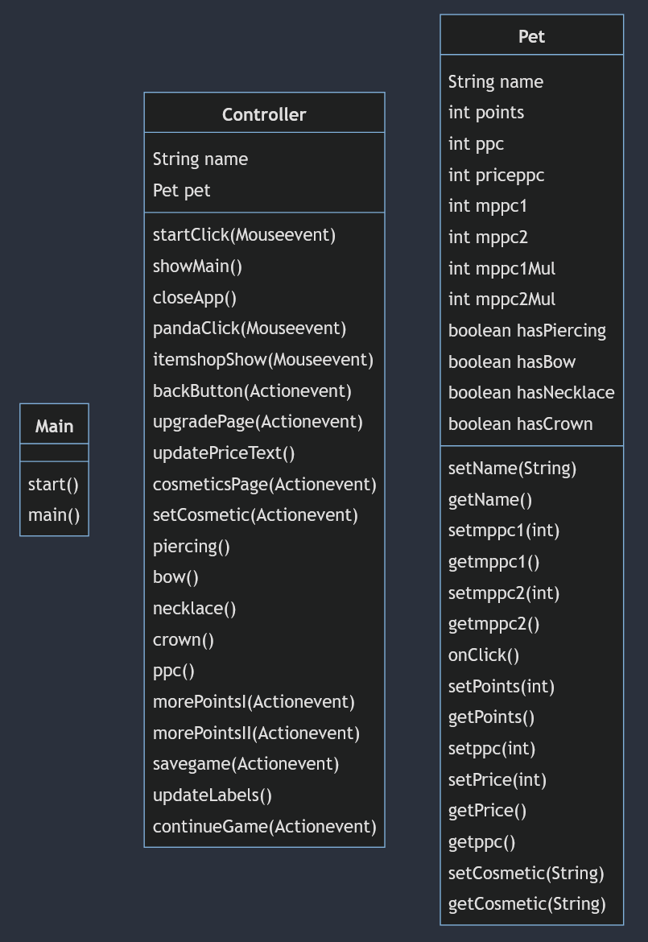
Implementation Manual
3 Classes
Main
Controller
Pet

Slide 7
What I Learned
Making an app takes a lot of effort
How OOP changes how you create programs
How to design an appealing app
Researching and debugging problems (JavaFX)

