Slide 1
Design Pattern
--Pinball Jump Rebuild

Slide 2
Agenda
Elder version
Brief
Demo
Architecture
Design Pattern

Slide 3
Elder version
Basic function
Singleton
Complex logical judgment
Poor expandability

Slide 4
Brief
Based on cocos2D-x engine
Based on Doodle jump model

Slide 5
Demo

Slide 6
Architecture
processController
boardController
gameScene
ballController
board
ball

Slide 7
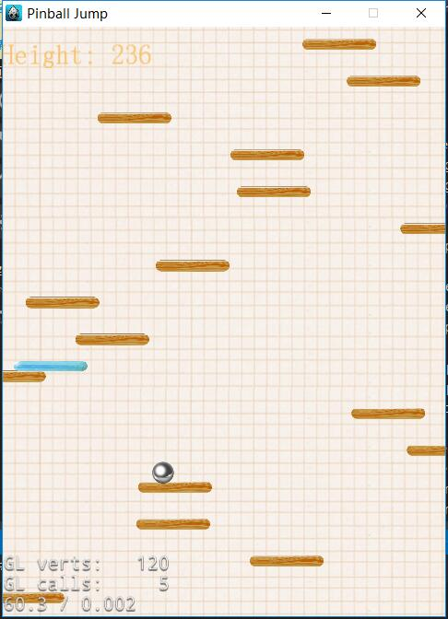
Design Pattern
Observer

Slide 8
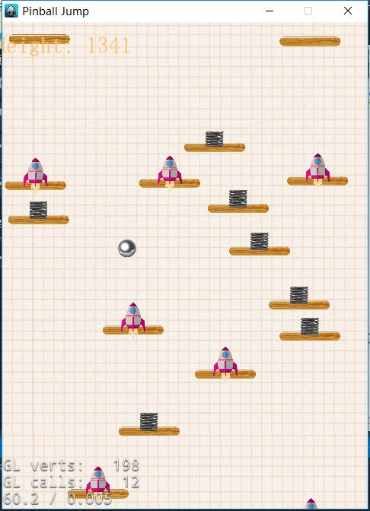
Design Pattern(cont.)
Observer
Prototype

Slide 9
Design Pattern(cont.)
Observer
Prototype
Factory

Slide 10
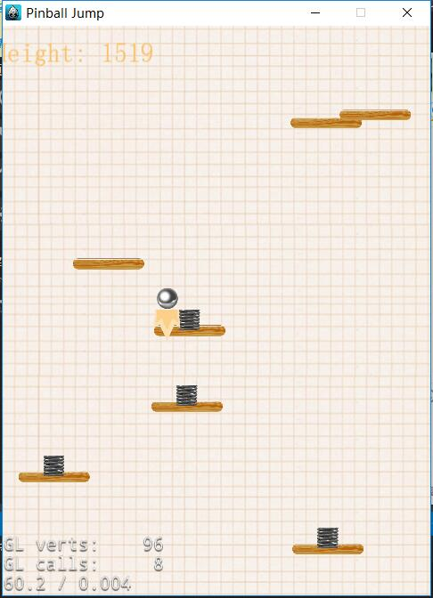
Design Pattern(cont.)
Observer
Prototype
Factory
Decorator

Slide 11
Elder version
Basic function
Singleton
Complex logical judgment
Poor expandability
Various functions
Decorator/Factory/Prototype/Observer
Complex logical judgment
Poor expandability?

Slide 12
Thank, you

