Slide 1
Pinball Jump
吴 咏新

Slide 2
Agenda
Introduction
Demo
Architect
Maintainability

Slide 3
Introduction
This is a game adapted from a game called “doodle jump”, they have almost same rules, player should control the ball go up and change direction with left&right arrow, once he falls down, game is over.

Slide 4
Demo

Slide 5
Architect
director
processcontroller
(单例类)
startscene
gamescene
pinball
boardmap
boards
overscene

Slide 6
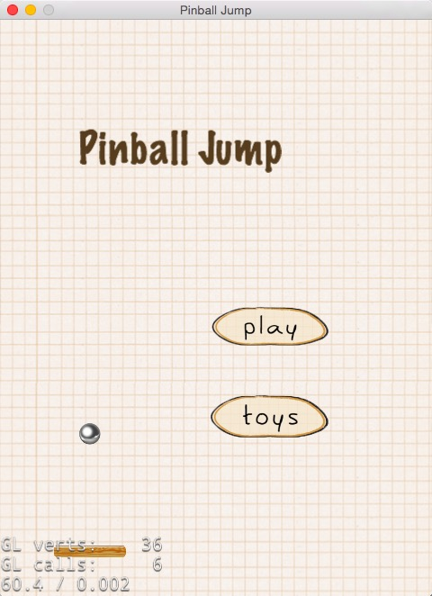
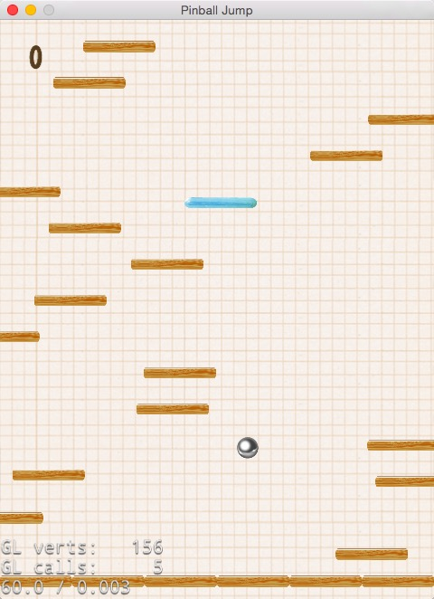
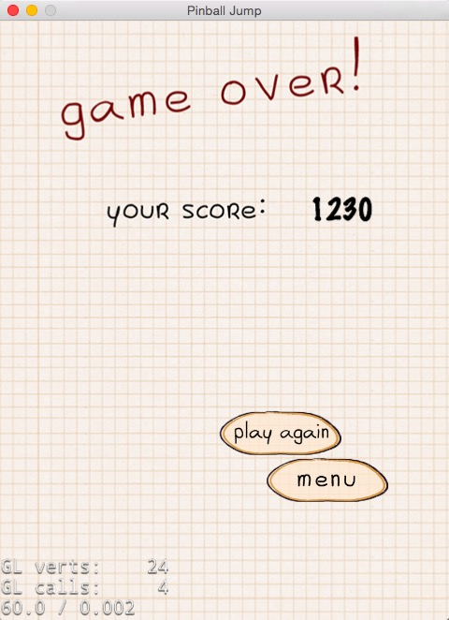
Architect(cont.)

Slide 7
Maintainability
ProcessController is the main processing class, being a singleton pattern, it’s convenient for other classes(game Items .etc) to maintain their unique function.
Boardmap is designed like a STL container, user just need to use its APIs to maintain the access of boards.
Board class is ready for addition of Items.
No friendship between classes.

