Slide 1
Emotional Support in an Online Suicide Support Community
Handong-Calvin Global Linguistics Conference
December 3, 2021
Notes:
Whether we are looking to receive support or there is another seeking support from us, with how integrated computers are in our lives, we all know the experience of trying to get or seek help from someone who only appears as a bit of text before us.
Through this presentation, we will examine how this act of seeking and receiving emotional support online takes place with the community r/SuicideWatch.

Slide 2
Disclaimer
South Korea Hotlines
Counsel24: 1566-2525
Lifeline Korea: 1588-9191
Mental Health Center Crisis Counseling 24hrs: 1577-0199
Ministry of Health & Welfare Call Center 24hrs: 129
United States Hotlines
National Suicide Prevention Lifeline: 1-800-273-8255
July 2022: 988
Nacional de Prevención del Suicidio: 1-888-628-9454
The Crisis Text Line: text HOME to 741-741
The TrevorLifeline: 1-866-488-7386
Notes:
This is a heavy topic.
I will avoid using specific user examples from the community for this reason.

Slide 3
Outline
What is emotional support?
What are suicide texts?
What is r/SuicideWatch?
Where does emotional support appear in r/SuicideWatch?

Slide 4

Emotional Support
Notes:
Defined as providing empathy, care, love, trust, esteem, concern, and listening.
Satisfies the need of comfort and security in the self and others.
Appears when a person is in a crisis situation, which is a situation that is sudden, threatening, and emotionally arousing.
But what does this look like when we’re online?
Comments that express positivity and support.
Emotional support appears most commonly in online health communities that impact personal relationships and have a greater risk of death.
Less common in health communities that have a greater stigma.
Now, why do we seek support online?
Computer-mediated contexts encourage support as users tend to find it easier to discuss personal problems online than in-person.
Anonymity protects from accountability for their opinions and the public’s reaction.
It also allows them to present themselves how they want to be seen which gives them a higher sense of control.
The lack of a physical presence also lets people focus on their similarities.
Ease of personal disclosure explains why people would participate in r/SuicideWatch.

Slide 5
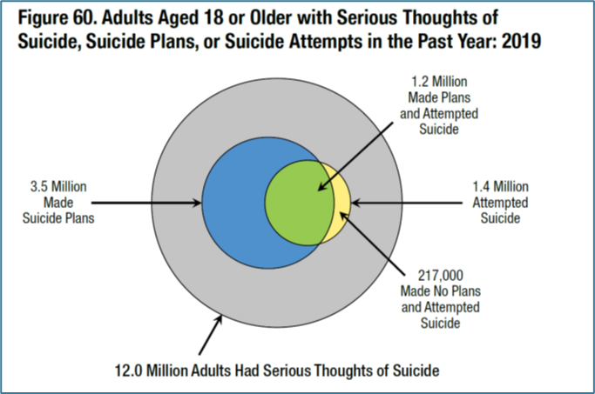
Suicide Texts
Notes:
Explain visual.
The American Psychological Association defines suicide ideation as thoughts about or a preoccupation with killing oneself, often as a symptom of a major depressive episode. Not all instances of suicide ideation progress to an attempted suicide.
This suicide ideation is then reflected in a suicide text, which manifest the themes found in the main triggers of suicide.
These come from psychological conditions, sociological factors, and ideological factors.

Slide 6
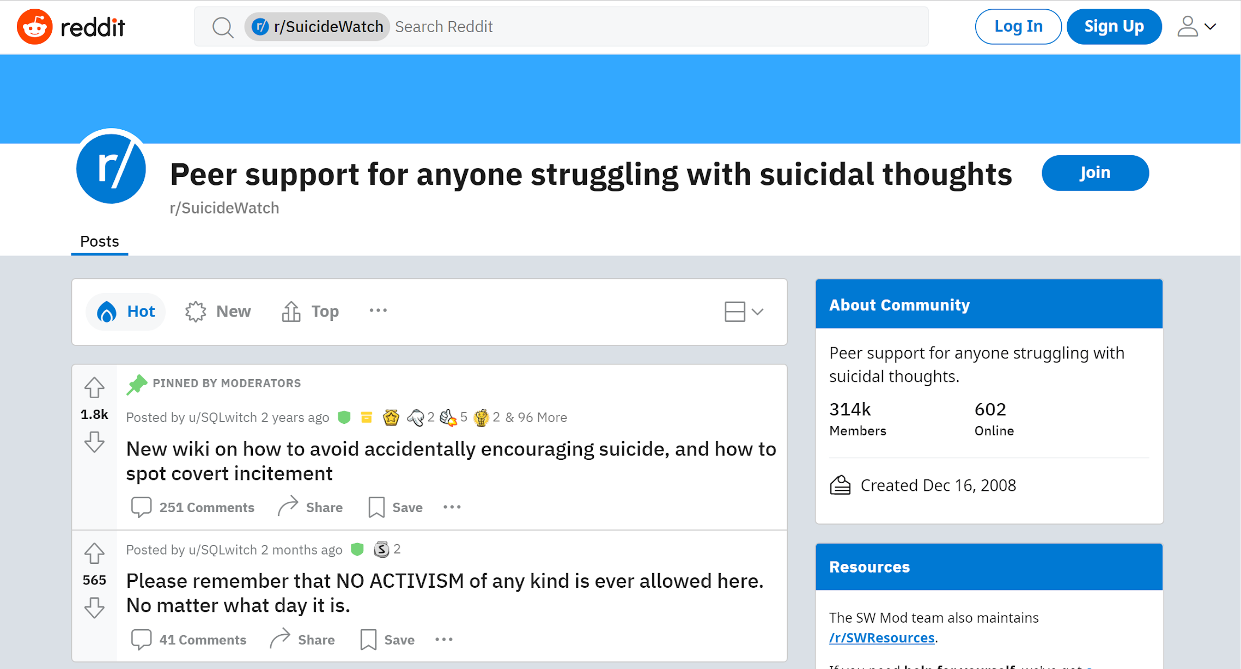
r/SuicideWatch
Notes:
A community on Reddit, which is a site where people can post text, images, links, or videos and receive comments on these posts.
Posts and comments can be “upvoted” or “downvoted,” where the vote affects whether they appear higher or lower in the feed.
Similar to a “like.”
Reddit is separated into smaller communities called “subreddits” which are dedicated to a specific topic of interest.
The subreddit r/SuicideWatch was created to provide nonjudgmental peer support for those with suicide ideation.
Members post to seek help or sympathetic opinions, leave a suicide note or get approval of their suicide note, seek company, or to share experiences.
Members comment on posts to provide support, share a similar experience, or give their opinion about the post’s topic.

Slide 7
Emotional Support on r/SuicideWatch
Do posts or comments have more emotional support?
Will texts with ideation or without ideation have more emotional support?
Does the amount of emotional support in a comment differ depending on the ideation of the post?
Notes:
Aimed to determine where emotional support is the most prevalent.
Do posts or comments have more emotional support?
Will texts with ideation or without ideation have more emotional support?
Does the amount of emotional support in a comment differ depending on the ideation of the post?
Extracted 656 posts and comments from r/SuicideWatch.
Coded the posts and comments collected as showing or not showing suicide ideation.
To determine where emotional support is the most prevalent, I performed two analyses examining two groups of independent variables.

Slide 8
Independent Variables
Analysis 1
Text Type
Post
Comment
Ideation
Yes
No
Analysis 2
Post Ideation
Yes
No
Comment Ideation
Yes
No
Notes:
Introduce independent variables.
Used LIWC to determine how much of the different texts contained linguistic word categories related to emotional support.

Slide 9
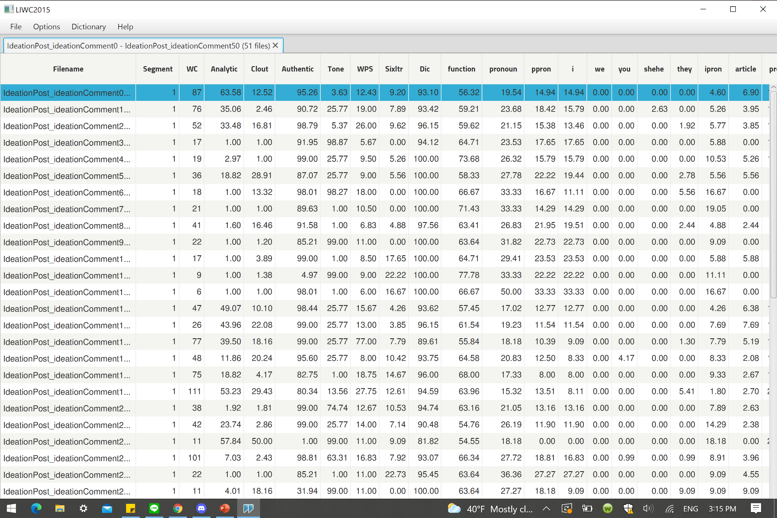
LIWC
Notes:
LIWC is a program that analyzes text and determines the percentage of each text that belongs to a certain word category.
The program goes word-by-word through the text and matches them to its dictionaries of different words.

Slide 10
LIWC
Notes:
For example, there is a dictionary called “you.”
LIWC searches each text file it receives for the words contained in this dictionary, in this case just “you.”
It then returns a percentage. For example, “4.17% of the words in this text were “you.”

Slide 11
LIWC
Notes:
LIWC is a program that analyzes text and determines the percentage of each text that belongs to a certain word category.
The program goes word-by-word through the text and matches them to its dictionaries of different words.
For example, there is a dictionary called “you.”
LIWC searches each text file it receives for the words contained in this dictionary, in this case just “you.”
It then returns a percentage. For example, “4.17% of the words in this text were “you.”

Slide 12
LIWC Word Categories for Emotional Support
Wang et al. (2012)
Positive Correlation: we, you, positive emotion, anger, and religion
Negative Correlation: she/he and time
Notes:
Wang et al. (2012) analyzed a breast cancer discussion board to determine which word categories were significant in determining the presence of emotional support.
While they found a variety of categories, they found that for LIWC variables emotional support was strongly positively correlated with we, you, positive emotion, anger and religion. It was negatively correlated with she/he and time.
I used these word categories to determine where emotional support is located in r/SuicideWatch.

Slide 13
Text Type and Ideation
Comments had higher emotional support values than posts.
Texts without ideation had higher emotional support values than texts with ideation.
There was an interaction between text type and ideation.
Notes:
In order to do this, for both analyses I used a Two-Way ANOVA, which stands for analysis of variance. This tells how two different independent variables impact the variable being measured.
The first ANOVA analyzed posts versus comments, texts with ideation versus texts without ideation, and then how these two interact.
Read first bullet.
This means that we expect for comments to be more supportive than posts.
Read second bullet.
This means that both posts and comments without ideation taken together have more emotional support than posts and comments with ideation combined.
However, the ideation of the comment may affect the amount of emotional support in the comment.
This is what the third bullet means.
Read third bullet.
Notably, a comment that shows suicide ideation has emotional support values much closer to that of posts than to a comment that does not show suicide ideation.
Show data, if you would like to look at this data later I can go back after the presentation.

Slide 14
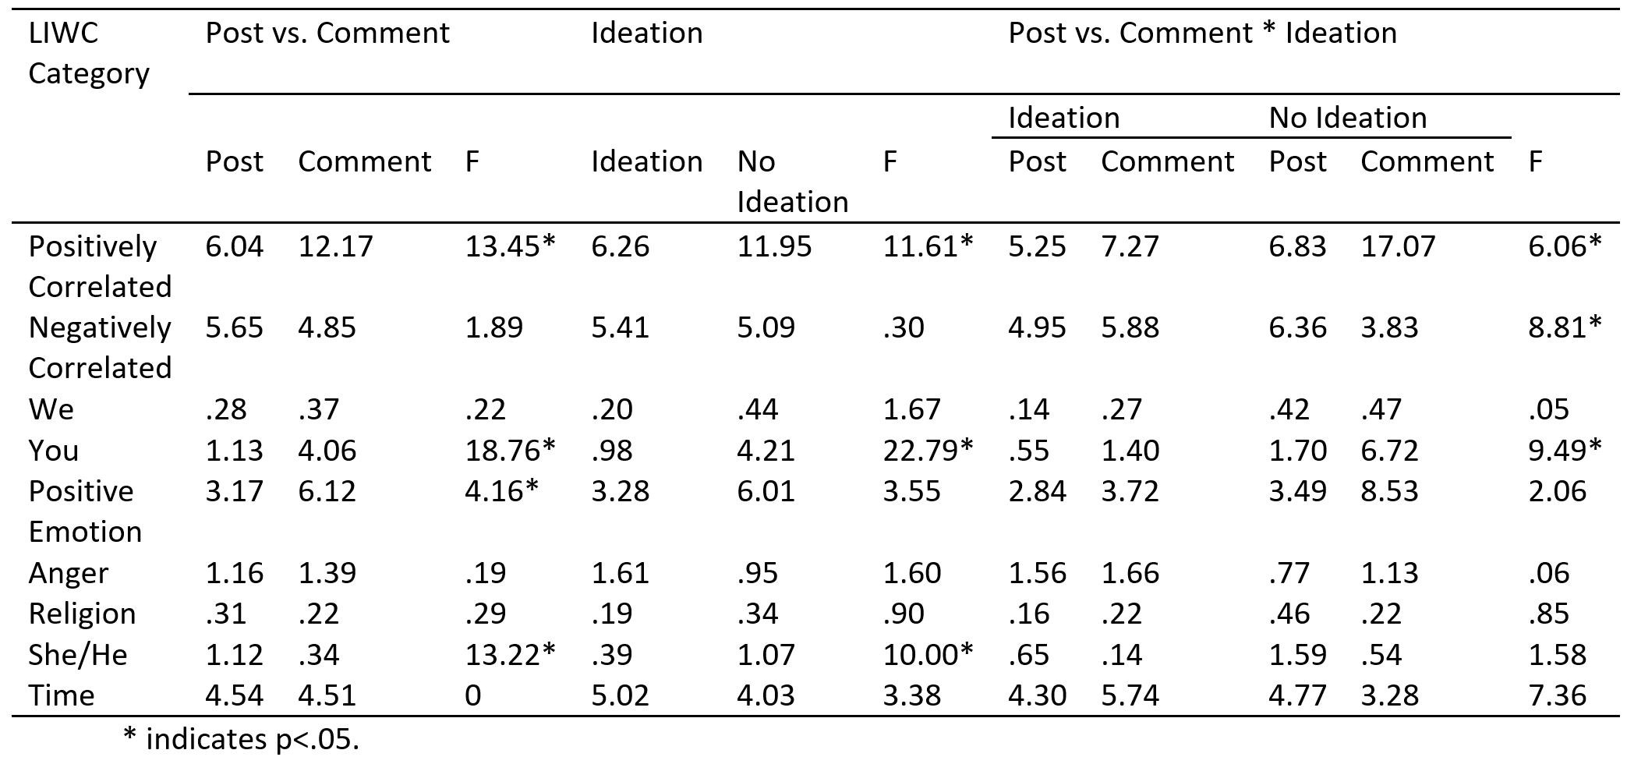
Text Type and Ideation

Slide 15
Post Ideation and Comment Ideation
Post ideation does not have a significant effect on the amount of emotional support in its corresponding comment.
Comments with ideation have less emotional support than comments without ideation.
No interaction between the ideation of the post with the ideation of the comments.
Notes:
The second ANOVA analyzed just the comments.
It first looked at if the amount of emotional support in the comments differs depending on the ideation of the comments' post.
It then analyzed if the comments differ depending on their own ideation.
Lastly, it determined if there was an interaction between these two.
First, I found that there is no significant difference between comments responding to posts with ideation and comments responding to posts without ideation.
Suggests that comments may be responding to the community expectations about what a comment should look like rather than the content of the post itself.
Read second and third bullet point.
Show data

Slide 16
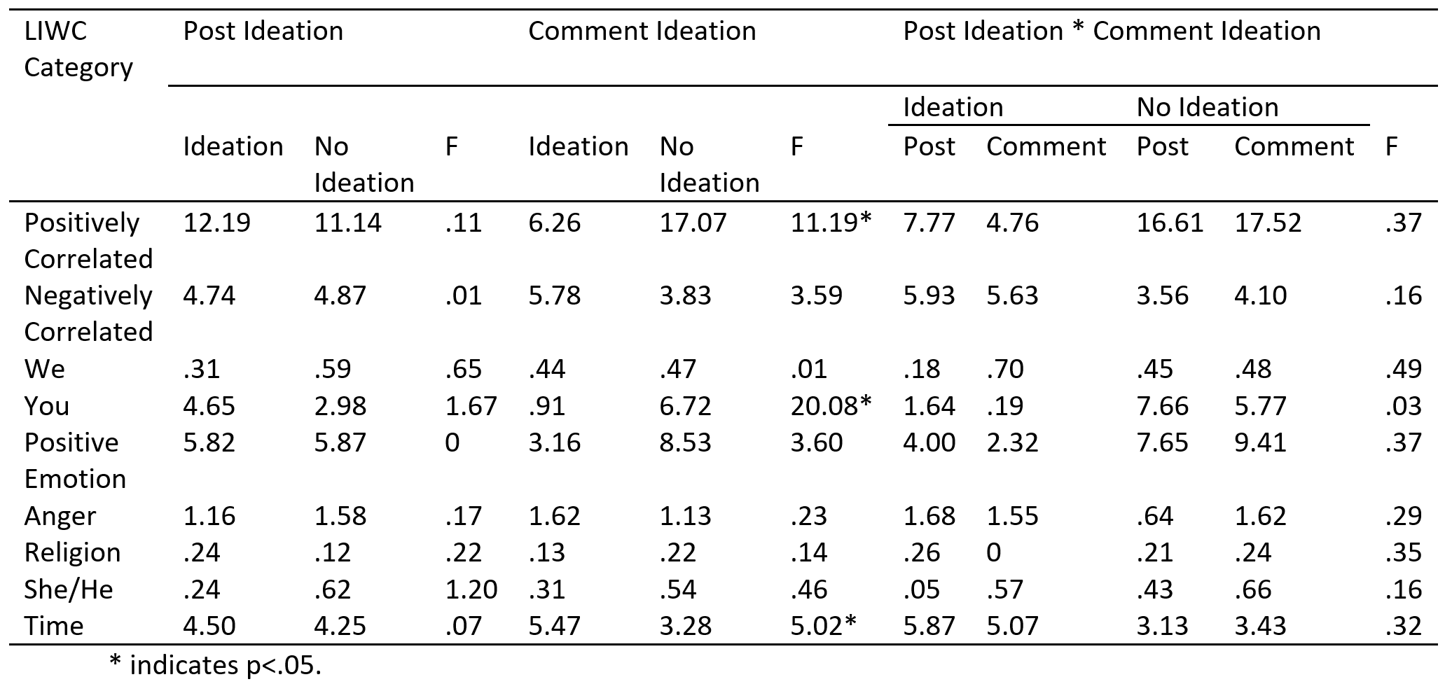
Post Ideation and Comment Ideation

Slide 17
Conclusion
The text type being a comment is the most important factor in determining the presence of emotional support in r/SuicideWatch.
The text not including ideation is a secondary factory in determining emotional support.
Emotional support is the most common in comments without ideation.
Notes:
Read bullets.

Slide 18
What questions do you have?

