Slide 1
Predicting spend
Lynnann Whitbeck
General Assembly Data Science Final Project

Slide 2
Overview
The project is about predicting spend on technology
This uses the Young People Survey
Explore the preferences, interests, habits, opinions, and fears of young people (ages 15-30)
publicly available on Kaggle:
https://www.kaggle.com/miroslavsabo/young-people-survey
The survey data is from 2013 where statistics students invited their friends to partake in the survey

Slide 3
About the Data
Dataset is small (1010x150)
Data is broken up by various categories
Music Preferences (19 items)
Movie preferences (12 items)
Hobbies & interests (32 items)
Phobias (10 items)
Health habits (3 items)
Personality traits, views on life, & opinions (57 items)
Spending habits (7 items)
Demographics (10 items)

Slide 4
Data Integrity
Is it too small?
Items are self-reported
Survey bias due to the network of students
Translation Error
The original questionnaire was in Slovak language and was later translated into English
Possible input error
The survey was presented to participants in both electronic and written form
What manipulation occurred here? Was it QC’d?

Slide 5
Assumptions and issues
The initial goal was to predict a persons spend based on one’s music preference
Available spending habits included
I save all the money I can
I enjoy going to large shopping centers
I prefer branded clothing to non branded
I spend a lot of money on partying and socializing
I spend a lot of money on my appearance
I spend a lot of money on gadgets
I will happily pay more money for good, quality or healthy food
The target variable I chose was spending on gadgets as a proxy for spending on technology

Slide 6
Data cleaning
There were only 2 files from the author
Responses: actual answers
Columns: full column names from the questionnaire
I didn’t remove any data as I wanted to the model to tell me which features were most important
According to the author there are students who “cheat” and randomly fill out answers but I wasn’t able to pick it up trying outlier detection so I left all the rows in
The missing data was minimal so extrapolated the median responses

Slide 7
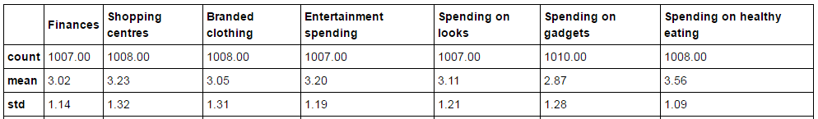
Process – Exploratory analysis
Types of variables:
138 Numeric Responses
11 Categorical Variables
Some missing data appeared in most columns
Imputed using the median
Created a correlation matrix but it wasn’t readable so broke up the items into various categories
Spending Summary Stats

Slide 8
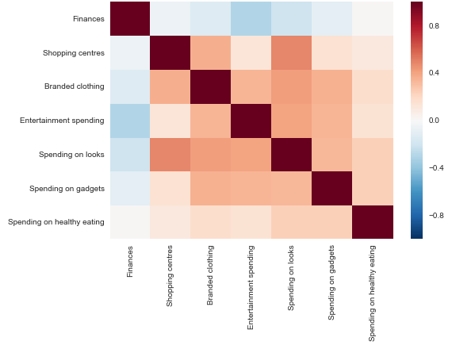
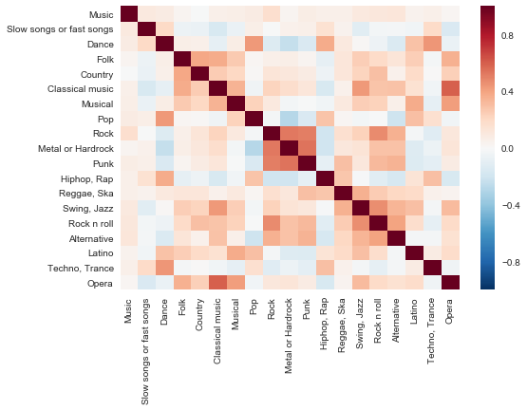
Process – Exploratory analysis
Spending Habits
Music

Slide 9
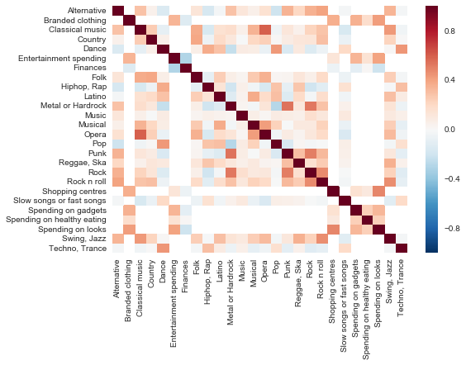
Process – Exploratory analysis
Spending Habits And Music

Slide 10
Process – Data cleaning
Not too much cleaning was needed
Missing Values
My target variable didn’t have any missing values
Imputed missing values using the median for numeric variables
Imputed missing values as “Missing” for categorical variables
Dummied out categorical variables
Decided to do this instead of factorizing because I wanted to compare across some models that don’t allow for categorical variables

Slide 11
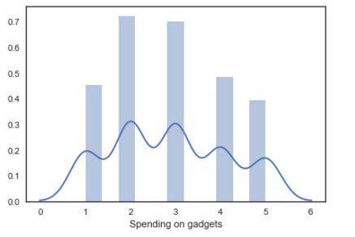
Process – Data Modeling
Experiment with Random Forest
Test Random Forest against other models
Decided to bucket the five classes into two classes
High technology spenders ~42%
Low technology spenders ~58%

Slide 12
Process – Data Modeling
Wanted to optimize the accuracy score
Cross validated with 10 folds
Cross validated against the binary target variable and the multiclass target variable
Binary Results of accuracy
KNN ~0.617
Random Forest Classifier ~0.698
Logit ~0.663
Multiclass Results of accuracy
Compared three models to see the most accurate
KNN ~ 0.294
Random Forest Classifier ~ 0.400
Logit ~0.279

Slide 13
Process – Data Modeling
Staying with the Random Forest
Started with a “baseline” model
Only set the random state, everything else was default
Only included numeric variables
Accuracy score ~.632
Added in categorical variables
Accuracy decreased to ~. 629
Leaving out until figure out optimal max feature amount and then will try one more time

Slide 14
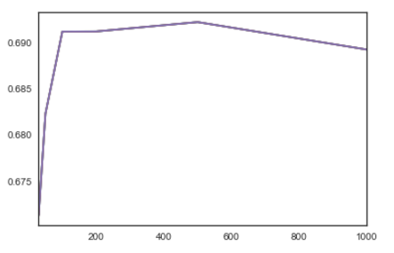
Process – Data Modeling
Tested the number of trees in the forest
Used various increments of n_estimator
Accuracy score peaked at ~0.692 at 500 trees
Using that amount moving forward

Slide 15
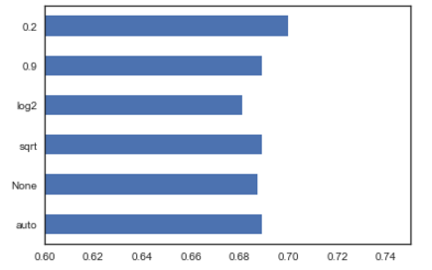
Process – Data Modeling
Tested the optimal amount of features
Max_features
The auto option and the sqrt option were closely tied
Accuracy score peaked at ~0.700 using 0.2 option
Also tested the minimum amount of the sample within a split to have the algorithm stop
Min_sample_leaf

Slide 16
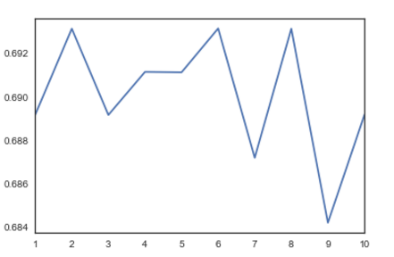
Process – Data Modeling
Tested the minimum amount of the sample within a split to have the algorithm stop
Min_sample_leaf
Accuracy score peaked at ~0.693 using 6 as the min sample size per leaf

Slide 17
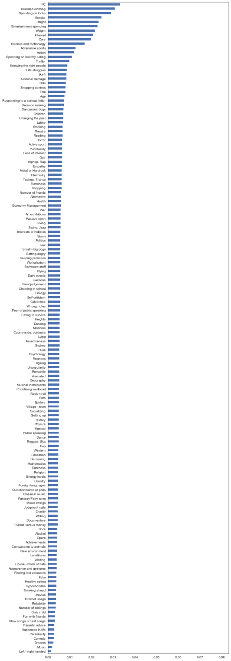
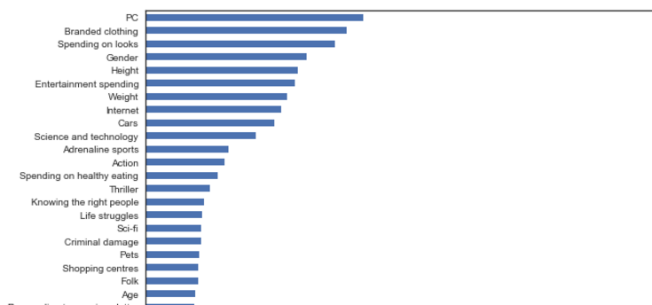
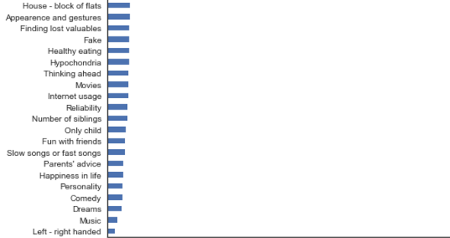
Feature Importance
To my surprise the most important feature interest in PC hardware and software
The second most important feature is interest in branded clothing
Music is the second to last least important feature in the model

Slide 18
Conclusion
The random forest worked best in terms of accuracy even with such a small data set
Logit was a close second
Fine tuning the model made a decent improvement
Lase model accuracy score ended at ~0.702
The model significantly decreases in accuracy (almost half) when I switch to a multiclass output
Music preferences have nothing to do with spending on technology
Further Areas of interest
Recommendation system
Branch out onto all spending
Compare additional models to the forest

Slide 19
Appendix
All the supporting code and additional analyses available on my_hw_repo in my github
Github.com/Lynnann

