Slide 1
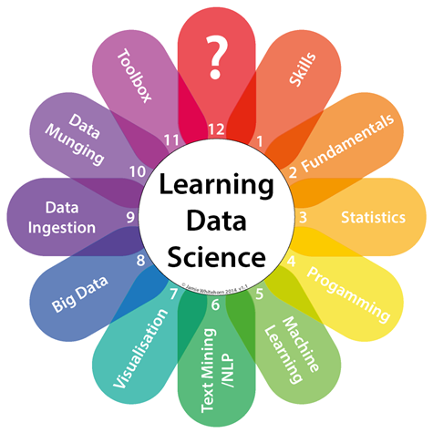
General Assembly Final Project Ideas
Lynnann Whitbeck

Slide 2

Young People Survey
Problem Statement
Can one’s music preference predict how likely they are to spend money on technology?
Data
The data are cleaned and publicly available on Kaggle
Hypothesis
People who prefer house music are more likely to spend their money on technology
Potential Issues
The survey using ranking on a scale of 1-5 which might get tricky in modeling and/or also in reporting results

Slide 3

Airline Analysis
Problem Statement
Can one’s predict revenue/sales based on tweets?
Data
The data are publicly available through MIT for revenue/sales
Information is provided by the US Department of Transportation and the Securities and Exchange commission
Hypothesis
Airlines with more negative tweets than positive tweets will have lower revenue
Potential Issues
Time availability
Data
Scraping the tweets
Revenue sales data seems to be available but only the summary tables by year, haven’t found any “raw data”

Slide 4

E-Commerce
Problem Statement
Want to do a market basket analysis or pricing optimization
Data
Subsets of data from Amazon are publicly available
Hypothesis
There is a optimal price point for a good when combined with other goods
Potential Issues
Not sure if I’ll be able to link customers
Not sure how “predictive” the hypothesis would be

