Slide 1

February 04 2018

Slide 2
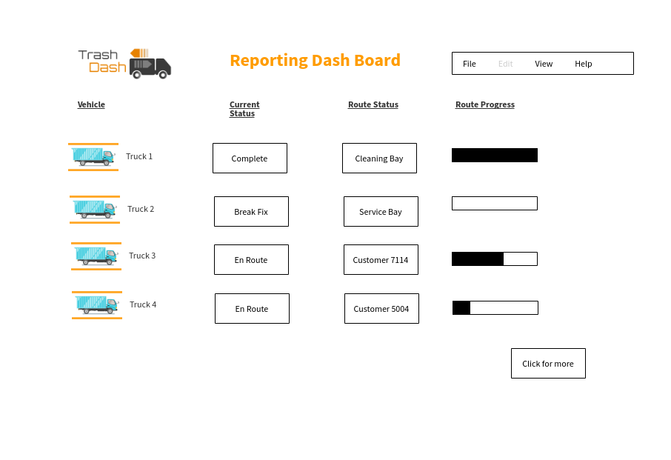

Slide 3
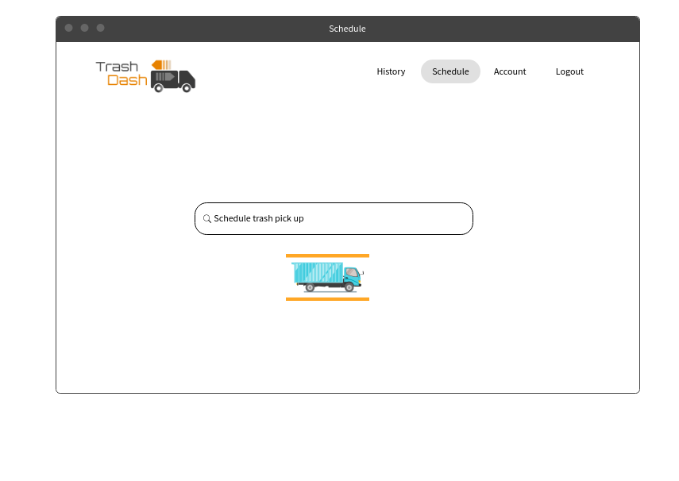

Slide 4
