Slide 1
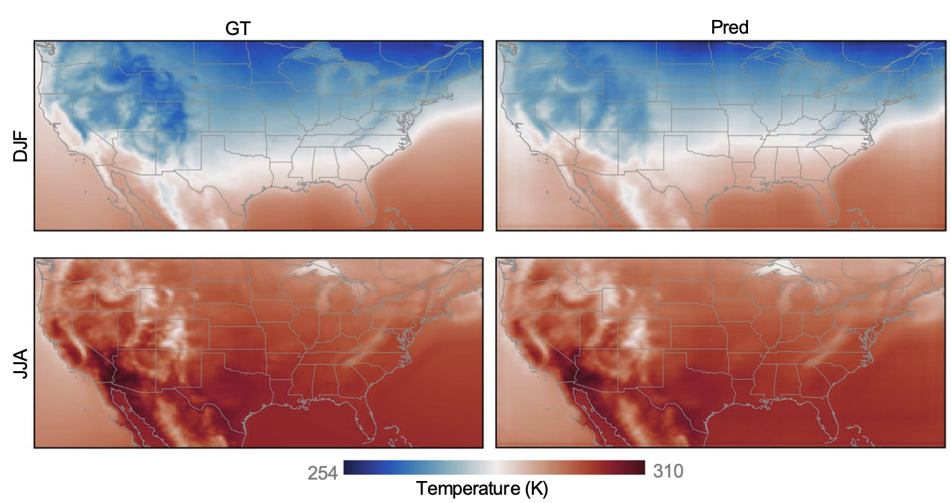



Historical states
Future states
Interannual (calendar-aligned) context
Final prediction
Temperature
Lead-time–conditioned recent dynamics
$△$year
$△$year
$△$year
same calendar day across years
τ
Time

Slide 3
