Slide 1
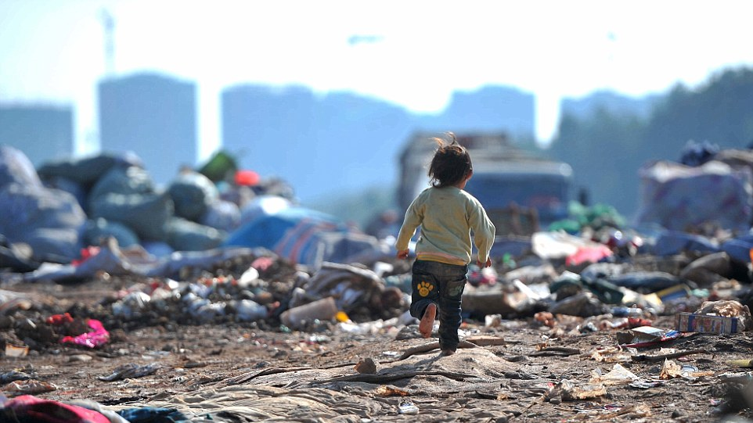

CNN Image Classification Implement: Waste Classification APP
Team:
Yuan Chen
Lynn Hong
Iris Wan
Willa Yu
Xingxuan Zhang

Slide 2



Business Background
china
3.4 Billion
15%
2.01 Billion
2 Billion Tons
of waste
per year
worldwide
15%
global municipal solid waste volume comes from China
46 Cities
in China issued
waste sortation policy
Notes:
Estimated by the World Bank Group in 2016, there were about 2.01 billion tons of waste generated per year, and this number will grow to 3.4 billion tons by 2050.
China had more than 228.02 million tons of waste in 2018, which accounted for about 15% of the global municipal solid waste volume.
Even worse, BBC News reported the biggest landfill (more than 34 million cubic meters) in China had been filled in 2019, 25 years earlier than planned.
In early 2019, 46 major cities in China issued a waste sortation policy which requires residuals to classify
the trash before throwing away. [5] Meanwhile, the Chinese government is also building up basic waste
sortation systems. The goal of these actions is to increase recycling rates to 35%.
However, even though communities paid a lot of effort on educating residuals about waste classification
and having volunteers to offer help, people still have a hard time to determine which category the trash is.

Slide 3
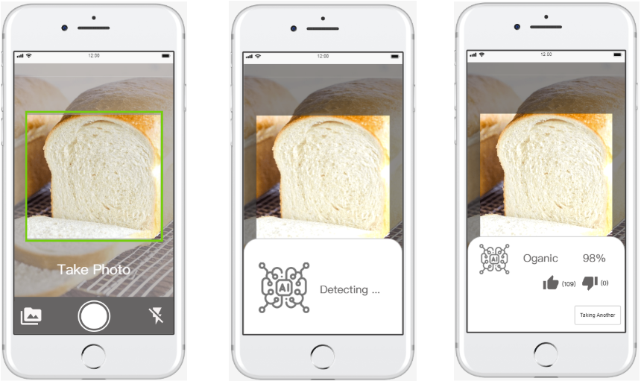
Business Initiative
A mobile APP that used CNN
techniques to help people distinguish between different kinds of waste
Prototype Photos
Notes:
CNN techniques to let the machine classify the waste, a mobile APP that can tell people what type of waste is when they are confused.
smart trash bin that can scan the trash and return the answer and automatic waste sortation machine that can be used in the waste disposal process.

Slide 4


Metric of Success
Before Launching…
Model Accuracy > 80%
Network Latency < 5s
After Launching…
Active Users
Usage Frequency
Notes:
[R&D]
accuracy of the image classification model should be more than 80% on average
network latency which should have a lower-than-5-second speed to return the predicted result.
[After launching]
track the number of downloads and the review score in the APP store
The APP should be downloaded by more than 40% of target users and receive
an average score that is more than 4.5/5.0 so we can say users are satisfied with our APP.

Slide 5



A Case Demo
Data Collection & Evaluation
Model Fitting
Implementation
Social Value
Data Collection
Data Evaluation
13.6K images
Kaggle
Pre-labeled
Captures all statements of trash
Organic
Recyclable
lighting conditions
placed squarely
Solutions
Notes:
we are using pre-labeled data images collected from Kaggle. The dataset contains 13.6K training images of organic and recyclable garbage.

Slide 6




A Case Demo
Data Collection & Evaluation
Model Fitting
Implementation
Social Value
Convoluted Neural Networks (CNN)
Primary choice for any image-related problems
Higher accuracy
Less computational power
Completely automatic
Notes:
we are using pre-labeled data images collected from Kaggle. The dataset contains 13.6K training images of organic and recyclable garbage.

Slide 7
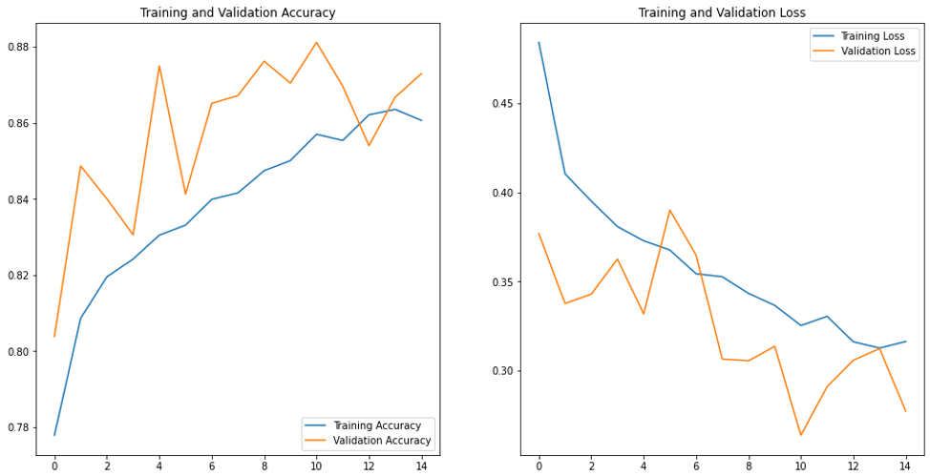
A Case Demo
Data Collection & Evaluation
Model Fitting
Implementation
Social Value
Hyperparameters tuning
3 convolution layers
ReLu activation function
…
Validation Accuracy :
85%
Notes:
we are using pre-labeled data images collected from Kaggle. The dataset contains 13.6K training images of organic and recyclable garbage.

Slide 8
A Case Demo
Data Collection & Evaluation
Model Fitting
Implementation
Social Value
1
3
Outsource the labeling work to the third party
Scaling up to classify more than two types of waste
2
Gaming competition
Notes:
we are using pre-labeled data images collected from Kaggle. The dataset contains 13.6K training images of organic and recyclable garbage.

Slide 9



A Case Demo
Data Collection & Evaluation
Model Fitting
Implementation
Social Value
For residents
Classify the wastes in seconds
Gain knowledge of the type of waste
For government
Save the cost of reclassification
Notes:
we are using pre-labeled data images collected from Kaggle. The dataset contains 13.6K training images of organic and recyclable garbage.

Slide 10
Questions?
Q&A

Slide 11
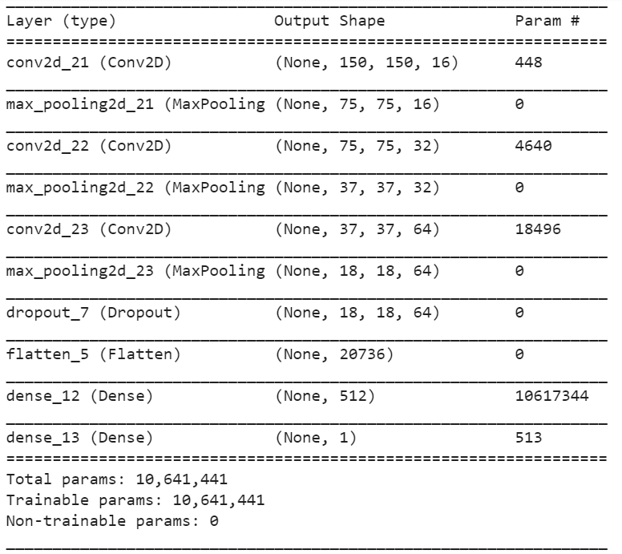
Appendix

Slide 12
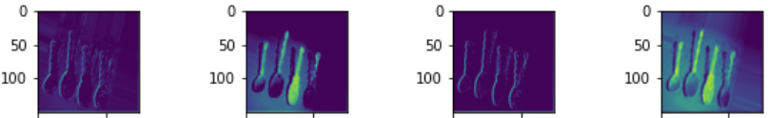
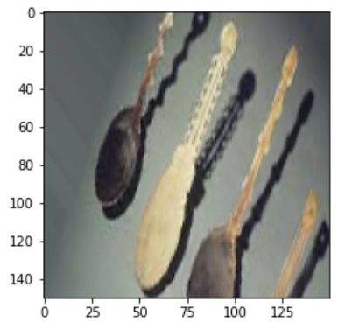
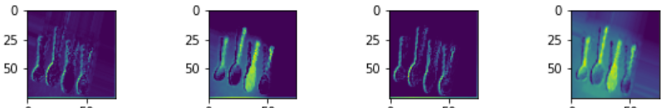
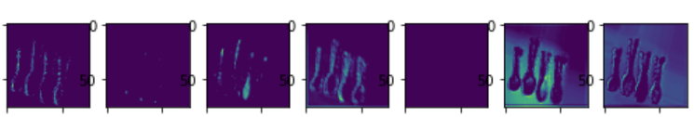
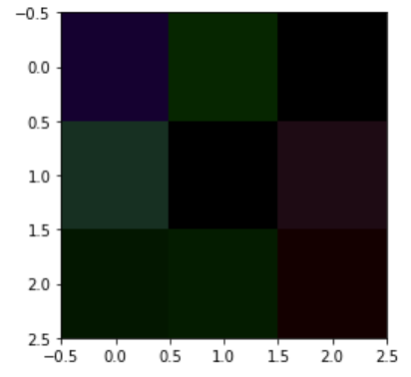
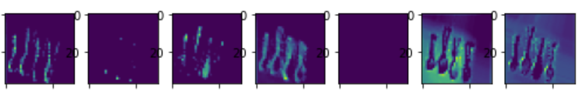
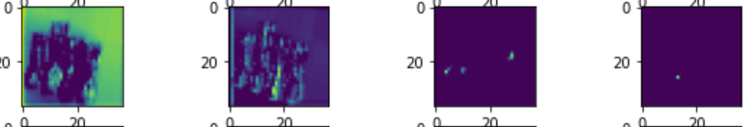
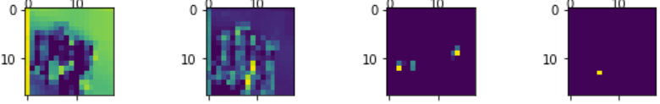
1.Convolution
2.Max_pooling
Input Image
3.Convolution
4.Max_pooling
5.Convolution
Filter Example
6.Max_pooling

