Slide 1
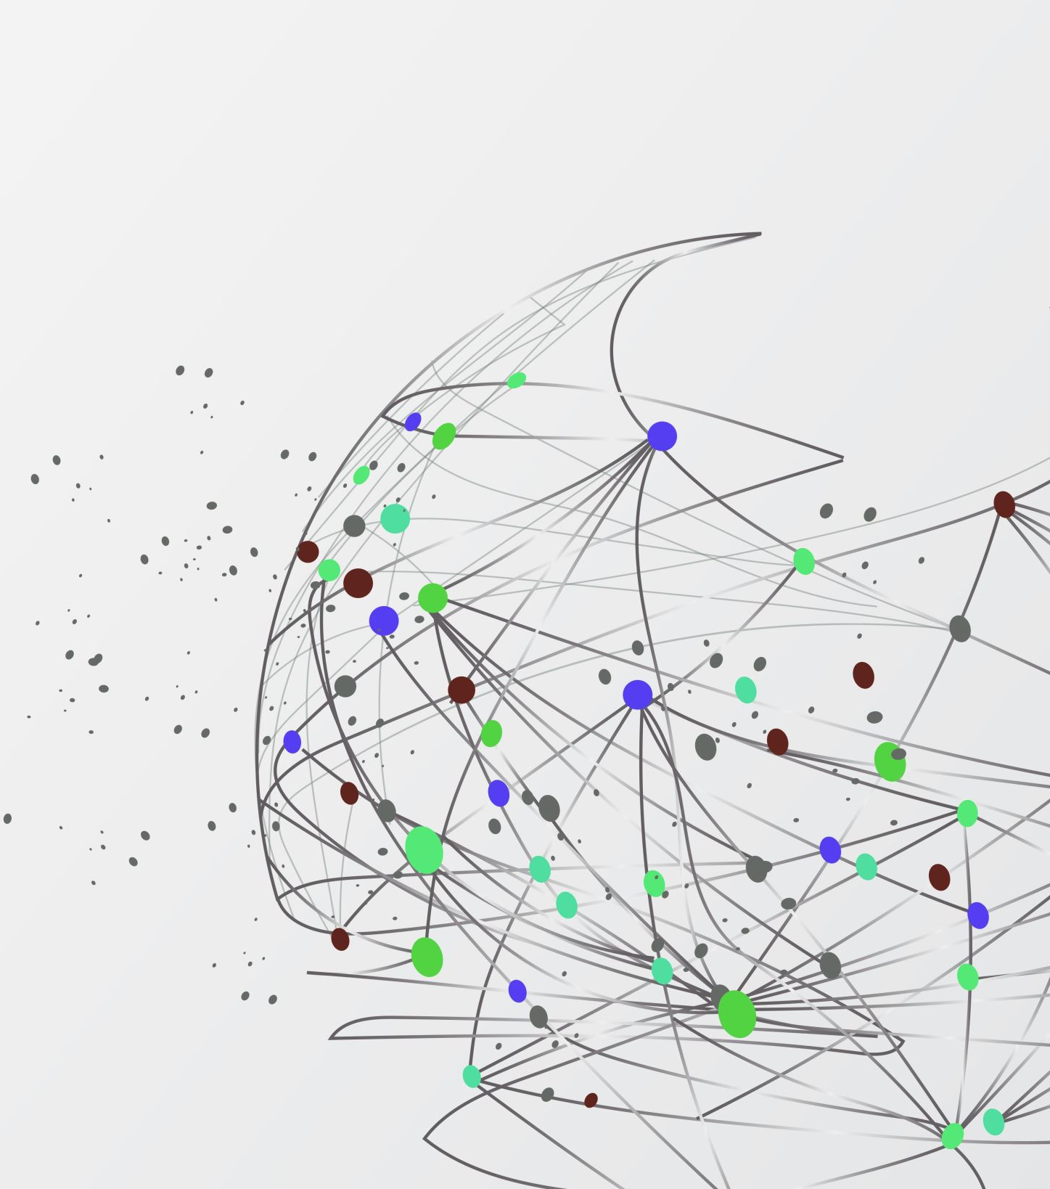

PerfectSpeechAi
Personalized AI Learning for All

Slide 2
Meet Team Noi Nois
Lynn-Shelsie Antioine
Jaeden Bowen

Slide 3
The challenge within education
Students with speech impediments can have difficulties with traditional learning methods since traditional education does not provide specific and diverse support for speech development for varying impediments.
Educators lack the resources and specialized tools to provide individualized, immediate support to help all students with their speech.
Under-privileged communities face lesser access to high-quality speech therapy and other language learning resources.

Slide 4
Introducing PerfectSpeechAI
Our AI-powered solution to aid with this issue.
This feature:
Uses a personalized learning-based approach on speech and language analysis.
Provides real-time feedback to help improve speech and communication.
Analyzes confidence, pacing, tone and overall delivery of speech.
Creates a free, more accessible learning aid for those in under-developed areas.

Slide 5
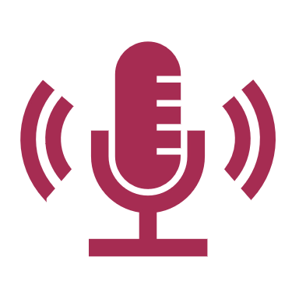
Key Features
Audio Recording – captures audio from the user’s microphone in real time and stores it.
Speech-to-text using the Google Cloud API speech to text.

Slide 6
Tools & Technologies used
Google Cloud API Speech to text
Additional json file

