Slide 1
Data Analysis in Python: pandas in Practice
Jan Smitka
jan.smitka@lynt.cz
@jansmitka
Lynt services s.r.o.

Slide 2


About Me

Slide 3


Slide 4
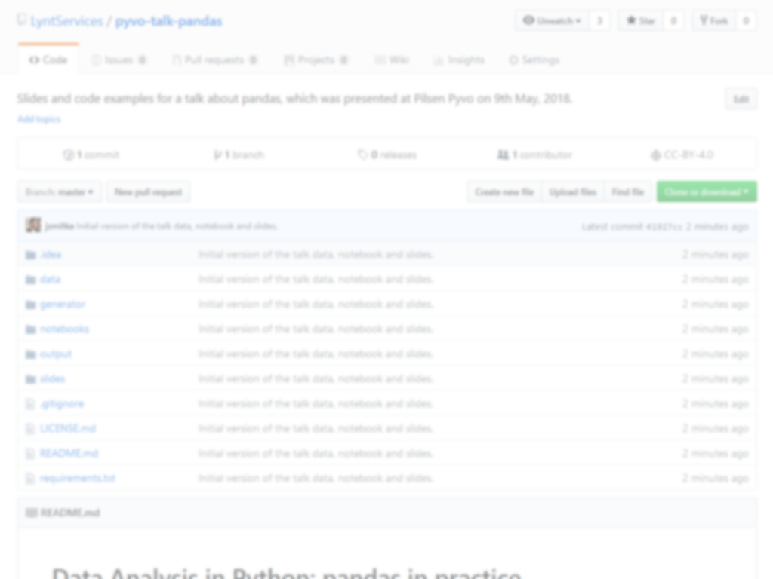
No need to write anything, everything is here:
https://u.lynt.cz/pandas

Slide 5
Motivation

Slide 6
Why not just use Excel, Google Sheets, etc.?

Slide 7
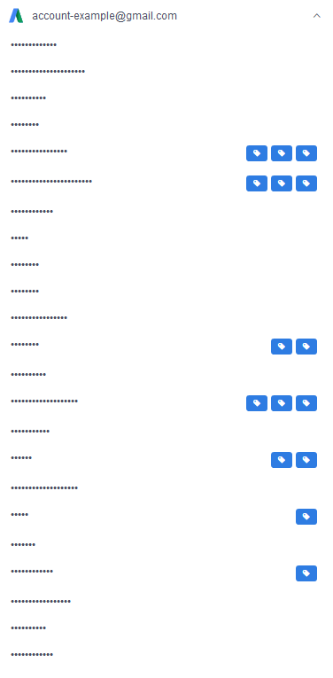

Slide 8


Slide 9

Quite a list!

Slide 10


Slide 11

Still going…

Slide 12


Slide 13

Are we there yet?

Slide 14


Slide 15

Are we there yet?

Slide 16

That was so long!

Slide 17

Card from Imperial Settlers board game, Copyright © 2014 PORTAL GAMES Ltd.
http://portalgames.pl/en/all-game-list/imperialsettlers/

Slide 18
Automation is a necessity

Slide 19
Why not just use pure Python?
Better performance
No need to reinvent the wheel

Slide 20
Say hello to pandas!
open-source (BSD), high-performance data analysis library
supported by the NumFOCUS non-profit organization under their PyData program
IPython, matplotlib, NumPy, Anaconda and many other tools
based on NumPy – many functions can be combined

Slide 21
Introduction

Slide 22
Installation
pip install pandas

Slide 23
Recommended libraries
bottleneck: accelerates several operations related to NaN handling
xlrd: enables reading of XLS and XLSX files
XlsxWriter: enables writing of XLSX files
SQLAlchemy: reading/writing from/to SQL databases, requires a database driver, such as pymysql or psycopg2

Slide 24
Data structures: Series
pandas.Series
homogeneous 1-dimensional array,
each element has the same dtype

Slide 25
Data structures: DataFrame
pandas.DataFrame
Index
ID
Name
Age
Job
Collection of named Series with index.

Slide 26
Data types (dtype)
fixed-size numerics:
bool
int32, int64
float64
datetime64[ns]
timedelta[ns]
arbitrary data:
category (like enum)
object
integers have limited size!

Slide 27
A real world example

Slide 28
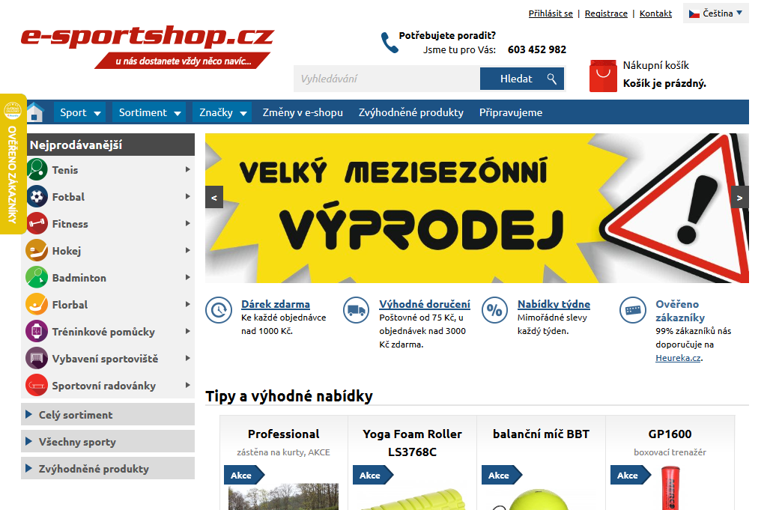
Source of Fake Data

Slide 29
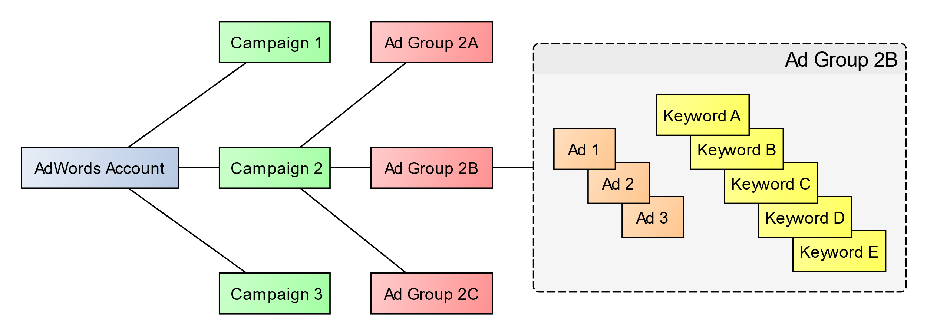
AdWords Account Structure
Notes:
Představit účet „odspoda“.

Slide 30
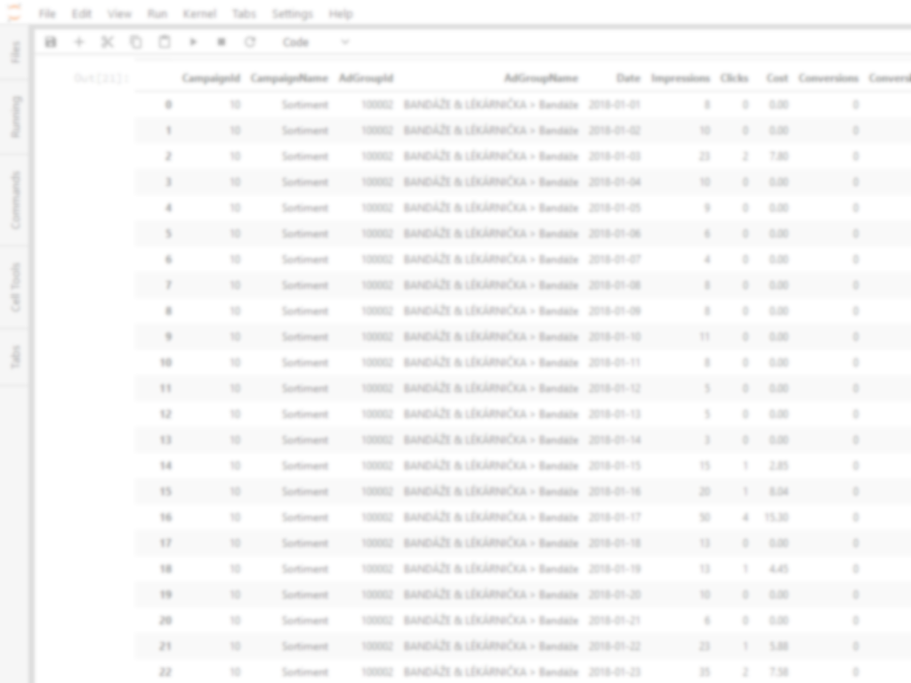
Open the Jupyter Notebook

Slide 31
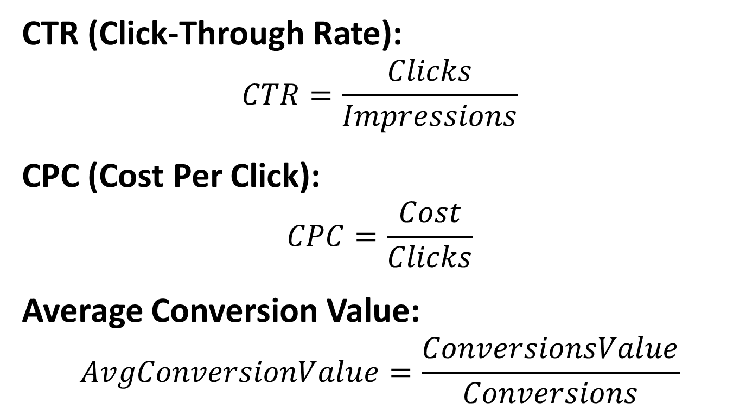
Common Metrics in AdWords
CTR (Click-Through Rate):
$$CTR=\frac{Clicks}{Impressions}$$
CPC (Cost Per Click):
$$CPC=\frac{Cost}{Clicks}$$
Average Conversion Value:
$$AvgConversionValue=\frac{ConversionsValue}{Conversions}$$

Slide 32
Return to Jupyter Notebook, section Computations

Slide 33
SQL-like joins: left join
left
right
key | name
A | Arthur Dent
B | Ford Prefect
C | Tricia McMillan
key | drink
C | Wine
D | That Old Janx Spirit
A | Tea
merge(how='left')
key | name | drink
A | Arthur Dent | Tea
B | Ford Prefect | NaN
C | Tricia McMillan | Wine

Slide 34
SQL-like joins: right join
left
right
key | name
A | Arthur Dent
B | Ford Prefect
C | Tricia McMillan
key | drink
C | Wine
D | That Old Janx Spirit
A | Tea
merge(how='right')
key | name | drink
C | Tricia McMillan | Wine
D | NaN | That Old Janx Spirit
A | Arthur Dent | Tea

Slide 35
SQL-like joins: inner join
left
right
key | name
A | Arthur Dent
B | Ford Prefect
C | Tricia McMillan
key | drink
C | Wine
D | That Old Janx Spirit
A | Tea
merge(how='inner')
key | name | drink
A | Arthur Dent | Tea
C | Tricia McMillan | Wine

Slide 36
SQL-like joins: outer join
left
right
key | name
A | Arthur Dent
B | Ford Prefect
C | Tricia McMillan
key | drink
C | Wine
D | That Old Janx Spirit
A | Tea
merge(how='outer')
key | name | drink
A | Arthur Dent | Tea
B | Ford Prefect | NaN
D | NaN | That Old Janx Spirit
C | Tricia McMillan | Wine

Slide 37
Return to Jupyter Notebook, section Joining Tables

Slide 38
Conclusion

Slide 39
Other Features
Working with Time Series and Time Deltas.
Categorical data.
Advanced statictics.
Other I/O formats:
CSV,
HDF5,
JSON,
Google BigQuery,
and more…

Slide 40
Related Projects
Data Visualization
matplotlib
seaborn
Bokeh
Computations
Statsmodels
scipy
Dask and Blaze
N-dimensional structures
xarray
Machine Learning
scikit-learn
sklearn-pandas
Output
pygsheets

Slide 41
Any Questions?

Slide 42


Attribution 4.0 International (CC BY 4.0)

Slide 43

We are looking for Python Devs! https://lynt.cz/kariera
Thank you for listening!
Interested in PPC? Follow: @PPCrobot

