Slide 1
Think Other

Slide 2
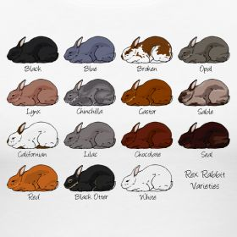
Rabbits
What are the commons?
What are the differences?

Slide 3
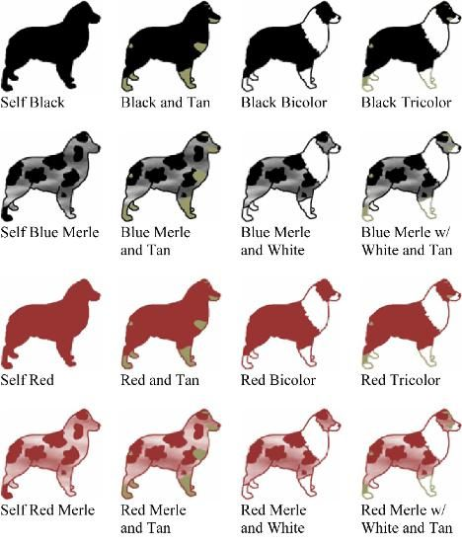
Dogs
What are the commons?
What are the differences?

Slide 4
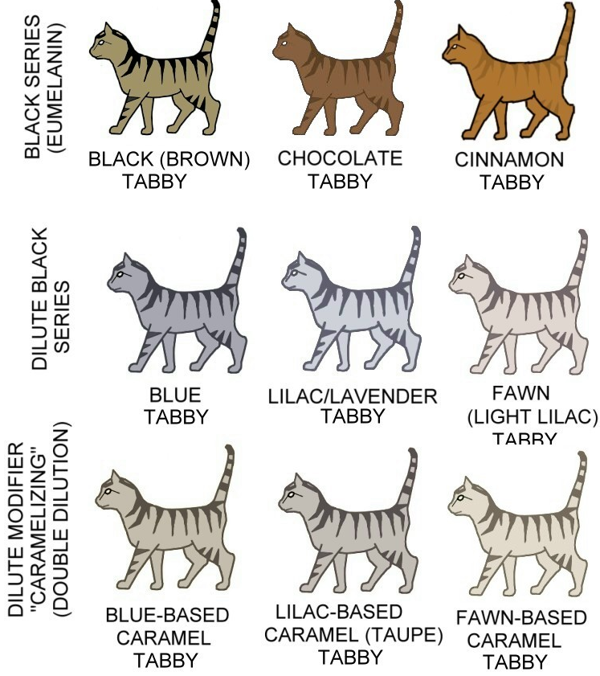
Stupid, huh? What are you really want to say?

Slide 5
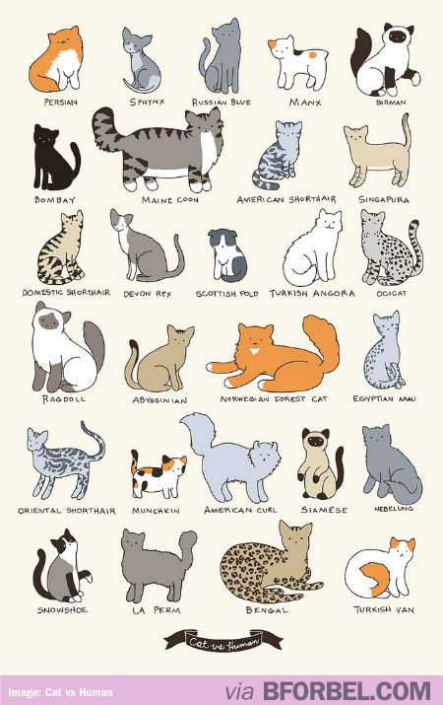
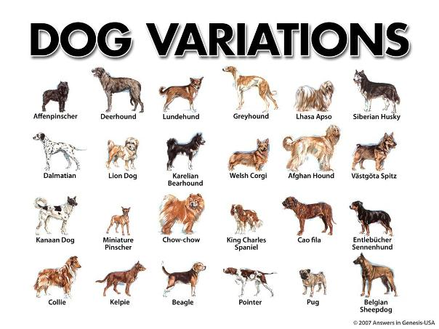

Slide 6
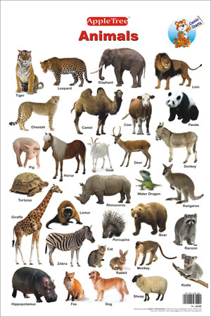

Slide 7
Human are good at recognizing commons and differences.
So what for?
To form concept. So what for?
Apply concept to others.
You don’t have to learn everything in the world.
You just need to learn every kind of things in the world.

Slide 8
Problems
Easy to know there is dog kind, cat kind and other kind of concrete stuff.
The more abstract things are, the more difficultly you can form concepts.

Slide 9
Problems
Get the sum from 1 to n.
Get the product from 1 to n.

Slide 10
Recursive Function

Slide 11
Some words from design patterns for ending.
When you design a system, it doesn’t mean you create objects/classes according to real/concrete existence in the world.
Often the objects/class you create do not exist concretely in the world at all. What exists are the concepts Human abstracts from things. Here things not only means physical things, also means methods, ideas and other intangible concepts. Those are the keys to the success design.

