Slide 1

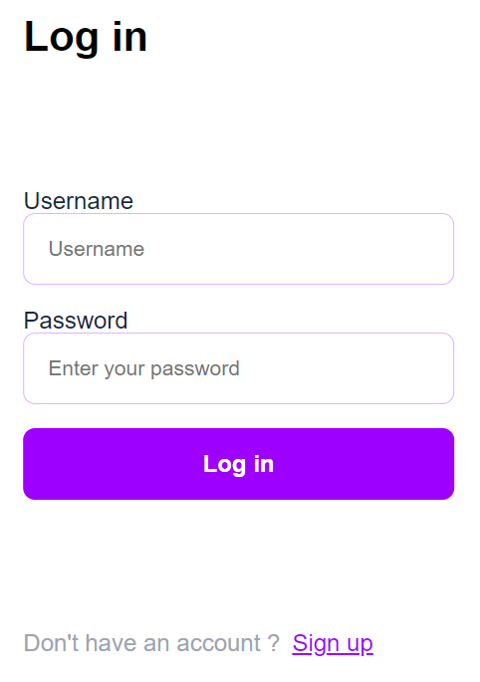
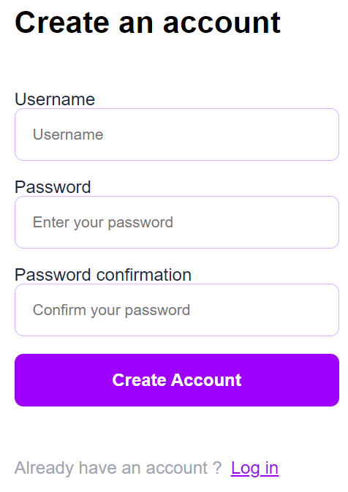


Test
Log in page
2. Register page
3. Home page
Registered (PW), no successful or failed box (no message box)
Using the information registered (PW:123) cannot log in (no message box)
Notes:
profile.html: This template will be used to display user's profile information.

Slide 2
Test
4. Meeting
Can create meeting in the past (eg: date: 01/01/2020)
Comment column is required
5. Profile
Cannot upload an avatar
Change PW does not work
Update email: abc@w is not successfully updated, but no message box show (maybe users get confused whether this is submitted or not)
6. Logout
7. Q&A
When click submit, no message box show
Notes:
profile.html: This template will be used to display user's profile information.

