Slide 1
What Brews a Winning Cup?
What 1,338 professional coffee reviews say about quality, and how much of it we can predict
Group 9
Bryan Larison • Gina Fuller • Alexandra Hagen • Garrett Williford
Notes:
We analyzed Coffee Quality Institute reviews to find what separates great coffee from average, and built models to weigh each factor.

Slide 2
Altitude, origin and clean beans brew a winning cup
26%
+0.1
−0.1
+4.6
of score variation predicted from farm data alone (Random Forest)
points per 100 m of altitude, other factors held equal
points per category 2 bean defect
point gap: Ethiopia vs. Mexico, the largest origin
On the cupping table
Flavor, aftertaste and the cupper's overall impression separate the top 10% from the rest
Processing method matters statistically, but only by about 0.1 flavor points
Scores have become more consistent: flavor spread fell ~25% from 2010–12 to 2015–17
What Brews a Winning Cup? | Group 9
2
Notes:
The headline numbers. Each one is backed up in the slides that follow.

Slide 3
1,338 CQI reviews, cleaned once and tested properly
1
2
3
4
Clean
Explore
Test
Model
Removed a 0-point review, 35 impossible altitudes (up to 190,164 m) and 264 zero moisture readings
Six questions on sensory traits, time, processing, altitude and origin
Kruskal-Wallis, Spearman and Levene tests so small gaps aren't over-read
Linear regression and Random Forest, 5-fold cross-validated
Source: Coffee Quality Institute reviews scraped by James Ledoux (2018), via TidyTuesday. 1,310 arabica and 28 robusta, graded 2010–2018.
What Brews a Winning Cup? | Group 9
3
Notes:
v1 cleaned the data separately for each chart. Now one cleaning step feeds everything.

Slide 4
Q1
Top coffees win on flavor, aftertaste and overall impression
Top 10% = 84.7+ points
The winners lead on every attribute, by the most on flavor, aftertaste and overall impression
Uniformity, clean cup and sweetness are near 10/10 for almost every coffee, so they rarely decide a winner
Flavor alone correlates 0.83 with the total score
What Brews a Winning Cup? | Group 9
4
Notes:
Top 10% = total cup points at or above the 90th percentile. Bars show how much higher the top group scores on each attribute.

Slide 5
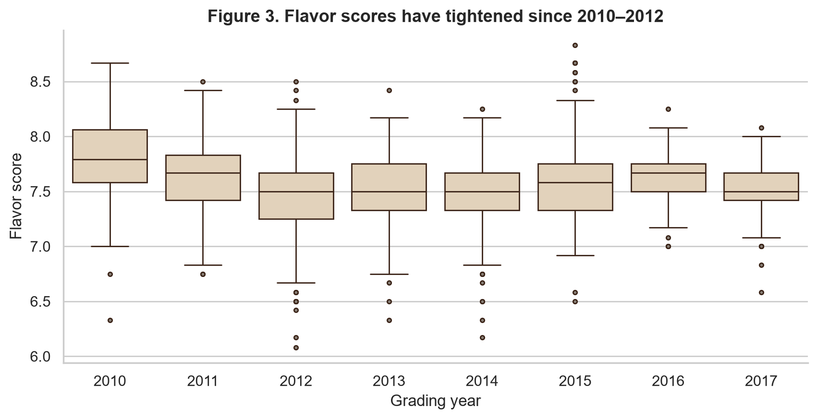
Q2
Flavor scores have become more consistent since 2012
−25%
drop in flavor-score spread, 2010–12 vs. 2015–17
Std. dev. fell from 0.39 to 0.29 (Levene p < 0.001)
Fewer extreme scores in recent years
Early years have fewer reviews, so some of this may reflect which coffees were submitted
What Brews a Winning Cup? | Group 9
5
Notes:
Grading year replaces v1's messy harvest_year. Levene test compares the variance of the two periods.

Slide 6
Q3
Processing method matters, but only by about 0.1 points
Real, but small
Differences are significant (Kruskal-Wallis p = 0.002)
…but processing explains only ~1% of flavor variation
Natural/dry beats washed by ~0.09 points (p < 0.001)
Semi-washed and honey have too few samples to rank confidently
What Brews a Winning Cup? | Group 9
6
Notes:
Kruskal-Wallis is a non-parametric ANOVA. Effect size epsilon-squared of about 0.01 means processing explains ~1% of flavor variation.

Slide 7
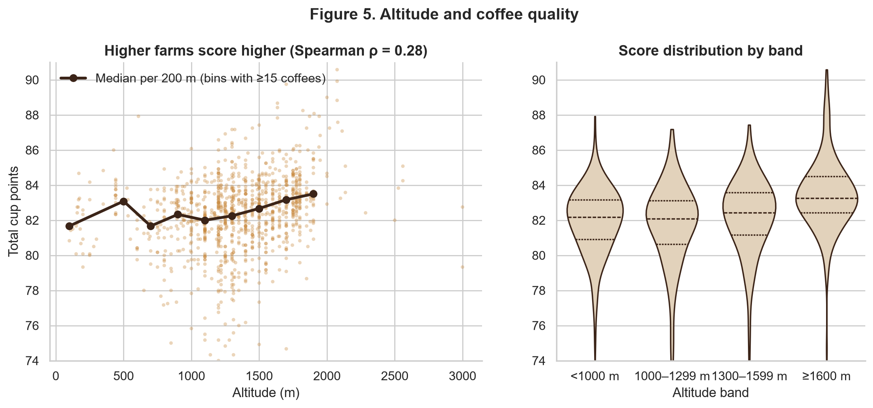
Q4
Higher farms score higher, especially above 1,300 m
ρ = 0.28
rank correlation between altitude and score (p < 0.001)
Median score 83.2 at ≥1,600 m vs. 82.2 below 1,000 m
Flat below ~1,300 m, then a steady climb
Too few farms above 2,000 m to judge
What Brews a Winning Cup? | Group 9
7
Notes:
Spearman correlation is rank-based, so it is robust to the skewed score distribution. The line only shows altitude bins with at least 15 coffees.

Slide 8
Q5
East Africa leads; Mexico and Central America trail
5-point spread
Ethiopia (85.5) and Kenya (84.3) top the list
Colombia is the best high-volume origin (183 reviews, 83.1)
Mexico has the most reviews (236) but averages 80.9
Differences across countries are highly significant (p < 0.001)
What Brews a Winning Cup? | Group 9
8
Notes:
Countries with at least 20 reviews. v1 counted samples per country, which measures how much each country submitted, not quality.

Slide 9
Q6
Can we predict quality before anyone tastes the coffee?
The tempting model
Our model
Predict total score from the 10 sensory scores
R² ≈ 1.0, because the total is their sum
Circular: it teaches us nothing new
Predict total score from information known before tasting
Farm: altitude, country, variety, species
Beans: processing, moisture, color, defects
Grading year
Three models compared with 5-fold cross-validation: a baseline that always guesses the average, linear regression, and a Random Forest.
What Brews a Winning Cup? | Group 9
9
Notes:
Total cup points is literally the sum of the 10 sensory scores, so regressing it on those scores is circular. We predict from pre-tasting information instead.

Slide 10
Q6
Farm data alone predicts about a quarter of quality
What this means
Both models clearly beat guessing the average
Random Forest wins because effects aren't straight lines (altitude only kicks in above ~1,300 m)
The other ~75% comes from roasting, the cupper and lot-to-lot differences we can't see
1.83 pts
1.65 pts
1.57 pts
avg. error, baseline
avg. error, linear regression
avg. error, random forest
What Brews a Winning Cup? | Group 9
10
Notes:
R² is averaged over 5 cross-validation folds. MAE is the average prediction error in points. On a held-out 20% test set, the Random Forest scored R² = 0.22.

Slide 11
Q6
Altitude, origin and bean defects carry the most weight
+0.10 pts
per 100 m of altitude (p < 0.001)
−0.11 pts
per category 2 defect, e.g. broken or insect-damaged beans (p < 0.001)
Processing method, bean color and species add almost nothing once these are known.
What Brews a Winning Cup? | Group 9
11
Notes:
Permutation importance: shuffle one feature on held-out data and measure how much R² drops. Effect sizes come from the linear regression, holding the other factors constant.

Slide 12
The recipe for a winning cup
For buyers
For producers
Limits and next steps
Favor lots grown above 1,600 m
Check green-bean defect counts
East African and Colombian origins lead
Sorting out defects is the most controllable lever
Processing choice is a small lever (~0.1 pts)
Flavor and aftertaste are what judges reward
Self-submitted coffees, not a random sample
17% of rows missing altitude; only 28 robusta
Next: add roast and price data; model specialty-grade odds
Code, data and notebook: github.com/LyonmanX/Coffee-Analysis
Notes:
Wrap up with the actionable takeaways, then the honest limits of the data.

