Slide 1
WIRELESS TECHNOLOGY EVOLUTION

Slide 2
Introduction
Mobile generations evolve every 10 years.
Each generation (G) represents a change in the fundamental nature of signal, the speed of data , and the types of services available to the public.
Mobile generations enable faster, more capable wireless connectivity for communication, data ,and emerging tech.

Slide 3
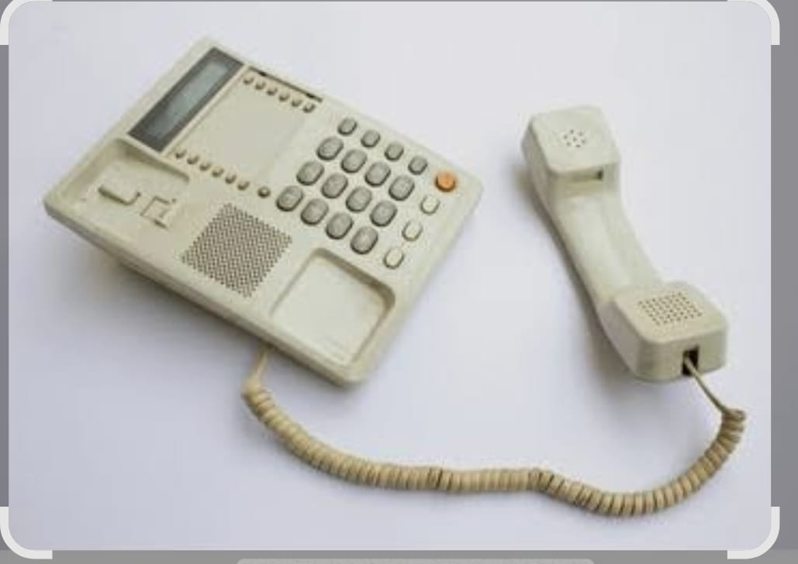
1G- The Analog Voice Era (1980s)
The 1980s marked the birth of mobile telecommunication.
It was defined by the transition from stationary landline to the first truly mobile devices.
The technology used was Advanced Mobile Phone systems (AMPS), a pioneering yet limited technology that laid the foundation for the cellular networks being used today

Slide 4
Technology and Characteristics
Analog Signals- AMPS used analog Frequency Modulation (FM) for voice transmission. This converted sound into continuous electronic pulses rather than the binary “1s” and “0s” (digital) used today.
The cellular concept- Engineers divided geographic regions into smaller, overlapping “cells “. This allowed frequencies to be reused in non- adjacent areas, enabling the system to support more users than a single large radio tower could.

Slide 5
3. FDMA ( Frequency Division Multiple Access)- In a 1G network, each conversation was assigned a dedicated pair of frequencies ( one for transmitting and one for receiving) with a 30kHz bandwidth for the entire duration of the call.
4. Networking Insight (circuit switching)- This meant a dedicated physical radio channel was kept open and “locked” for a single all.
Because it was an open analog circuit , it had no encryption, making it extremely easy for eavesdroppers to listen in using simple
Radio scanners.

Slide 6
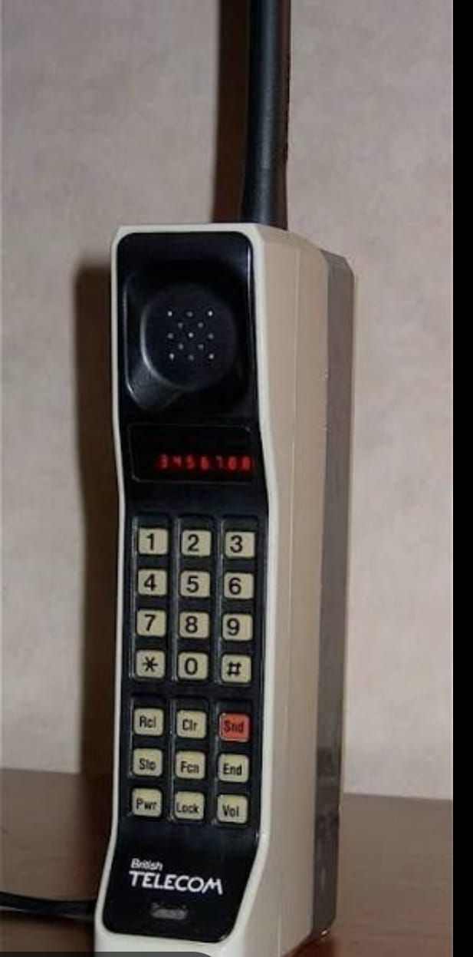
The era of “The Brick”
The Motorola DynaTAC 8000X- was invented by Martin Cooper, this was the world’s first handheld mobile phones. Known as the “Brick Phone”, due to its weight and shape. It was popular in the 1980s.
Car and “Bag” phones- Due to their high-power requirements and the size of transceivers, many 1G phones were not truly pocketable. They were either permanently installed in vehicles (car phones) or carried in shoulder bag containing a heavy battery pack and a handset (Bag Phones)
.

Slide 7
Target Audience- These devices were luxury items, costing thousands of dollars, and were used almost exclusively by high-level business executives and government officials.

Slide 8
2G-The digital Revolution(1990s)
It was introduced in 1991.
In this era the most significant pivot in telecommunication ocured: the transition from Analog to Digital.

Slide 9
4G – The Broadband Era (2010s)
Introduction
4G technology, introduced in the late 2000s and widely deployed in the 2010s, revolutionized mobile communication by providing significantly faster data speeds and enhanced network capabilities compared to 3G. It enabled high-quality video streaming, faster downloads, and improved overall mobile internet experience.

Slide 10
Technology and Characteristics
LTE (Long Term Evolution): The dominant 4G technology, offering high data rates and low latency.
OFDM (Orthogonal Frequency Division Multiplexing): A key modulation technique used in 4G to improve spectral efficiency and reduce interference.
All-IP Network: 4G networks are fully IP-based, supporting seamless integration of voice, data, and multimedia services.
Data Speeds: Typical speeds range from 10 Mbps to 100 Mbps, with peak speeds reaching up to 1 Gbps in advanced deployments.

Slide 11
Key Features
High-Speed Mobile Internet: Enabled HD video streaming, online gaming, and faster web browsing.
Enhanced Voice Services: Introduction of VoLTE (Voice over LTE) for clearer and faster voice calls.
Improved Network Capacity: Better support for multiple devices and higher data traffic.
Low Latency: Critical for real-time applications like gaming and video conferencing.

Slide 12
Applications
Streaming Services: Popularized mobile video platforms like YouTube, Netflix, and Twitch.
Mobile Gaming: Supported the rise of multiplayer and cloud gaming on mobile devices.
IoT Expansion: Facilitated growth of Internet of Things devices with reliable connectivity.
Smart Cities: Enabled smart infrastructure and connected services in urban areas.

Slide 13
Advantages
Much faster data speeds than 3G.
Improved network reliability and capacity.
Support for advanced multimedia and real-time applications
Challenges
High deployment costs for infrastructure upgrades.
Spectrum allocation and management complexities.
Initial device compatibility issues during early rollout.

Slide 14
5G-Wireless Technology
Introduction
5G is the fifth generation of mobile wireless communication designed to provide very high data speeds, ultra-low latency, high reliability, and massive device connectivity. Unlike earlier generations, 5G supports not only human communication but also machines and smart systems, enabling advanced technologies such as IoT, smart cities, and autonomous vehicles.

Slide 15
Key Objectives of 5G
Achieve multi-Gbps data speeds.
Provide low latency (≈1 m s).
Support millions of devices simultaneously.
Ensure high reliability.
Improve energy efficiency.
Main Features
High Speed: Up to 10–20 Gbps, enabling HD/8K streaming and fast downloads,
Low Latency: Suitable for real-time applications like remote surgery and self-driving cars.
Massive Connectivity: Supports IoT and smart devices.
High Reliability: Used in mission-critical services.
Energy Efficiency: Lower power consumption and longer battery life.

Slide 16
5G Frequency Bands
Low Band: Wide coverage, lower speed
Mid Band: Balanced speed and coverage
High Band (mm Wave): Very high speed, short range
Key Technologies in 5G
Massive MIMO: Multiple antennas to increase capacity.
Beamforming: Directs signals to users for better performance.
Network Slicing: Multiple virtual networks on one physical network.
Edge Computing: Reduces latency by processing data closer to users.
5G Service Types
eMBB ( enhanced mobile broadband): High-speed mobile broadband
URLLC (ultra-reliable low-latency communication): Ultra-reliable, low-latency communication
MTC ( massive machine -type communication): Massive machine-type communication (IoT)

Slide 17
Applications of 5G
Smart cities
Autonomous vehicles
Telemedicine
Industrial automation
Smart agriculture
Virtual reality and online gaming
Advantages
Faster speeds
Lower delay
Supports future technologies
Better network efficiency
Challenges
High deployment cost
Limited mm Wave coverage
Security and privacy issues
-5G is a major advancement in wireless communication that enables a highly connected and intelligent world. With its speed, low latency, and massive connectivity, it forms the foundation for future digital technologies and next-generation networks.

Slide 18
6G- The Intelligence Era (2030s and Beyond)
This is the sixth generation of wireless technology, a successor to 5G.
6G is being developed to connect the physical, digital and human worlds.
Expected to be commercially available around 2030.

Slide 19
Technology and characteristics
6G will utilize several technologies:
Terahertz (THz) Frequencies: 6G will operate at frequencies from 100 GHz to 10 THz, offering massive bandwidth and unprecedented data transfer speeds.
2. AI-Native Architecture: Artificial Intelligence will be the "brain" of the network, managing THz waves, fixing signal drops, and optimizing energy use in real-time.
3. Cell-Free Networking: Devices will connect to multiple small sensors simultaneously, providing a "follow-me" bubble of high-speed connectivity.
4. Extreme Low Latency: 6G aims for latency below 0.1 ms, critical for "synchronous" communication.

Slide 20
Capabilities of 6G
It will enable:
Holographic Telepresence: Transmitting high-fidelity 3D holograms of people, allowing for virtual presence in real-time.
2. The Internet of Senses: Supporting haptic communication, transmitting textures, resistance, smells, and tastes via neural interfaces.
3. Digital Twins: Creating real-time digital replicas of humans, factories, or cities, predicting health issues or traffic accidents.
4. Centimeter-Level Sensing: The network acts as a radar, detecting object locations and shapes without cameras, protecting privacy while ensuring safety . Networking Insight: Global Coverage6G aims for universal connectivity through:1. Space-Air-Ground Integration: Integrating terrestrial towers with LEO satellites and high-altitude drones, ensuring 100% global coverage

Slide 21
5G vs 6G
Speed:
6G blows 5G out of the water with data rates shooting up to 1 Tbps - that's like 50 times faster.
Latency:
6G's got it down to under 0.1 ms. Like, almost instant .
Connectivity:
While 5G connects things, 6G connects everything - physical, digital, human worlds.
Coverage:
6G's going to blanket the globe, integrating space, air, and ground networks. No more dead zones .And with 6G, you get wild stuff like holographic calls, feeling textures over the network

Slide 22
Conclusion
​The Foundation (1G & 2G): We began by simply trying to untether ourselves from the wall. We moved from Analog Voice to Digital Text, making communication portable and private for the first time.
​The Content Revolution (3G & 4G): This was the era where the 'Phone' died and the 'Smartphone' was born. We shifted from talking to consuming. We brought the entire internet into our pockets, enabling the streaming, social media, and gig economy we live in today.​
The Connectivity Leap (5G & 6G): We are now moving beyond the screen. 5G is about connecting the world around us—our cars, our cities, and our industries. Looking toward 6G, we are entering the 'Intelligence Era,' where the line between the physical and digital worlds will disappear through holograms, AI-native networks, and total global connectivity.

