Slide 1
REMIT · PRODUCT SHOWCASE
Invoices your agents can actually pay.
Autonomous accounts payable with exact-action controls.
Notes:
Open with the one-line promise: routine supplier invoices can be handled by agents, while risky changes stop before money moves.
[Sources]
- https://remithq.xyz
- /Users/oisinlyons/Documents/Codex/2026-07-24/okay-so-i-have-a-hackathon/worktrees/remit-main/docs/product/PRODUCT-BRIEF.md
[/Sources]

Slide 2
The bottleneck is authorization, not extraction.
THE 990 Routine invoices
Known supplier. Unchanged beneficiary. Amount inside policy. The agent can prepare and execute the exact permitted action without interrupting a person.
THE 10 Material exceptions
New supplier. Changed bank account. Unusual amount. The payment is held until the exact change has the evidence and distinct-human approval the policy requires.
2
Notes:
The model can read invoices, but the company still needs a safe decision about whether this exact payment is allowed. Remit separates the routine majority from the material exceptions.
[Sources]
- /Users/oisinlyons/Documents/Codex/2026-07-24/okay-so-i-have-a-hackathon/worktrees/remit-main/README.md
- /Users/oisinlyons/Documents/Codex/2026-07-24/okay-so-i-have-a-hackathon/worktrees/remit-main/docs/product/PRODUCT-BRIEF.md
[/Sources]

Slide 3
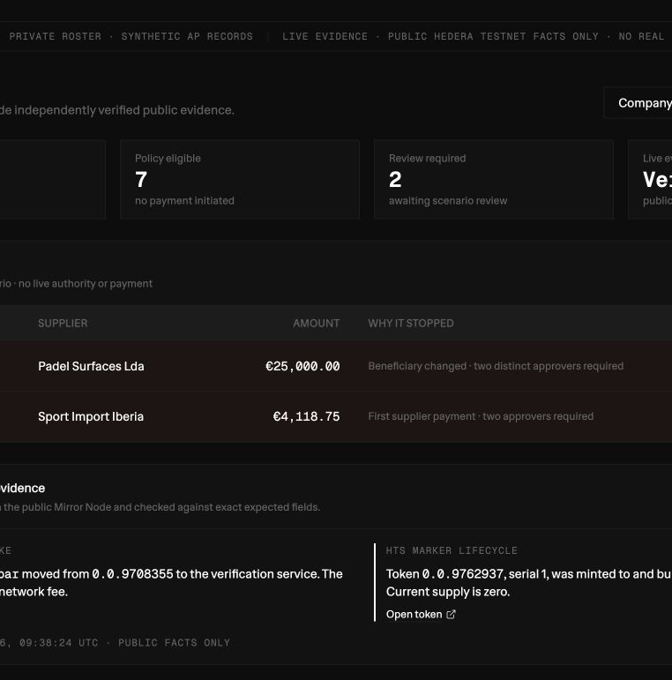
One queue for the whole AP day.
See what can move — and what must stop.
Remit receives invoices, applies deterministic policy, and surfaces only the exceptions that need a decision. • routine invoices become policy-eligible • risky changes are held before payment • product state sits beside public Hedera evidence
3
Notes:
This is the live public demo. Point first to the policy-eligible and review-required counts, then to the held invoices, and finally to the independently checked Hedera Testnet evidence.
[Sources]
- https://remithq.xyz/dashboard
- /tmp/remit-product-deck-20260726/remit-dashboard.png
- /Users/oisinlyons/Documents/Codex/2026-07-24/okay-so-i-have-a-hackathon/worktrees/remit-main/apps/web/src/app/(app)/dashboard/page.tsx
[/Sources]

Slide 4
Example: the invoice matches — except where the money goes.
Padel Surfaces Lda · €25,000
The supplier, amount, invoice record, and business context match the expected purchase.
But the beneficiary account is different. That one change makes this a new, higher-risk payment action.
WHAT MATCHES
WHAT CHANGED
Supplier and invoice identity
€25,000 amount and reference
PO, tax, and duplicate checks
Beneficiary bank account
Route changes to review
Two distinct approvers required
4
Notes:
Use this as the demo story. Remit is not claiming the invoice is genuine; it is showing that a beneficiary change is materially different from the previously trusted supplier baseline and therefore cannot ride the routine lane.
[Sources]
- https://remithq.xyz/dashboard
- /Users/oisinlyons/Documents/Codex/2026-07-24/okay-so-i-have-a-hackathon/worktrees/remit-main/docs/product/PRODUCT-BRIEF.md
[/Sources]

Slide 5
From invoice to a provable payment decision.
01 / FREEZE
02 / ROUTE
03 / SETTLE
Receive + freeze
Lock supplier, beneficiary, amount, reference, and expiry into one canonical action digest.
Policy + authority
Route to autonomous, review, or blocked. Any approval is bound to that exact digest.
Execute + reconcile
Execute the admitted effect once, then expose durable receipts and public ledger evidence.
5
Notes:
The digest is the thread through the system. If any material field changes after approval, the digest changes and the old authority no longer applies.
[Sources]
- /Users/oisinlyons/Documents/Codex/2026-07-24/okay-so-i-have-a-hackathon/worktrees/remit-main/docs/architecture/decisions/0002-canonical-action-protocol.md
- /Users/oisinlyons/Documents/Codex/2026-07-24/okay-so-i-have-a-hackathon/worktrees/remit-main/docs/architecture/decisions/0003-deterministic-authorization.md
- /Users/oisinlyons/Documents/Codex/2026-07-24/okay-so-i-have-a-hackathon/worktrees/remit-main/docs/product/PRODUCT-BRIEF.md
[/Sources]

Slide 6
A wallet is an actor — not automatically a vote.
AGENT The acting software unit. It holds a wallet, submits exact actions, and executes only inside a standing mandate.
HUMAN World groups wallets by backing person. Five agent wallets owned by one human still count once for quorum.
COMPANY ROLE Organisation membership and approval authority stay separate. A unique human is not automatically an approver.
6
Notes:
This answers the common wallet question: one person may have multiple agents and wallets, but multiplying wallets must not multiply approval power. Human uniqueness and company authority are deliberately independent.
[Sources]
- /Users/oisinlyons/Documents/Codex/2026-07-24/okay-so-i-have-a-hackathon/worktrees/remit-main/docs/architecture/AUTHORITY-MODEL.md
- /Users/oisinlyons/Documents/Codex/2026-07-24/okay-so-i-have-a-hackathon/worktrees/remit-main/docs/sponsors/WORLD.md
- /Users/oisinlyons/Documents/Codex/2026-07-24/okay-so-i-have-a-hackathon/worktrees/remit-main/packages/world-adapter/src/ens.ts
[/Sources]

Slide 7
The experimental settlement uses two NFTs and one payment asset.
Atomic means the whole settlement succeeds — or none of it does.
Hedera Testnet mechanism proof · synthetic value · not a production payment rail.
RMPAY · Payable NFT
Commits to the invoice and exact payment-action digest: what is being settled.
RMCTL · Control NFT
One-use execution artifact bound to the same action and authorization evidence.
RMEURT · Settlement token
Synthetic two-decimal fungible asset. This is what actually moves between accounts.
HIP-551 · Atomic batch
Transfer exact RMEURT, return and burn both NFTs, then commit the digest — all or none.
7
Notes:
The Payable NFT is the payment identity, the Control NFT is the one-use execution artifact, and RMEURT is the synthetic money-like asset. The successful batch transfers 48,000 atoms and consumes both NFTs. The control artifact currently uses fixture authorization evidence, so this is a mechanism proof, not production authority.
[Sources]
- /Users/oisinlyons/Documents/Codex/2026-07-24/okay-so-i-have-a-hackathon/worktrees/remit-main/docs/architecture/decisions/0011-experimental-dual-token-atomic-settlement.md
- /Users/oisinlyons/Documents/Codex/2026-07-24/okay-so-i-have-a-hackathon/worktrees/remit-main/docs/evidence/hedera-dual-token-live-2026-07-26.md
- https://hips.hedera.com/hip/hip-551
[/Sources]

Slide 8
Each sponsor is load-bearing for a different reason.
ENS Find the agent
Readable names and forward/reverse resolution make agent wallets discoverable. ENS never grants authority.
WORLD Count the human
AgentBook and action-time proof prevent one person with multiple agents from filling multiple quorum slots.
HEDERA Enforce the effect
Atomic settlement, consensus receipts, token consumption, and Mirror evidence make execution exact and auditable.
8
Notes:
Keep the boundaries crisp. ENS says what the wallet is called, World says whether two wallets represent distinct people, and the company says whether those people have the required role. Hedera executes and proves the exact admitted effect.
[Sources]
- /Users/oisinlyons/Documents/Codex/2026-07-24/okay-so-i-have-a-hackathon/worktrees/remit-main/packages/world-adapter/src/ens.ts
- /Users/oisinlyons/Documents/Codex/2026-07-24/okay-so-i-have-a-hackathon/worktrees/remit-main/docs/sponsors/WORLD.md
- /Users/oisinlyons/Documents/Codex/2026-07-24/okay-so-i-have-a-hackathon/worktrees/remit-main/docs/sponsors/HEDERA.md
[/Sources]

Slide 9
REMIT
Autonomy for the routine. Hard stops for the risky.
Live product demo · remithq.xyz
Live Hedera Testnet evidence
Experimental dual-token settlement
Notes:
Close on the control promise. Today the public product and Hedera Testnet evidence are live. The dual-token path is an experimental mechanism proof. Action-time World approval and real supplier-bank settlement remain the next production boundary.
[Sources]
- https://remithq.xyz
- /Users/oisinlyons/Documents/Codex/2026-07-24/okay-so-i-have-a-hackathon/worktrees/remit-main/docs/evidence/demo-live-2026-07-26.md
- /Users/oisinlyons/Documents/Codex/2026-07-24/okay-so-i-have-a-hackathon/worktrees/remit-main/docs/evidence/hedera-dual-token-live-2026-07-26.md
[/Sources]

