Slide 1
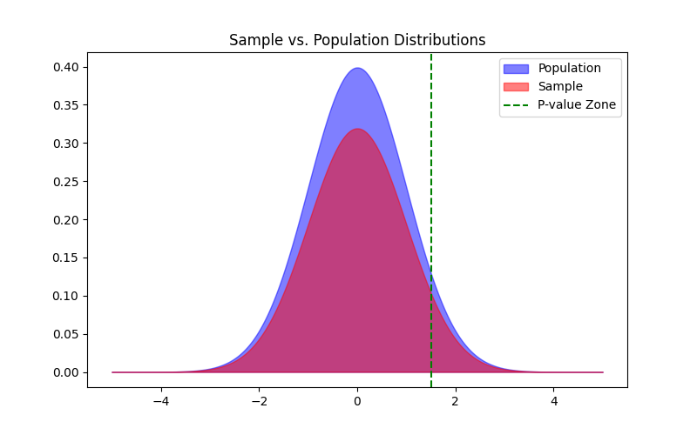
Topic: Significance Test
Sample vs. Population
Testing Differences
P-value Zone
Formal Definition:
"A significance test is a statistical method that evaluates the degree to which sample data supports a specific hypothesis about a population."

Slide 2
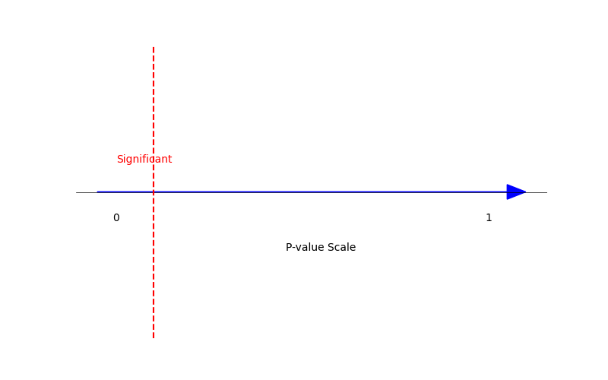
Topic: Significance Test
P-value : a tool we use to determine if the results we're seeing are genuine or if they're likely just due to random chance.
< 0.05 Typical Cutoff
Low P = Strong Evidence

Slide 3
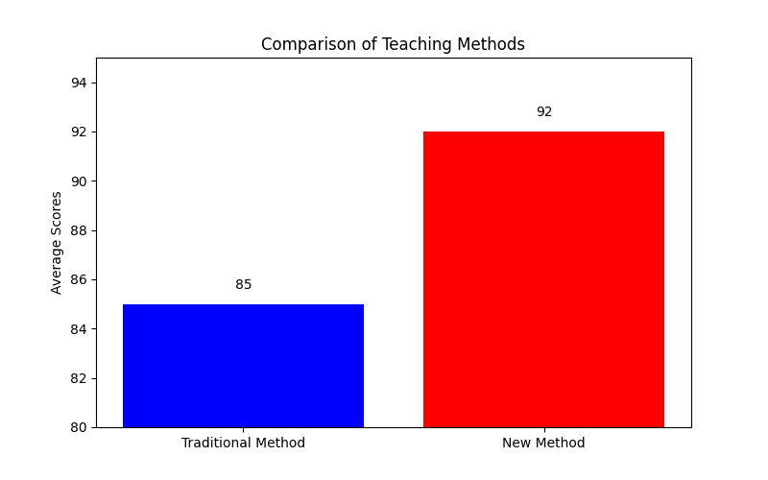
Topic: Significance Test
Real Example: Teaching Methods
New Method Score Higher?
Test the Significance!

