Slide 1

Pacman
Capture the Flag
Group Name : NaivePacman
Group Member : Han Jiang, Junlin Chen, Yuansan Liu

Slide 2
Technique Stack used
01
Approximate Q Learning
Deep Q-Network with CNN network; SARSA learning
02
Heuristic Search
A-star Search
03
Graph Theory
Max-flow; Flood-fill;

Slide 3
Section
Break
Insert the Sub Title of
Your Presentation

Slide 4
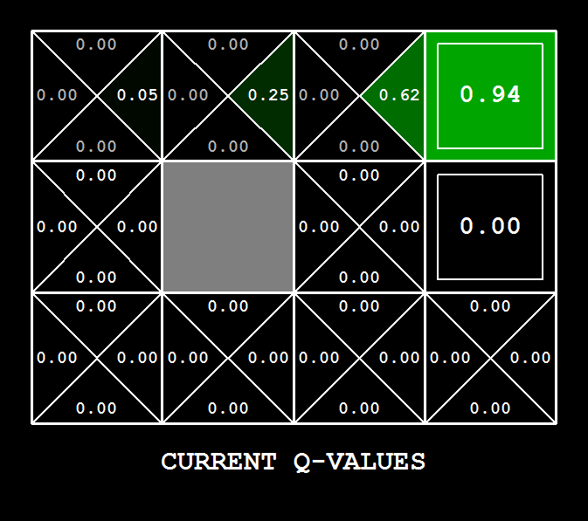
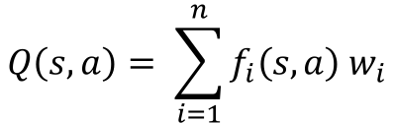
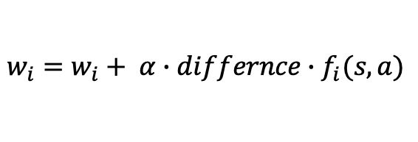
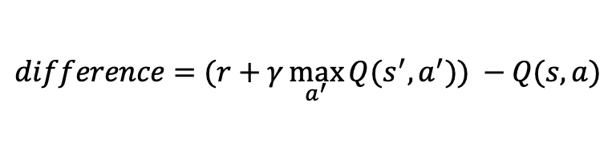
Theoretical basis of techniques
Approximate Q-Learning
Pacman chooses action with highest Q-value
Q-value is approximated using simplified model rather than building Q table
Approximated
Q-value
State feature vector
$$Q\left(s,a\right)= \sum_{i=1}^{n}{f_{i}\left(s, a\right) w_{i}}$$
$$difference=(r+γ\max_{a^{′}}{Q(s^{′}, a^{′})) −Q(s, a)}$$
$$w_{i}=w_{i}+ α∙differnce∙f_{i}(s, a)$$

Slide 5
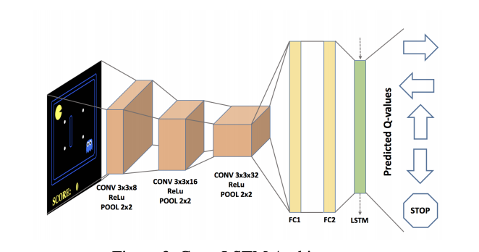
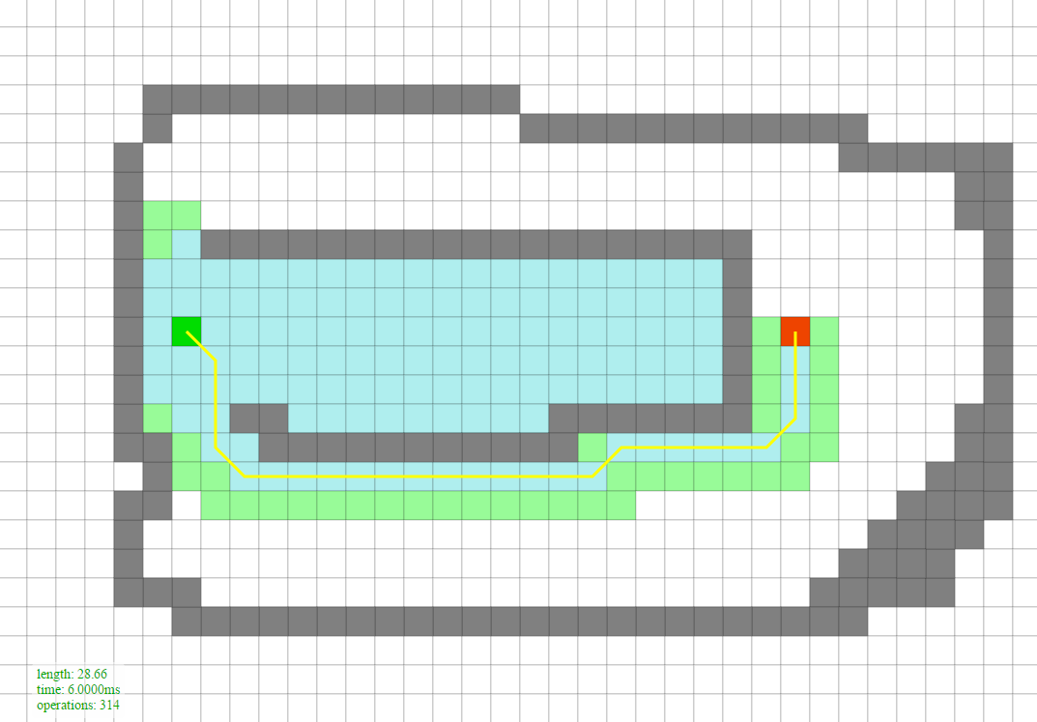
Theoretical basis of techniques
Deep Q-network
Input become multiple matrices
Let the network extract features
Approximated
Q-value
State feature vector
$$Q\left(s,a\right)= \sum_{i=1}^{n}{f_{i}\left(s, a\right) w_{i}}$$
A-star Search
Use heuristic value to determine explorations
Explore much less nodes than non-heuristic search

Slide 6
DQN agent
SARSA agent
Approximate q with fixed weight & heuristic search
Technique evolution
SARSA learning
with linear weight
Deep Q-network
Fixed weight
Less human work (no need to design features)
Hard to design hyper parameter
Hard to converge
Sensitive to map
Difficult to interpret
Human design features
Hard to design hyper parameter
Hard to converge
Easy to interpret
Less human work (no need to design feature)
Hard to design hyper parameter
Hard to converge
Sensitive to map
Easy to understand the behavior of the Pacman from weight

