Slide 1
Programming Languages (程序设计语言)
Hongfei Yan
School of EECS, Peking University
Sept. 28, 2021
Notes:
对程序设计语言作说明，目的是使大家对不同的语言及其使用场合有个初步了解。首先讨论语言的演化。

Slide 2
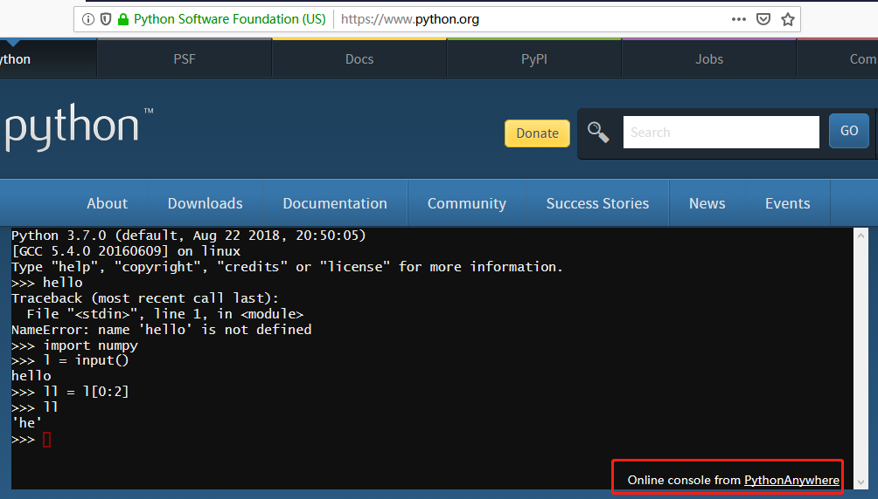
Recap
推荐两个本地Python集成开发环境
https://www.python.org/ ，官网简版IDE
https://www.anaconda.com/，大多数人喜欢的IDE
云端开发环境

Slide 3
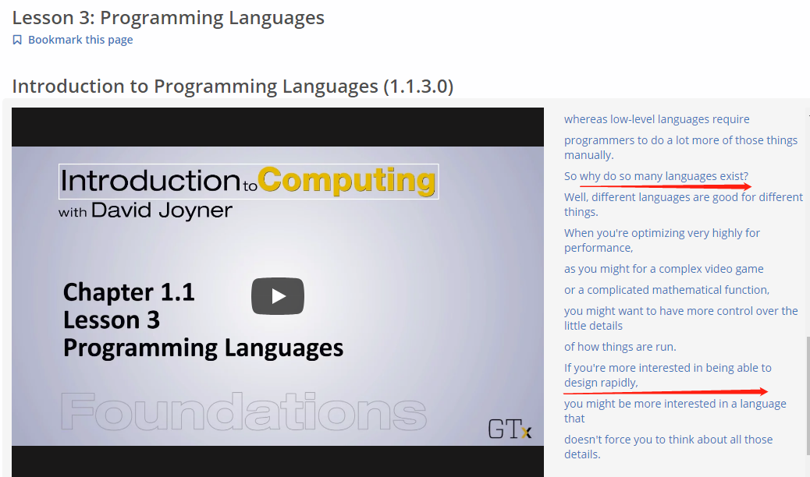

Slide 4
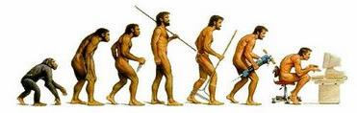
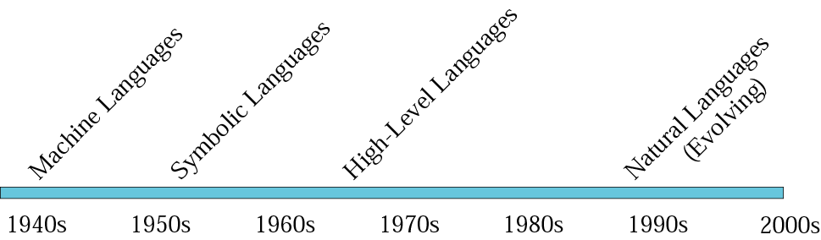
Evolution
Evolution of computer languages
Notes:
http://zh.wikipedia.org/wiki/演化
英文中的「evolution」一詞，起源於拉丁文的「evolvere」，原本的意思是將一個卷在一起的東西打開，也可以指任何事物的生長、變化或發展。包括恆星的演變，化學的演變，文化的演變或者觀念的演變[7]。自從19世紀以後，演化通常用來指生物學上，不同世代之間外表特徵與基因頻率的改變。

Slide 5
计算机语言的演化
机器语言
指令由0和1串组成, 程序可直接执行
符号语言
用符号表示不同的机器语言指令,必须被汇编(assembler)为机器语言
高级语言
从关注计算机转移到关注问题本身. 用语句(statement)构造应用逻辑.通常不能直接执行, 要编译(compile)或解释(interpret)执行.

Slide 6
Computer language
The term computer language includes a large variety of artificial languages used to communicate with computers.
It is broader than the more commonly-used term programming language.
Programming languages are a subset of computer languages.
E.g., HTML is a markup language and a computer language, but it is not a programming language.
Machine code is a computer language.
It can technically be used for programming, and has been (e.g. the original bootstrapper for Altair BASIC),
though most would not consider it a programming language.
Notes:
http://en.wikipedia.org/wiki/Computer_language
http://en.wikipedia.org/wiki/Altair_BASIC
Altair BASIC was an interpreter for the BASIC programming language that ran on the MITS Altair 8800 and subsequent S-100 bus computers. It was Microsoft's first product (as Micro-Soft), distributed by MITS under a contract. Altair BASIC was the start of the Microsoft BASIC product range.

Slide 7
Types of Computer Languages
Programming languages
are the primary means by which developers of computing systems instruct a machine to
organize or manipulate information
or control physical devices.
Most software is written using one or more programming languages.
Common examples include Python, C++, C, Java, and many others.
Scripting languages
are designed to control other software or to coordinate the actions of multiple software applications.
Machine code
a non human-readable binary computer language which corresponds to the available instructions for a microprocessor.
……

Slide 8
What problem gave birth to programming languages?
Before high level programming languages existed,
computers were programmed one instruction at a time using binary or hex.
a tedious job and a lot of errors.
Obviously, this job did not attract many people, so there was a shortage of programmers.
Expensive computers sat idle for long periods of time while software was being developed.
Software often cost two to four times as much as the computer.
This led to the development of assembly languages.
Programming became somewhat easier,
but many users still wanted floating point numbers and array indexing. Since these capabilities were not supported in hardware,
high level languages had to be developed to support them.
Notes:
Sources: "Concepts of Programming Languages" by Robert W. Sebesta, The Benjamin/Cummings Publishing Company, Inc, 1993.

Slide 9
What Makes a Language Hot?
Ease of use
Language Features
Performance
Corporate Support
Experienced Programmers
Legacy Code
Notes:
It seems that there are many factors in what languages are hot. We can boil them all down to one statement. A language is hot because many programmers are interested in programming in it. From this definition, we can also look at the factors that make a language desirable to program in. Also, the factors that make a language hot may not be the same that keep it hot. For example, both Fortran and COBOL became hot languages for ease of use reasons. They were simply easier to use that their alternatives. However, they stayed hot languages because of experienced programmers and legacy code.
Ease of use
This seems to be very important in the choice of a new language. Is this language going to be faster and easier to use than other languages. This should be viewed in an historical perspective. Is COBOL easy to use? Was it in 1960? New languages and programming paradigms change what we consider to be easy to use.
Language Features
A language may also be chosen because it has a particular feature. You would write in Java if you wanted to write an application that ran over the Internet. You would not use COBOL if you wanted to write scientific programs.
Performance
In some applications performance is a big issue. This alone will keep Fortran and C alive for a long time to come. Other applications don't need a high performance language to get good responses on some hardware. Why do we need to write interactive software in a very fast language?
Corporate Support
Is there a large corporation or organization that is pushing the language? Would C have become so popular if Unix had not been written in it? Also, the reappearance of Basic may be solely due to Microsoft's support of it.
Experienced Programmers
This is especially important on long projects. Are future programmers going to be able to understand the code and continue development? Also, you are more likely to program an application in a language you know well instead of a language you will need to learn.
Legacy Code
The amount of legacy code dictates the need for programmers to understand a language. This in itself can make a language hot. The prime example is COBOL. Long after this language should have faded away, it was still in heavy use. The only reason was the large amount of code written in COBOL that was still necessary to support.

Slide 10
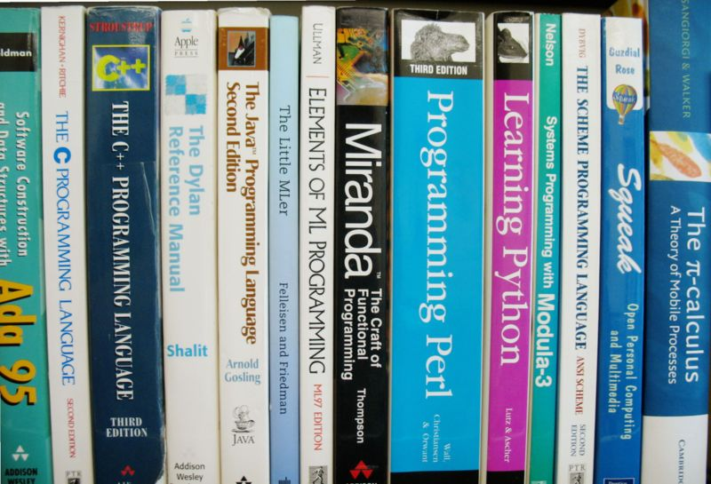

Slide 11
Evolution of programming languages
Years 50: Creation of high-level languages.
Years 60: Expansion of specialized languages​​.
Forth. Simula I. Lisp, Cobol.
Years 70: Duel between structured programming with Pascal and efficiency of C language.
Years 80: Experimenting other ways including objects.
ML. Smalltalk.
Years 90: Generalization of object-oriented programming with the performance of microcomputers.
Java, Perl, Python languages.
2000s: Internet Programming.
Years 2010: Concurrency and asynchronicity.
JavaScript and Go languages among others help to create online fluid applications.

Slide 12
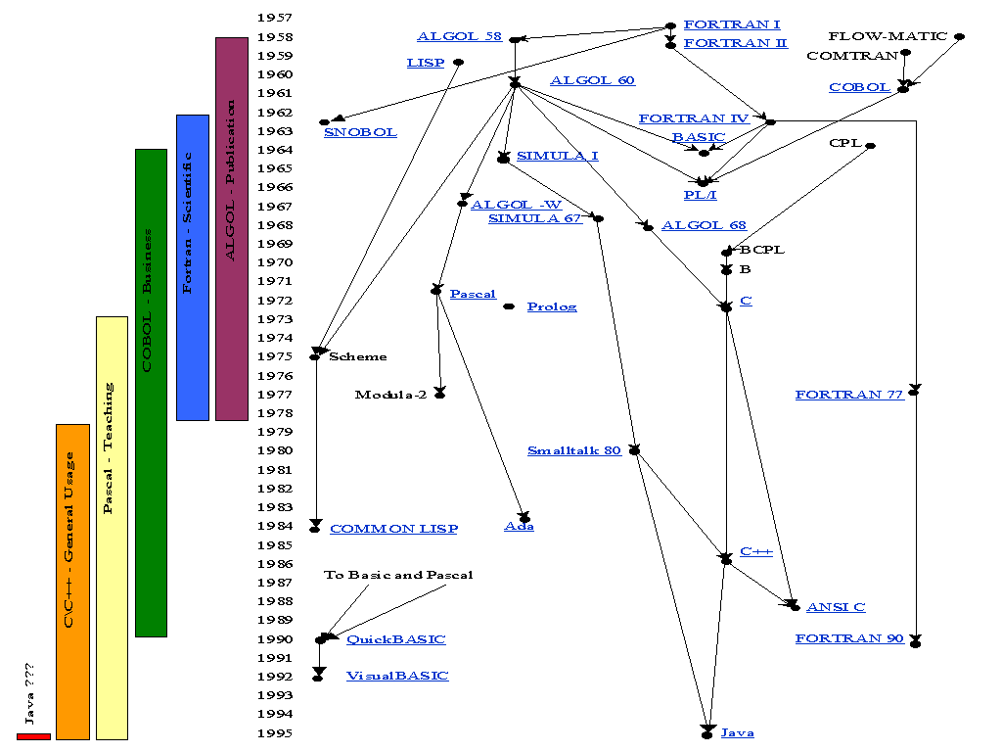
Evolution of programming languages
Python
Notes:
http://www.eecs.ucf.edu/~leavens/ComS541Fall97/hw-pages/history/
http://www.levenez.com/lang/history.html
https://en.wikipedia.org/wiki/History_of_programming_languages
1991 - Python

Slide 13
Python - 1991 - From the english TV movie "Monty Python Flying Circus“ Guido Van Rossum.
Scripting language with dynamic types.
This is a replacement to Perl.
Inspired by ABC, but is extensible with C libraries, and object oriented.
As ABC, used evolved types: tuple, list, dictionary.
The slicing operator [a : b] allows to extract a sub-list from a list.
There is a version that compiles in Java bytecode, jython and ports for .NET.
Notes:
Monty Python Flying Circus
巨蟒飞行马戏团

Slide 14
PASCAL
Pascal 语言是由著名瑞士计算机科学家 N. Wirth （1984年图灵奖得主）设计的一种语言，1968 年提出后被全世界广泛接受，成为一种对计算机科学技术发展有巨大影响的语言。
这个语言的名字是为了纪念历史上著名的数学家和计算学科的先驱 Blaise Pascal（帕斯卡）。
Pascal 语言把许多好的东西结合在一个很简练的语言里，被计算机教育界广泛采用。从七十年代末往后的很长一段时间里，Pascal 成为世界范围的计算机专业教学语言。

Slide 15

Niklaus Wirth
In 1984 he won the Turing Award for
developing a sequence of innovative computer languages.
Euler, Algol W, Pascal, Modula, Modula-2 and Oberon.
His article Program Development by Stepwise Refinement,
about the teaching of programming,
is considered to be a classic text in software engineering.
In 1975 he wrote the book Algorithms + Data Structures = Programs,
which gained wide recognition and is still useful today.
Notes:
http://en.wikipedia.org/wiki/Niklaus_Wirth
Software engineering is the application of a systematic, disciplined, quantifiable approach to the development, operation, and maintenance of software.

Slide 16
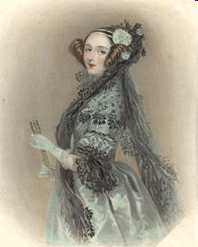
ADA
Ada生活在十九世纪中叶，是著名诗人拜伦的女儿
设计了巴贝奇分析机上解伯努利方程的一个程序，并证明当时的19世纪计算机狂人巴贝奇的分析器可以用于许多问题的求解。她甚至还建立了循环和子程序的概念。由于她在程序设计上的开创性工作，被称为世界上第一位程序员。
Ada 语言开发的目的是作为新一代的美国军用程序设计语言（1983-1995），作为所有与国防有关的程序和软件的统一语言标准。
Ada语言自 1983 年作为标准提出后，虽由美国国防部大力推行，也受到各国军方的重视，但不像预想的那样成功，其中一个原因是它太复杂。
Notes:
http://baike.baidu.com/view/1107373.htm
http://en.wikipedia.org/wiki/Ada_Lovelace

Slide 17
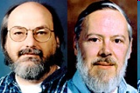
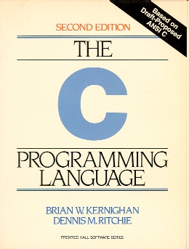
C
Ken Thompson (left) with Dennis Ritchie (right)
C programming language
was devised by Bell Labs of AT & T
as a system implementation language for the nascent Unix operating system.
Contribution:
Efficiency
Casting
Flexible array Library
Good portability
Notes:
nascent
英 [ˈnæsnt] 美 [ˈnæsənt, ˈnesənt]
GRE /
adj.初期的； 初生的； 开始形成的； 发生中的

Slide 18
C语言
C 是由美国贝尔实验室的 Dennis Ritchie 在 1972 年设计开发的，开发目的是想成为一种编制“系统程序”的工具语言。
Ritchie 等人首先用自己发明的 C 语言编写了 Unix 操作系统。以后 C 语言逐步发展成为开发系统软件的主要语言。
C 语言已成为最重要的软件系统开发语言，由此可见 C 语言在计算机领域地位之重要。

Slide 19
SIMULA
Although never widely used, SIMULA is historically important.
1964-67, designed as a language to aid in creating simulations.
To contain many more features so that it could be used for more general purpose areas.
The result was SIMLUA 67.
To help make simulation easier, SIMULA 67
introduced the concept of
classes, including instancing and coroutine.
This was the beginning of data abstraction.
Notes:
coroutine协程详解
https://www.jianshu.com/p/2782f8c49b2a
协程
Coroutines are computer-program components that generalize subroutines for non-preemptive multitasking, by allowing multiple entry points for suspending and resuming execution at certain locations. Coroutines are well-suited for implementing familiar program components such as cooperative tasks, exceptions, event loops, iterators, infinite lists and pipes.
Process -> Thread -> Coroutine
协程(Coroutine)编译器级的，进程(Process)和线程(Thread)操作系统级的
进程(Process)和线程(Thread)是os通过调度算法，保存当前的上下文，然后从上次暂停的地方再次开始计算，重新开始的地方不可预期，每次CPU计算的指令数量和代码跑过的CPU时间是相关的，跑到os分配的cpu时间到达后就会被os强制挂起，开发者无法精确的控制它们。
协程（Coroutine）是一种轻量级的用户态线程，实现的是非抢占式的调度，即由当前协程切换到其他协程由当前协程来控制。目前的协程框架一般都是设计成 1:N 模式。所谓 1:N 就是一个线程作为一个容器里面放置多个协程。那么谁来适时的切换这些协程？答案是有协程自己主动让出 CPU，也就是每个协程池里面有一个调度器，这个调度器是被动调度的。意思就是他不会主动调度。而且当一个协程发现自己执行不下去了（比如异步等待网络的数据回来，但是当前还没有数据到)，这个时候就可以由这个协程通知调度器，这个时候执行到调度器的代码，调度器根据事先设计好的调度算法找到当前最需要 CPU 的协程。切换这个协程的 CPU 上下文把 CPU 的运行权交个这个协程，直到这个协程出现执行不下去需要等等的情况，或者它调用主动让出 CPU 的 API 之类，触发下一次调度。

Slide 20
What is a coroutine? https://stackoverflow.com/questions/553704/what-is-a-coroutine
Coroutines and concurrency are largely orthogonal.
Coroutines are a general control structure whereby flow control is cooperatively passed between two different routines without returning.
The 'yield' statement in Python is a good example.
It creates a coroutine.
When the 'yield ' is encountered the current state of the function is saved and control is returned to the calling function.
The calling function can then transfer execution back to the yielding function and its state will be restored to the point where the 'yield' was encountered and execution will continue.

Slide 21
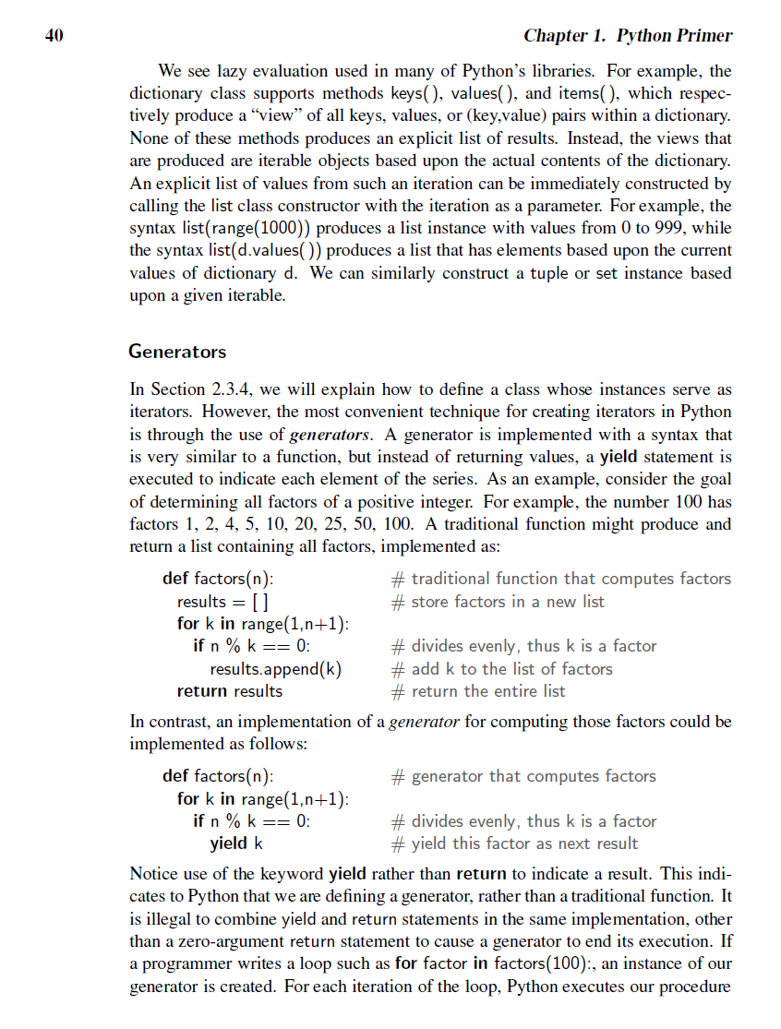
我们教材40页有解释yield

Slide 22
C++
C++ was designed to provide
Simula's facilities for program organization
together with C's efficiency and flexibility for systems programming.
It was intended to deliver that to real projects.
Contribution:
One line comment
Inline function
Multiple inheritance
Overloading operators and functions
Notes:
http://en.wikipedia.org/wiki/C%2B%2B
C++ ("C Plus Plus", pronounced /ˌsiːˌplʌsˈplʌs/) is a general-purpose programming language. It is regarded as a middle-level language, as it comprises a combination of both high-level and low-level language features.[1] It is a statically typed, free-form, multi-paradigm, compiled language where compilation creates machine code for a target machine hardware, supports procedural programming, data abstraction, object-oriented programming, and generic programming.
The language was developed by Bjarne Stroustrup in 1979 at Bell Labs as an enhancement to the C programming language and originally named "C with Classes". It was renamed to C++ in 1983. Enhancements started with the addition of classes, followed by, among other features, virtual functions, operator overloading, multiple inheritance, templates, and exception handling.
The C++ programming language standard was ratified in 1998 as ISO/IEC 14882:1998, the current version of which is the 2003 version, ISO/IEC 14882:2003. A new version of the standard (known informally as C++0x) is being developed.
C++ enjoys wide use in the software industry. Some of its application domains include systems software, device drivers, embedded software, high-performance server and client applications, and entertainment software such as video games. Several groups provide both free and commercial C++ compiler software, including the GNU Project, Microsoft, Intel, Borland and others.

Slide 23
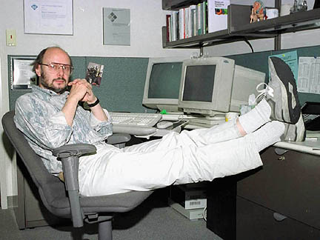
C++语言
C++ 是在 C 语言基础上发展出的一种“面向
对象”语言。它是由 Bjarne Stroustrup 在美国
贝尔实验室开发的（1979）。
C++ 是 C 语言的一个扩充，
修正了 C 的一些弱点和不足，使用起来更方便可靠；
以支持“面向对象”（Object-Oriented，简称为OO）的程序设计方法为基本目标，提供了一套支持面向对象程序设计的机制，如“类”（class）、“对象”（object）等等。
面向对象的方法被认为是开发复杂软件系统的一种有效途径， OO 程序设计语言也已经被广泛接受。

Slide 24
"Hello, world!" in C++
1 // HelloWorld.cpp
2 #include <iostream>
3 using namespace std;
4
5 int main()
6 {
7 cout << "Hello, world!\n";
8 // cin.get();
9
10 return 0;
11 }
$g++ -g -Wall HelloWorld.cpp -o HelloWorld
Notes:
// HelloWorld.cpp
#include <iostream>
using namespace std;
int main()
{
cout << "Hello, world!\n";
// cin.get();
return 0;
}

Slide 25
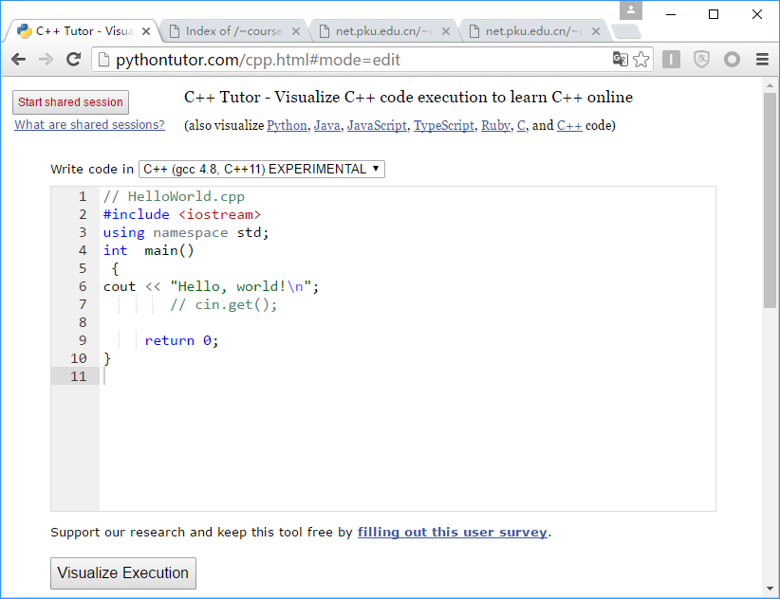

Slide 26
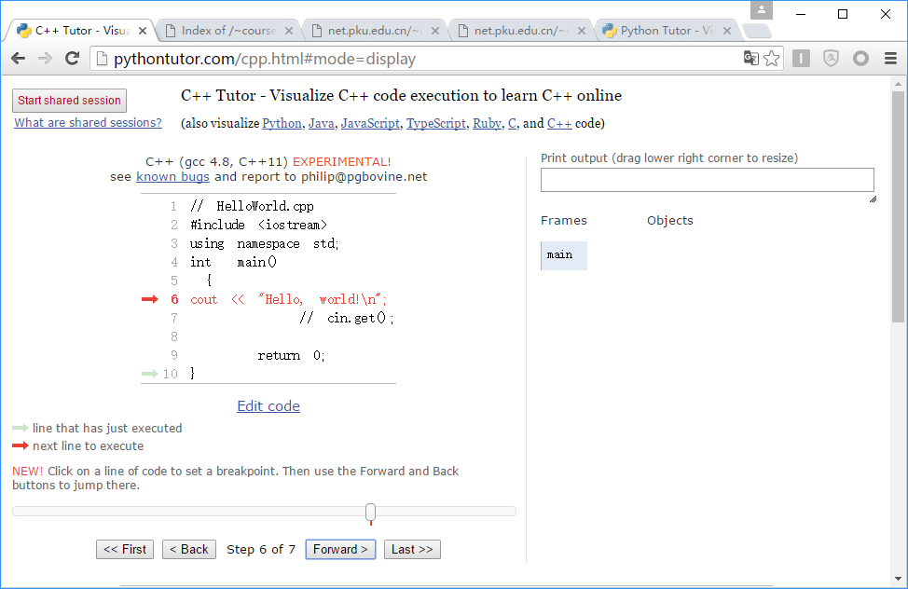

Slide 27
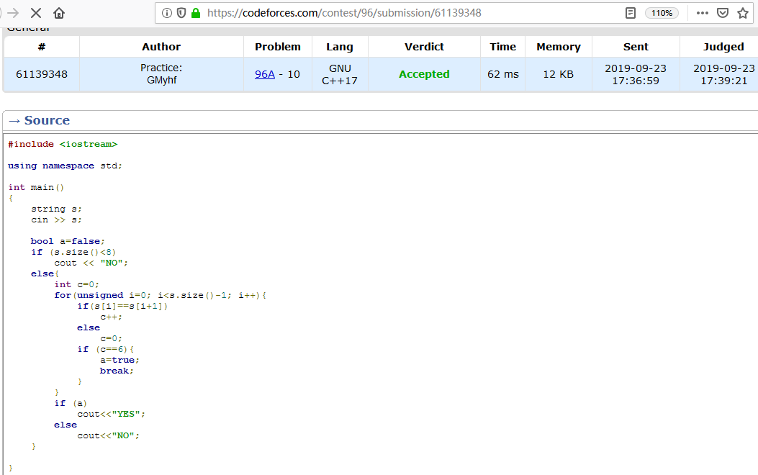
Notes:
https://codeforces.com/contest/96/submission/61139348

Slide 28
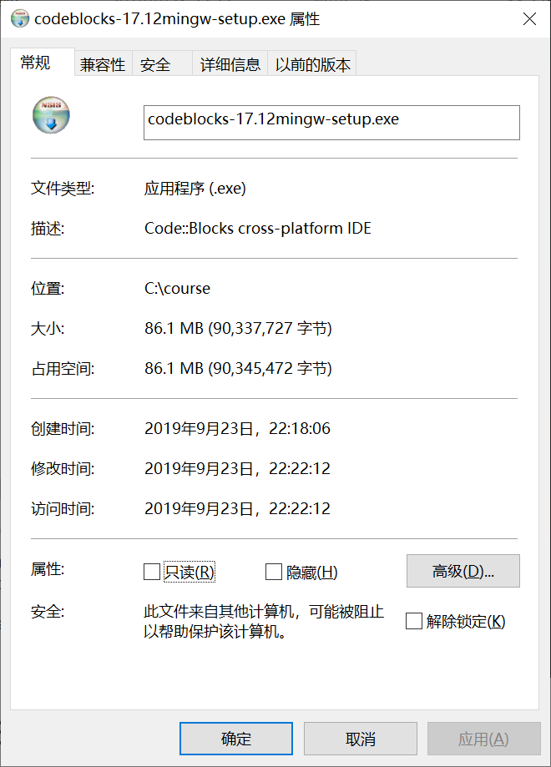
C++集成开发环境
想顺便熟悉C++语法的，可以用这个IDE http://www.codeblocks.org/

Slide 29
Python
Paradigm | multi-paradigm: object-oriented, imperative,functional, procedural,reflective
Designed by | Guido van Rossum
Developer | Python Software Foundation
First appeared | 20 Feb. 1991; 25years ago
Stable release | 3.5.2 / 27 June 2016 2.7.12 / 28 June 2016
Typing discipline | duck, dynamic, strong,gradual (as of Python 3.5)^{[3]}
OS | Cross-platform
License | Python Software Foundation License
Filename extensions | .py, .pyc, .pyd, .pyo,^{[4]}pyw, .pyz
Website | www.python.org
Notes:
https://en.wikipedia.org/wiki/Python_(programming_language)
https://en.wikipedia.org/wiki/Gradual_typing
Gradual typing is a type system in which some variables and expressions may be given types and the correctness of the typing is checked at compile-time(which is static typing) and some expressions may be left untyped and eventual type errors are reported at run-time (which is dynamic typing). Gradual typing allows software developers to choose either type paradigm as appropriate, from within a single language.^{[1]} In many cases gradual typing is added to an existing dynamic language, creating a derived language allowing but not requiring static typing to be used. In some cases a language uses gradual typing from the start.

Slide 30
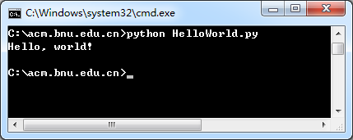
"Hello, world!" in Python
1 # HelloWorld.py
2 print ("Hello, world!\n“)

Slide 31
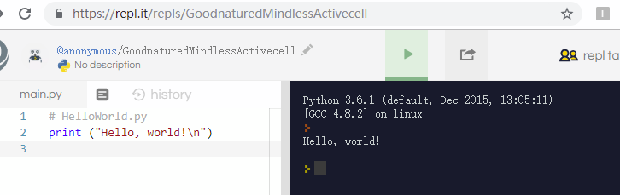
http://repl.it/languages/Python3

Slide 32
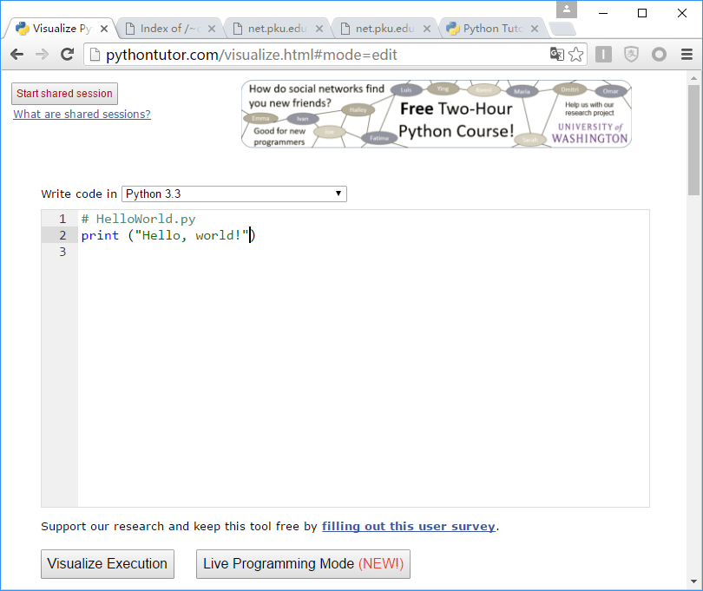

Slide 33
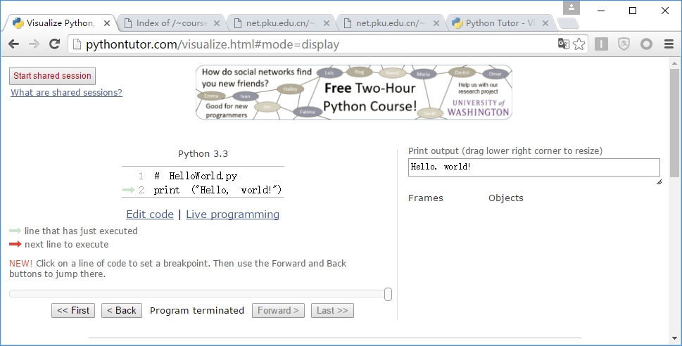

Slide 34
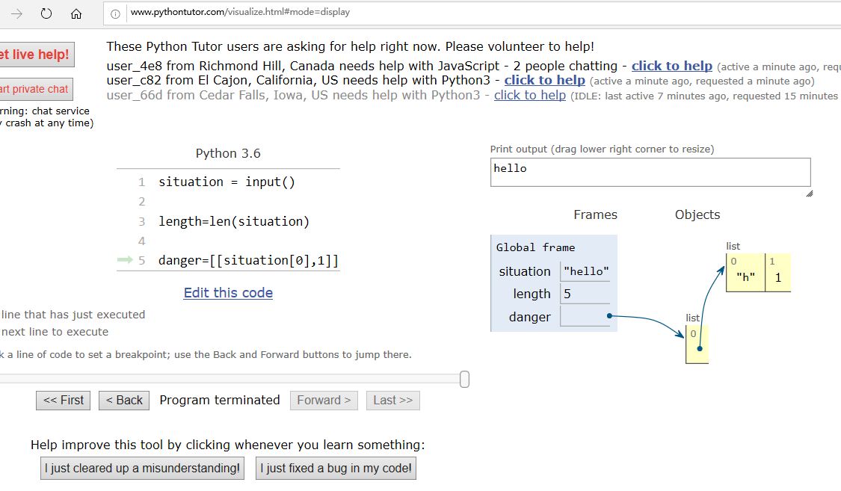
Notes:
只看源码，理解可能不对。运行出来，一定是对的。所以通常看不懂，就一步一步运行，就明白了。 这个网站，可以单步运行程序，以及看内存中变量情况，特别适合初学者，http://www.pythontutor.com/

Slide 35
Life is short. You need Python.

Slide 36
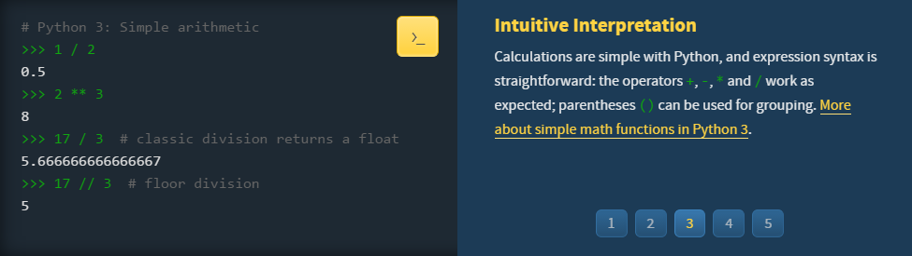
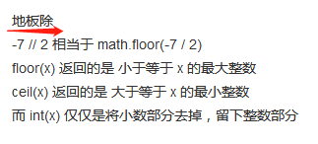

Slide 37
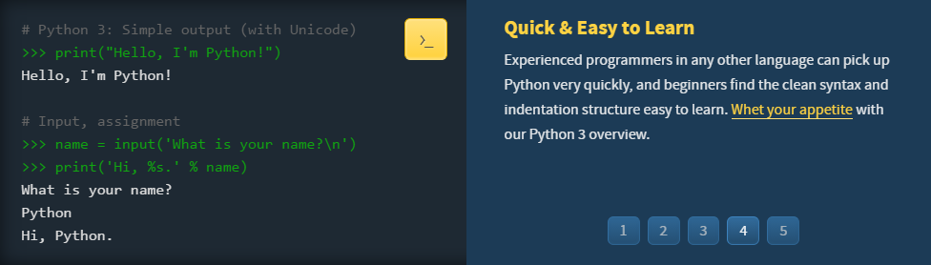

Slide 38
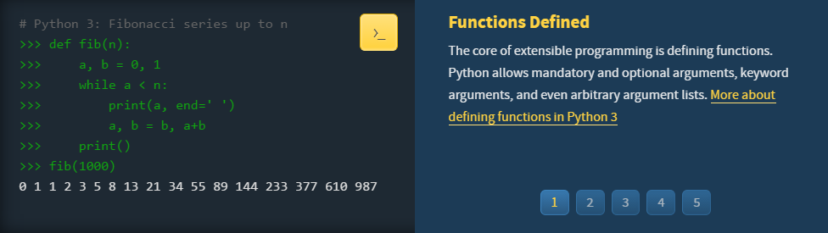

Slide 39
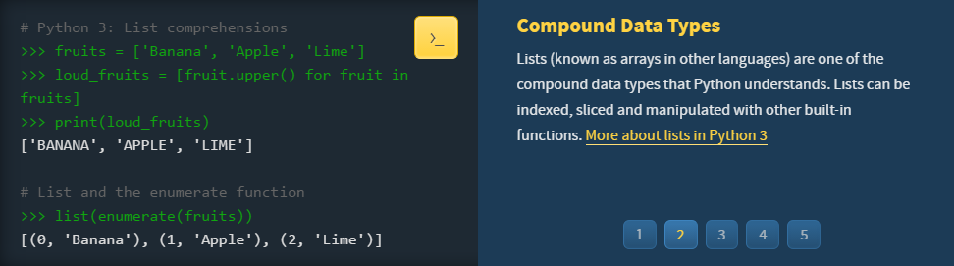

Slide 40
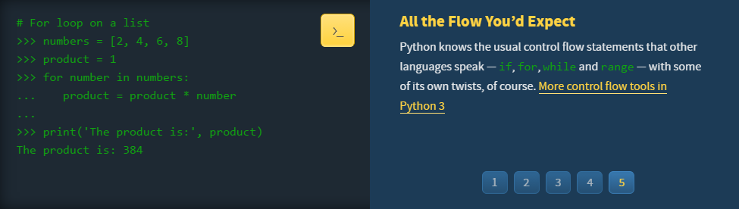

Slide 41
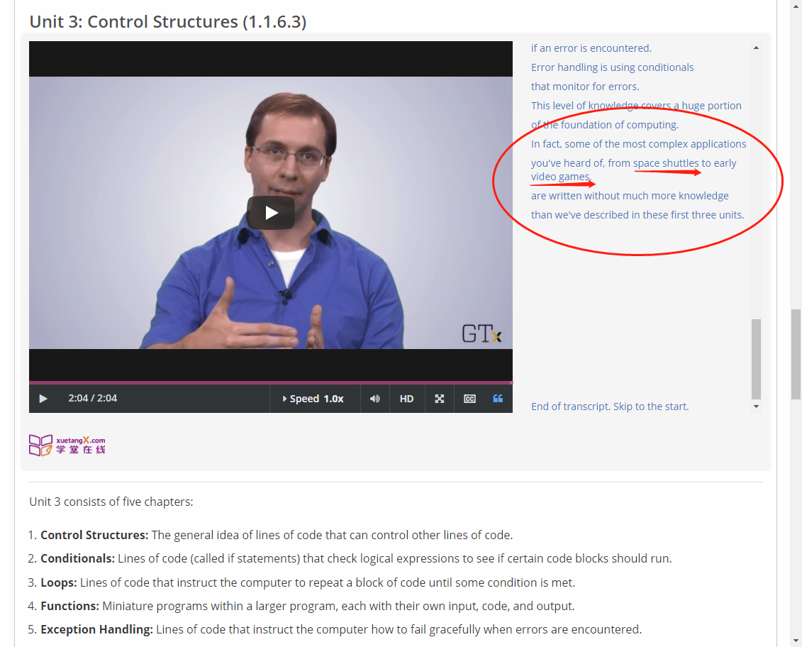

Slide 42
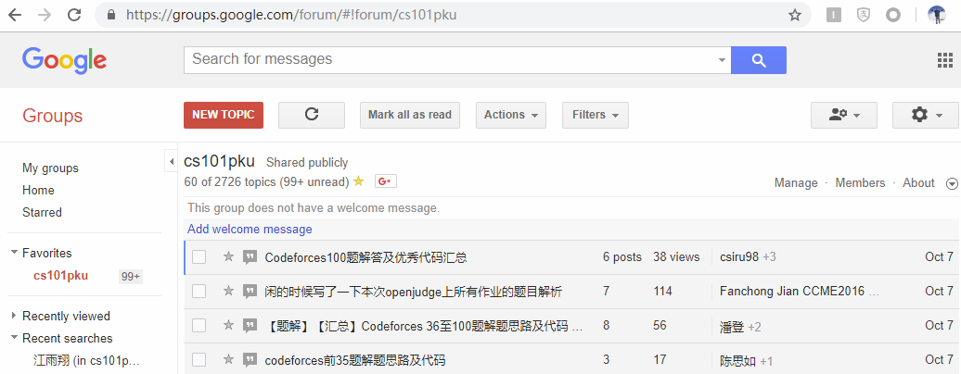

Slide 43
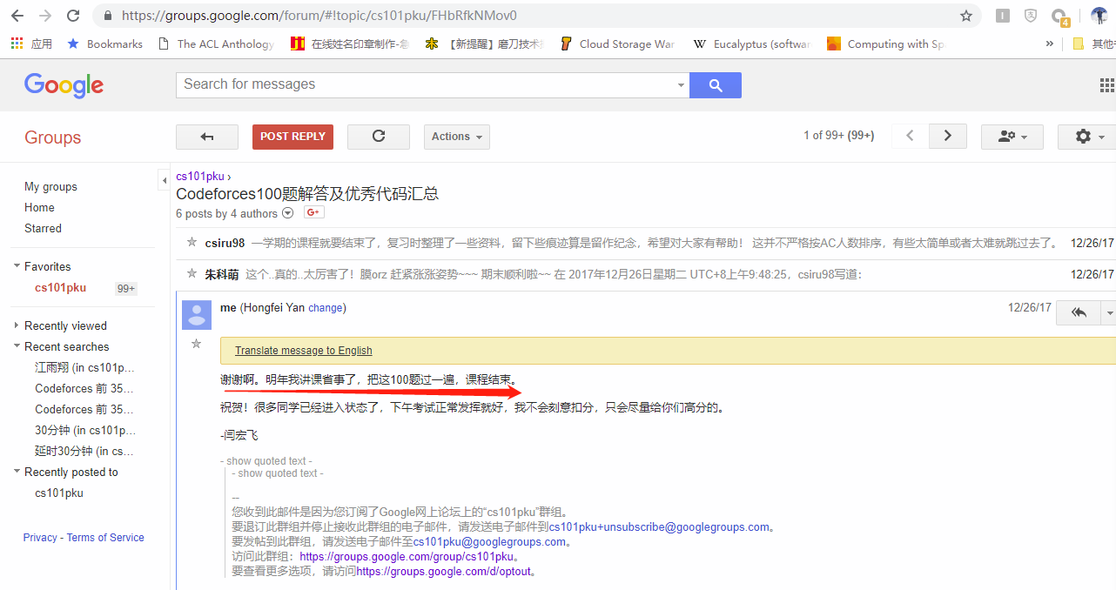

Slide 44
附录：Python语法

Slide 45
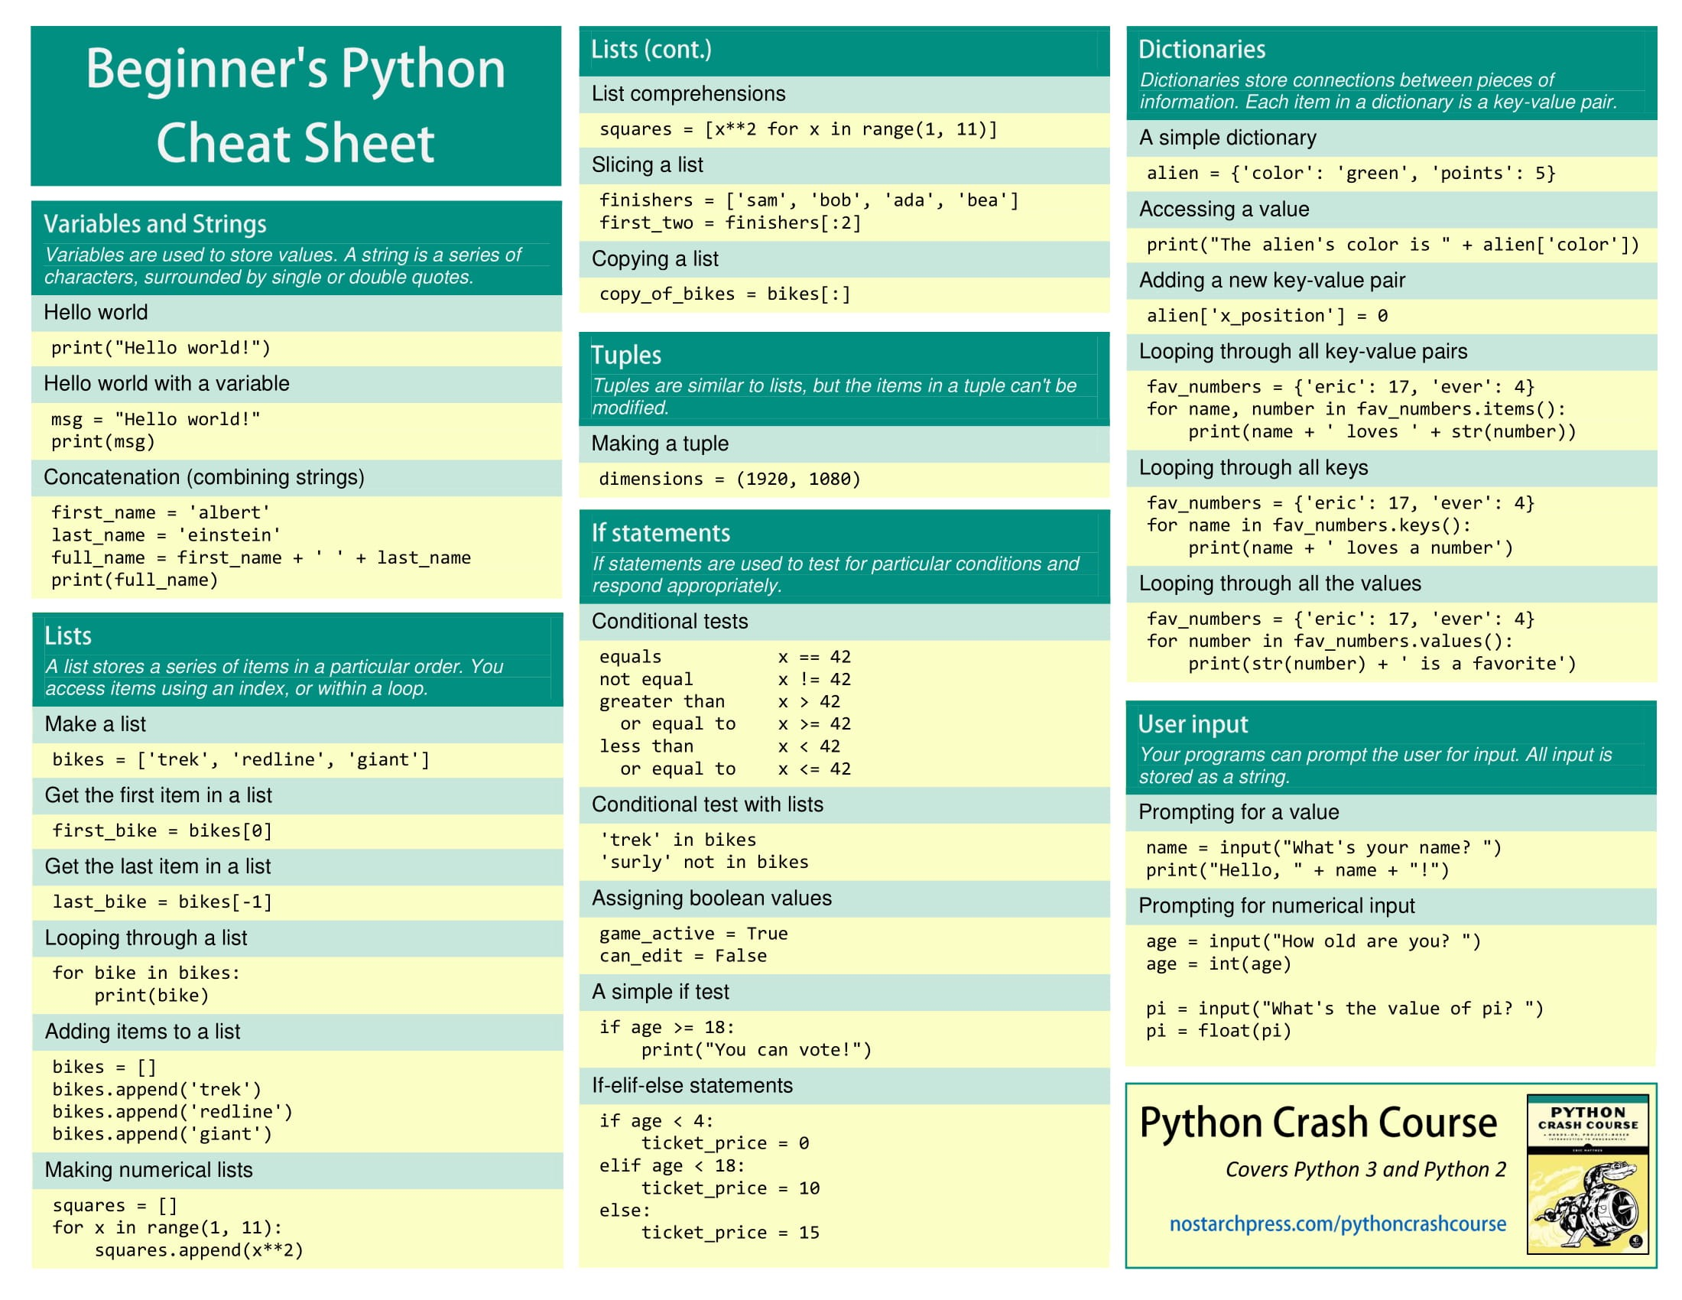

Slide 46
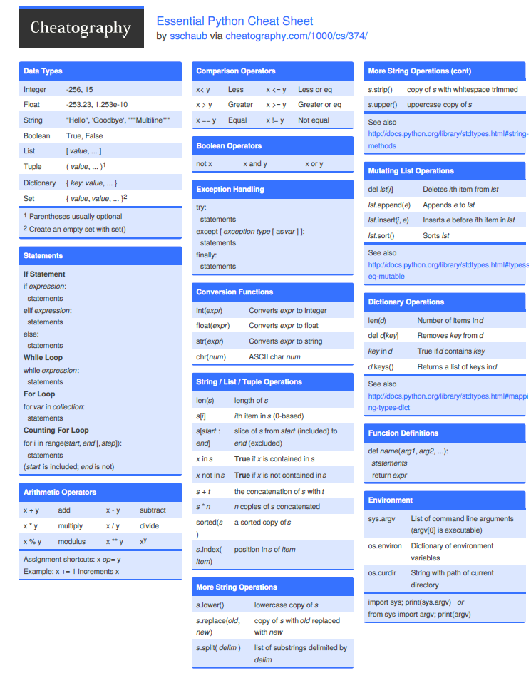
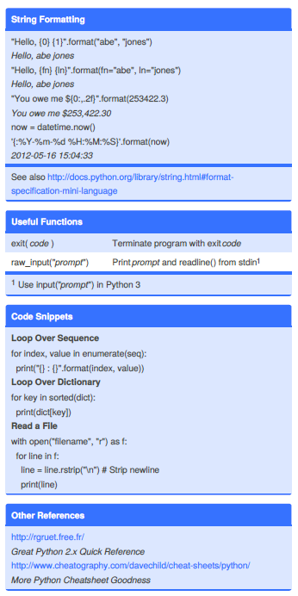
Notes:
https://www.cheatography.com/sschaub/cheat-sheets/essential-python/

