Slide 1
遍历Traversing
Hongfei Yan
2021/11/30
Notes:
参考《Programming Challenges The Programming Contest Training Manual》第8章 回溯法
Steven S Skiena, Miguel A. Revilla著，刘汝佳 译

Slide 2
遍历
一个问题的求解就是从最开始的状态，利用已经存在的规则和条件改变当前状态，直到把当前状态变为最终目的状态
把中间出现的状态全部连接起来，变成一条遍历路径的过程
通过图的遍历，可以找到这条径
图的遍历算法主要有两种，一种是按照深度优先的顺序展开遍历的算法，也就是深度优先遍历；
另一种是按照宽度优先的顺序展开遍历的算法，也就是宽度优先遍历。
宽度优先遍历和深度优先遍历一样，是一种盲目的遍历方法
也就是说，遍历算法并不使用经验法则算法， 并不考虑结果的可能地址，只是彻底地遍历整张图，直到找到结果为止

Slide 3
Graph traversal
(also known as graph search) refers to the process of visiting (checking and/or updating) each vertex in a graph.
Such traversals are classified by the order in which the vertices are visited.
Tree traversal is a special case of graph traversal.

Slide 4
图的遍历问题分为四类
遍历完所有的边而不能有重复，即所谓“欧拉路径问题”（又名一笔画问题）；
遍历完所有的顶点而没有重复，即所谓“哈密顿路径问题”。
遍历完所有的边而可以有重复，即所谓“中国邮递员问题”；
遍历完所有的顶点而可以重复，即所谓“旅行推销员问题”。
对于第一和第三类问题已经得到了完满的解决，而第二和第四类问题则只得到了部分解决。
第一类问题就是研究所谓的欧拉图的性质，而第二类问题则是研究所谓的哈密顿图的性质。

Slide 5
宽度优先遍历Breadth-first search (BFS)
BFS是沿着图的深度遍历图的所有节点，每次遍历都会沿着当前节点的邻接点遍历，直到所有点全部遍历完成。
如果当前节点的所有邻接点都遍历过了，则回溯到上一个节点，重复这一过程一直到已访问从源节点可达的所有节点为止
如果还存在没有被访问的节点，则选择其中一个节点作为源节点并重复以上过程，直到所有节点都被访问为止
通过沿着图的宽度遍历图的节点，如果所有节点均被访问，算法随即终止。宽度优先遍历的实现一般需要一个队列来辅助完成。

Slide 6
Graph traversal algorithms
If each vertex in a graph is to be traversed by a tree-based algorithm (such as DFS or BFS),
then the algorithm must be called at least once for each connected component of the graph.
This is easily accomplished by iterating through all the vertices of the graph,
performing the algorithm on each vertex that is still unvisited when examined.

Slide 7
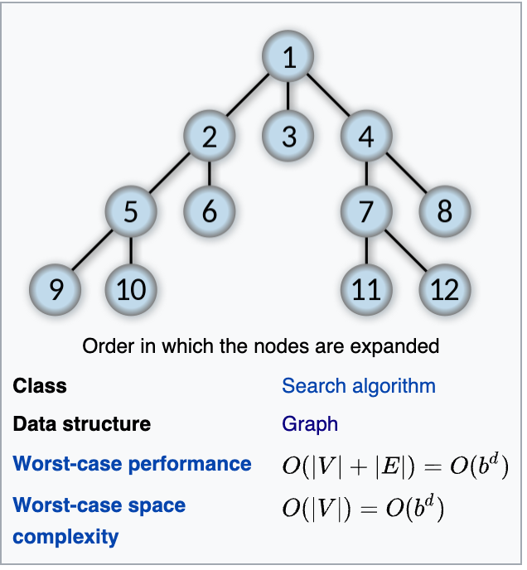
Breadth-first search (BFS)
Breadth-first search (BFS) is an algorithm for searching a tree data structure for a node that satisfies a given property. It starts at the tree root and explores all nodes at the present depth prior to moving on to the nodes at the next depth level. Extra memory, usually a queue, is needed to keep track of the child nodes that were encountered but not yet explored.
For example, in a chess endgame a chess engine may build the game tree from the current position by applying all possible moves, and use breadth-first search to find a win position for white. Implicit trees (such as game trees or other problem-solving trees) may be of infinite size; breadth-first search is guaranteed to find a solution node^{[1]} if one exists.
Notes:
https://en.wikipedia.org/wiki/Breadth-first_search

Slide 8
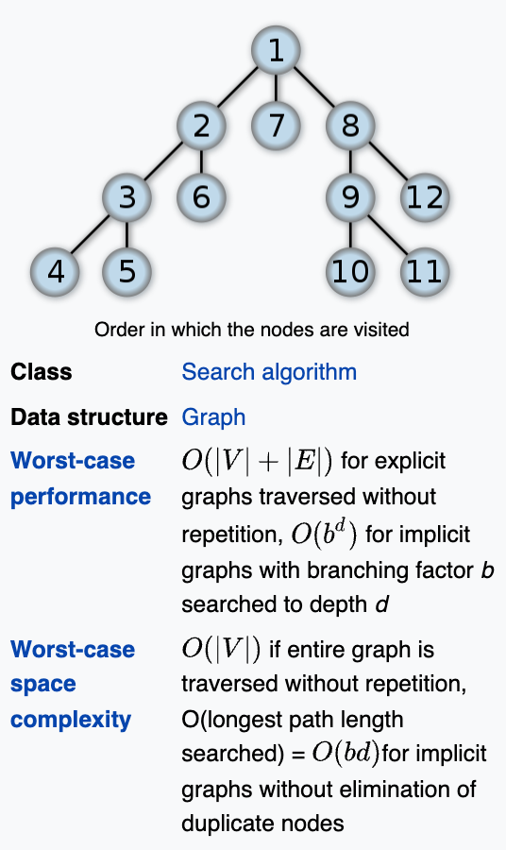
Depth-first search (DFS)
DFS is an algorithm for traversing or searching tree or graph data structures.
The algorithm starts at the root node (selecting some arbitrary node as the root node in the case of a graph) and explores as far as possible along each branch before backtracking.
A version of depth-first search was investigated in the 19th century by French mathematician Charles Pierre Trémaux^{[1]} as a strategy for solving mazes.
Notes:
https://en.wikipedia.org/wiki/Depth-first_search

Slide 9
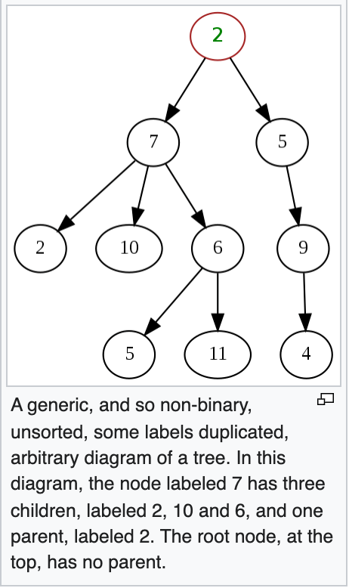
Tree (data structure)
In computer science, a tree is a widely used abstract data type that simulates a hierarchical tree structure, with a root value and subtrees of children with a parent node, represented as a set of linked nodes.
A tree data structure can be defined recursively as a collection of nodes, where each node is a data structure consisting of a value and a list of references to nodes. The start of the tree is the "root node" and the reference nodes are the "children". No reference is duplicated and none points to the root.
Notes:
https://en.wikipedia.org/wiki/Tree_(data_structure)

Slide 10
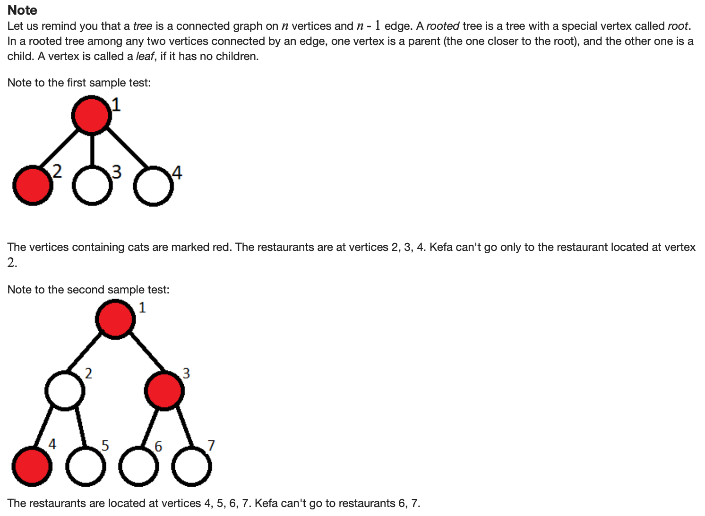
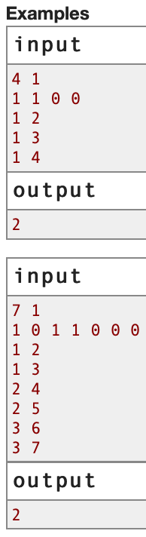
580C.Kefa and Park, dfs and similar/graphs/tree, 1500
https://codeforces.com/contest/580/problem/C

Slide 11
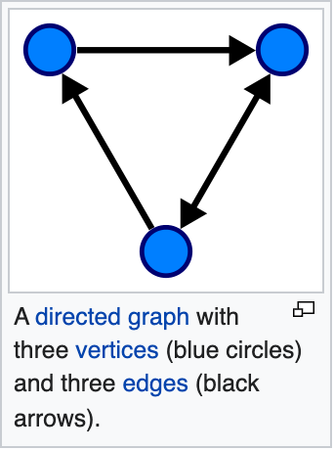
Graph (abstract data type)
In computer science, a graph is an abstract data type that is meant to implement the undirected graph and directed graph concepts from the field of graph theory within mathematics.
A graph data structure consists of a finite (and possibly mutable) set of vertices (also called nodes or points), together with a set of unordered pairs of these vertices for an undirected graph or a set of ordered pairs for a directed graph. These pairs are known as edges (also called links or lines), and for a directed graph are also known as edges but also sometimes arrows or arcs.

Slide 12
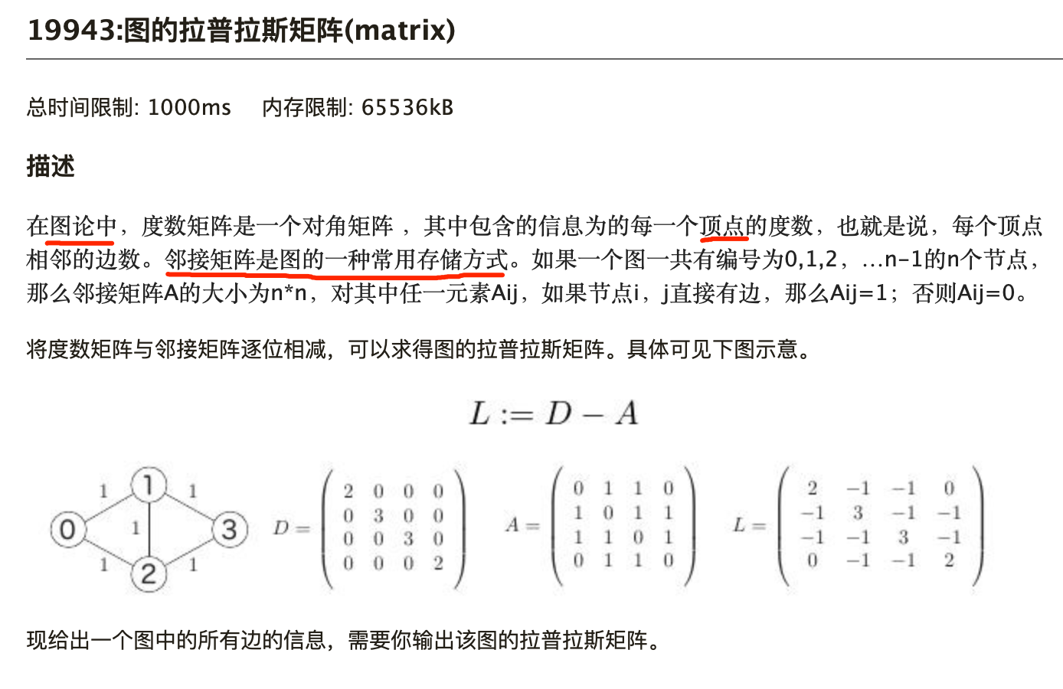

Slide 13
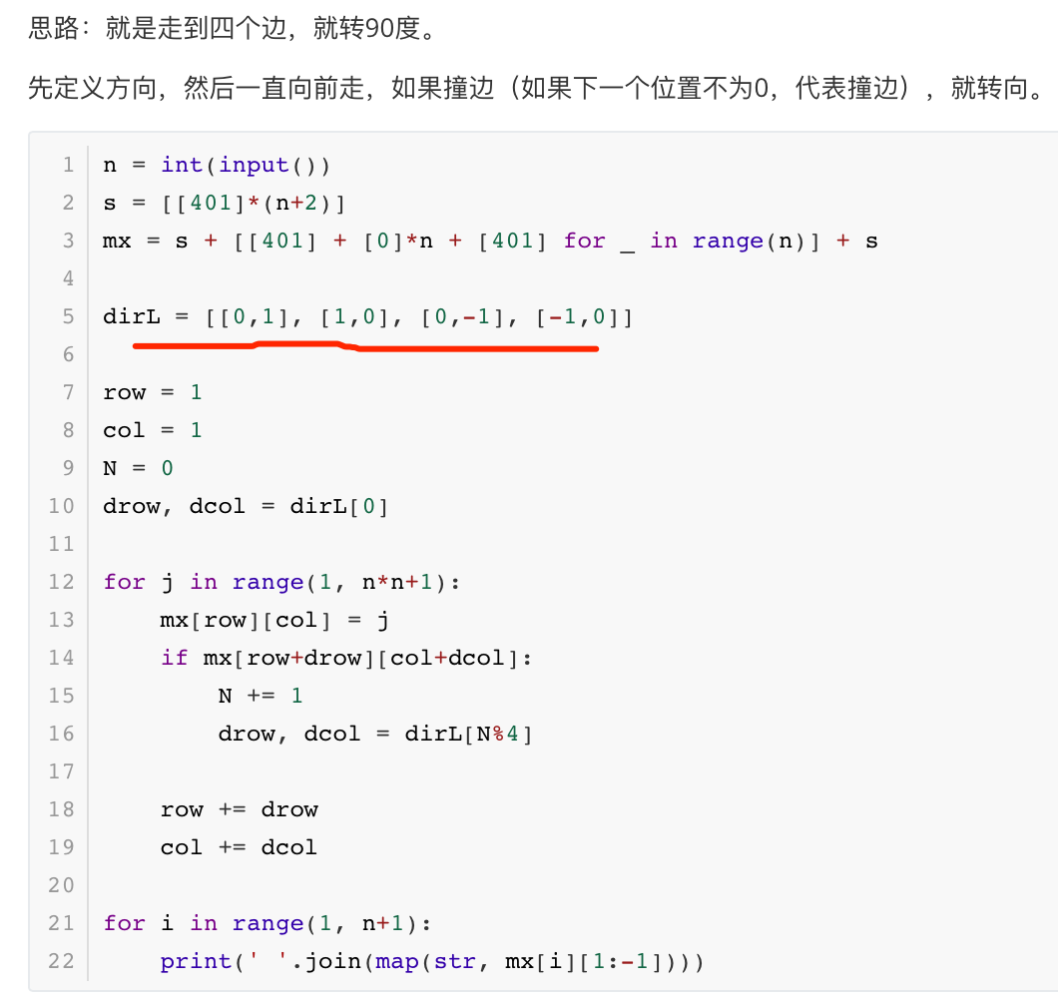
18106: 螺旋矩阵, matrices http://cs101.openjudge.cn/practice/18106

Slide 14
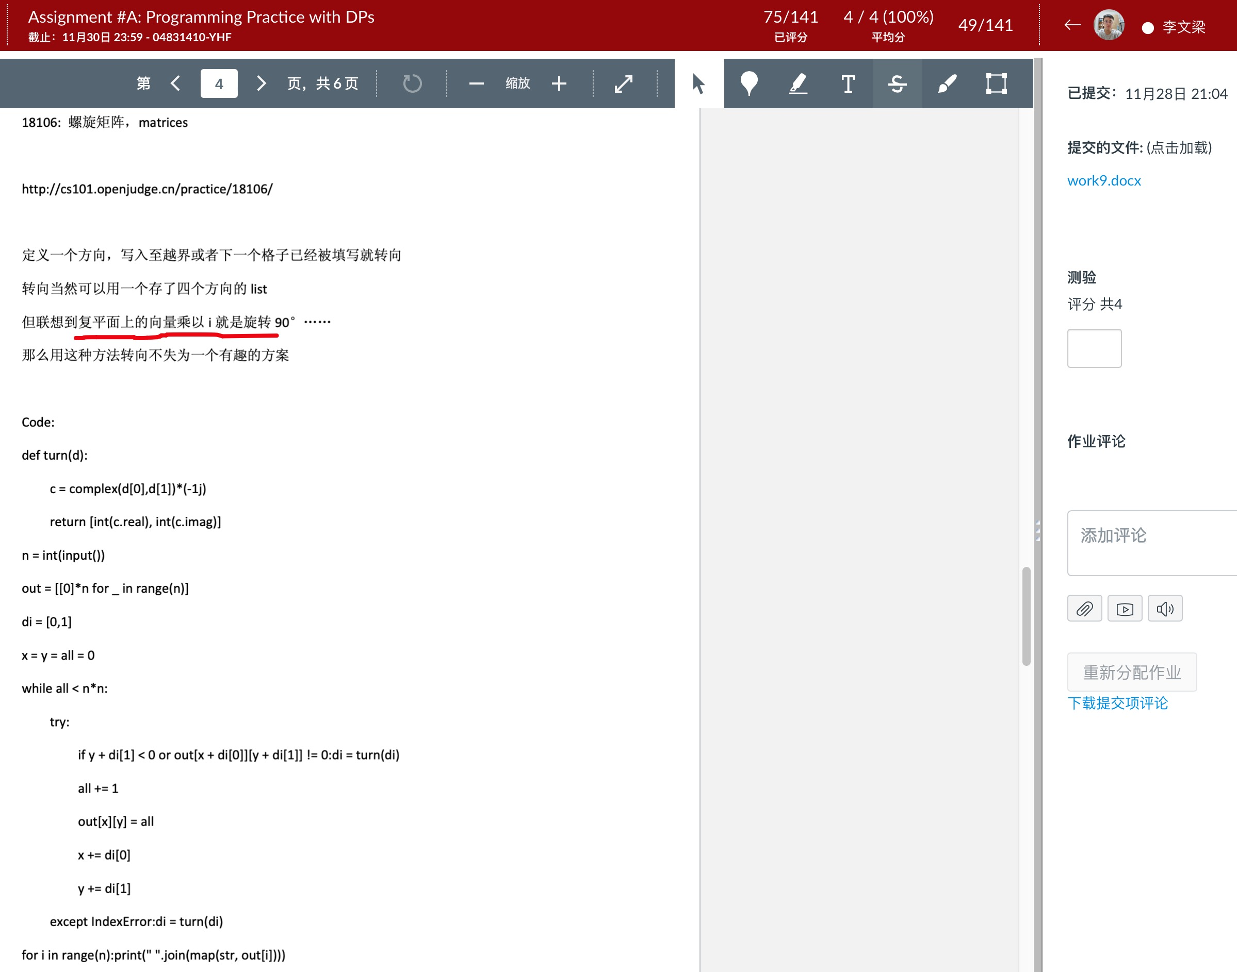
Notes:
2100011791, 李文梁，化学与分子工程学院

Slide 15
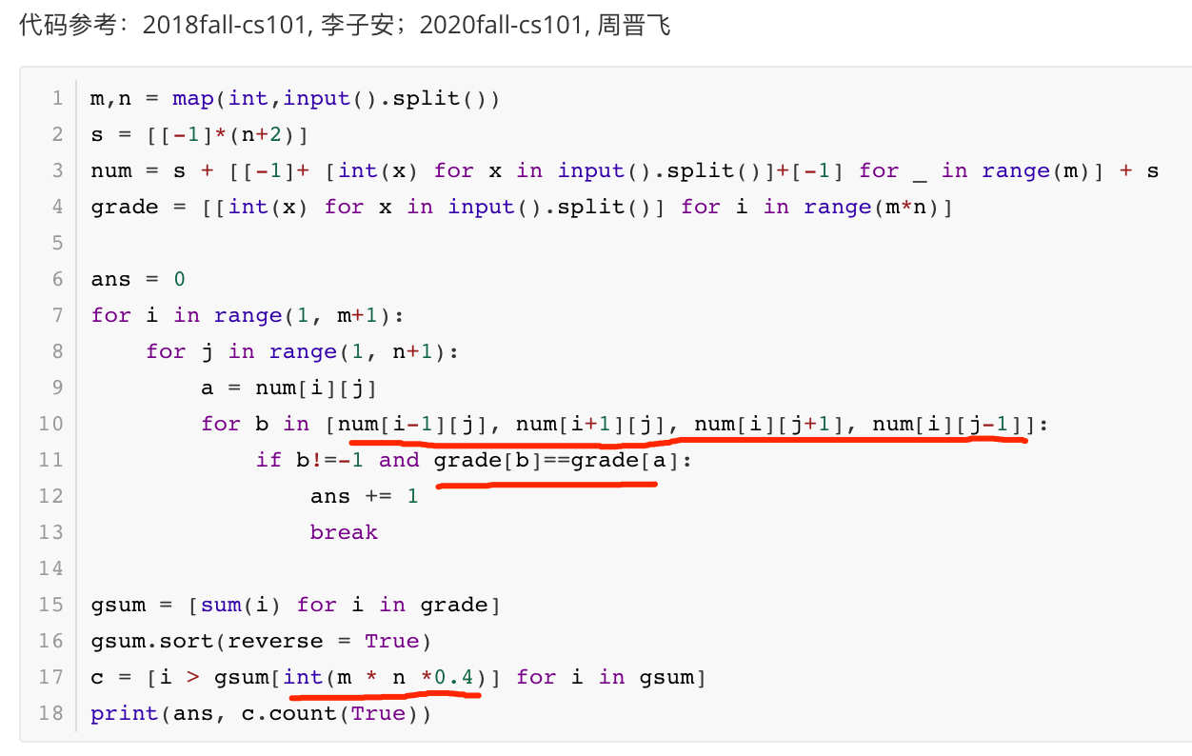
16531: 上机考试, matrices, , cs10117 Final Exam
http://cs101.openjudge.cn/practice/16531/

Slide 16
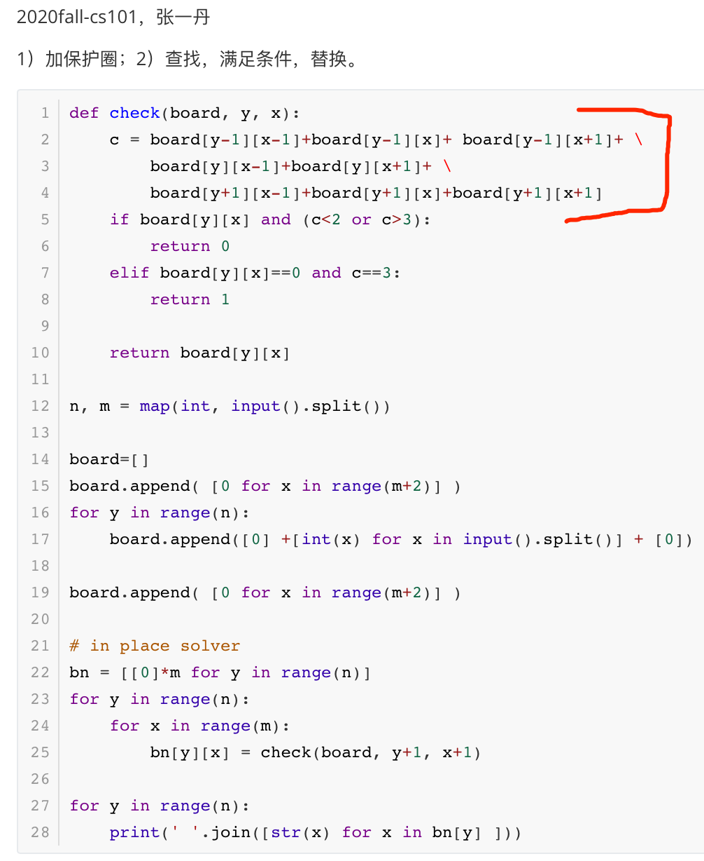
12560: 生存游戏
matrices, http://cs101.openjudge.cn/practice/12560/

Slide 17
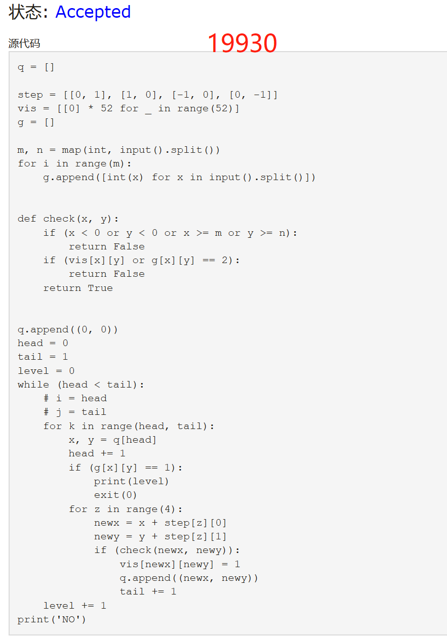
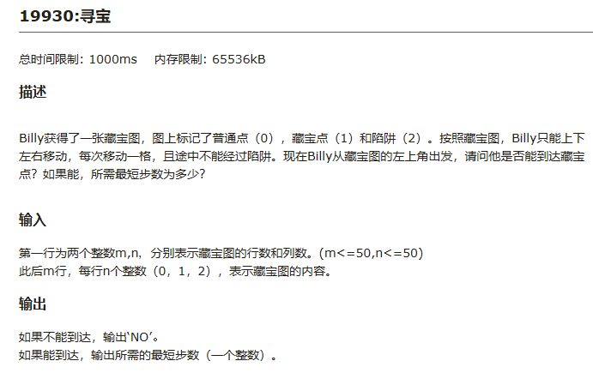

Slide 18
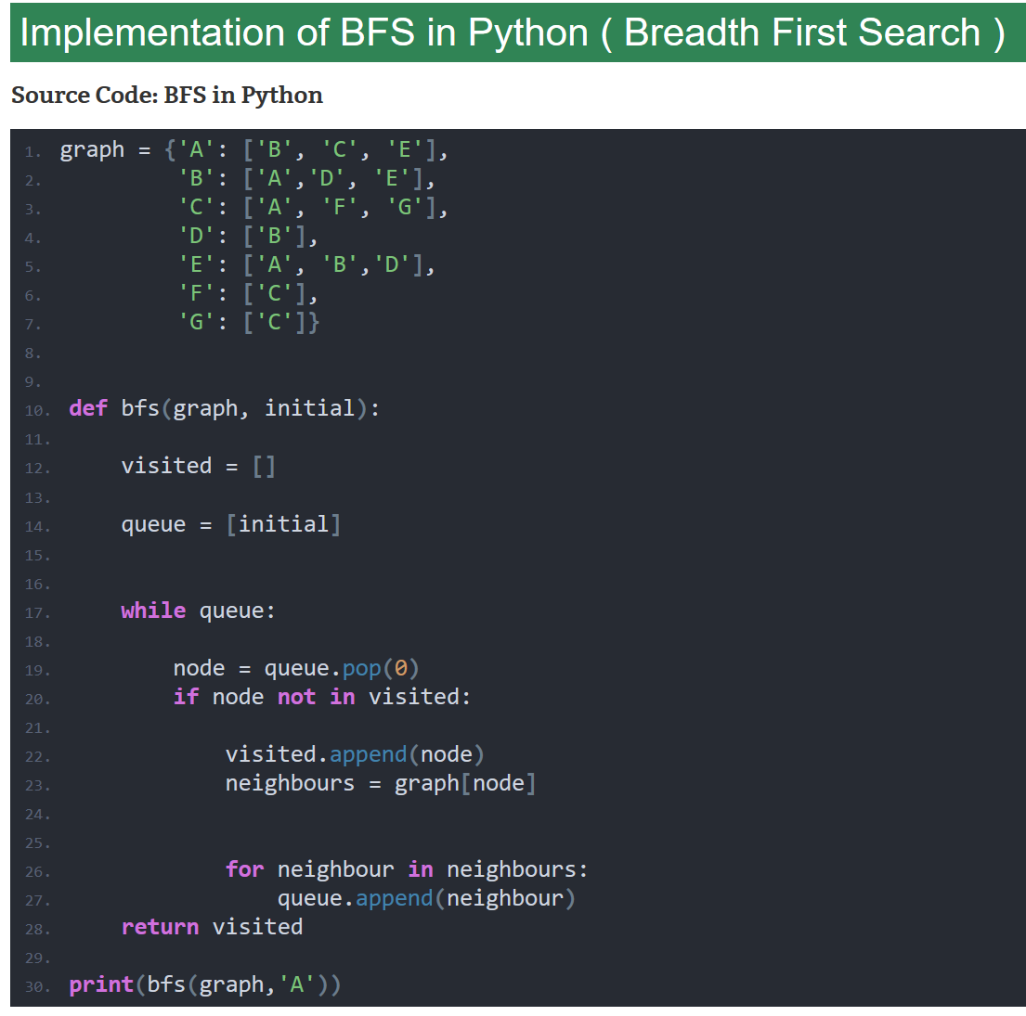
BFS/DFS，主要针对图的遍历
之前接触多是矩阵，上下左右
BFS这程序，也好理解
Notes:
How to implement Breadth First Search algorithm in Python https://www.codespeedy.com/breadth-first-search-algorithm-in-python/

Slide 19
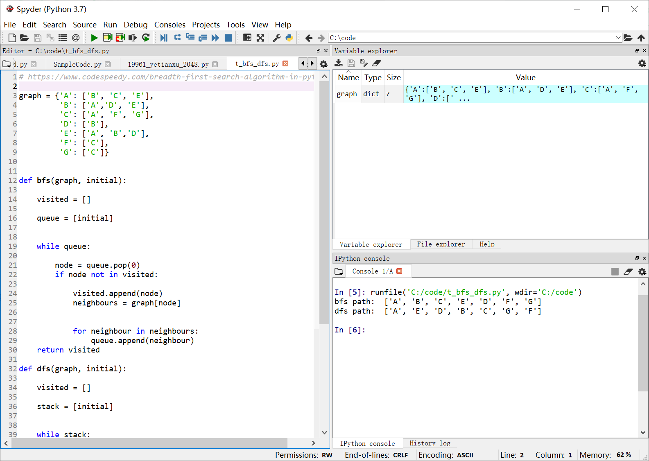
Notes:
# https://www.codespeedy.com/breadth-first-search-algorithm-in-python/
graph = {'A': ['B', 'C', 'E'],
'B': ['A','D', 'E'],
'C': ['A', 'F', 'G'],
'D': ['B'],
'E': ['A', 'B','D'],
'F': ['C'],
'G': ['C']}
def bfs(graph, initial):
visited = []
queue = [initial]
while queue:
node = queue.pop(0)
if node not in visited:
visited.append(node)
neighbours = graph[node]
for neighbour in neighbours:
queue.append(neighbour)
return visited
def dfs(graph, initial):
visited = []
stack = [initial]
while stack:
node = stack.pop()
if node not in visited:
visited.append(node)
neighbours = graph[node]
for neighbour in neighbours:
stack.append(neighbour)
return visited
print('bfs path: ', bfs(graph,'A'))
print('dfs path: ', dfs(graph,'A'))

Slide 20
Backtracking DFS
Notes:
参考《Programming Challenges The Programming Contest Training Manual》第8章 回溯法
Steven S Skiena, Miguel A. Revilla著，刘汝佳 译

Slide 21
计算机速度快，Brute force是解决问题的有效途径
现代个人计算机的时钟频率为1GHz
即每秒运算10亿次，即10⁹
由于大多数有用的操作需要数百条指令（甚至更多），所以每秒钟能搜索几百万个元素就不错.
一百万有多大
约是10个元素的所有排列(permuation)的总数
约是20个元素的所有组合(combination)
如果需要求解更大规模的问题，需要在搜索中剪枝，以确保只会搜索到有必要搜索的元素
介绍穷举搜索中的回溯法，并为它设计有效的剪枝(pruning)策略

Slide 22
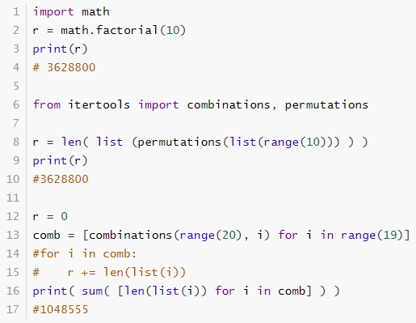
Notes:
import math
r = math.factorial(10)
print(r)
# 3628800
from itertools import combinations, permutations
r = len( list (permutations(list(range(10))) ) )
print(r)
#3628800
r = 0
comb = [combinations(range(20), i) for i in range(19)]
#for i in comb:
# r += len(list(i))
print( sum( [len(list(i)) for i in comb] ) )
#1048555

Slide 23
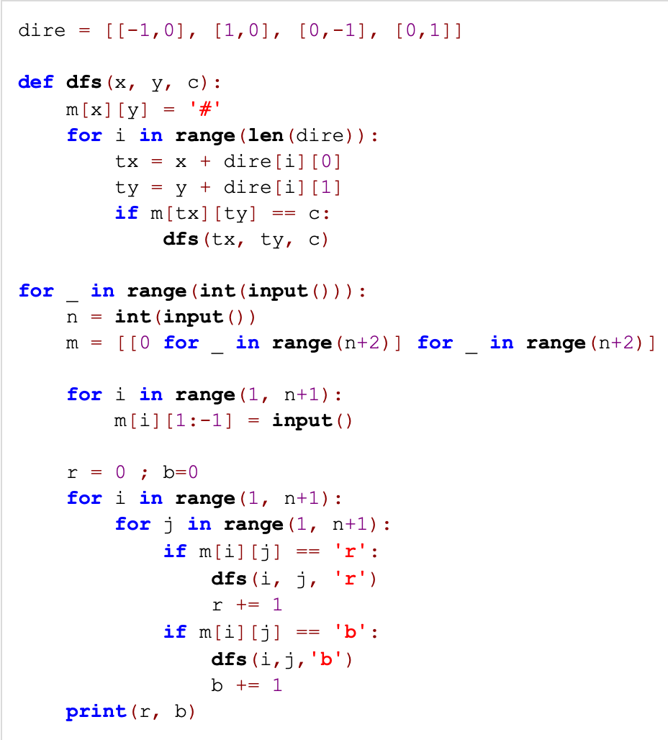
晶矿的个数， http://cs101.openjudge.cn/practice/05585
找四个邻居
遍历，无回溯
如果真考的话，套着模板写，八九不离十
Notes:
# http://cs101.openjudge.cn/practice/05585
dire = [[-1,0], [1,0], [0,-1], [0,1]]
def dfs(x, y, c):
m[x][y] = '#'
for i in range(len(dire)):
tx = x + dire[i][0]
ty = y + dire[i][1]
if m[tx][ty] == c:
dfs(tx, ty, c)
for _ in range(int(input())):
n = int(input())
m = [[0 for _ in range(n+2)] for _ in range(n+2)]
for i in range(1, n+1):
m[i][1:-1] = input()
r = 0 ; b=0
for i in range(1, n+1):
for j in range(1, n+1):
if m[i][j] == 'r':
dfs(i, j, 'r')
r += 1
if m[i][j] == 'b':
dfs(i,j,'b')
b += 1
print(r, b)

Slide 24
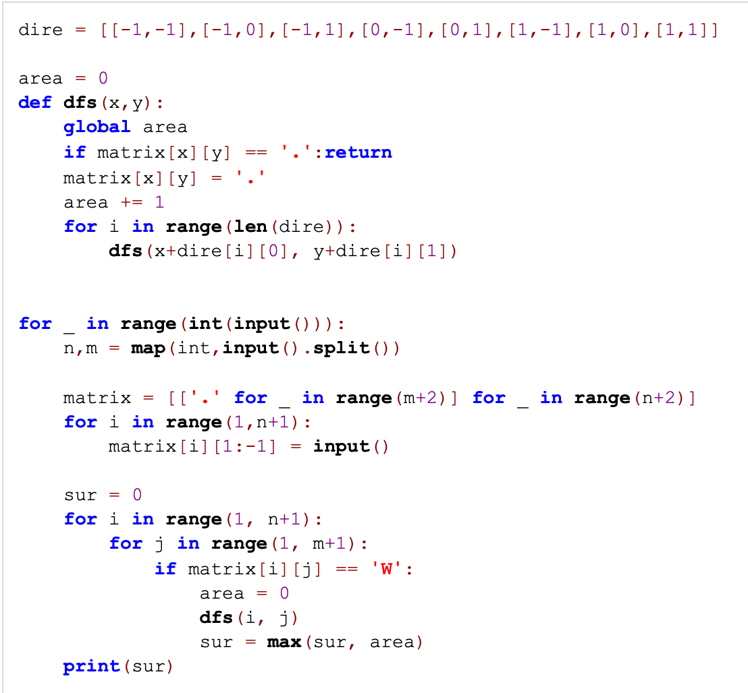
最大连通域面积， http://cs101.openjudge.cn/practice/18160/
比晶矿复杂，找八个邻居
遍历，无回溯
Notes:
#http://cs101.openjudge.cn/practice/18160/
dire = [[-1,-1],[-1,0],[-1,1],[0,-1],[0,1],[1,-1],[1,0],[1,1]]
area = 0
def dfs(x,y):
global area
if matrix[x][y] == '.':return
matrix[x][y] = '.'
area += 1
for i in range(len(dire)):
dfs(x+dire[i][0], y+dire[i][1])
for _ in range(int(input())):
n,m = map(int,input().split())
matrix = [['.' for _ in range(m+2)] for _ in range(n+2)]
for i in range(1,n+1):
matrix[i][1:-1] = input()
sur = 0
for i in range(1, n+1):
for j in range(1, m+1):
if matrix[i][j] == 'W':
area = 0
dfs(i, j)
sur = max(sur, area)
print(sur)

Slide 25
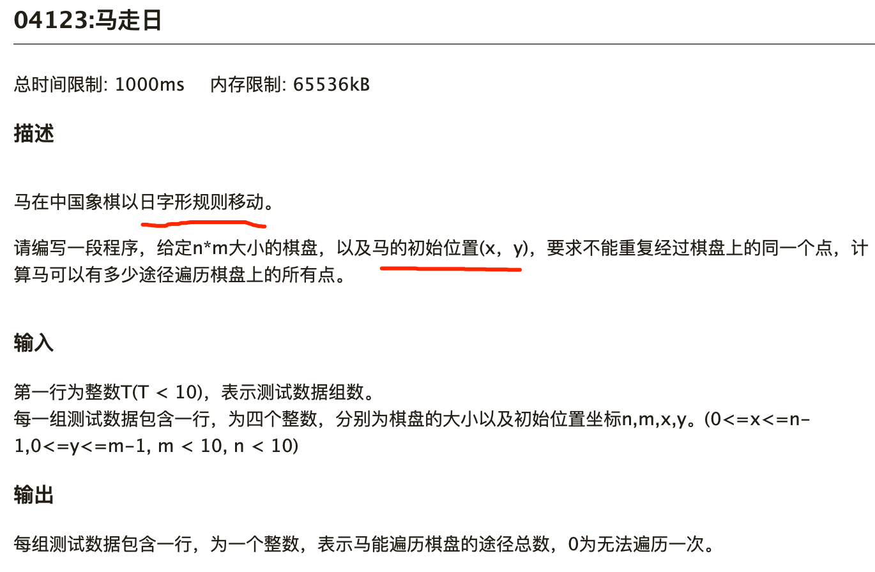

Slide 26
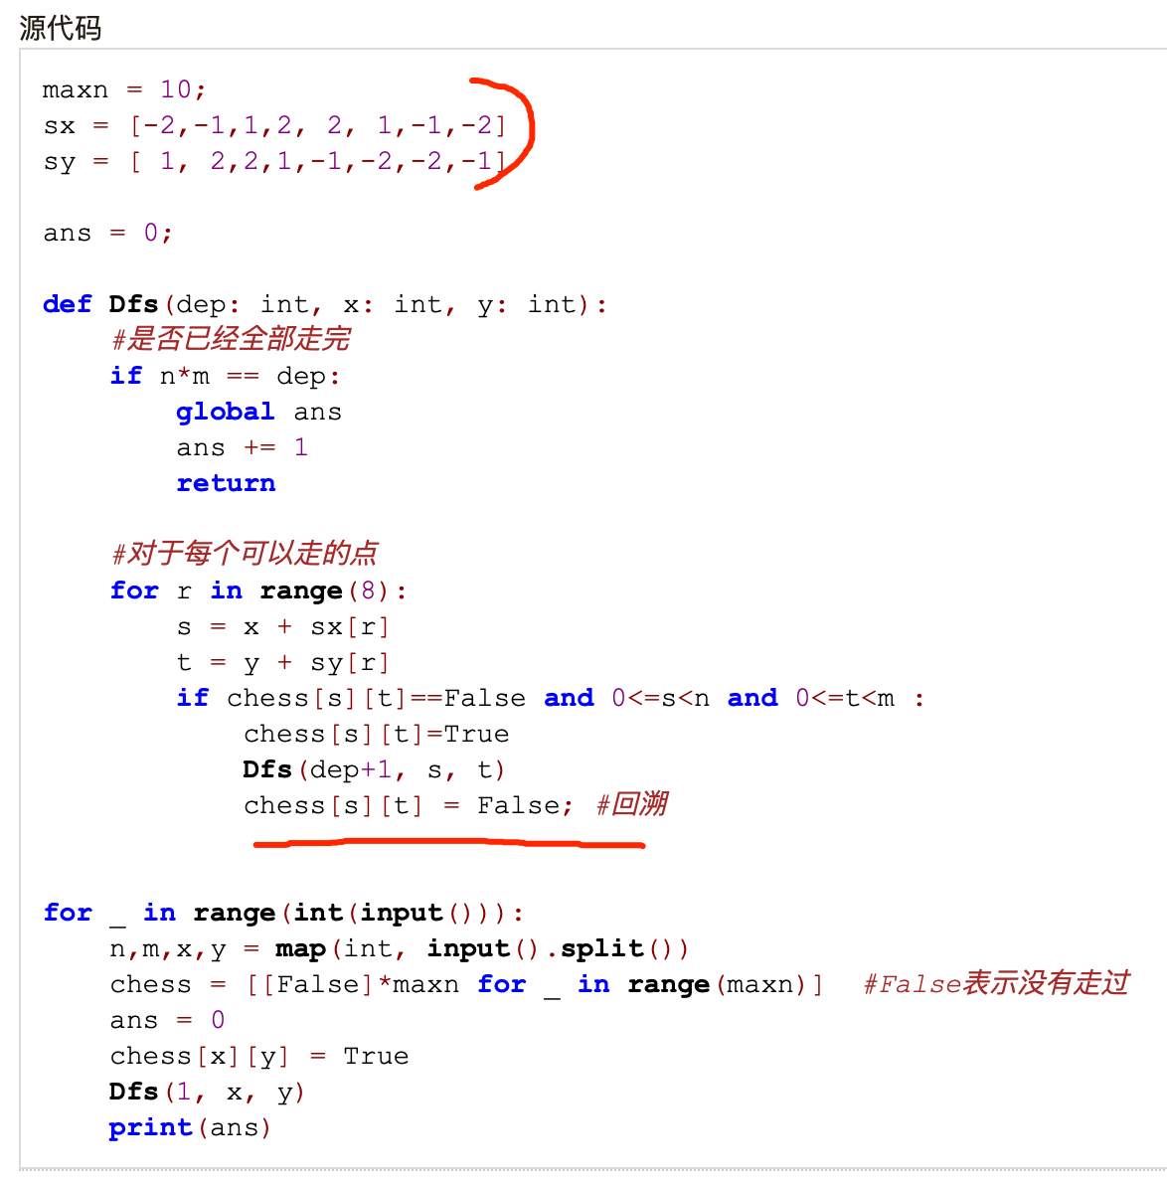
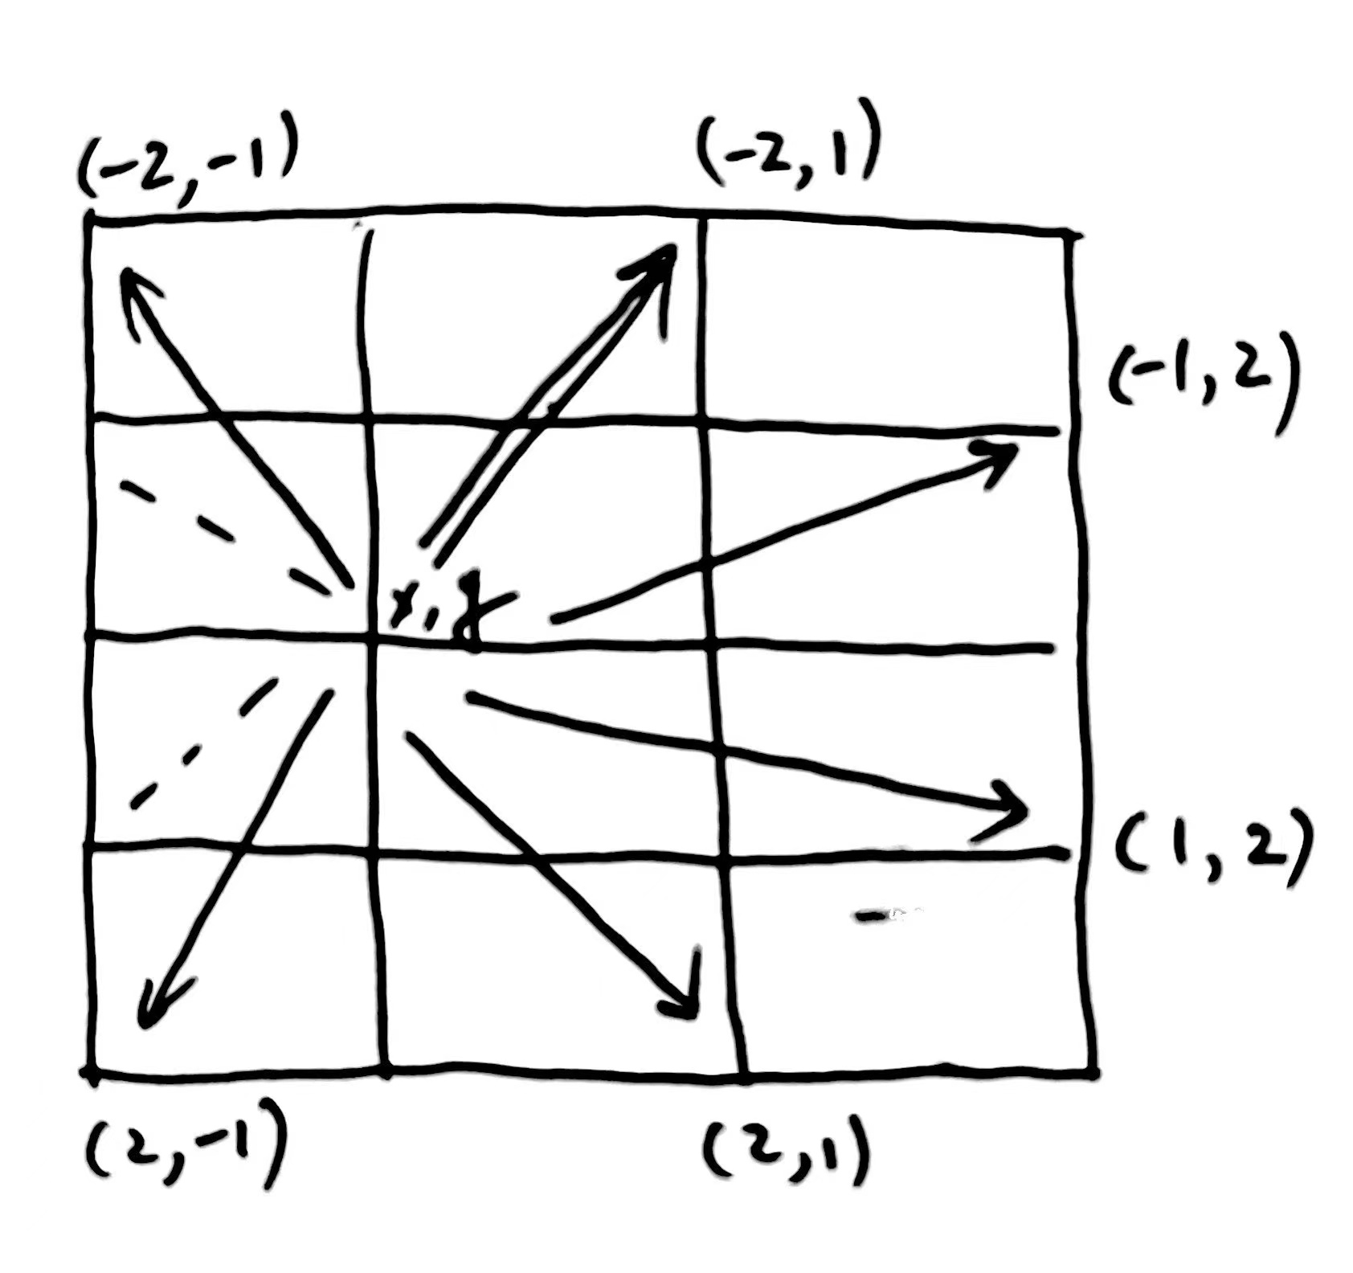

Slide 27
回溯法（1/2）
回溯法是一种枚举状态空间中所有可能状态的系统方法
是一个一般性的算法框架（或称技巧），应用时须具体问题具体分析
对于一般情况，把解表示成向量 a = (a1,a2,…,an)，其中每个元素ai取自一个有限序集Si
可以表示一个排列，其中ai是排列中的第i个元素；
甚至可以表示游戏中的行动序列或者图中的路径，其中ai表示序列中的第i个元素

Slide 28
在回溯法的每一步（2/2）
从一个给定的部分解（partial solution）a = (a1,a2,…,ak)开始
尝试着在最后添加元素来扩展这个部分解
扩展之后，必须测试它是否为一个完整的解
如果是的话，需要输出这个解、更新解的计数器或者其他你想做的事
如果仍不完整，必须检查这个部分解是否仍有可能扩展成完整解
如果有可能，递归下去
如果没有可能，从a中删除新加入的最后一个元素（回溯），然后尝试该位置上的其他可能性（如果有的话）

Slide 29
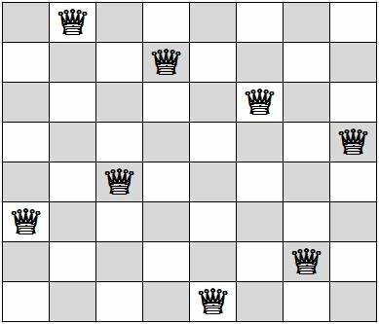
举例：八皇后问题
目标是在8 X 8棋盘上放置八个皇后，使得任意两个皇后不会互相攻击
即任意两个皇后不会在同一行、同一列或者同一条45°斜线上
很多人研究过这个问题，包括数学家高斯和同学们

Slide 30
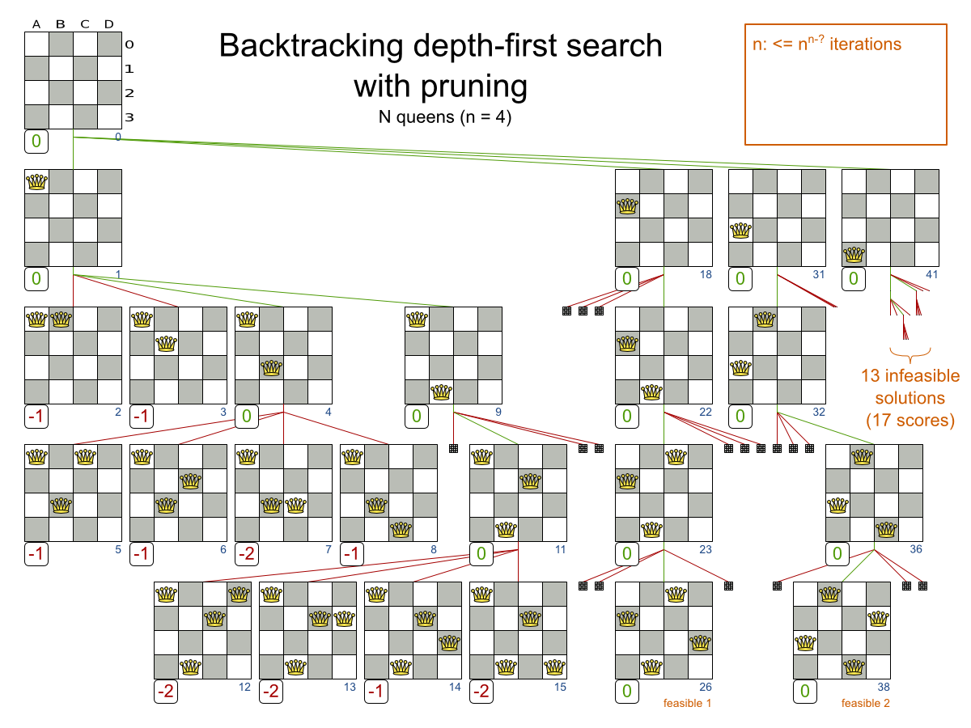

Slide 31
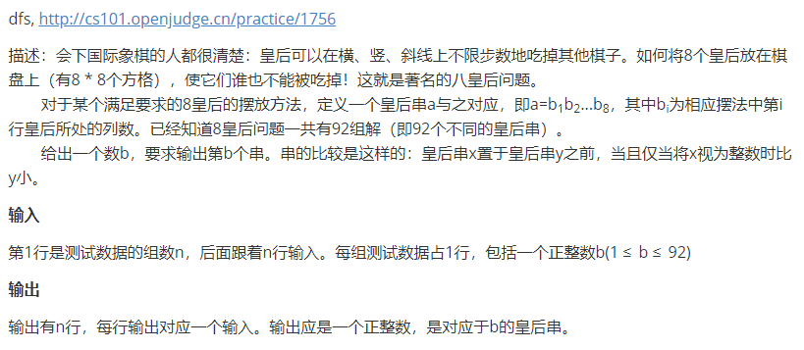
OJ 1756 八皇后
Notes:
http://cs101.openjudge.cn/practice/1756

Slide 32
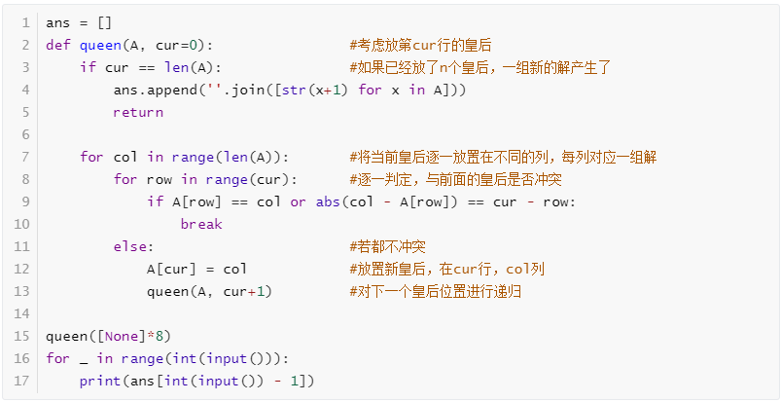
回溯/dfs
Notes:
ans = []
def queen(A, cur=0): #考虑放第cur行的皇后
if cur == len(A): #如果已经放了n个皇后，一组新的解产生了
ans.append(''.join([str(x+1) for x in A]))
return
for col in range(len(A)): #将当前皇后逐一放置在不同的列，每列对应一组解
for row in range(cur): #逐一判定，与前面的皇后是否冲突
if A[row] == col or abs(col - A[row]) == cur - row:
break
else: #若都不冲突
A[cur] = col #放置新皇后，在cur行，col列
queen(A, cur+1) #对下一个皇后位置进行递归
queen([None]*8)
for _ in range(int(input())):
print(ans[int(input()) - 1])

Slide 33
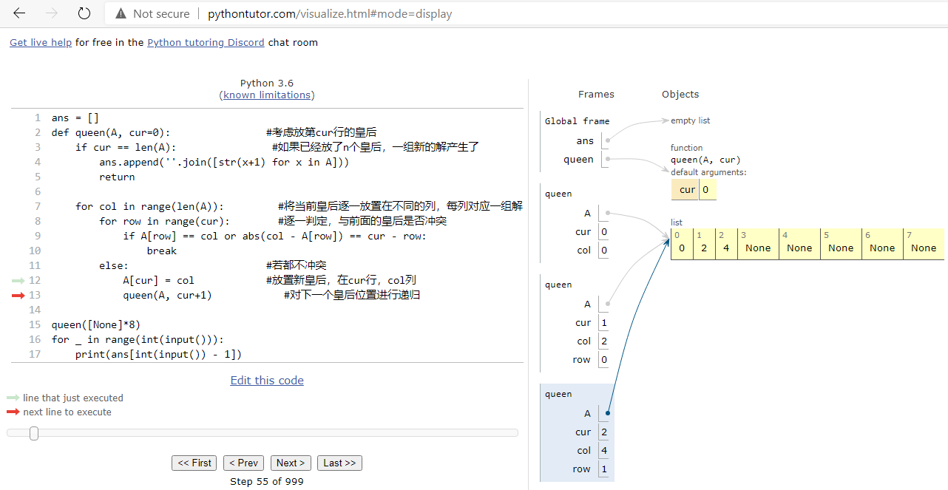

Slide 34
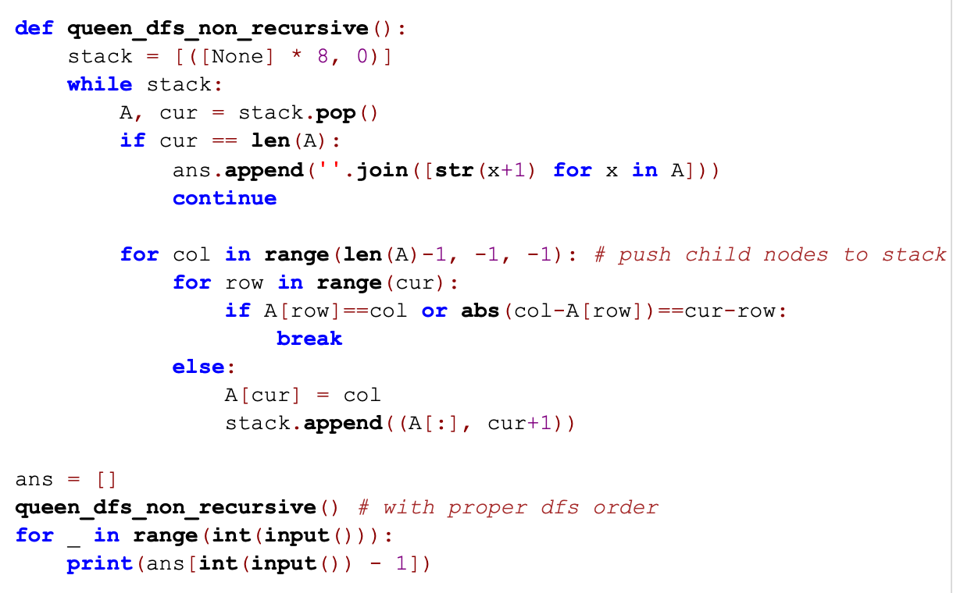

Slide 35
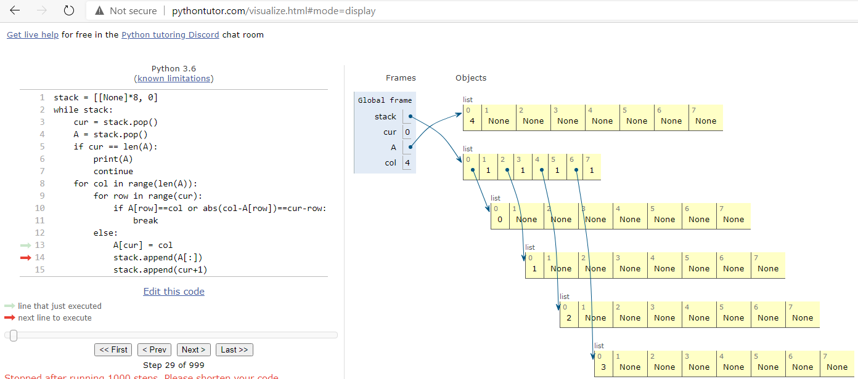
2020fall-cs101，李博海，bfs
Notes:
stack = [[None]*8, 0]
while stack:
cur = stack.pop()
A = stack.pop()
if cur == len(A):
print(A)
continue
for col in range(len(A)):
for row in range(cur):
if A[row]==col or abs(col-A[row])==cur-row:
break
else:
A[cur] = col
stack.append(A[:])
stack.append(cur+1)

