Slide 1
Two Dimensional Array
Hongfei Yan
2021/11/8

Slide 2
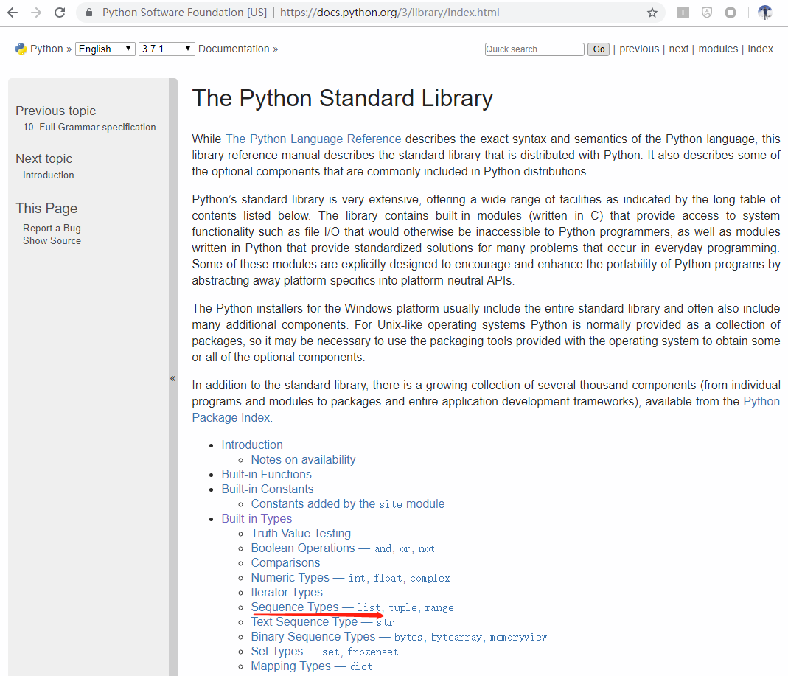

Notes:
https://docs.python.org/3/library/index.html

Slide 3
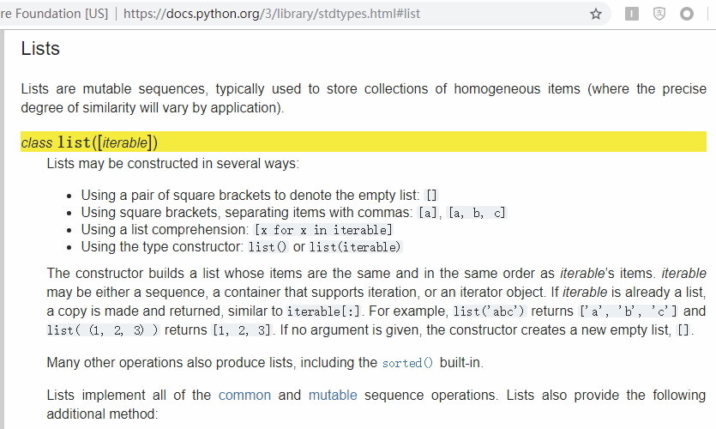
Notes:
https://docs.python.org/3/library/stdtypes.html#list

Slide 4
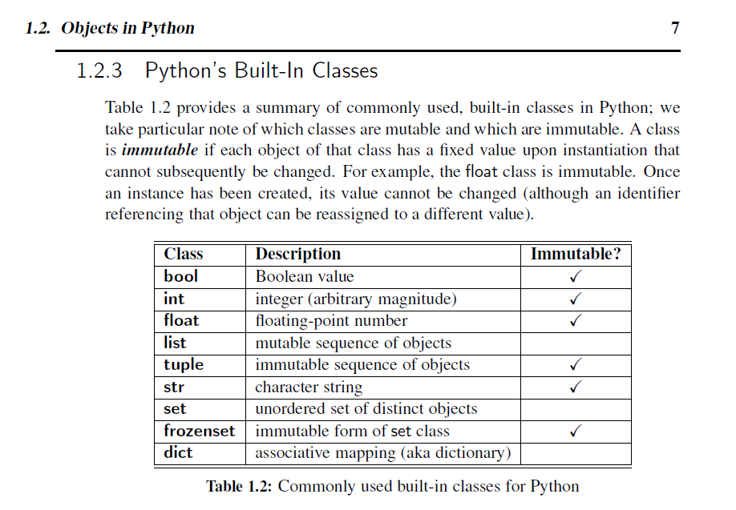


Slide 5

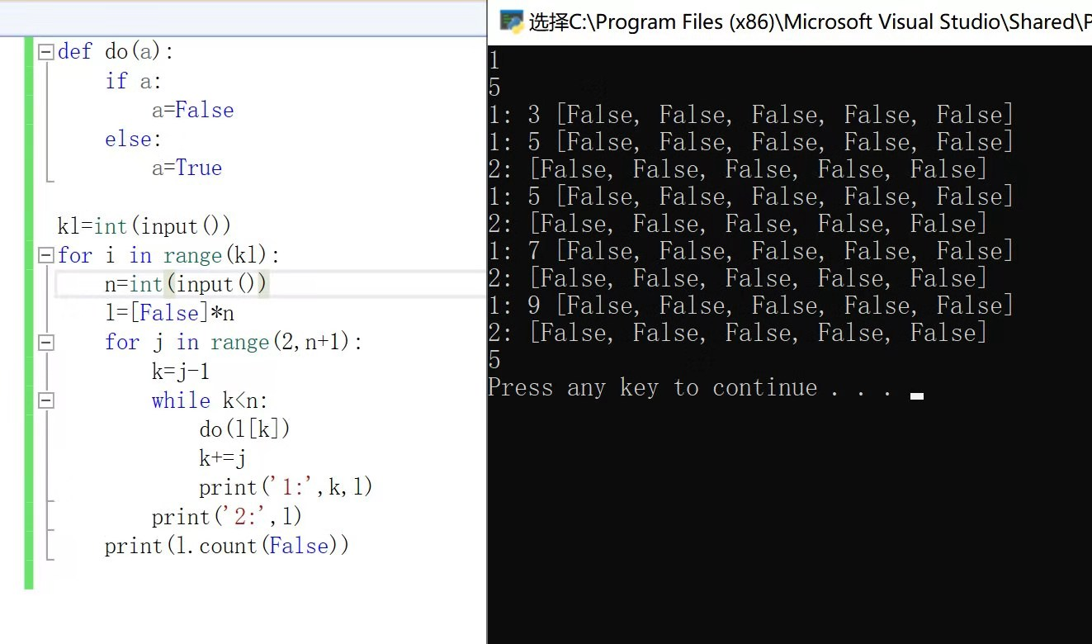
为什么每次循环do函数都没有执行呢？ python的参量不是默认传引用嘛

Slide 6
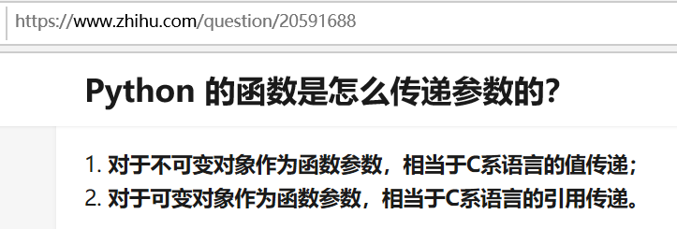

如传l进去函数，就是可变对象。传l[k]是不可变对象。
在Python中，对于不可变对象，调用自身的任意方法，并不会改变对象自身的内容，这些方法会创建新的对象并返回，保证了不可变对象本身是永远不可变的。

Slide 7
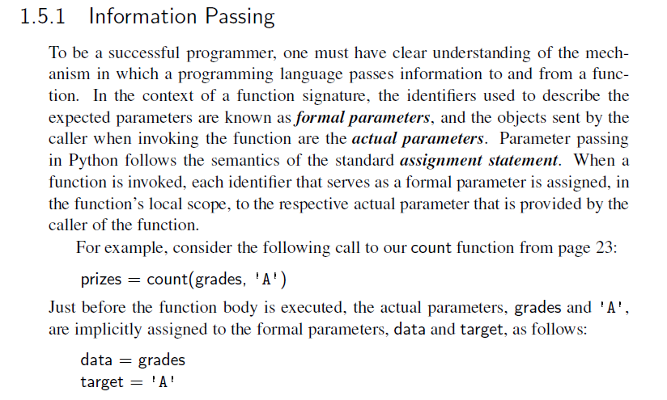
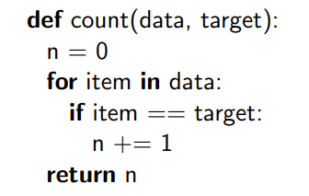
教材上的例子，传了一个可变，一个不可变（1/2）

Slide 8
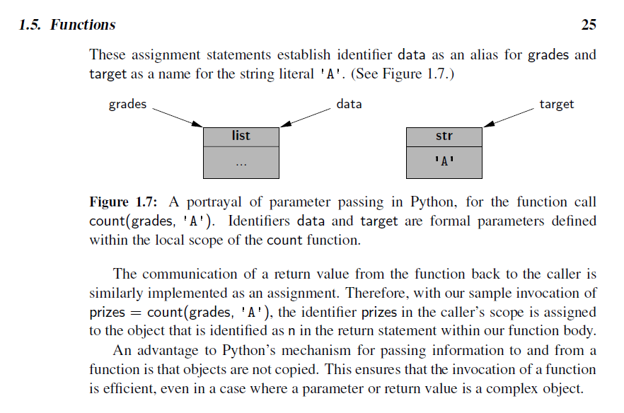
教材上的例子，传了一个可变，一个不可变（2/2）

Slide 9
都能看懂Python函数传递参数吗？感觉能看懂，还好！

Slide 10


Slide 11
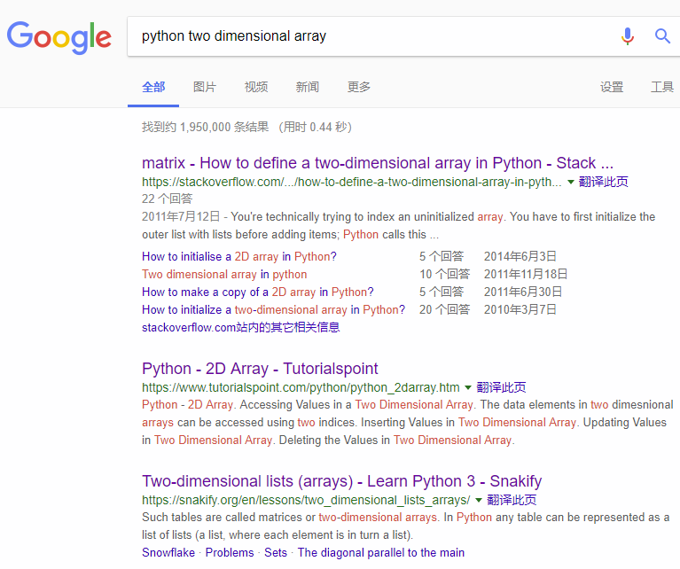
Notes:
https://stackoverflow.com/questions/6667201/how-to-define-a-two-dimensional-array-in-python

Slide 12
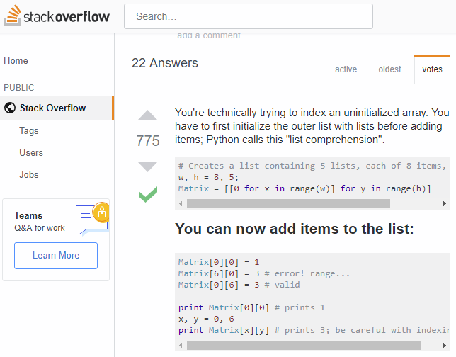

Slide 13
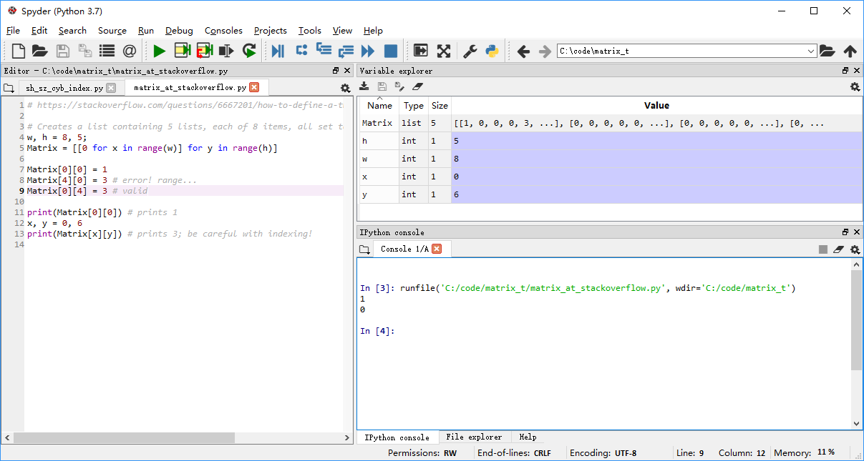
Notes:
# https://stackoverflow.com/questions/6667201/how-to-define-a-two-dimensional-array-in-python
# Creates a list containing 5 lists, each of 8 items, all set to 0
w, h = 8, 5;
Matrix = [[0 for x in range(w)] for y in range(h)]
Matrix[0][0] = 1
Matrix[4][0] = 3 # error! range...
Matrix[0][4] = 3 # valid
print(Matrix[0][0]) # prints 1
x, y = 0, 6
print(Matrix[x][y]) # prints 3; be careful with indexing!

Slide 14
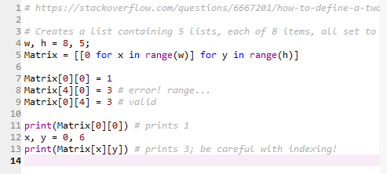

Slide 15
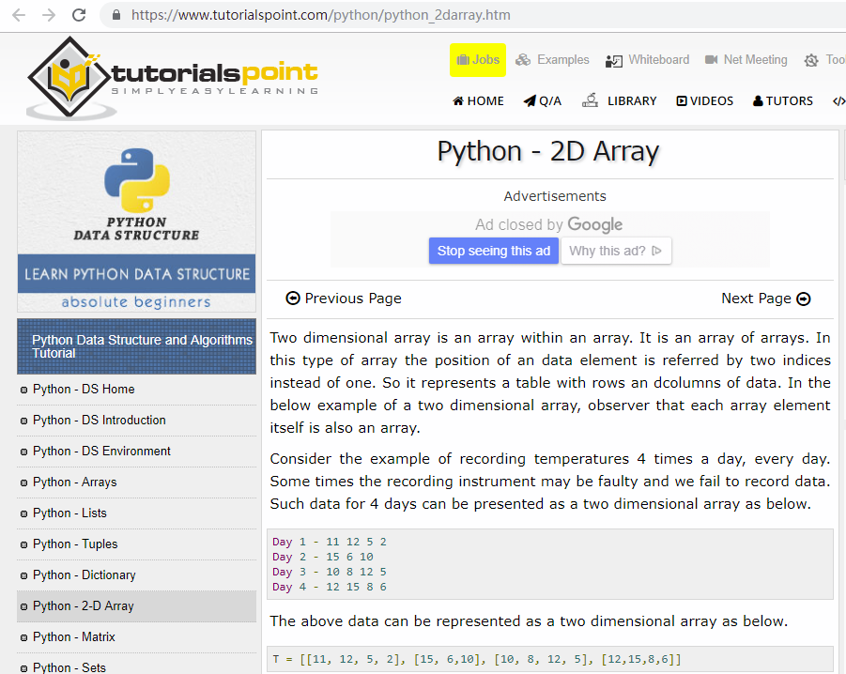
Notes:
https://www.tutorialspoint.com/python/python_2darray.htm

Slide 16
Python - 2D Array
Two dimensional array is an array within an array.
It is an array of arrays.
A data element is referred by two indices instead of one.
So it represents a table with rows and columns of data.
Notes:
In the below example of a two dimensional array, observer that each array element itself is also an array.

Slide 17
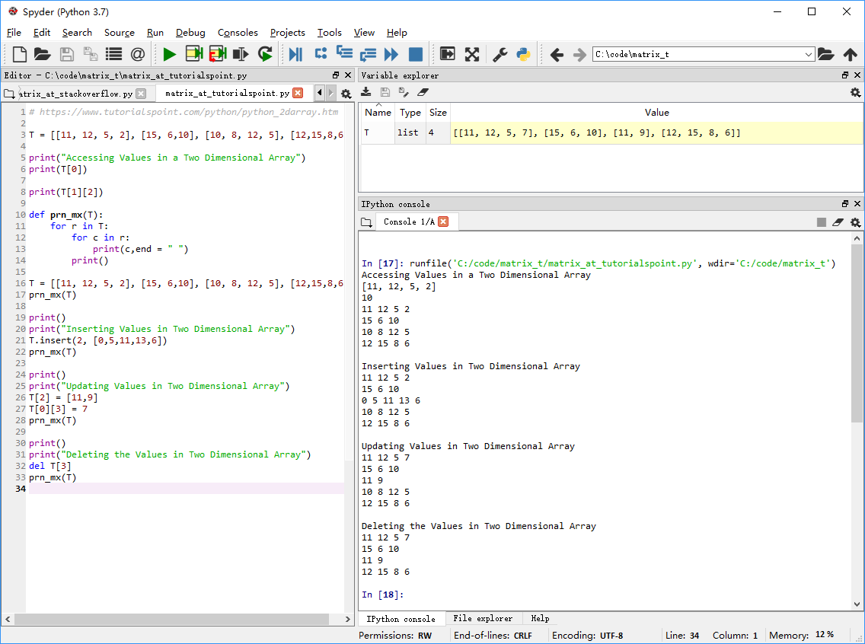
Notes:
# https://www.tutorialspoint.com/python/python_2darray.htm
T = [[11, 12, 5, 2], [15, 6,10], [10, 8, 12, 5], [12,15,8,6]]
print("Accessing Values in a Two Dimensional Array")
print(T[0])
print(T[1][2])
def prn_mx(T):
for r in T:
for c in r:
print(c,end = " ")
print()
T = [[11, 12, 5, 2], [15, 6,10], [10, 8, 12, 5], [12,15,8,6]]
prn_mx(T)
print()
print("Inserting Values in Two Dimensional Array")
T.insert(2, [0,5,11,13,6])
prn_mx(T)
print()
print("Updating Values in Two Dimensional Array")
T[2] = [11,9]
T[0][3] = 7
prn_mx(T)
print()
print("Deleting the Values in Two Dimensional Array")
del T[3]
prn_mx(T)

Slide 18
Python - Matrix
Matrix is a special case of two dimensional array where each data element is of strictly same size.
So every matrix is also a two dimensional array but not vice versa.
Matrices are very important data structures for many mathematical and scientific calculations.
Notes:
https://www.tutorialspoint.com/python/python_matrix.htm

Slide 19

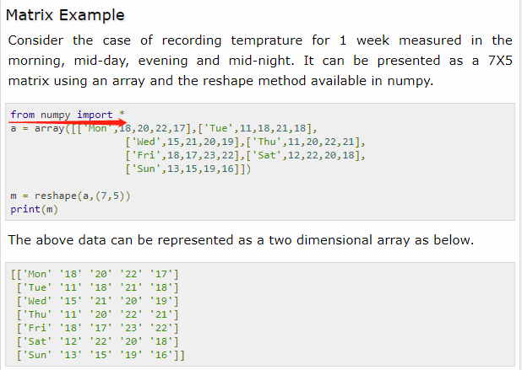
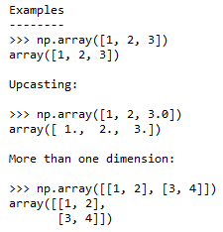
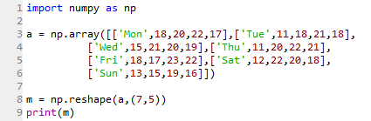



Notes:
import numpy as np
a = np.array([['Mon',18,20,22,17],['Tue',11,18,21,18],
['Wed',15,21,20,19],['Thu',11,20,22,21],
['Fri',18,17,23,22],['Sat',12,22,20,18],
['Sun',13,15,19,16]])
m = np.reshape(a,(7,5))
print(m)

Slide 20
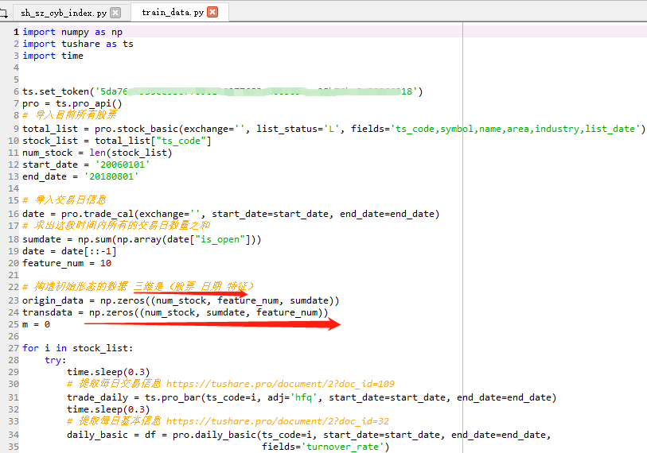
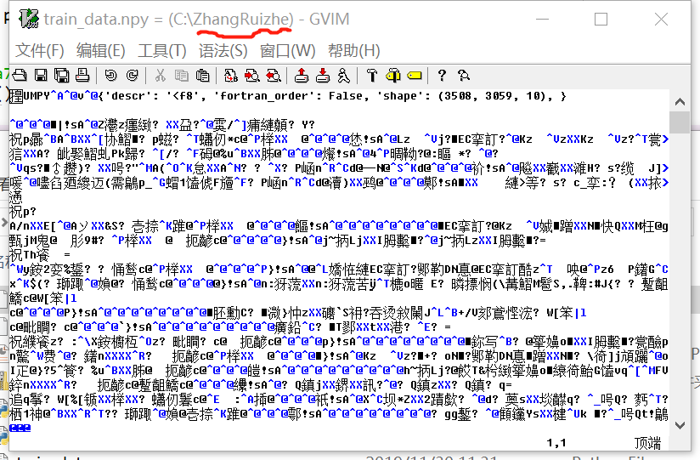

Slide 21
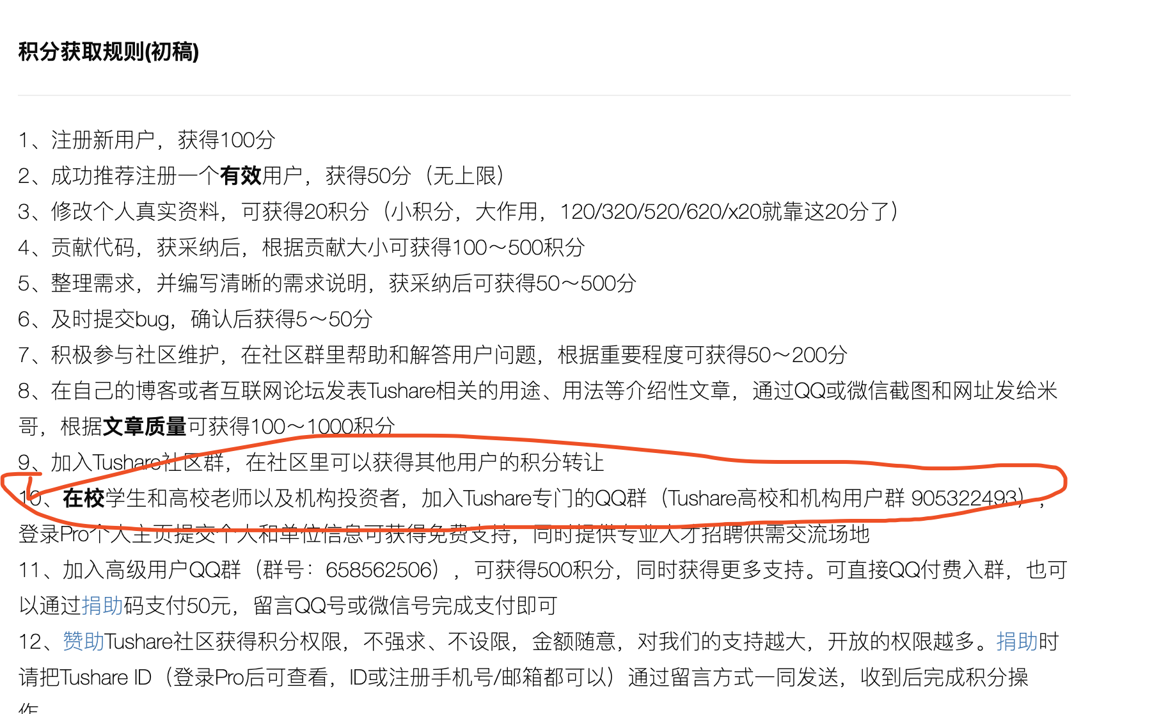



Slide 22
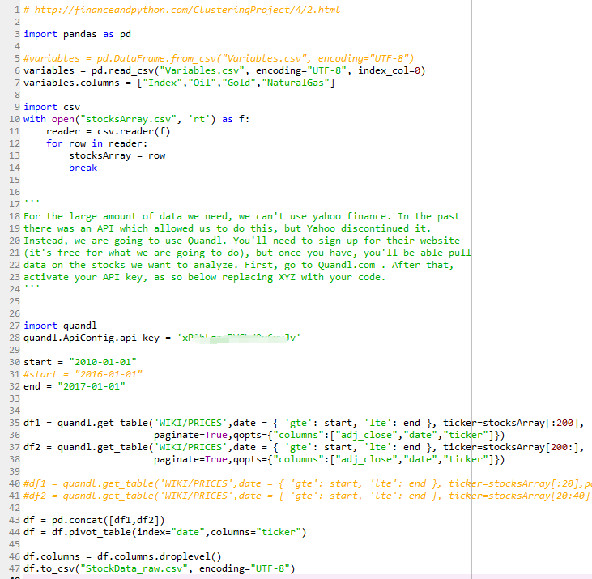

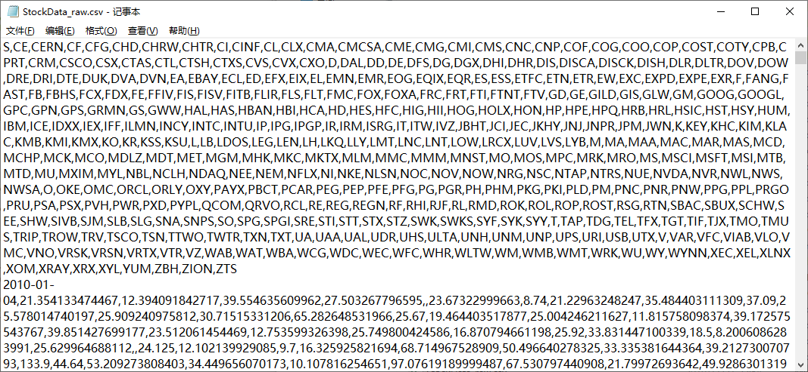

Slide 23

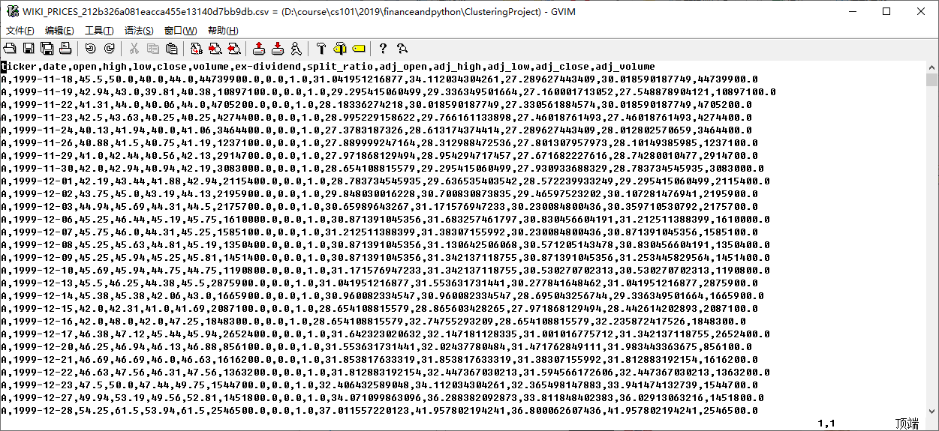
多维度，可以通过增加列来实现。类似quandle 的wiki_price.
三维数组，理解起来有点困难。

Slide 24
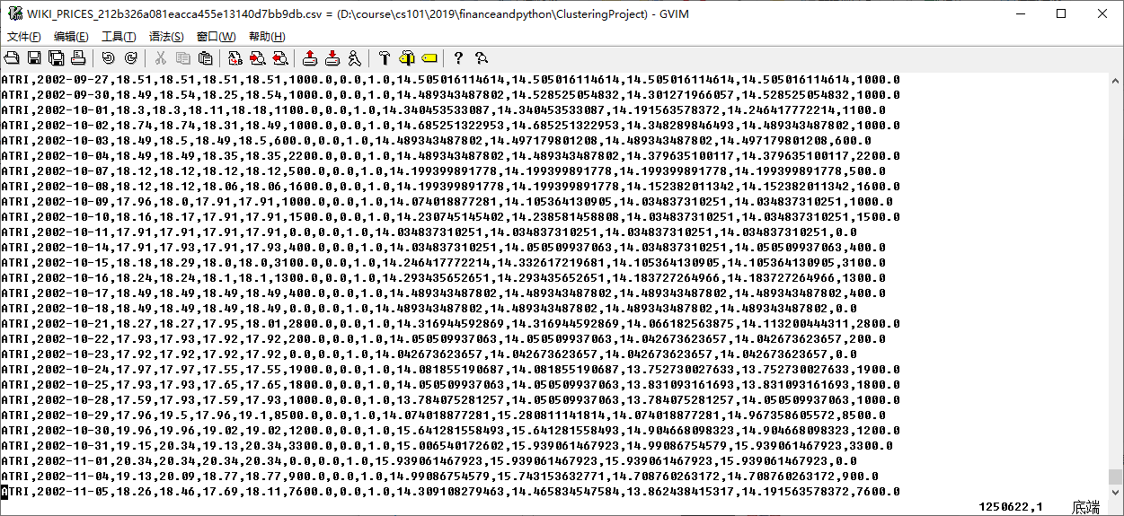
Notes:
.csv便于交互。我看金融多数用这个格式。

Slide 25
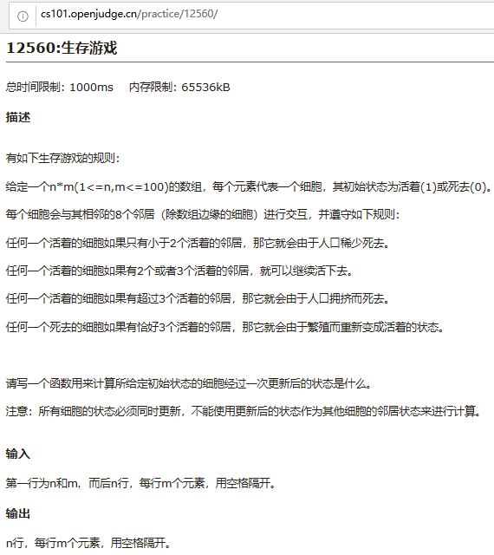
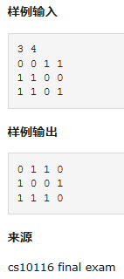
Notes:
http://cs101.openjudge.cn/practice/12560/

Slide 26
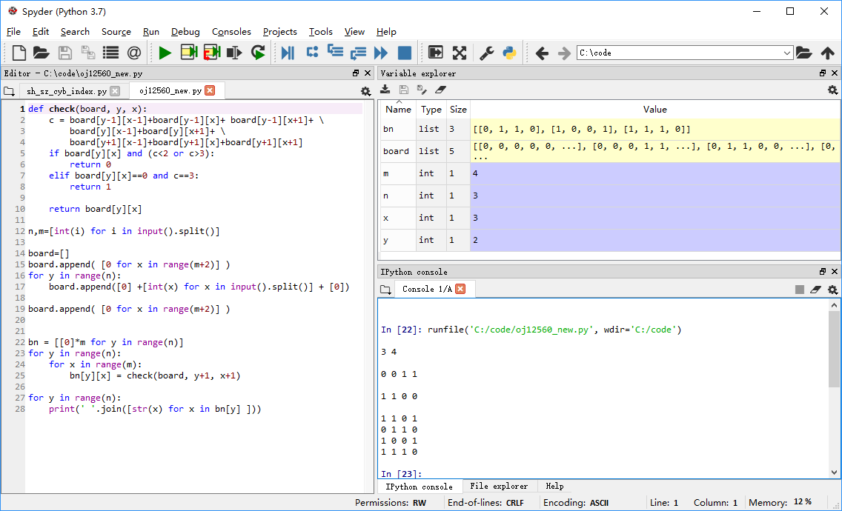
' '.join(map(str, bn[y])
Notes:
# http://cs101.openjudge.cn/practice/12560/
def check(board, y, x):
c = board[y-1][x-1]+board[y-1][x]+ board[y-1][x+1]+ \
board[y][x-1]+board[y][x+1]+ \
board[y+1][x-1]+board[y+1][x]+board[y+1][x+1]
if board[y][x] and (c<2 or c>3):
return 0
elif board[y][x]==0 and c==3:
return 1
return board[y][x]
n,m=[int(i) for i in input().split()]
board=[]
board.append( [0 for x in range(m+2)] )
for y in range(n):
board.append([0] +[int(x) for x in input().split()] + [0])
board.append( [0 for x in range(m+2)] )
bn = [[0]*m for y in range(n)]
for y in range(n):
for x in range(m):
bn[y][x] = check(board, y+1, x+1)
for y in range(n):
print(' '.join([str(x) for x in bn[y] ]))

Slide 27
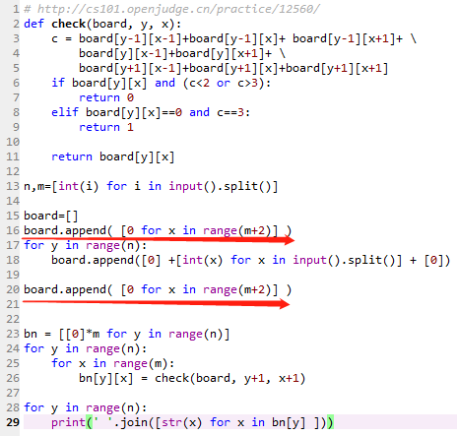
函数
保护圈
' '.join(map(str, bn[y])

Slide 28
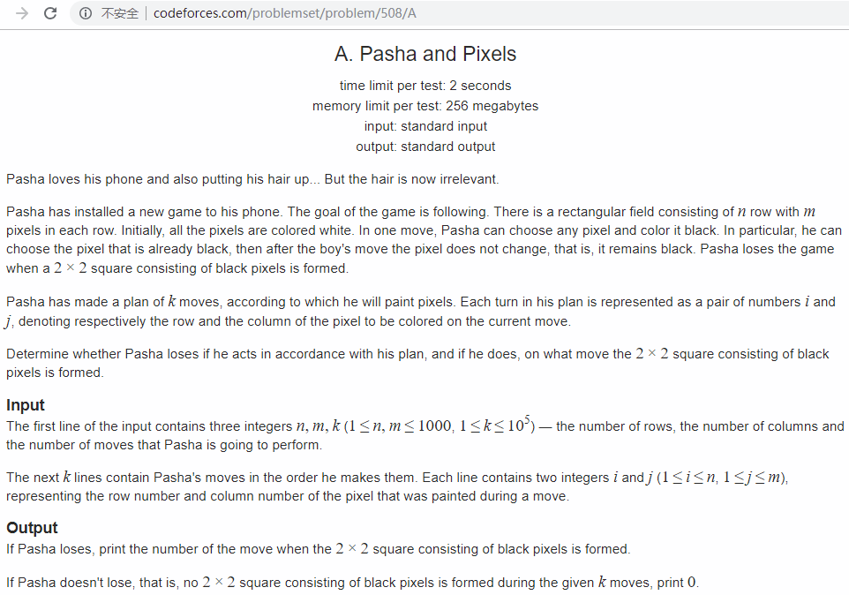

Notes:
http://codeforces.com/problemset/problem/508/A

Slide 29
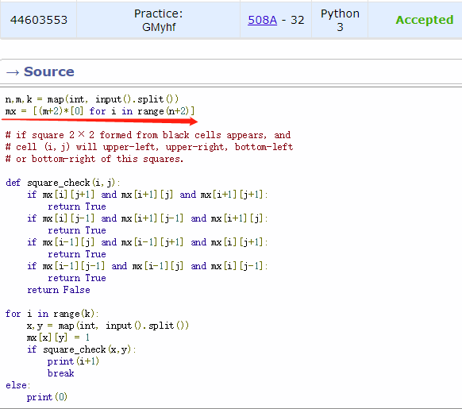
保护圈
函数
Notes:
# http://codeforces.com/contest/508/submission/44603553
n,m,k = map(int, input().split())
mx = [(m+2)*[0] for i in range(n+2)]
# if square 2 × 2 formed from black cells appears, and
# cell (i, j) will upper-left, upper-right, bottom-left
# or bottom-right of this squares.
def square_check(i,j):
if mx[i][j+1] and mx[i+1][j] and mx[i+1][j+1]:
return True
if mx[i][j-1] and mx[i+1][j-1] and mx[i+1][j]:
return True
if mx[i-1][j] and mx[i-1][j+1] and mx[i][j+1]:
return True
if mx[i-1][j-1] and mx[i-1][j] and mx[i][j-1]:
return True
return False
for i in range(k):
x,y = map(int, input().split())
mx[x][y] = 1
if square_check(x,y):
print(i+1)
break
else:
print(0)

Slide 30
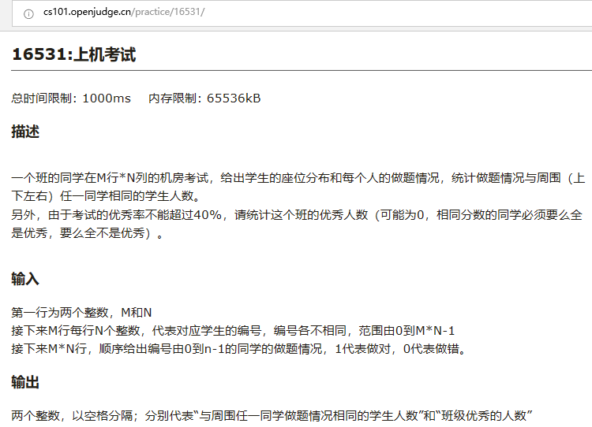
Notes:
http://cs101.openjudge.cn/practice/16531/

Slide 31
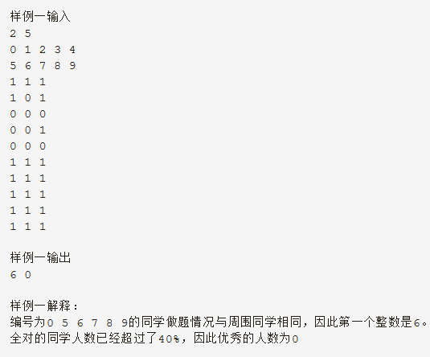
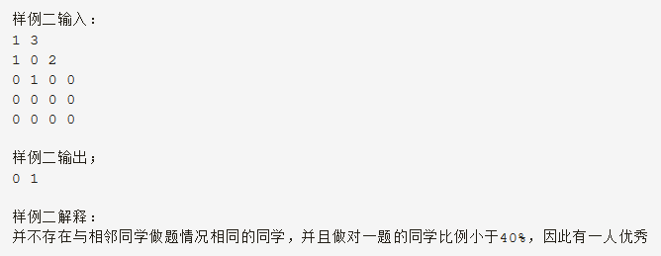

Slide 32
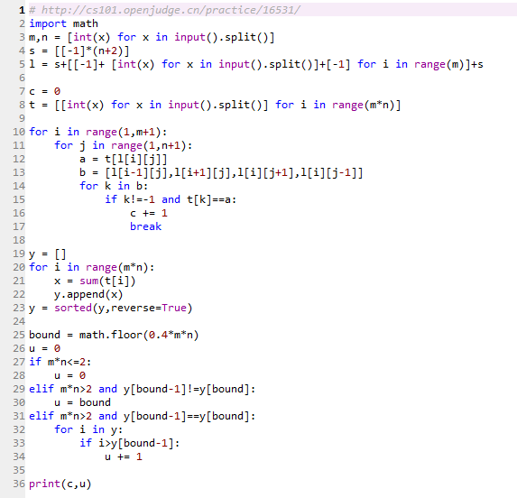
# cs101-2018 by李子安
Notes:
# http://cs101.openjudge.cn/practice/16531/
# cs101-2018 by李子安
import math
m,n = [int(x) for x in input().split()]
s = [[-1]*(n+2)]
l = s+[[-1]+ [int(x) for x in input().split()]+[-1] for i in range(m)]+s
c = 0
t = [[int(x) for x in input().split()] for i in range(m*n)]
for i in range(1,m+1):
for j in range(1,n+1):
a = t[l[i][j]]
b = [l[i-1][j],l[i+1][j],l[i][j+1],l[i][j-1]]
for k in b:
if k!=-1 and t[k]==a:
c += 1
break
y = []
for i in range(m*n):
x = sum(t[i])
y.append(x)
y = sorted(y,reverse=True)
bound = math.floor(0.4*m*n)
u = 0
if m*n<=2:
u = 0
elif m*n>2 and y[bound-1]!=y[bound]:
u = bound
elif m*n>2 and y[bound-1]==y[bound]:
for i in y:
if i>y[bound-1]:
u += 1
print(c,u)

Slide 33
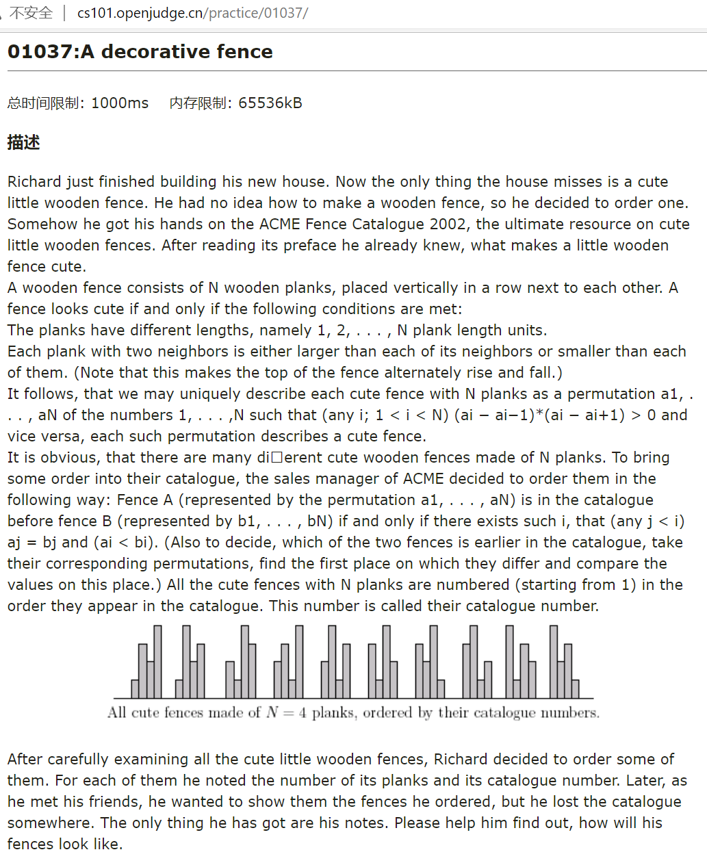

Slide 34
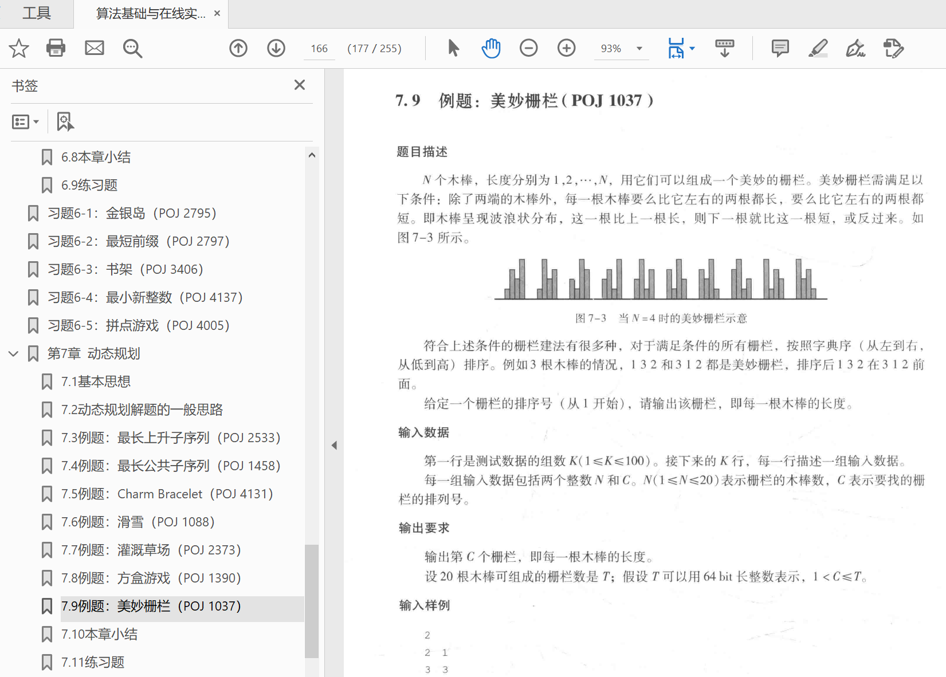

Slide 35
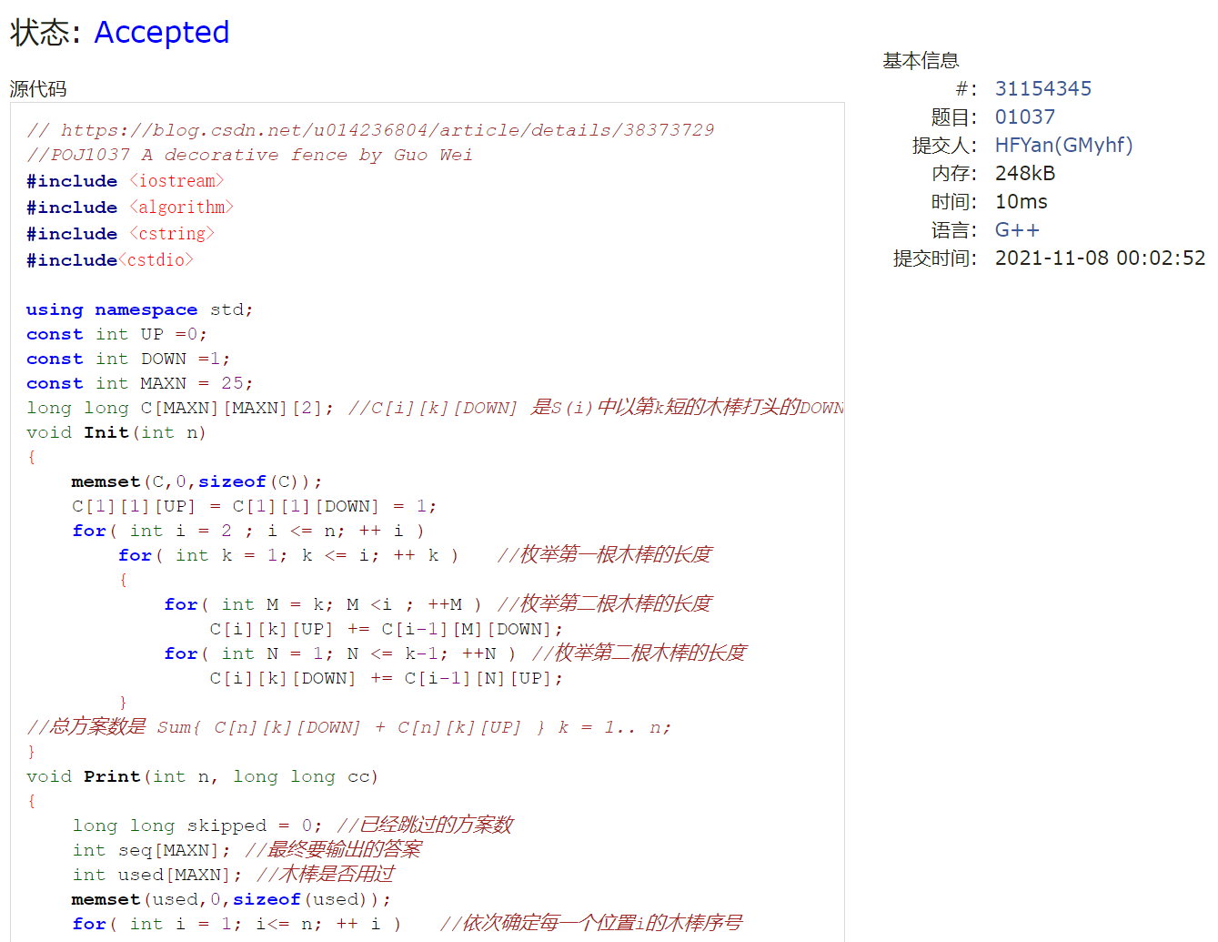
Notes:
// https://blog.csdn.net/u014236804/article/details/38373729
//POJ1037 A decorative fence by Guo Wei
#include <iostream>
#include <algorithm>
#include <cstring>
#include<cstdio>
using namespace std;
const int UP =0;
const int DOWN =1;
const int MAXN = 25;
long long C[MAXN][MAXN][2]; //C[i][k][DOWN] 是S(i)中以第k短的木棒打头的DOWN方案数,C[i][k][UP] 是S(i)中以第k短的木棒打头的UP方案数,第k短指i根中第k短
void Init(int n)
{
memset(C,0,sizeof(C));
C[1][1][UP] = C[1][1][DOWN] = 1;
for( int i = 2 ; i <= n; ++ i )
for( int k = 1; k <= i; ++ k ) //枚举第一根木棒的长度
{
for( int M = k; M <i ; ++M ) //枚举第二根木棒的长度
C[i][k][UP] += C[i-1][M][DOWN];
for( int N = 1; N <= k-1; ++N ) //枚举第二根木棒的长度
C[i][k][DOWN] += C[i-1][N][UP];
}
//总方案数是 Sum{ C[n][k][DOWN] + C[n][k][UP] } k = 1.. n;
}
void Print(int n, long long cc)
{
long long skipped = 0; //已经跳过的方案数
int seq[MAXN]; //最终要输出的答案
int used[MAXN]; //木棒是否用过
memset(used,0,sizeof(used));
for( int i = 1; i<= n; ++ i ) //依次确定每一个位置i的木棒序号
{
long long oldVal = skipped;
int k;
int No = 0; //k是剩下的木棒里的第No短的,No从1开始算
for( k = 1; k <= n; ++k ) //枚举位置i的木棒 ，其长度为k
{
oldVal = skipped;
if( !used[k])
{
++ No; //k是剩下的木棒里的第No短的
if( i == 1 )
skipped += C[n][No][UP] + C[n][No][DOWN];
else
{
if( k > seq[i-1] && ( i <=2 || seq[i-2]>seq[i-1]))//合法放置
skipped += C[n-i+1][No][DOWN];
else if( k < seq[i-1] &&(i<=2 || seq[i-2]<seq[i-1])) //合法放置
skipped += C[n-i+1][No][UP];
}
if( skipped >= cc )
break;
}
}
used[k] = true;
seq[i] = k;
skipped = oldVal;
}
for( int i = 1; i <= n; ++i )
printf("%d ",seq[i]);
printf("\n");
}
int main()
{
int T,n;
long long c;
Init(20);
scanf("%d",&T);
while(T--)
{
scanf("%d %lld",&n,&c);
Print(n,c);
}
return 0;
}

Slide 36
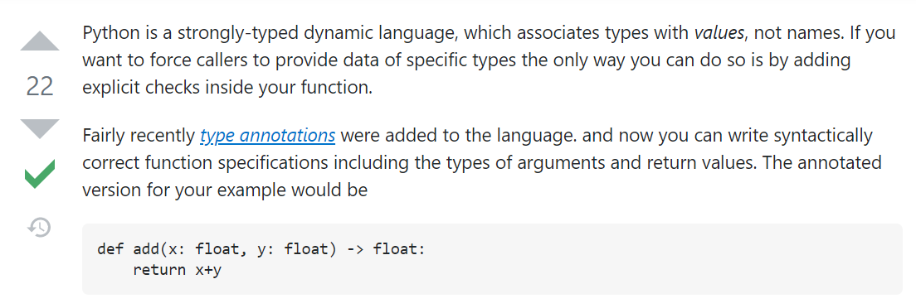
https://stackoverflow.com/questions/43233535/explicitly-define-datatype-in-python-function

Slide 37
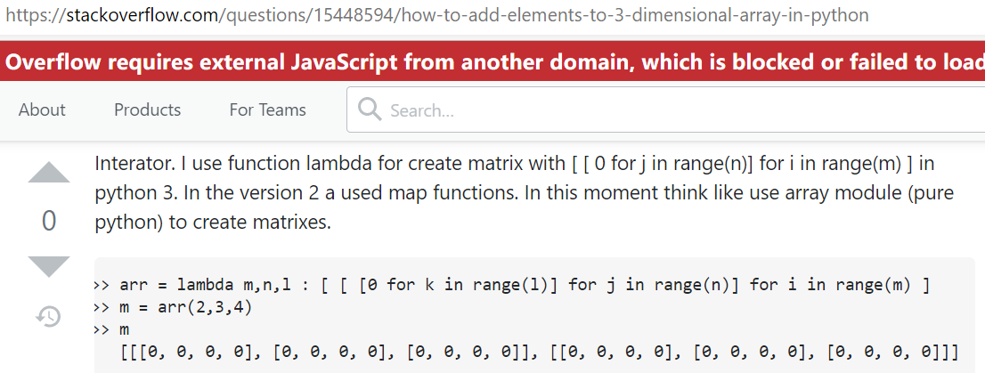
https://stackoverflow.com/questions/15448594/how-to-add-elements-to-3-dimensional-array-in-python

Slide 38
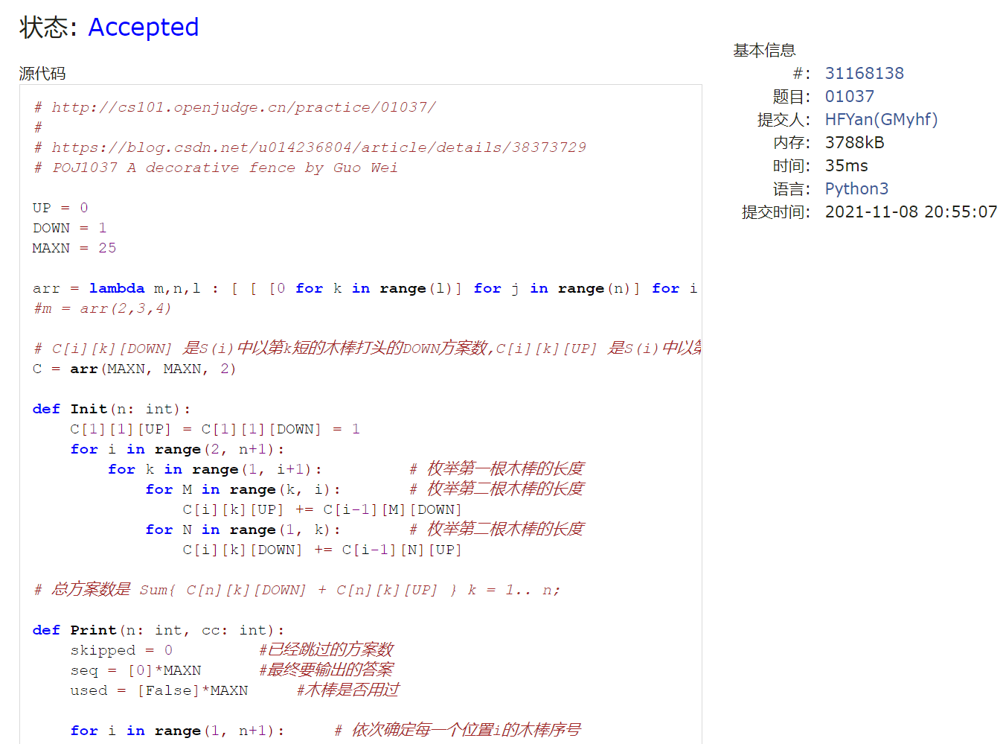
Notes:
# http://cs101.openjudge.cn/practice/01037/
#
# https://blog.csdn.net/u014236804/article/details/38373729
# POJ1037 A decorative fence by Guo Wei
UP = 0
DOWN = 1
MAXN = 25
arr = lambda m,n,l : [ [ [0 for k in range(l)] for j in range(n)] for i in range(m) ]
#m = arr(2,3,4)
# C[i][k][DOWN] 是S(i)中以第k短的木棒打头的DOWN方案数,C[i][k][UP] 是S(i)中以第k短的木棒打头的UP方案数,第k短指i根中第k短
C = arr(MAXN, MAXN, 2)
def Init(n: int):
C[1][1][UP] = C[1][1][DOWN] = 1
for i in range(2, n+1):
for k in range(1, i+1): # 枚举第一根木棒的长度
for M in range(k, i): # 枚举第二根木棒的长度
C[i][k][UP] += C[i-1][M][DOWN]
for N in range(1, k): # 枚举第二根木棒的长度
C[i][k][DOWN] += C[i-1][N][UP]
# 总方案数是 Sum{ C[n][k][DOWN] + C[n][k][UP] } k = 1.. n;
def Print(n: int, cc: int):
skipped = 0 #已经跳过的方案数
seq = [0]*MAXN #最终要输出的答案
used = [False]*MAXN #木棒是否用过
for i in range(1, n+1): # 依次确定每一个位置i的木棒序号
oldVal = skipped
k = 0
No = 0 # k是剩下的木棒里的第No短的,No从1开始算
for k in range(1, n+1): # 枚举位置i的木棒 ，其长度为k
oldVal = skipped
if used[k]==False:
No += 1 # k是剩下的木棒里的第No短的
if i == 1:
skipped += C[n][No][UP] + C[n][No][DOWN]
else:
if k > seq[i-1] and ( i <=2 or seq[i-2]>seq[i-1]): #合法放置
skipped += C[n-i+1][No][DOWN]
elif k < seq[i-1] and (i<=2 or seq[i-2]<seq[i-1]): #合法放置
skipped += C[n-i+1][No][UP]
if skipped >= cc:
break
used[k] = True
seq[i] = k
skipped = oldVal
print(' '.join(map(str, seq[1:n+1])))
'''
for i in range(1, n+1):
print("{}".format(seq[i]), end=' ')
print()
'''
Init(20);
for _ in range(int(input())):
n, c = map(int, input().split())
Print(n,c)

Slide 39


